Slide 1
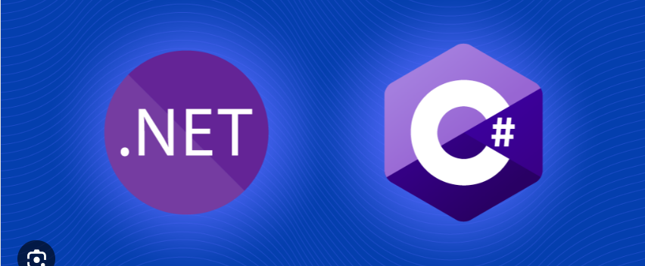

.NET and C#

Slide 2
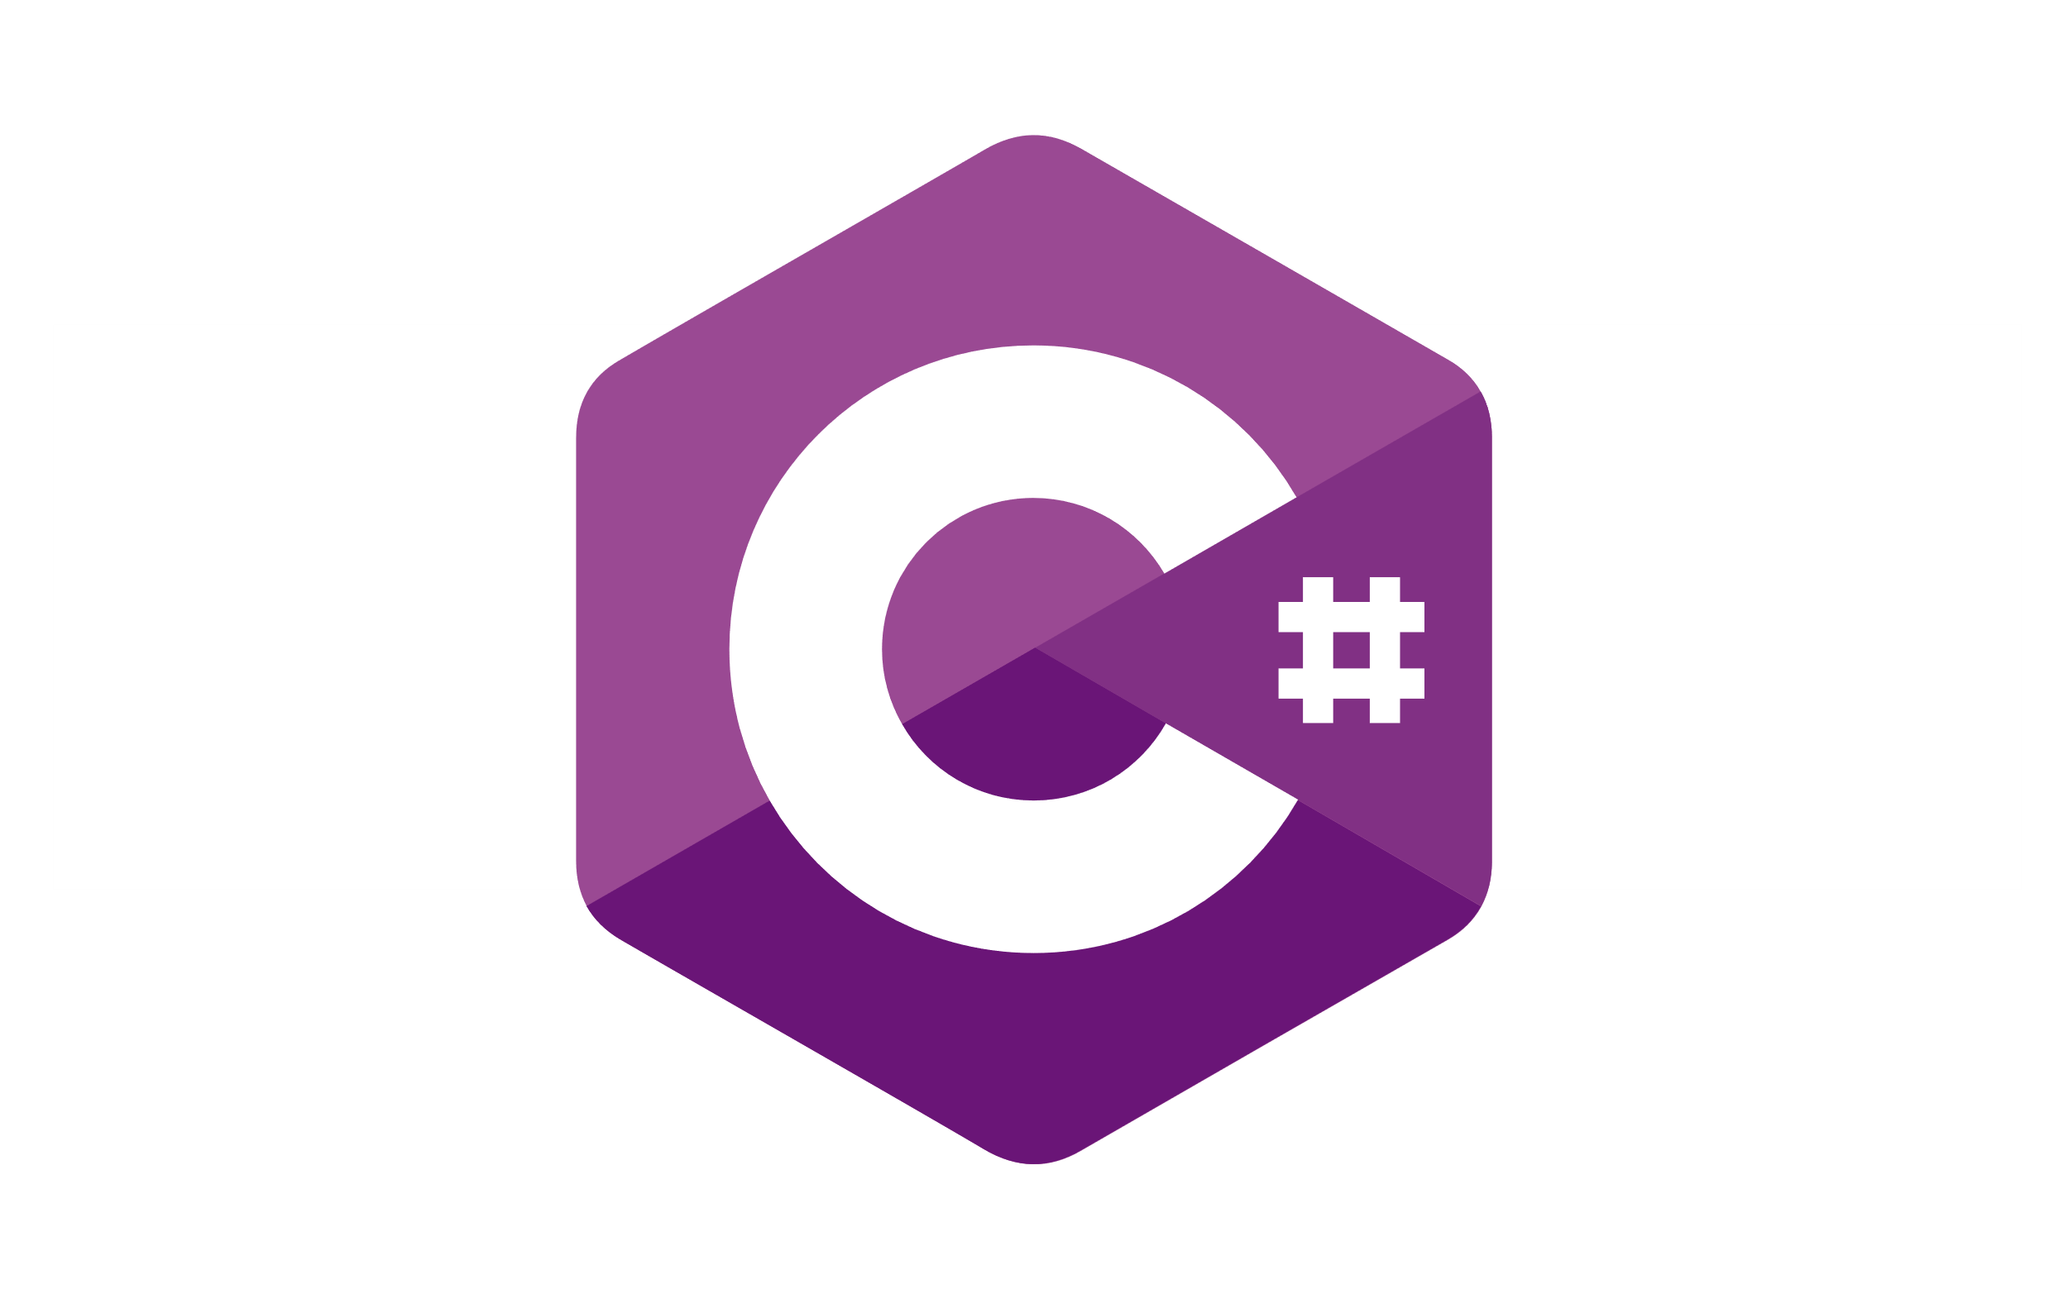
C# Programming Language
C# is Object Oriented Programming language – uses classes, objects, methods, variables, loops and many more language constructions.
Important topics for beginners:
What is .NET, CLR, C#, Compiler, Library?
Working with variables (knowing of different datatypes: string, int, etc.)
Working with functions (methods)
Working with Array, List and Dictionary
Working with conditional statements (If/else if/else and switch/case)
Working with loops (foreach, for, while, do-while)
Working with continue/break/return
Working with classes and objects
Debugging

Slide 3



C# next steps (advanced)
OOP Object Oriented Programming: classes, objects, properties, fields, interfaces, abstract classes, events, delegates, virtual methods, method overloading and method overriding
Important topics for more advanced people:
OOP principles: Inheritance, Polymorphism, Encapsulation and Abstraction
Working with files, directories and streams (Read/Write/Create/Delete)
Working with LINQ
Working with Stack, Queue and HashSet (data structures)
Working with databases: MS SQL server, MySQL, SQLite, etc. (connection, read, write, update, query executions in plain SQL)
Working with Entity Framework Core: Code First and Database first approaches.
Working with different frameworks: Windows Form, WPF, ASP .NET Core, Console, Windows Service

Slide 4
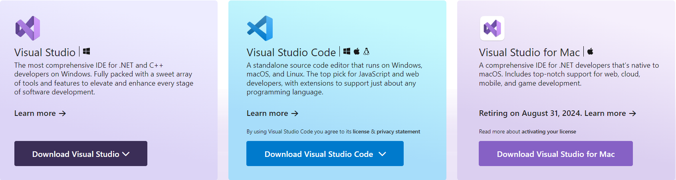
What is IDE? Integrated Development Environment

Slide 5
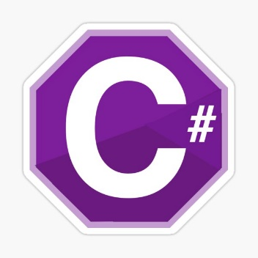


What is .NET
.NET is free, open source and cross-platform for developing of different application types.
.NET contains programming languages, runtime environment and different libraries with useful resources for developing of console, web, desktop, IoT, game applications.
.NET has two main building blocks called: CoreCLR and CoreFX
We can write on C#, Visual Basic, F# and many other programming languages.

Slide 6
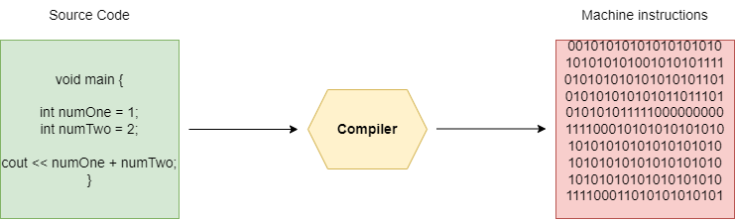
What is a compiler?
A compiler is special computer program which translates our source code into machine code or in byte code. Mostly our source code is written in high (C#, Java) or middle level programming language (C++). CS WIN is written in C++.

Slide 7
The compiler in C#
In C# the compiler translates our code to Intermediate language called IL. After that JIT compiler (Just in time compiler) translates our code to machine code for the specific processor architecture. CS WIN extensions can be written in many programming languages as C#, Java, etc.

Slide 8
What is a CLR (Common Language Runtime)?
CLR is a virtual machine which manages the execution of our program and communicates with the operating system.
Compiles the Intermediate language (IL) to specific for the certain machine processor instructions.
It has Garbage Collector which is responsible for cleaning of not needed resources.
It manages the memory
Note: If we have .NET installed on certain PC/Laptop then we can run/write .NET programs via CLR. These program mainly are written in C#, F# or Visual Basic.

Slide 9
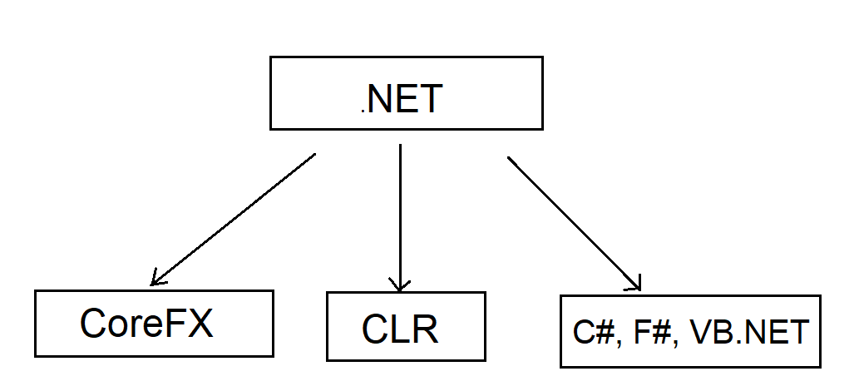
.NET
Programming languages (C#, F#, Visual Basic)
Execution environment (Common Language Runtime - CLR)
Libraries (CoreFX)

Slide 10
.NET predecessor
Current .NET platform is open source and platform independent but that not always was true.
There is one platform called .NET Framework that is the .NET predecessor. It was only for Windows.
The last version of .NET Framework is 4.8.1 and the development on it is stopped.
The .NET Framework is supported yet and will be for many years, just something new will not come.
We use .NET Framework very intensive in our C# projects.

Slide 11
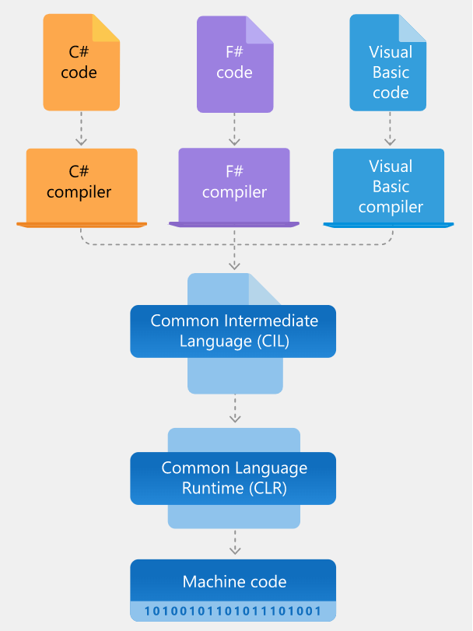
.NET Architecture

Slide 12
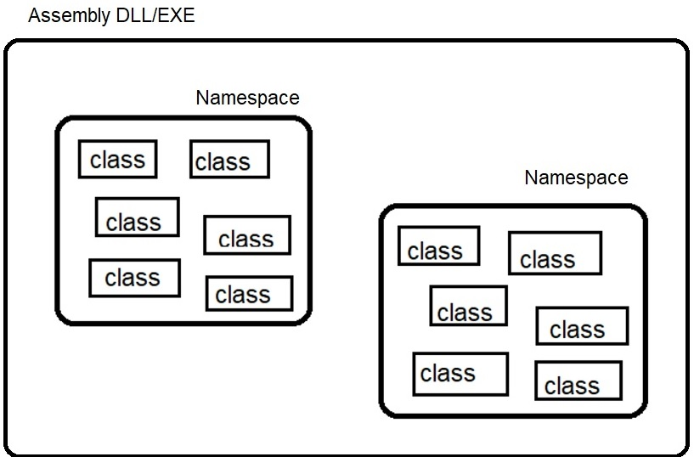
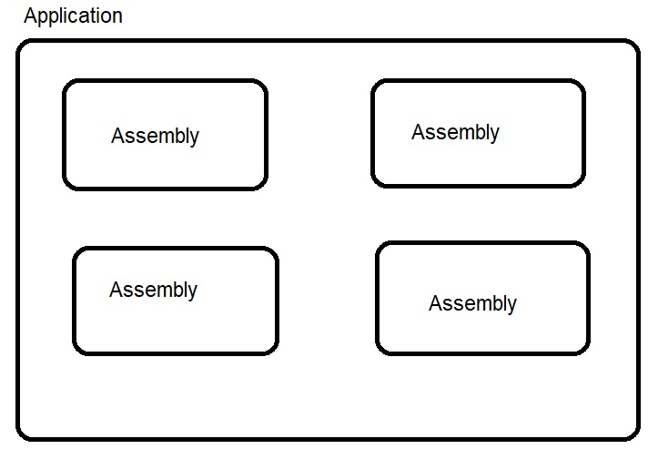
Architecture of .NET applications

Slide 13
What is a programming library (.DLL)?
The programming library is a project which contains source on some language (C# for example), which does some work, and which is reusable in many other projects.
The main idea behind the programming libraries is reusing of code. Which means write once, use in many places.
The source in the programming libraries usually is collection of classes and methods that do some work.
The programming libraries CANNOT be used as a standalone project. They are always used in another projects.
Note: In Bulgarian team, we use .NET library project for making of COM components which extends the functionality of CS WIN.

Slide 14
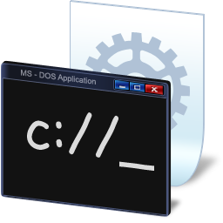
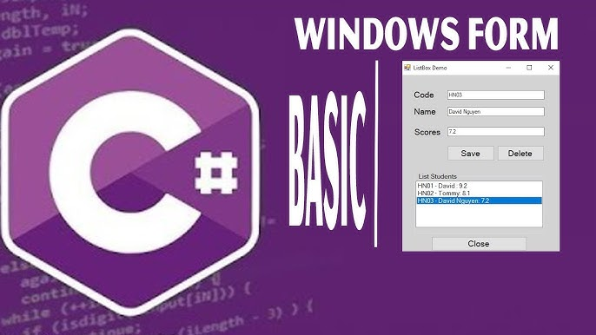

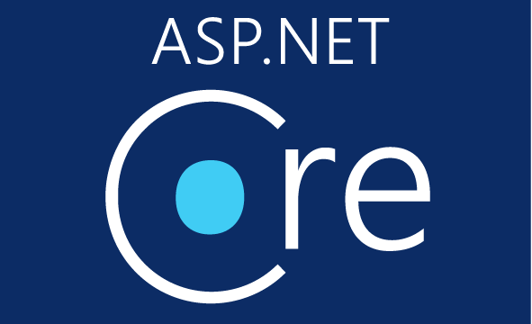
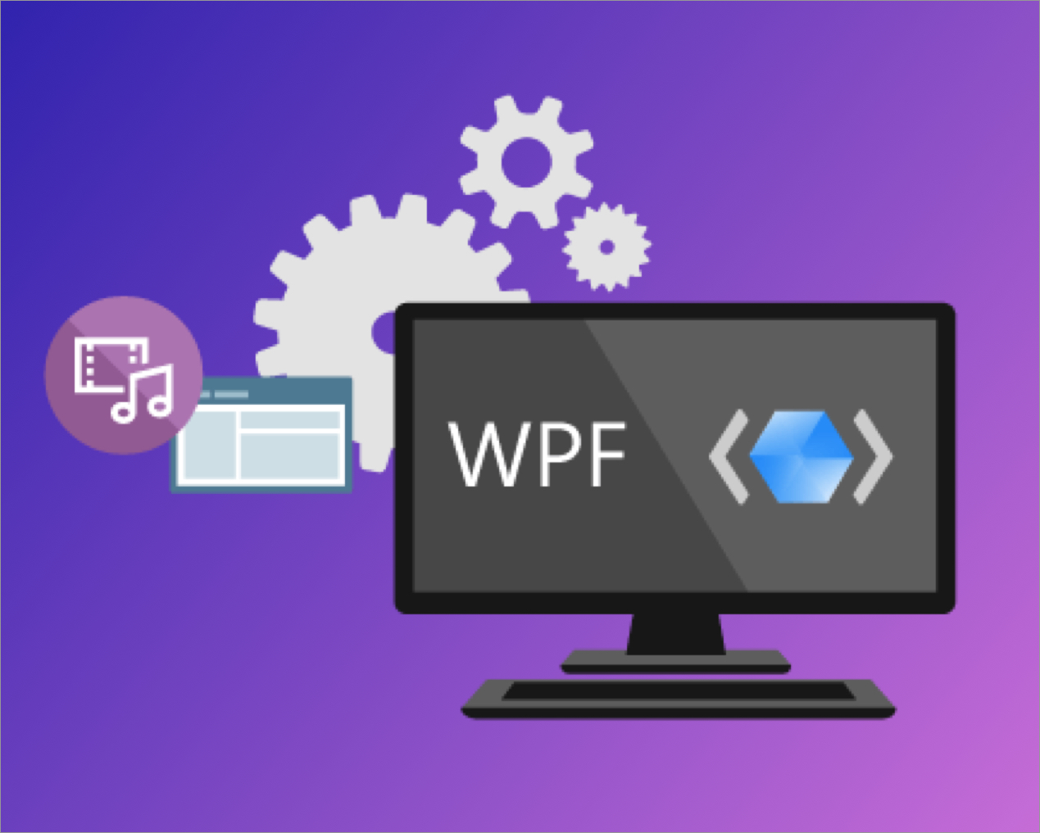
Different C# project types
Console application
Windows Service application
Windows Form application – GUI
WPF application – GUI
ASP .NET Core application – Web
Class Library application

