Slide 1
Entity Framework Core and Databases overview

Slide 2
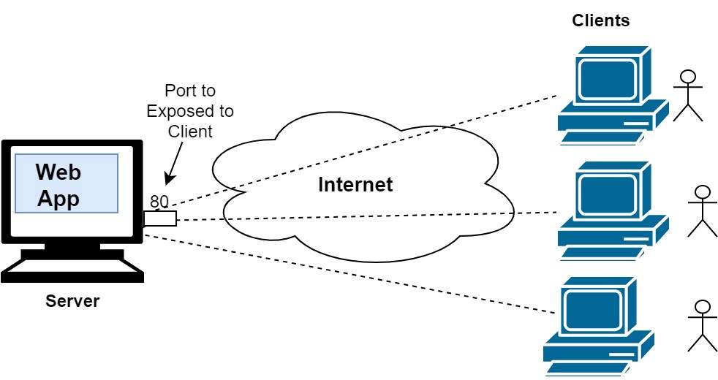
The rise of Internet and storage systems!

Slide 3

Where to store my data?
In our Internet era, the database systems grows constantly. The efficiency, durability and the good maintenance are absolutely mandatory for the business!

Slide 4
SQL vs NoSQL databases
SQL Database systems
NoSQL Database systems
MS SQL Server
MySQL
Oracle Database
PostgreSQL
IBM DB2
MongoDB
Redis
Couchbase
RavenDB
Cassandra

Slide 5
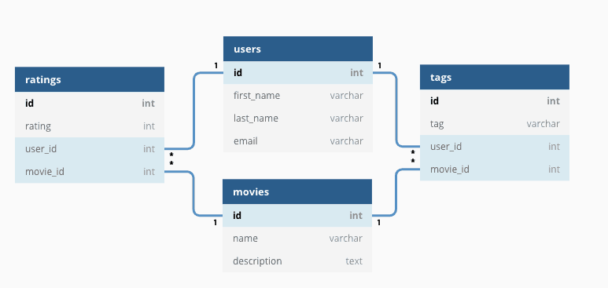
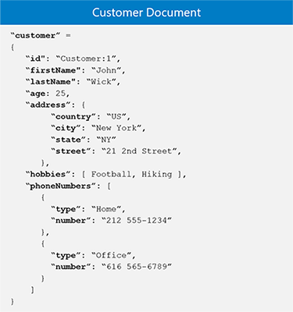
SQL vs NoSQL (fundamental differences)
Table relations
Document model

Slide 6
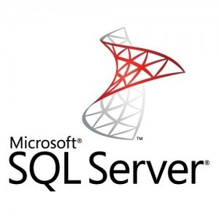
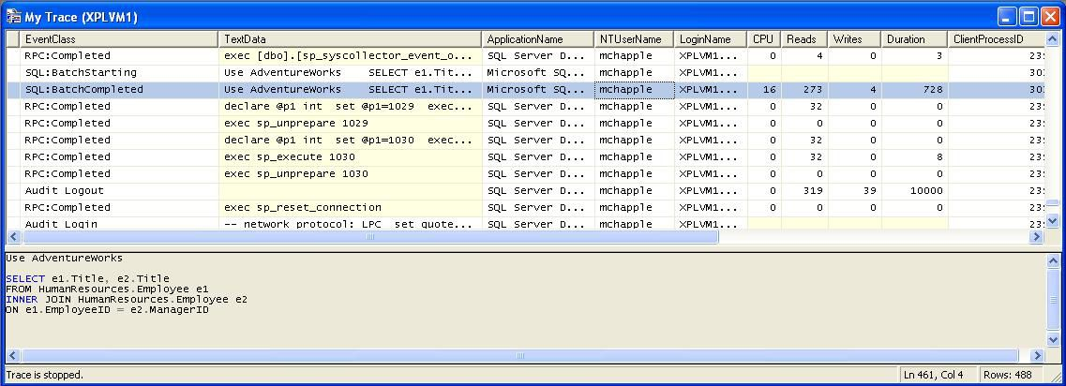
MS SQL server profiler is a great tool!

Slide 7
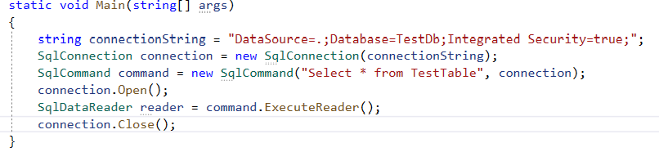
ADO.NET
C# demo source
ADO.NET is the latest Microsoft database access technology. It’s a set of classes that expose data access services.

Slide 8
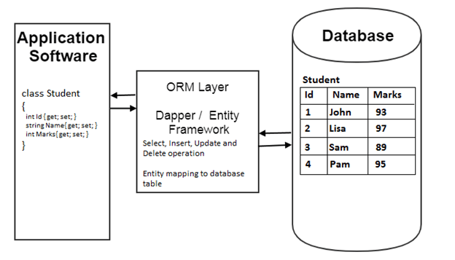
What is ORM and how it works?
ORM stands from Object Relational Mapper and is a library that automates the transfer of data between database tables into objects and vice versa.

Slide 9
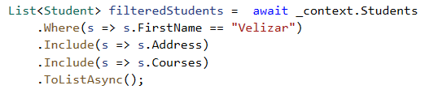
The benefits of ORM systems?
We work with C# but not with SQL anymore!
Productivity
Application Design
Code Reuse
Application Maintainability

Slide 10
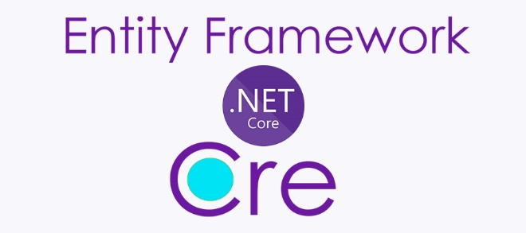
Entity Framework Core
EF Core is open source and cross-platform object-relational mapper
Enables developers to work with a database using .NET objects
Eliminates the need for most of the data-access code that typically needs to be written
Supports many database providers

Slide 11
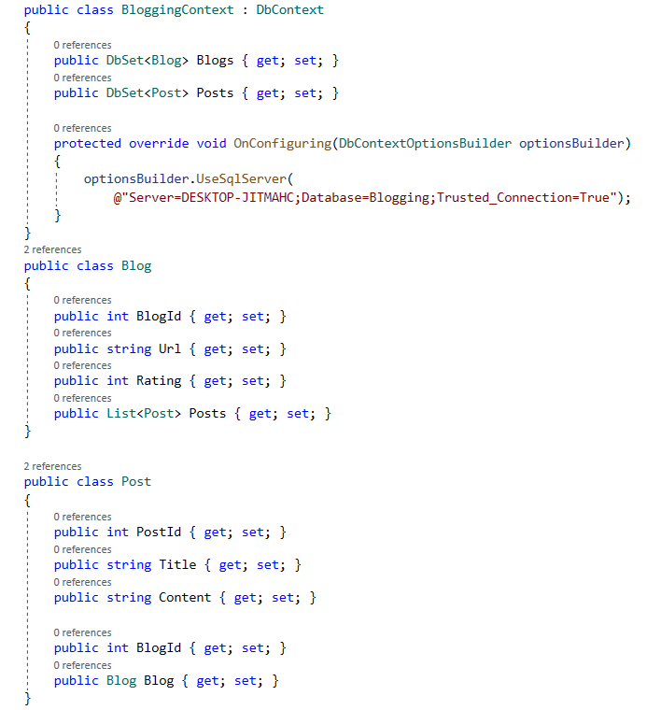
The Model (code first approach)
A model is made up of entity classes and a context object that represents a session with the database. The context object allows querying and saving data.
Database structure is updated using migrations

Slide 12
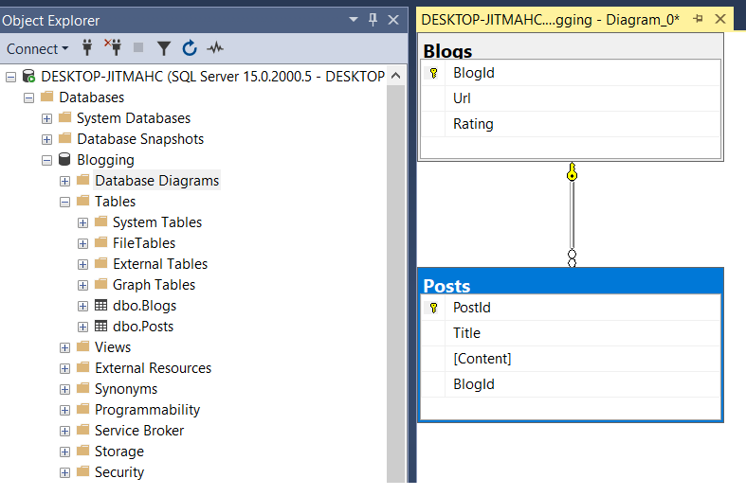
The Model (database first approach)
A model is made up from previously build MS SQL tables.
In “database first approach” we scaffold our C# classes from these tables using command line.

Slide 13

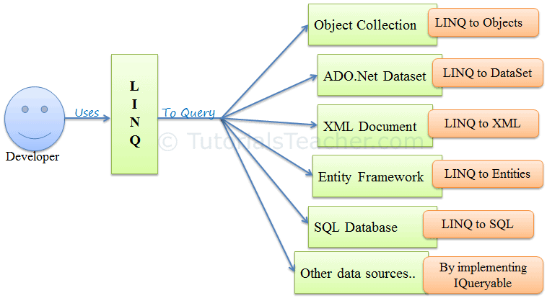
What is LINQ and how we use it with EF Core?
Sample C# LINQ query:
Language-Integrated-Query (LINQ) is the name for set of technologies based on the integration of query capabilities directly into C#.

Slide 14
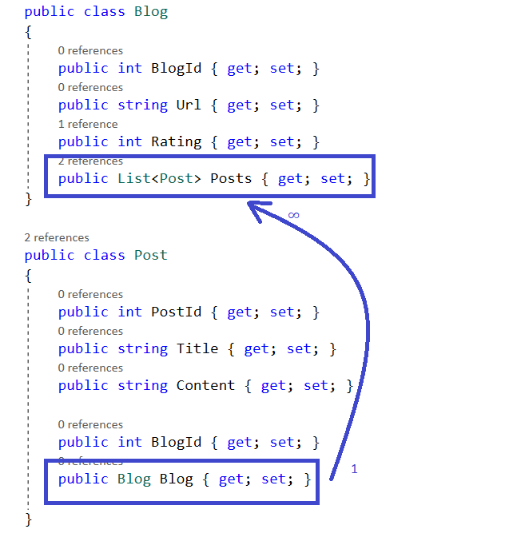
Entity relations
One to One
One to Many /most used/
Many to Many

Slide 15
General Overview of EF Core
EF Core is Object Relation Mapper
Increase the productivity of programmers
Use C# LINQ instead of SQL direct queries
There are “Code First” and “Database First” approaches in creating of our database model system
Supports many database providers

Slide 16
Thank you!

