Slide 1
Entity Framework Core and Databases overview

Slide 2
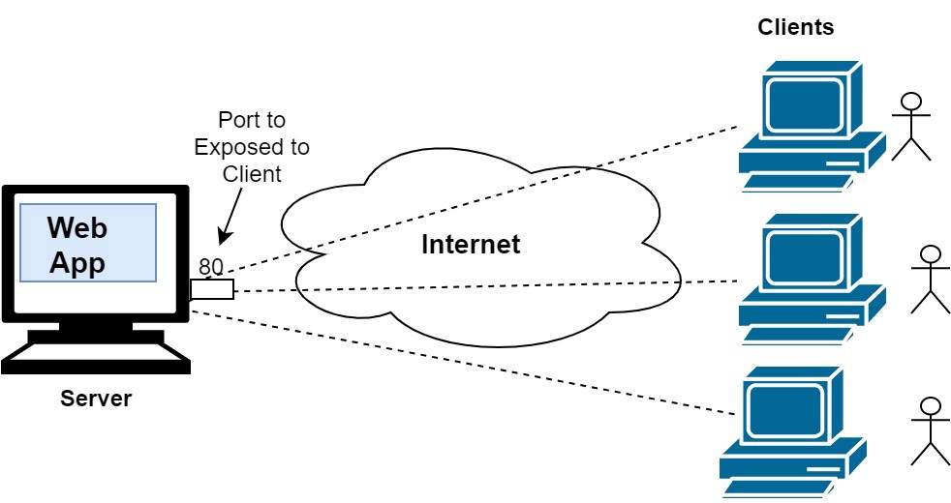
The rise of Internet and storage systems!

Slide 3
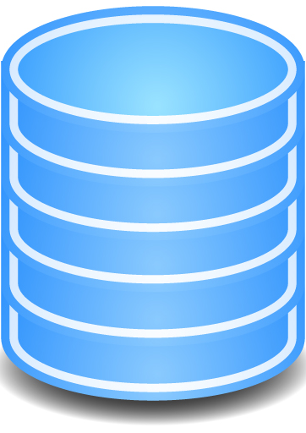
Where to store my data?
In our Internet era, the database systems grows constantly. The efficiency, durability and the good maintenance are absolutely mandatory for the business!

Slide 4
SQL vs NoSQL databases
SQL Database systems
NoSQL Database systems
MS SQL Server
MySQL
Oracle Database
PostgreSQL
IBM DB2
MongoDB
Redis
Couchbase
RavenDB
Cassandra

Slide 5
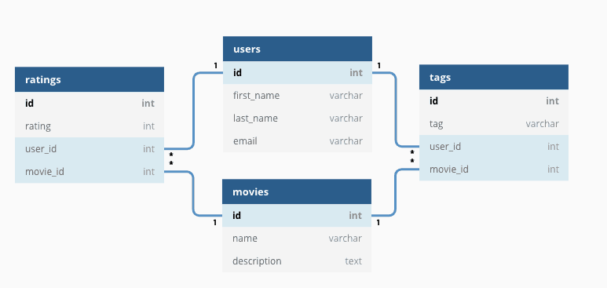
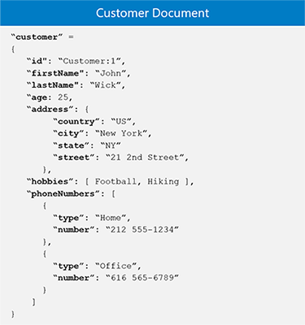
SQL vs NoSQL (fundamental differences)
Table relations
Document model

Slide 6
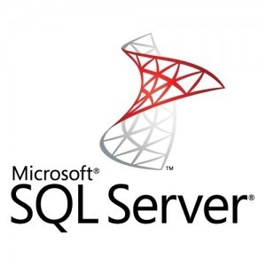
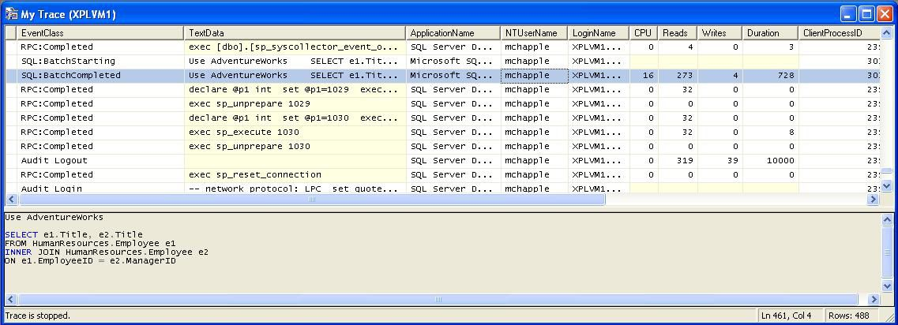
MS SQL server profiler is a great tool!

Slide 7
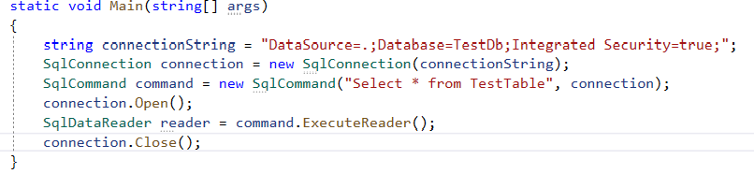
ADO.NET
C# demo source
ADO.NET is the latest Microsoft database access technology. It’s a set of classes that expose data access services.

Slide 8
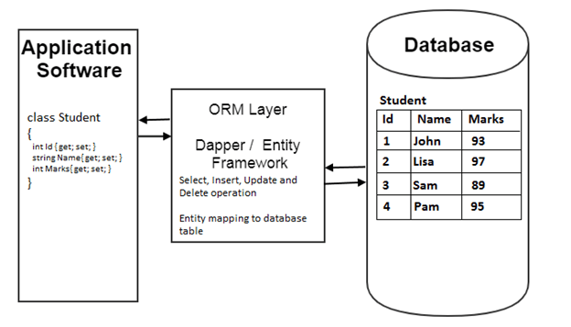
What is ORM and how it works?
ORM stands from Object Relational Mapper and is a library that automates the transfer of data between database tables into objects and vice versa.

Slide 9
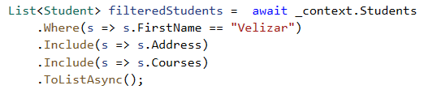
The benefits of ORM systems?
We work with C# but not with SQL anymore!
Productivity
Application Design
Code Reuse
Application Maintainability

