Slide 1
Entity Framework Core and Databases overview

Slide 2

Table of Contents
Database Systems
ADO.NET
Object Relation Mapper (ORM)
Entity Framework Core
Model Design Approaches
Entity Relations
LINQ
C++ and Bonus slides

Slide 3
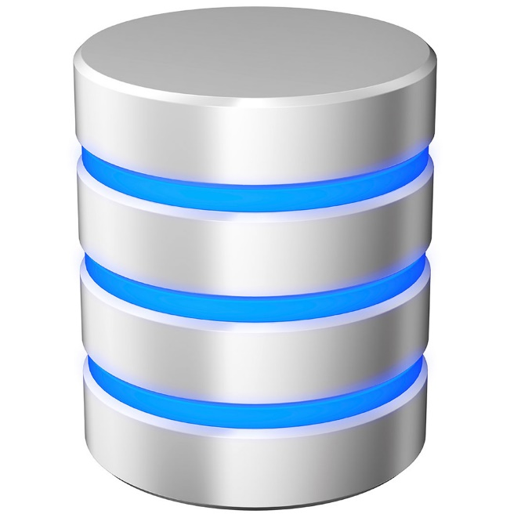
Database Systems

Slide 4
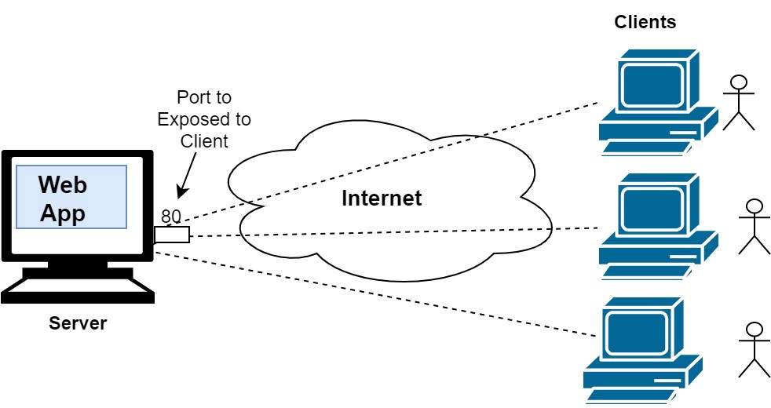
The rise of Internet and storage systems

Slide 5
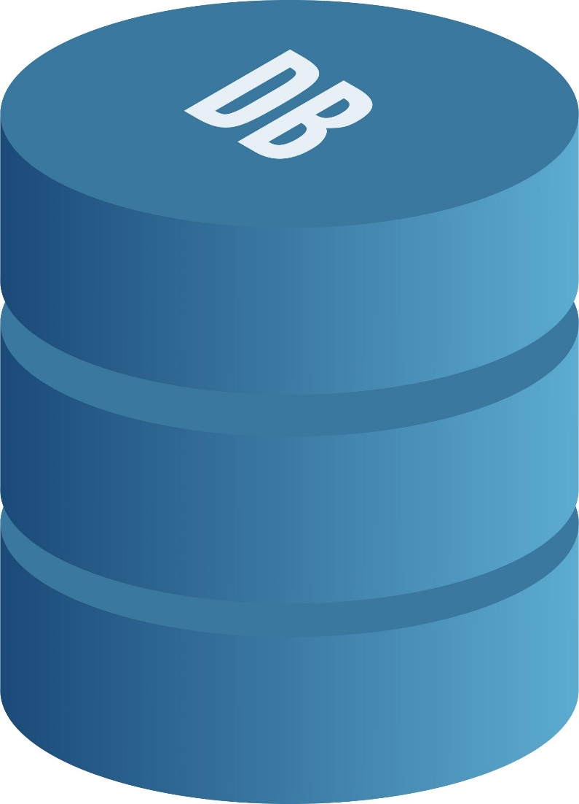
What is a Database?
A database is an organized collection of structured information, or data, typically stored electronically in a computer system.
A database is usually controlled by a database management system (DBMS).

Slide 6
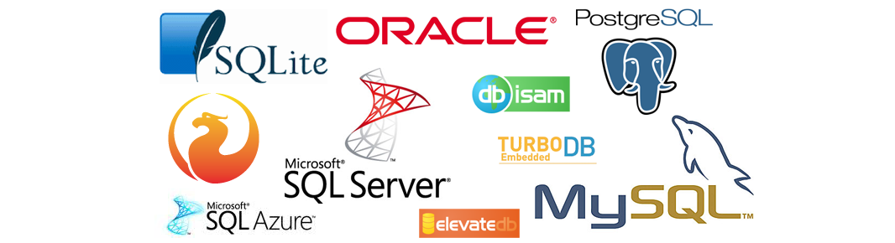
Where to store my data?
In our Internet era, the database systems grows constantly. The efficiency, durability and the good maintenance are absolutely mandatory for the business!
The rules are changing constantly!

Slide 7
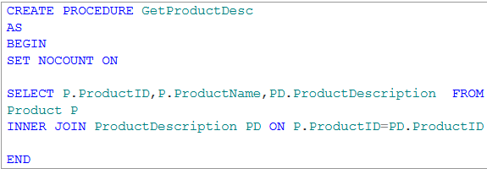
Stored Procedures
Pros:
All business logic is in one place
Good Performance
Cons:
Extremely tight software coupling
Need from developers with special skills
No separation of concerns
Vendor locking
Difficult for Unit Testing
Cannot pass a complex parameters

Slide 8
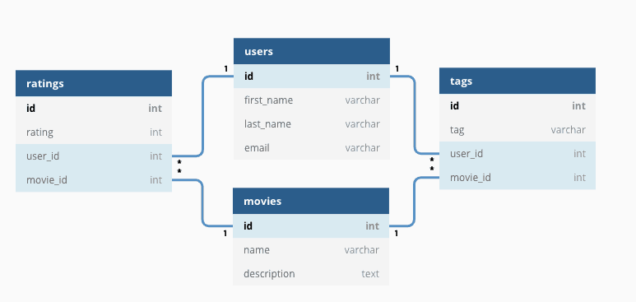
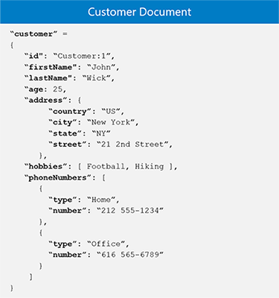
SQL vs NoSQL (fundamental differences)
Table relations
Document model

Slide 9
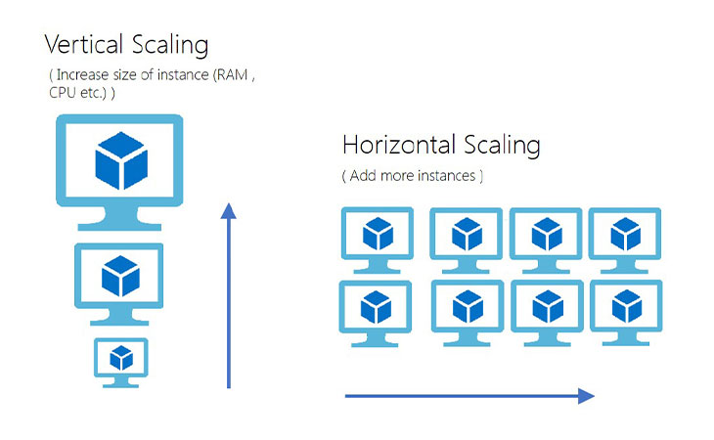
Database Scalability

Slide 10
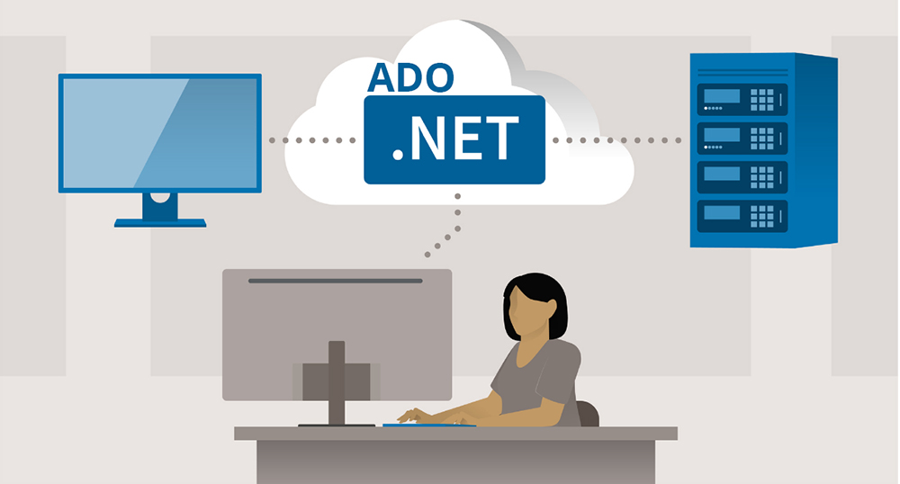
ADO.NET

Slide 11
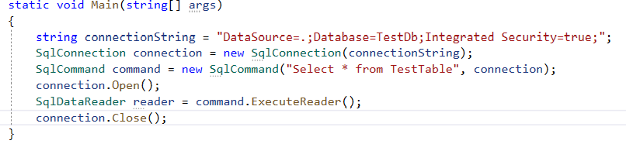
ADO.NET
C# demo source
ADO.NET is the latest Microsoft database access technology. It’s a set of classes that expose data access services.

Slide 12
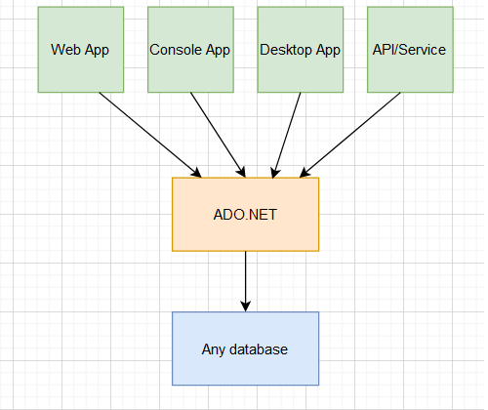
ADO.NET layer
With ADO.NET we can access almost any database system

Slide 13

ADO.NET downsides
Again, we should know SQL on a good level
No InteliSense for queries
Many runtime errors
Writing more code
Manual Handling of connections
Possible SQL injection

Slide 14

Object Relational Mapper
ORM

Slide 15
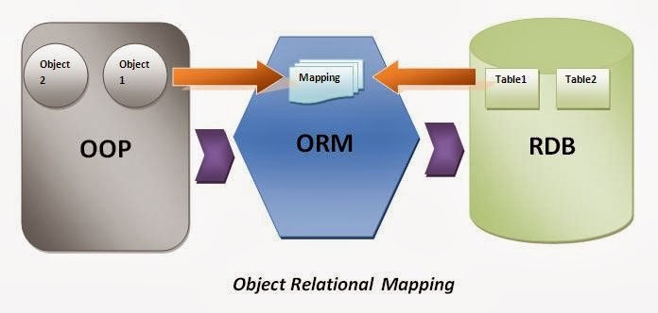
What is ORM and how it works?
ORM stands from Object Relational Mapper and is a library that automates the transfer of data between database tables into objects and vice versa.

Slide 16
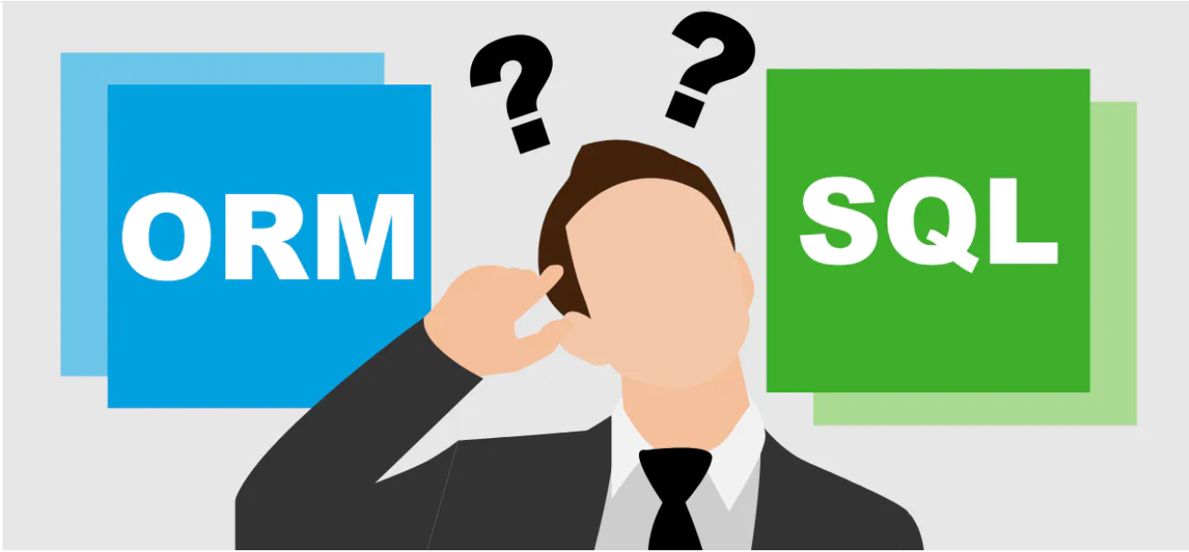
The benefits of ORM systems?
Productivity
Application Design
Code Reuse
Application Maintainability
Focus on OOP

Slide 17
ORM downsides
Slow performance in complex queries
Limitations
Tuning

Slide 18

Entity Framework Core

Slide 19

Entity Framework Core
EF Core is open source and cross-platform object-relational mapper
Enables developers to work with a database using .NET objects
Eliminates the need for most of the data-access code that typically needs to be written
Supports many database providers

Slide 20
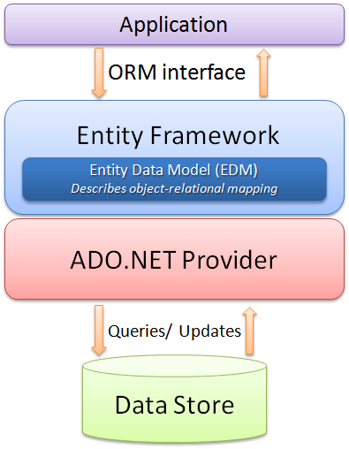
EF Core in the whole picture
Architecture diagram

Slide 21
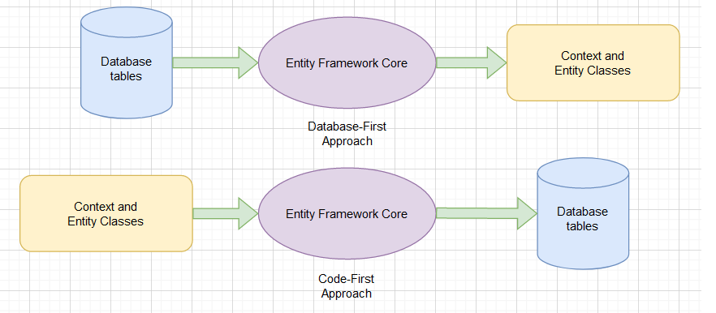
Model design approaches

Slide 22
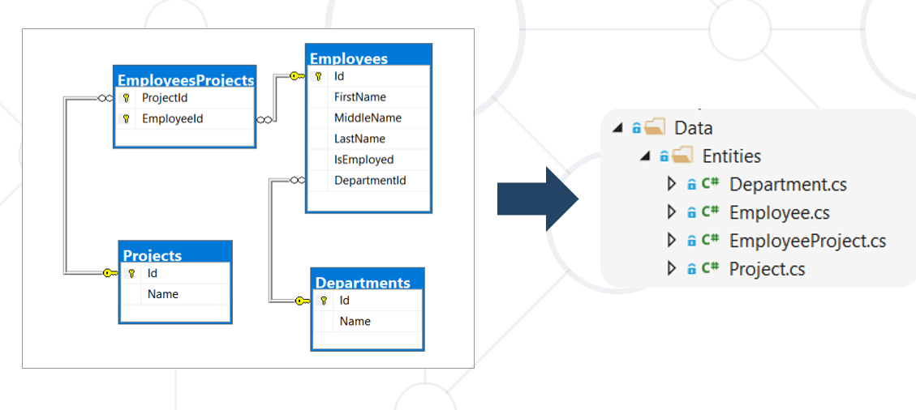
The Model (database first approach)
A model is made up from previously build MS SQL tables.
In “database first approach” we scaffold our C# classes from these tables using command line.

Slide 23
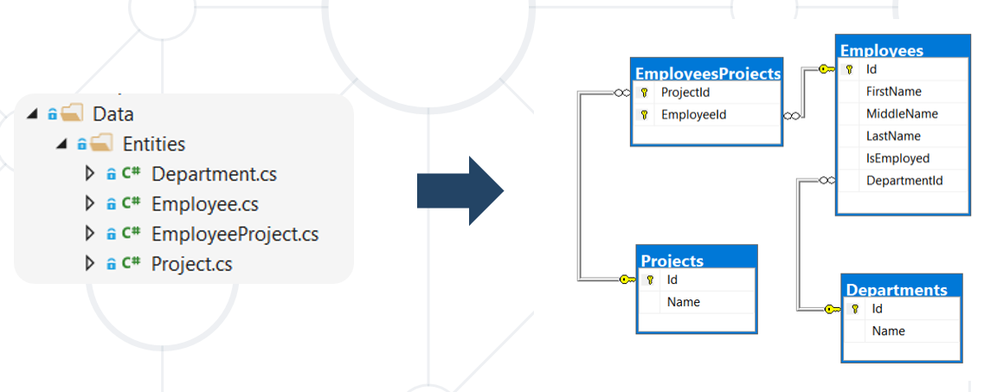
The Model (code first approach)
A model is made up of entity classes and a context object that represents a session with the database. The context object allows querying and saving data.
Database structure is updated using migrations

Slide 24
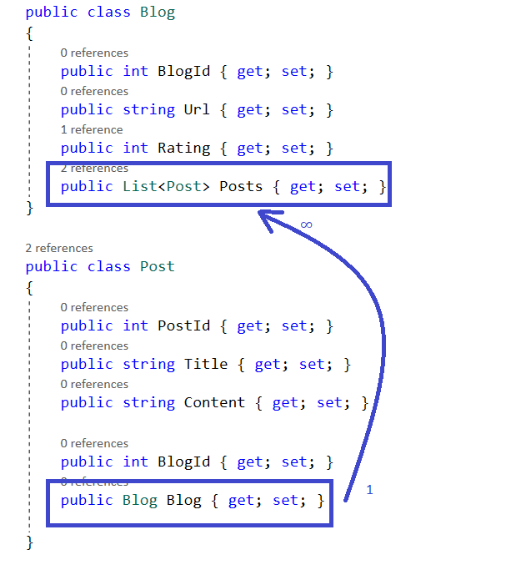
Entity relations
One to One
One to Many /most used/
Many to Many

Slide 25

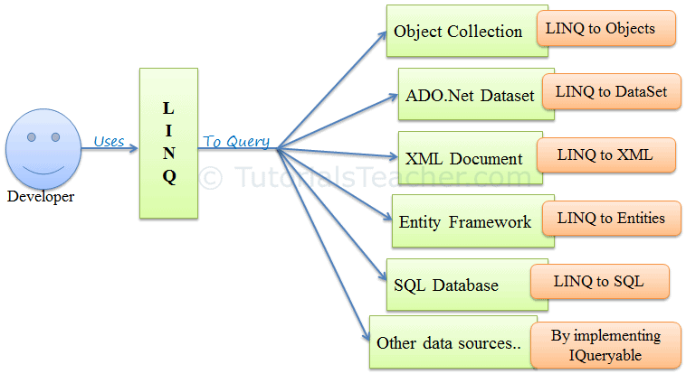
What is LINQ and how we use it with EF Core?
Sample C# LINQ query:
Language-Integrated-Query (LINQ) is the name for set of technologies based on the integration of query capabilities directly into C#.

Slide 26
Microsoft creates such software by reflection?
Reflection in C# is a way to retrieve metadata for any types or assemblies at runtime. In other words we can use reflection to inspect metadata of the types in our program dynamically.
Reflection in C# is similar to RTTI (Run-Time Type Information) in C++.

Slide 27
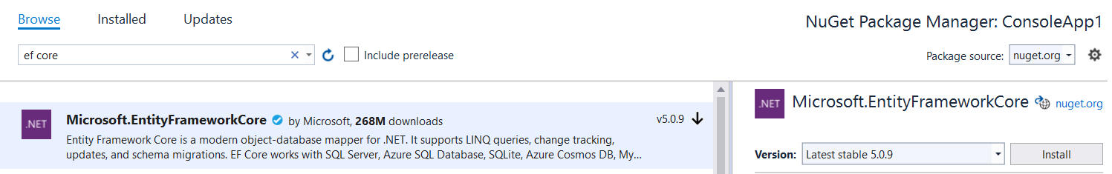
How to include EF Core in our project?

Slide 28
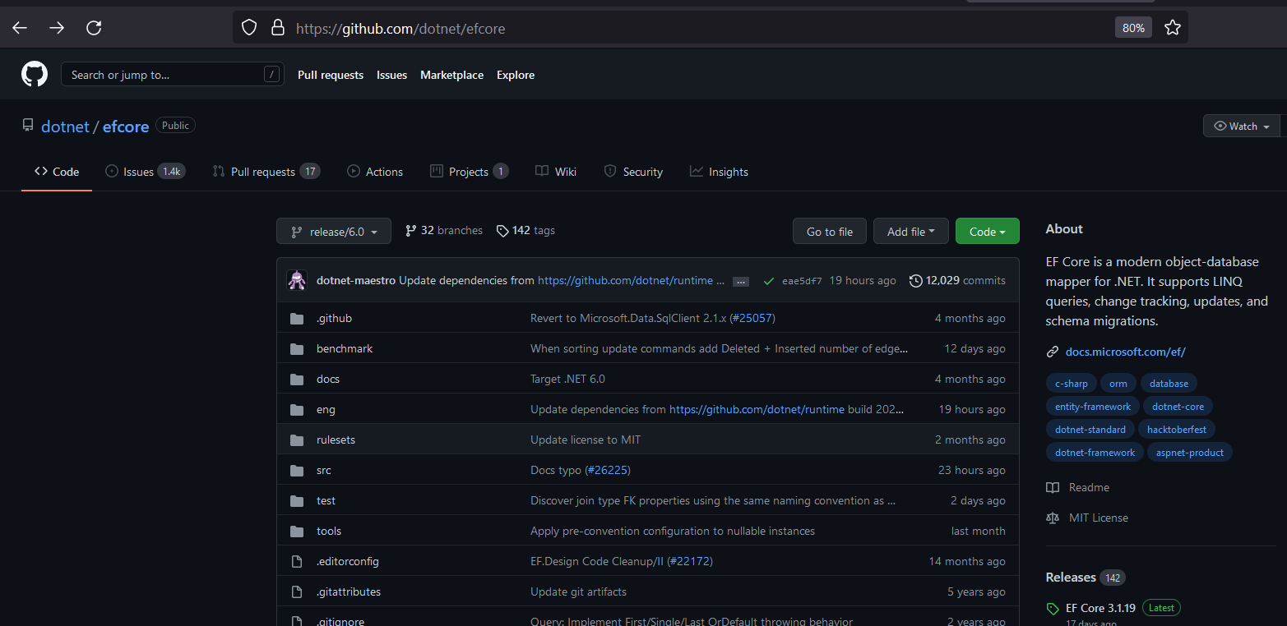
Entity Framework Core (source)
Entity Framework Core is with open source like many of the latest Microsoft technologies
It is plugin/package oriented unlike Entity Framework 6 (.NET based)
GitHub repository of EF Core: https://github.com/dotnet/efcore

Slide 29

C++ ODB
ODB - Open Source and cross platform relation mapper
Supports: Oracle, MS SQL Server, MySQL, PostgreSQL and SQLite
Supports calling of MS SQL and MySQL stored procedures
https://www.codesynthesis.com/products/odb/doc/manual.xhtml#2

Slide 30

QxOrm
QxOrm library is and Object Relation Mapping (ORM) database library for C++/Qt developers.
It has the following features:
Persistence
Serialization
Reflection
Is based on Qt framework!

Slide 31
General Overview of EF Core
EF Core is Object Relation Mapper
Increase the productivity of programmers
Use C# LINQ instead of SQL direct queries
There are “Code First” and “Database First” approaches in creating of our database model system
Supports many database providers https://docs.microsoft.com/en-us/ef/core/providers/?tabs=dotnet-core-cli

Slide 32
Interesting resources
EF Core - https://docs.microsoft.com/en-us/ef/core/
SQL vs NoSQL - https://www.mongodb.com/nosql-explained/nosql-vs-sql
CAP Theorem - https://towardsdatascience.com/cap-theorem-and-distributed-database-management-systems-5c2be977950e
ADO.NET - https://www.javatpoint.com/ado-net-tutorial
C# Reflection - https://docs.microsoft.com/en-us/dotnet/csharp/programming-guide/concepts/reflection
LINQ - https://www.tutorialsteacher.com/linq/what-is-linq
NHibernate - https://nhibernate.info/
EF Core Migrations - https://www.entityframeworktutorial.net/efcore/entity-framework-core-migration.aspx
ODB - https://www.codesynthesis.com/products/odb/
QxOrm - https://www.qxorm.com/qxorm_en/home.html

Slide 33
Thank you!

