Slide 1
Entity Framework Core and Databases overview

Slide 2

Table of Contents
Database Systems
ADO.NET
Object Relation Mapper (ORM)
Entity Framework Core
Model Design Approaches
Entity Relations
LINQ
Bonus slides

Slide 3
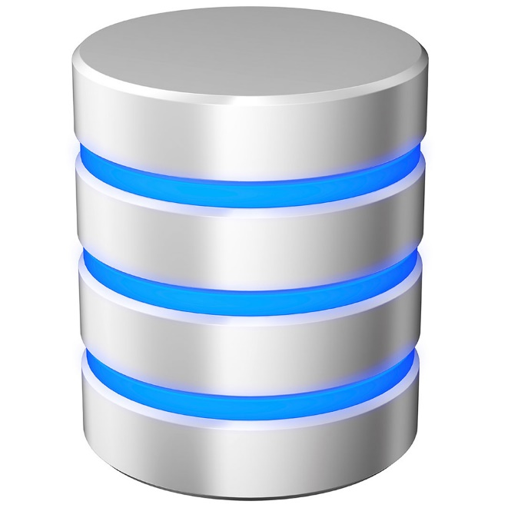
Database Systems

Slide 4
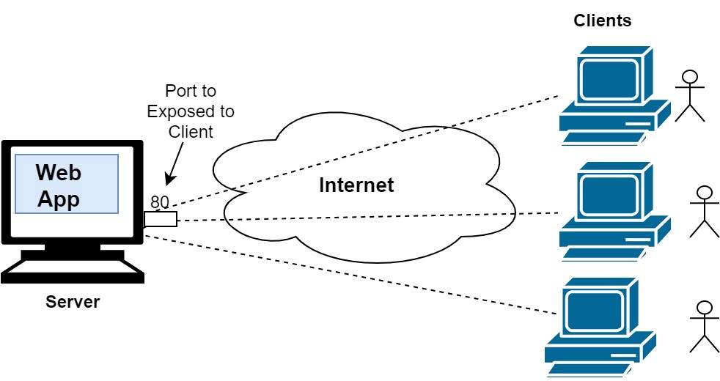
The rise of Internet and storage systems

Slide 5
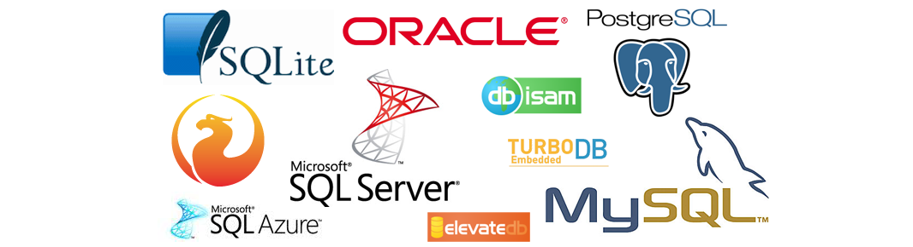
Where to store my data?
In our Internet era, the database systems grows constantly. The efficiency, durability and the good maintenance are absolutely mandatory for the business!

Slide 6
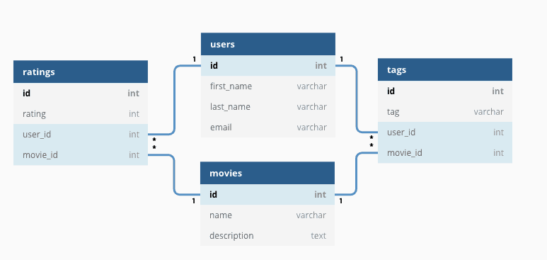
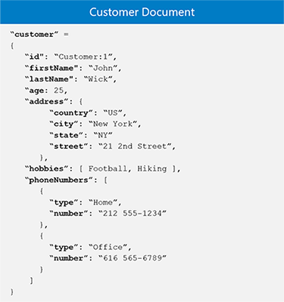
SQL vs NoSQL (fundamental differences)
Table relations
Document model

Slide 7
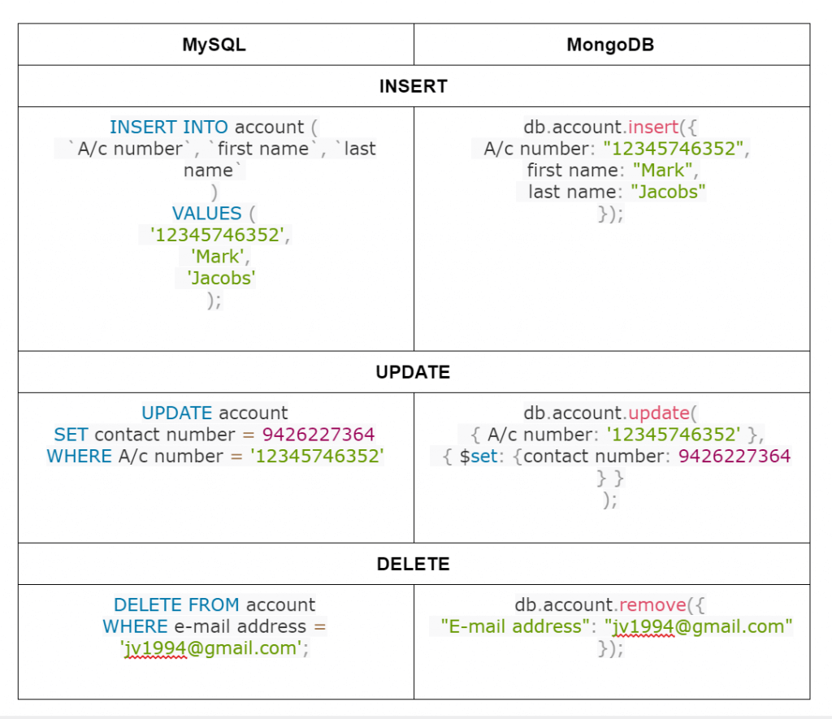
Queries (MySQL vs MongoDB)

Slide 8
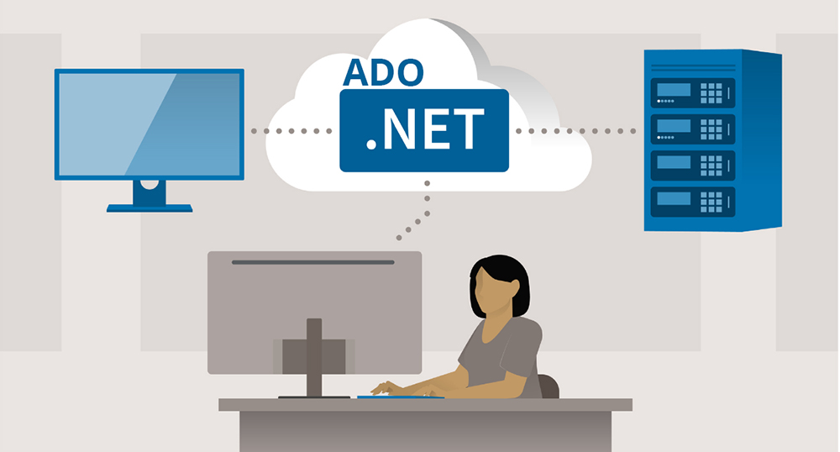
ADO.NET

Slide 9
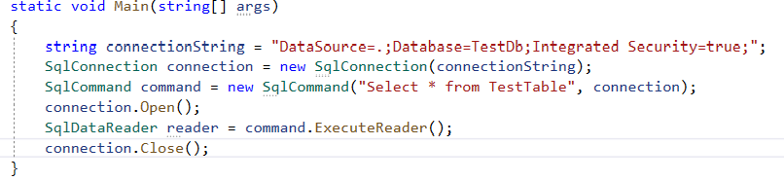
ADO.NET
C# demo source
ADO.NET is the latest Microsoft database access technology. It’s a set of classes that expose data access services.

Slide 10
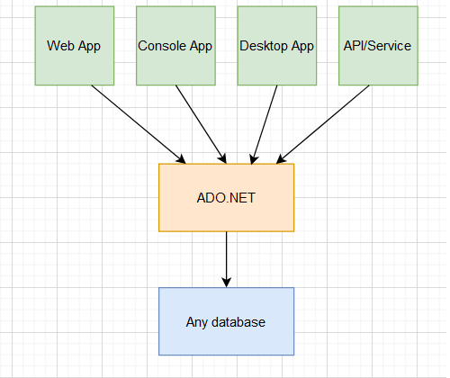
ADO.NET layer
With ADO.NET we can access almost any database system

Slide 11
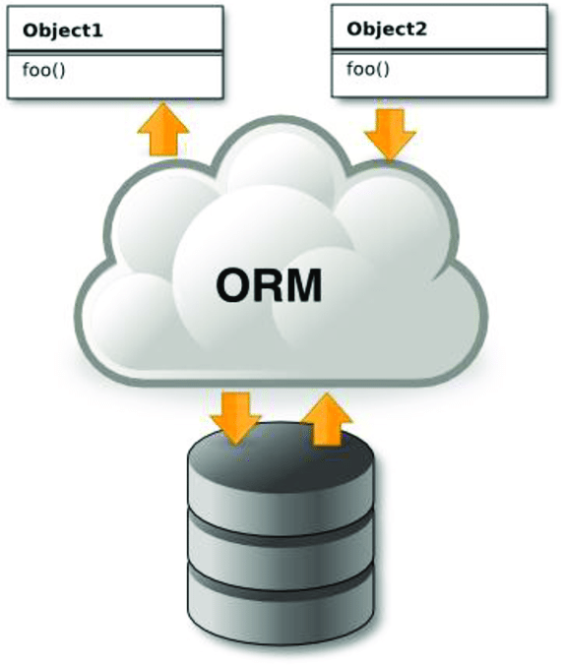
Object Relational Mapper
ORM

Slide 12
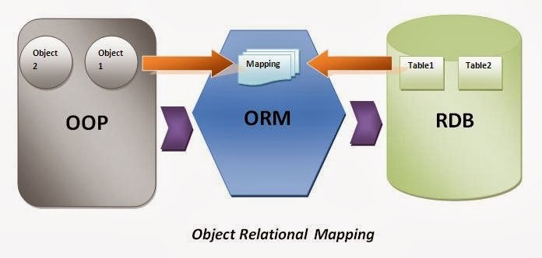
What is ORM and how it works?
ORM stands from Object Relational Mapper and is a library that automates the transfer of data between database tables into objects and vice versa.

Slide 13
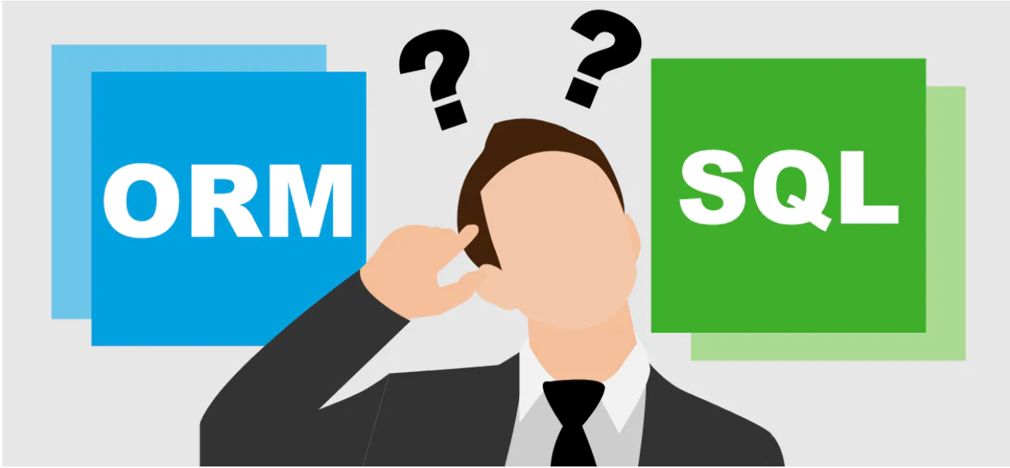
The benefits of ORM systems?
Productivity
Application Design
Code Reuse
Application Maintainability
Focus on OOP

Slide 14

What is the reality?

Slide 15

ORM downsides
Vendor lock-in
Performance in complex queries
Limitations
Tuning

Slide 16

Entity Framework Core

Slide 17

Entity Framework Core
EF Core is open source and cross-platform object-relational mapper
Enables developers to work with a database using .NET objects
Eliminates the need for most of the data-access code that typically needs to be written
Supports many database providers

Slide 18
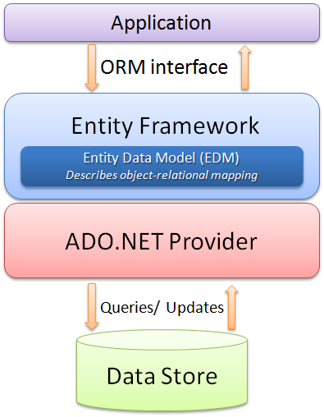
EF Core in the whole picture
Architecture diagram

Slide 19
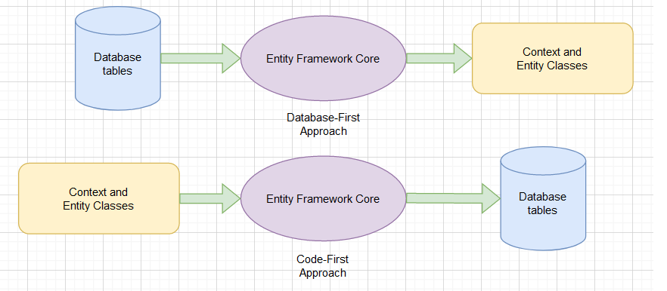
Model design approaches

Slide 20
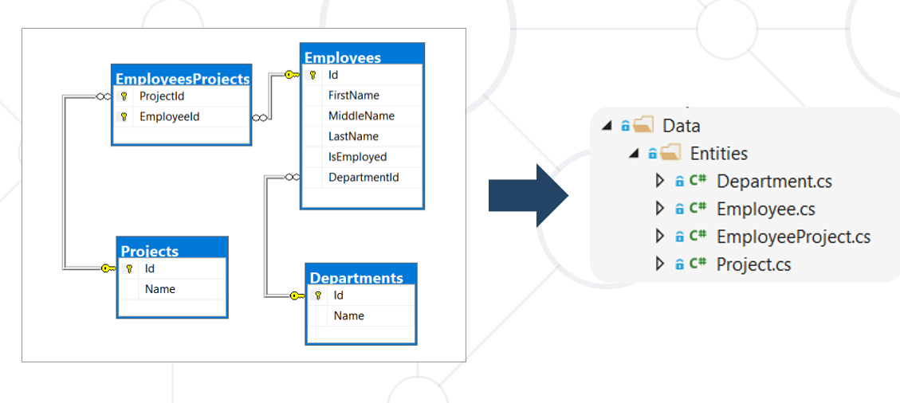
The Model (database first approach)
A model is made up from previously build MS SQL tables.
In “database first approach” we scaffold our C# classes from these tables using command line.

Slide 21
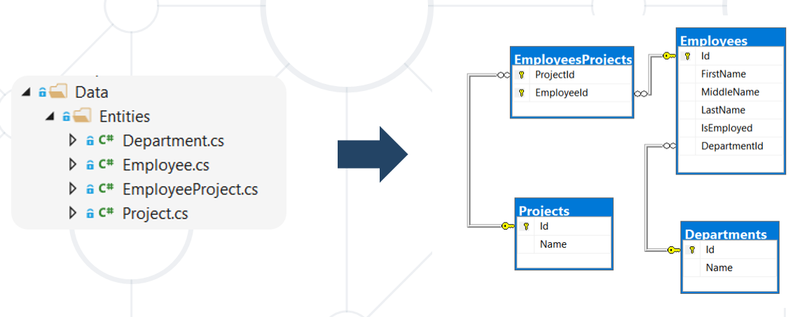
The Model (code first approach)
A model is made up of entity classes and a context object that represents a session with the database. The context object allows querying and saving data.
Database structure is updated using migrations

Slide 22
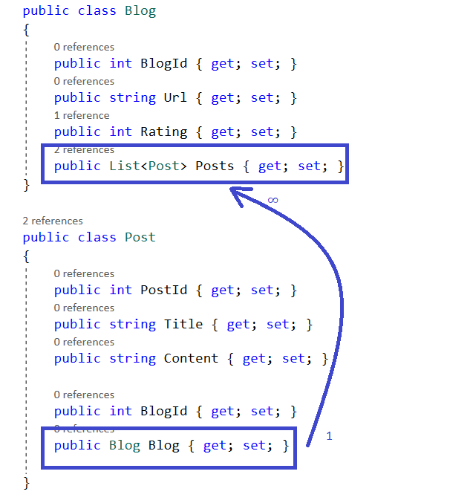
Entity relations
One to One
One to Many /most used/
Many to Many

Slide 23

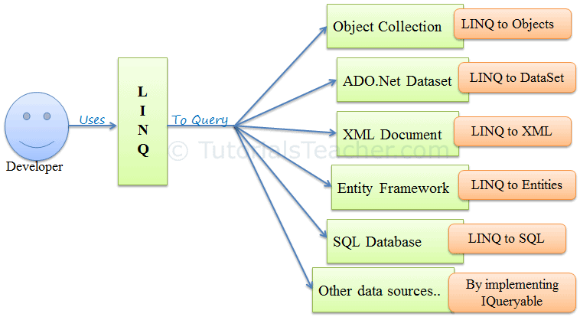
What is LINQ and how we use it with EF Core?
Sample C# LINQ query:
Language-Integrated-Query (LINQ) is the name for set of technologies based on the integration of query capabilities directly into C#.

Slide 24
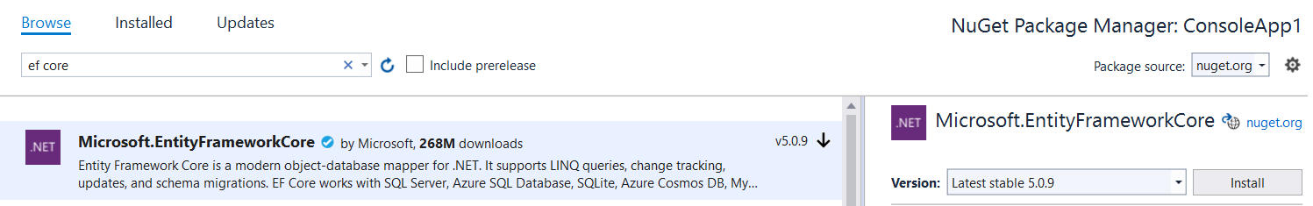
How to include EF Core in our project?

Slide 25
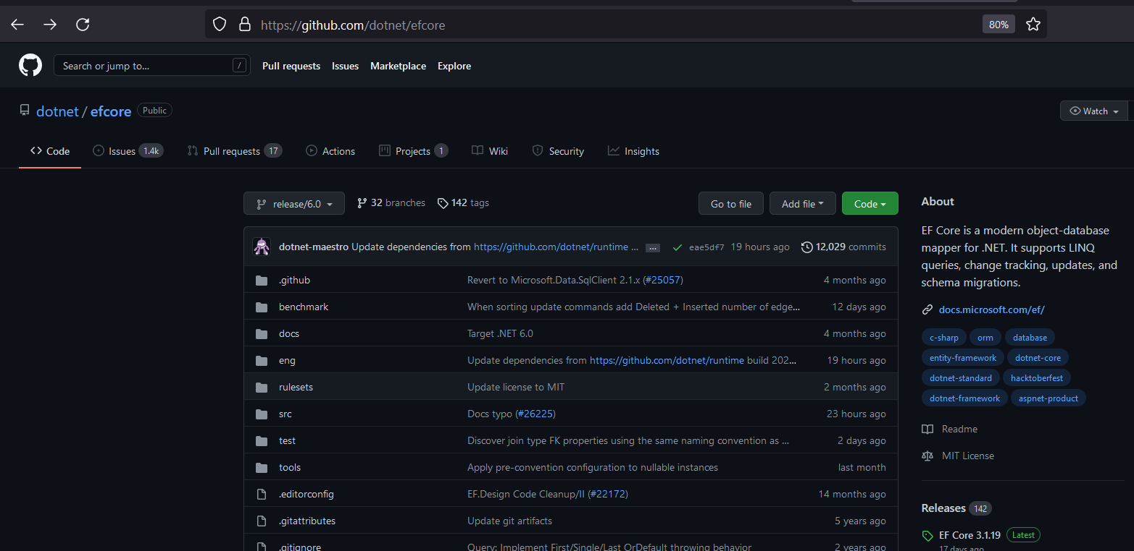
Entity Framework Core (source)
Entity Framework Core is with open source like many of the latest Microsoft technologies
It is plugin/package oriented unlike Entity Framework 6 (.NET based)
GitHub repository of EF Core: https://github.com/dotnet/efcore

Slide 26
General Overview of EF Core
EF Core is Object Relation Mapper
Increase the productivity of programmers
Use C# LINQ instead of SQL direct queries
There are “Code First” and “Database First” approaches in creating of our database model system
Supports many database providers https://docs.microsoft.com/en-us/ef/core/providers/?tabs=dotnet-core-cli

Slide 27
Thank you!

