Slide 1


Hierarchical Feature Fusion for Improved Optical Character Recognition using CNN-Transformer Architecture
Veljko Petković
Faculty of Sciences and Mathematics
University of Niš
ORCID: 0009-0008-6082-3224
SICAAI 2026 · Kragujevac · May 20–21

Slide 2


Why is Optical Character Recognition still hard?
Clean text
Heavy noise, perspective distortion, brightness shift, typical heavily augmented sample

Slide 3



Synthetic dataset - 100,000 images (288 × 64 px)
EASY
MEDIUM
HARD
Gaussian blur, moderate noise, contrast adjustment, compression, ±2% rotation
Perspective distortion, heavy noise, gamma, contrast, brightness shifts, ±3% rotation
Slight noise, ±1% rotation
max 12 characters per string
14 fonts
63-char alphabet

Slide 4
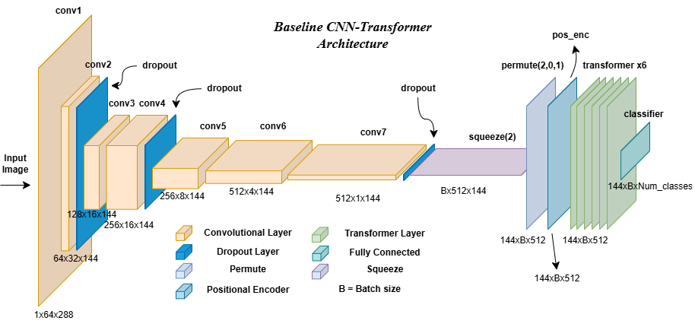
Baseline CNN-Transformer architecture
24.5M parameters
7 CNN layers
6 Transformer layers with 8 heads

Slide 5
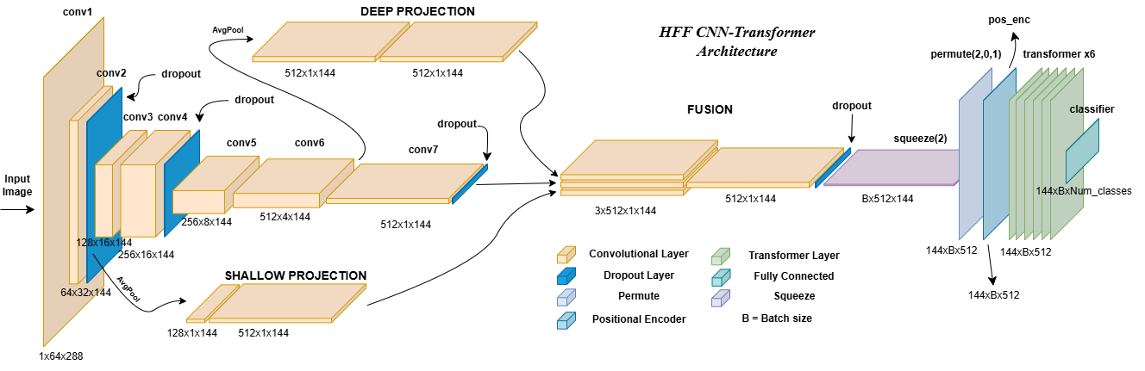
Hierarchical Feature Fusion Architecture
25.6M parameters (+1.1M)
Shallow, deep, and final features get fused

Slide 6
Training setup
Both models trained identically.
Optimizer
AdamW
Learning rate 7e-5
Batch size 128
Loss & decoding
CTC loss
Greedy decoding
Schedule
3-epoch linear warmup
Cosine decay for next 12 epochs
Weight decay 1e-2
Gradient clipping at 5.0
Hardware
NVIDIA L4 GPU

Slide 7
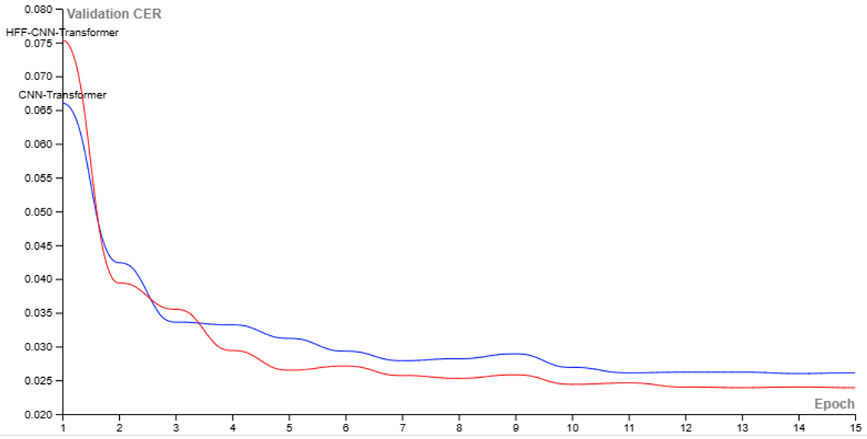
Quantitative results
MODEL | CER | Loss | Total training time | Params
Baseline CNN-Transformer | 2.62% | 0.0622 | 62.22 min | 24.5M
HFF-CNN-Transformer | 2.44% | 0.0570 | 67.22 min | 25.6M
HFF Model CER
6.87% relative Character Error Loss improvement
Baseline Model CER
+8% training time

Slide 8




Qualitative examples
Image | Baseline model prediction | HFF model prediction
 | Program fies ❌ | Program files ✅
 | AccJe1223 ❌ | ABcde123 ✅
 | I writin9 ❌ | I am writin9 ❌
 | Hadto read ❌ | Hardto ready ❌
 | Transformer 5 ✅ | Transformer 5 ✅

Slide 9
Conclusions & Limitations & Future work
Conclusions:
HFF + adaptive masking improves CER by 6.87% (relative)
+1.1M parameters (~4% increase)
+5 min training time (~8% increase)
Limitations:
We evaluated on synthetic data only
No component-level ablation
Future work:
Train and test on real text images
Beam search decoding
Larger architectures and longer sequences

Slide 10
Thank you. Questions?
veljko.petkovic@pmf.edu.rs

