Slide 1




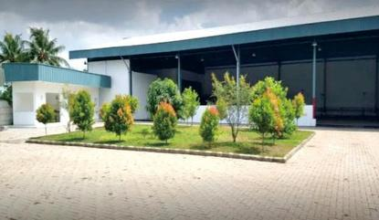
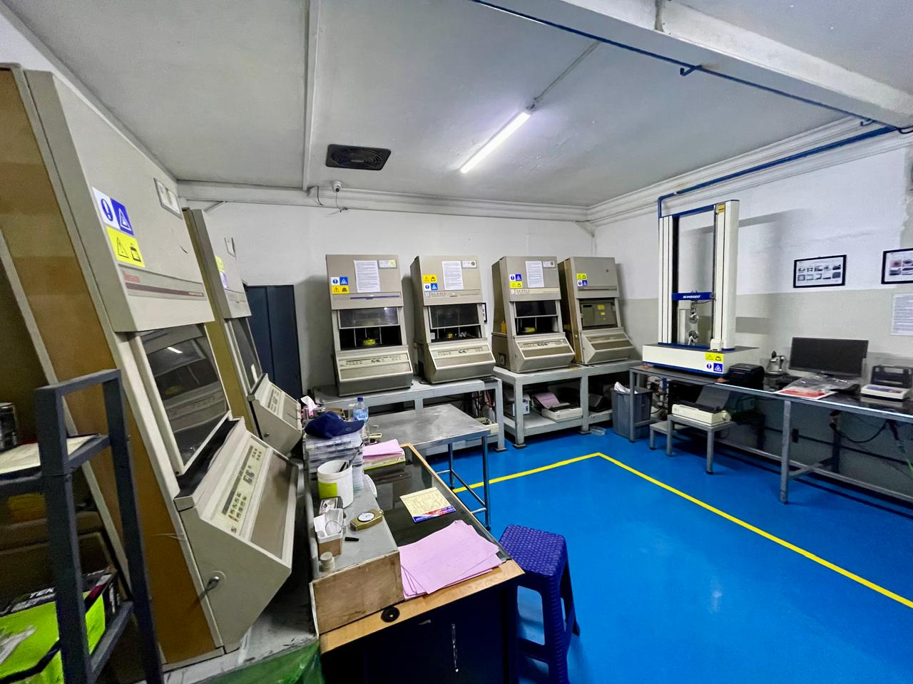
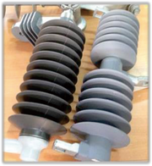
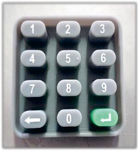
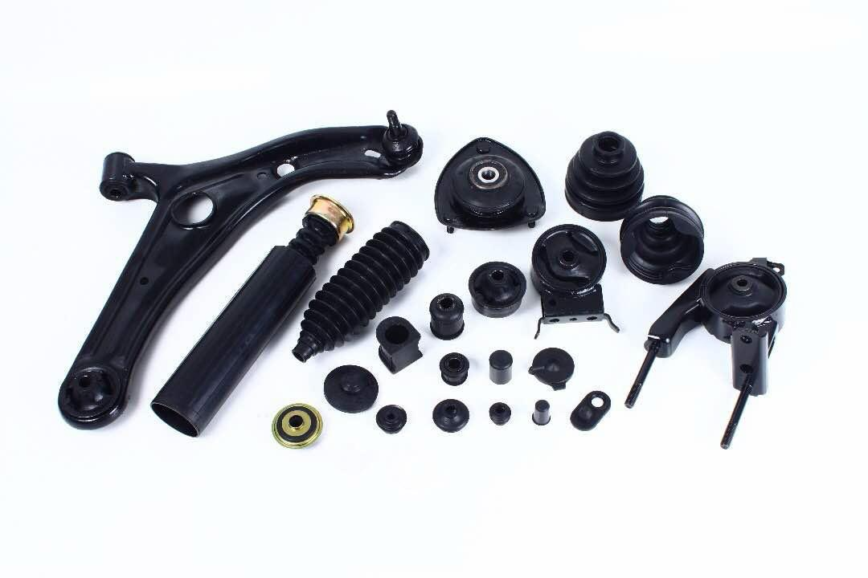
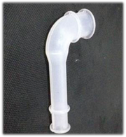
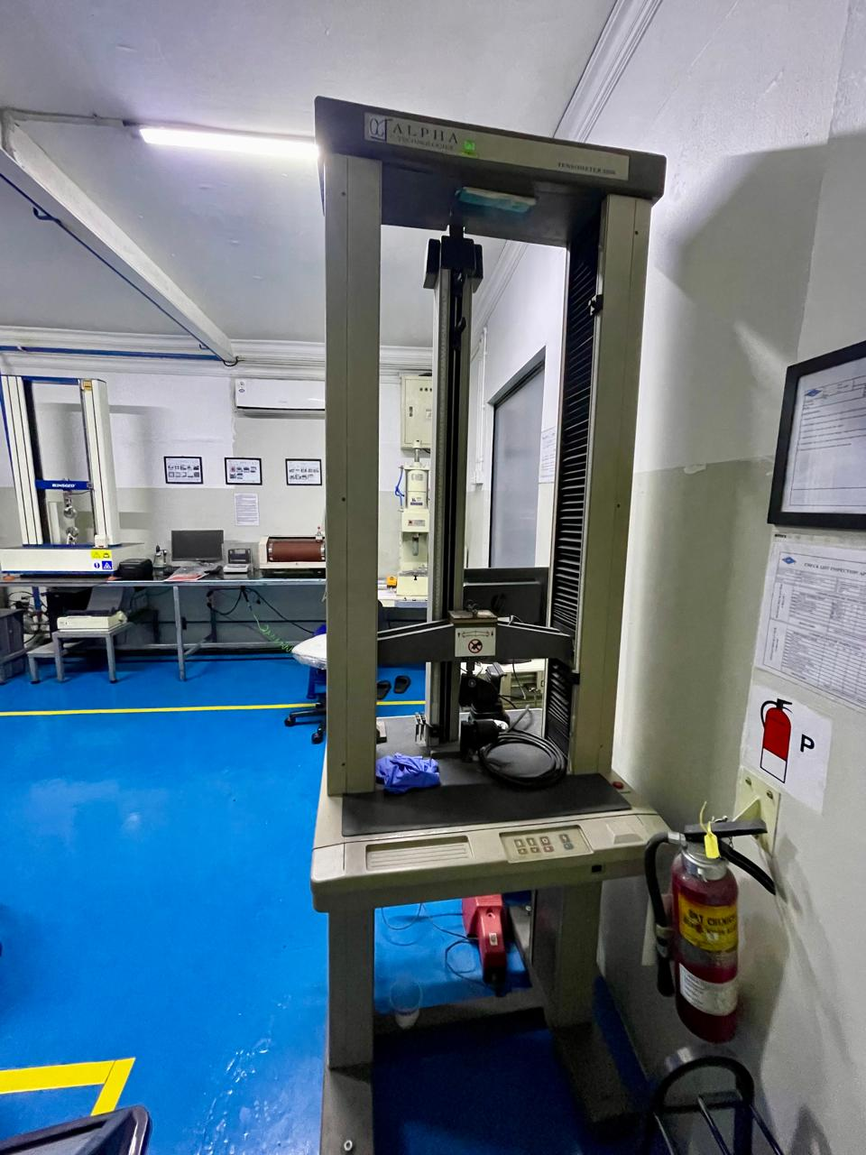
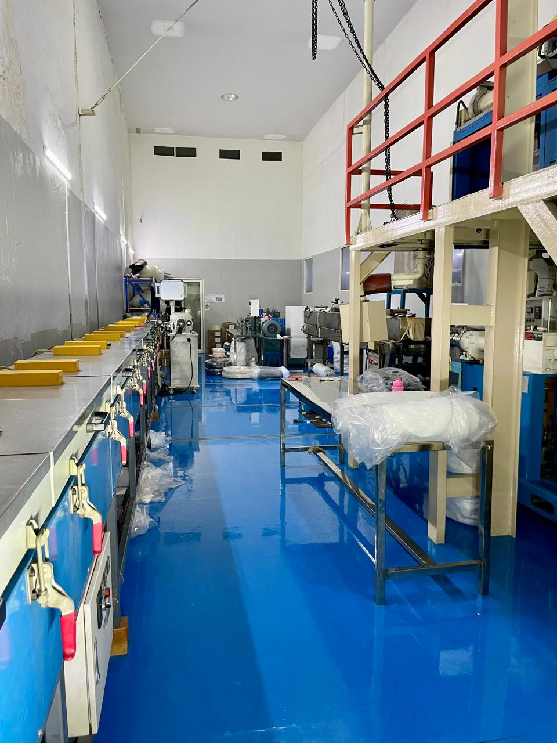
SANTO RUBBER GROUP
Complete Rubber Manufacturing Solutions
From rubber compound development to finished OEM components
30+ years experience | Multiple production facilities | ISO 9001:2015
www.industrikaret.com • Jakarta & Tangerang, Indonesia

Slide 2
ONE GROUP — BROAD RUBBER CAPABILITY
Integrated capabilities across compound, finished rubber goods, footwear, marine/industrial products and recycling.
RUBBER COMPOUND
CUSTOM RUBBER PRODUCTS
NR, SBR, BR, NBR, EPDM, CR, IIR, CSM/Hypalon, NBR/PVC, PU, Silicone, HNBR, FKM, ACM, ECO and Fluorosilicone.
Compression molded, injection molded and extruded rubber products for customer-specific applications.
FOOTWEAR
MARINE & INDUSTRIAL
Rubber shoe and sandal outsoles, foxing and custom footwear components.
Marine fenders, bumpers, rubber rolls, protection pads and impact-absorption products.
RECYCLED RUBBER
OEM DEVELOPMENT
Rubber powder, granules, recycled compound applications, rubber tiles and sport/playground applications.
Product development based on drawing, sample, material requirement and target performance.

Slide 3
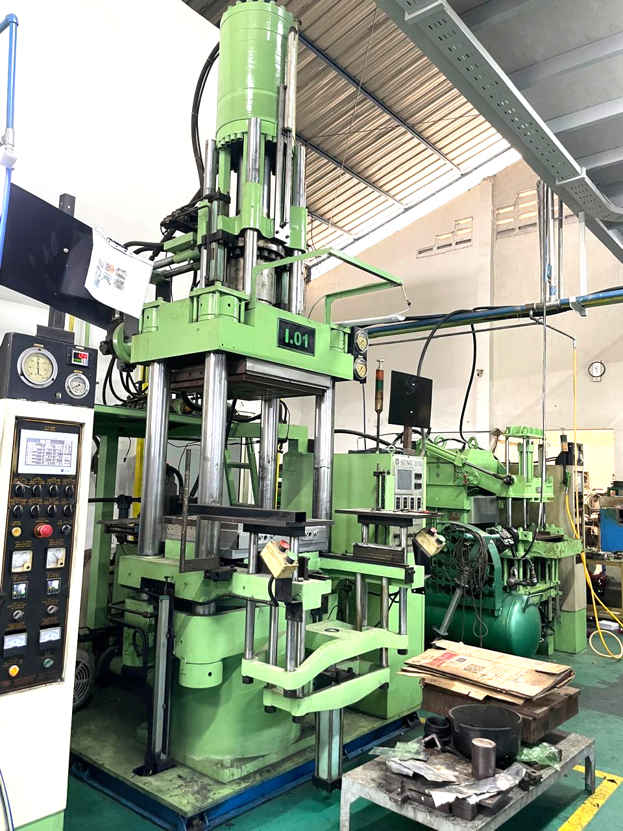
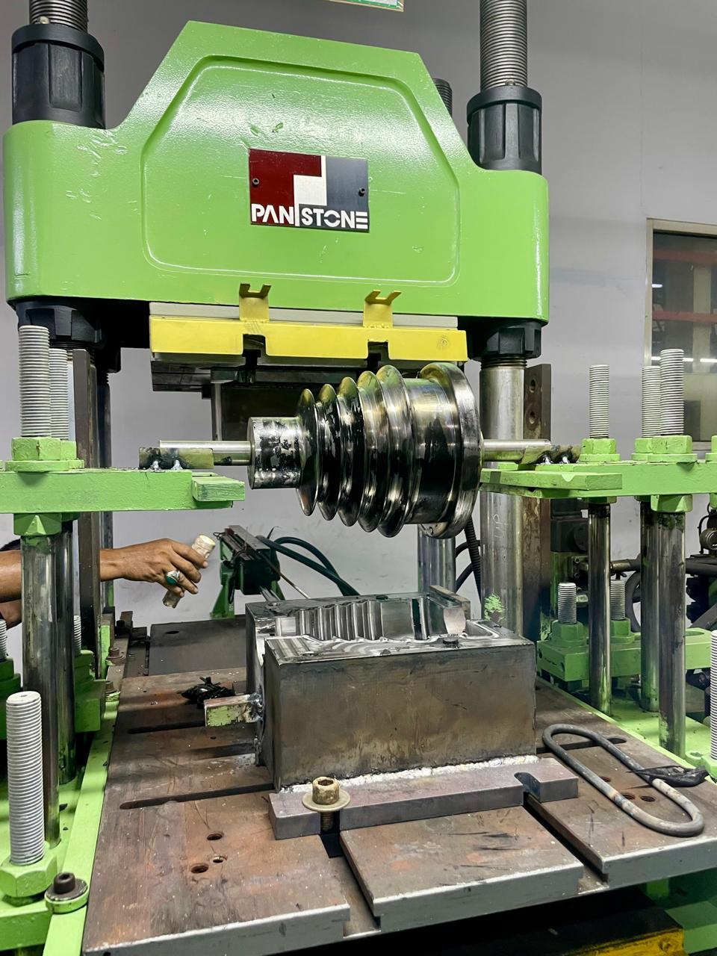
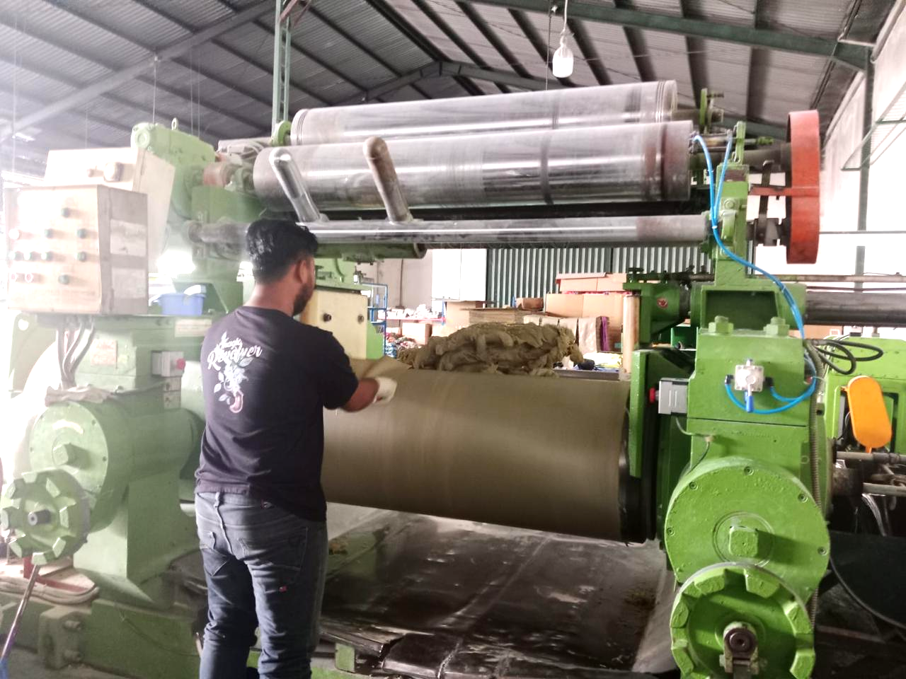
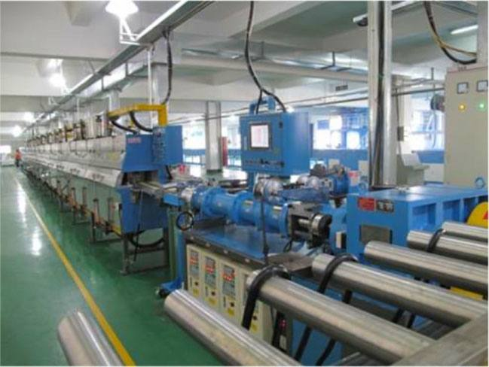
CUSTOM MOLDED, COMPRESSION, INJECTION & EXTRUDED RUBBER
OEM rubber components for automotive, electronics, oil & gas, health, household and general industry.
Typical capabilities
• Seals & gaskets
• Boots & bellows
• Bushings & pads
• Diaphragms
• Rubber-metal bonded parts
• Tubes, cords & profiles
• Hoses & strips
• Silicone molded parts
• Customer-specific OEM parts
Development basis
Drawing • physical sample • material specification • performance target

Slide 4
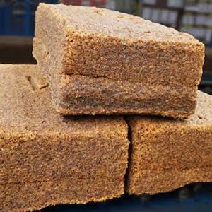
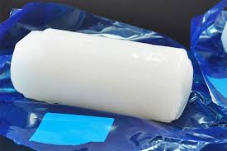
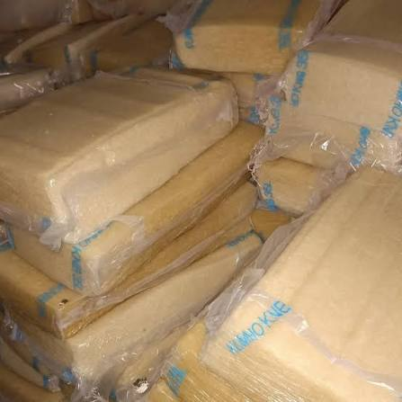
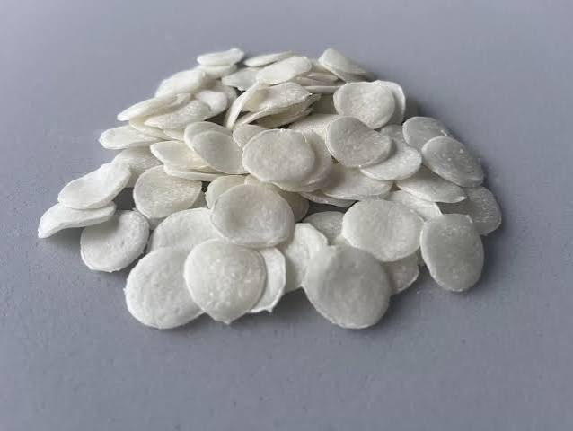
CUSTOM RUBBER COMPOUNDS
Material selection and compound development for different environments, properties and processing requirements.
AVAILABLE ELASTOMERS
NR • SBR • BR • NBR • EPDM • CR / Neoprene • IIR / Butyl • CSM / Hypalon • NBR/PVC • PU • Silicone • HNBR • FKM / Viton • ACM • ECO • Fluorosilicone
Development support
• Compound mixing
• Material property adjustment
• Cure optimization
• Prototype & trial batch
• In-house laboratory testing
• Production scale-up

Slide 5
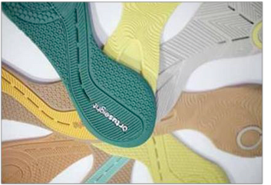
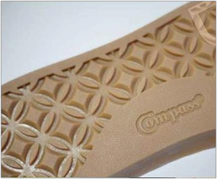
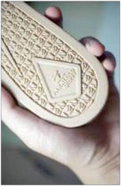
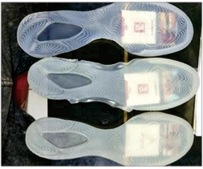
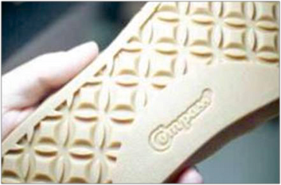
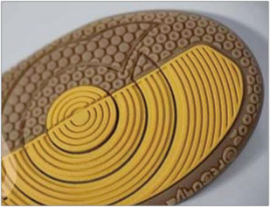
RUBBER FOOTWEAR PRODUCTS
Outsoles and footwear rubber products produced according to required color, material, quality and application.
Product range
• Shoe outsoles
• Sandal soles
• Foxing
• Sports footwear
• Casual footwear
• Military footwear
• Safety footwear
• Custom rubber outsole projects
Custom development
Material, hardness, color, pattern and performance can be developed according to customer requirements.

Slide 6
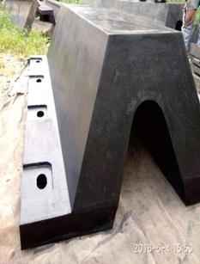
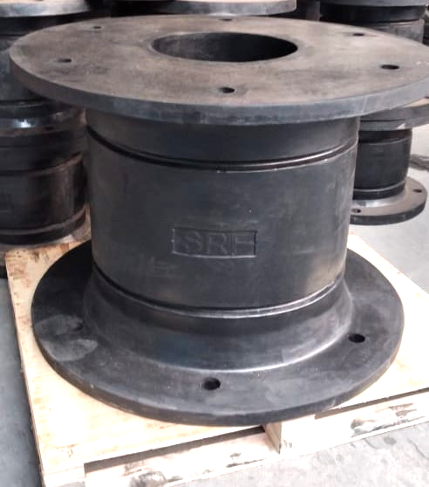
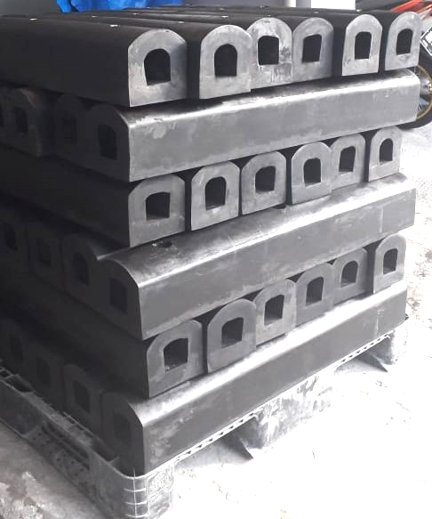
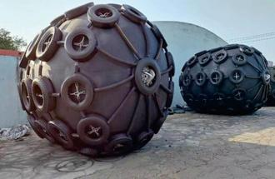
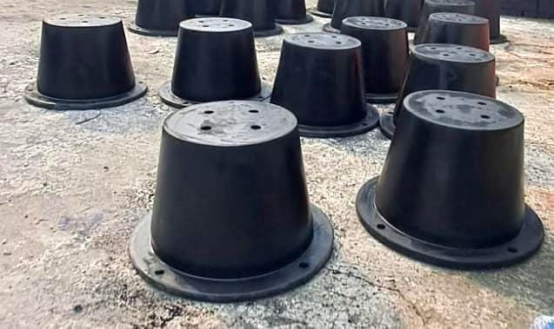
MARINE FENDER & HEAVY INDUSTRIAL RUBBER
Impact protection and heavy-duty rubber products for ports, warehouses and industrial applications.
Fender types
• V / Arch
• D type
• Cell
• Cone
• Cylindrical
• Square
• Pneumatic
Other industrial products
Rubber rolls, warehouse bumpers, pier support/protection pads and custom impact-absorption components.

Slide 7
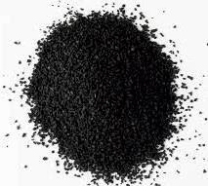
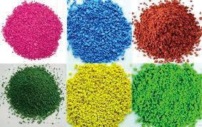
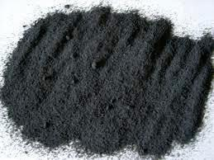
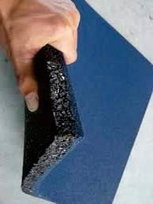
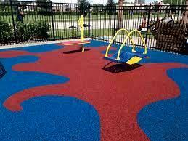
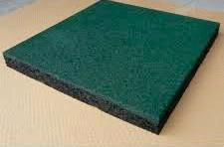
RECYCLED RUBBER & CIRCULAR APPLICATIONS
Rubber waste processing into reusable powder and granules for secondary rubber applications.
Products & applications
• Fine rubber powder
• Coarser rubber granules
• Grade-C compound
• Rubber paving / tiles
• Jogging tracks
• Futsal/ indoor soccer courts
• Children's playground surfaces
Sustainability focus
Supporting wider reuse of rubber waste and development of more resource-efficient rubber applications.

Slide 8
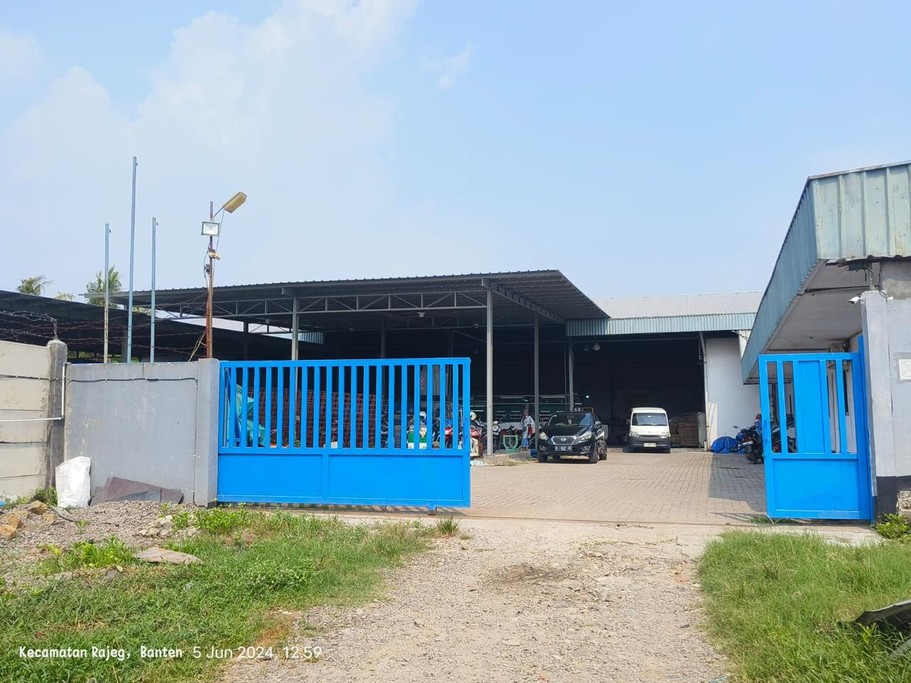
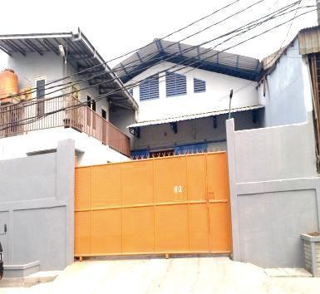
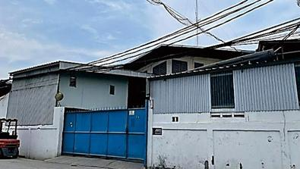
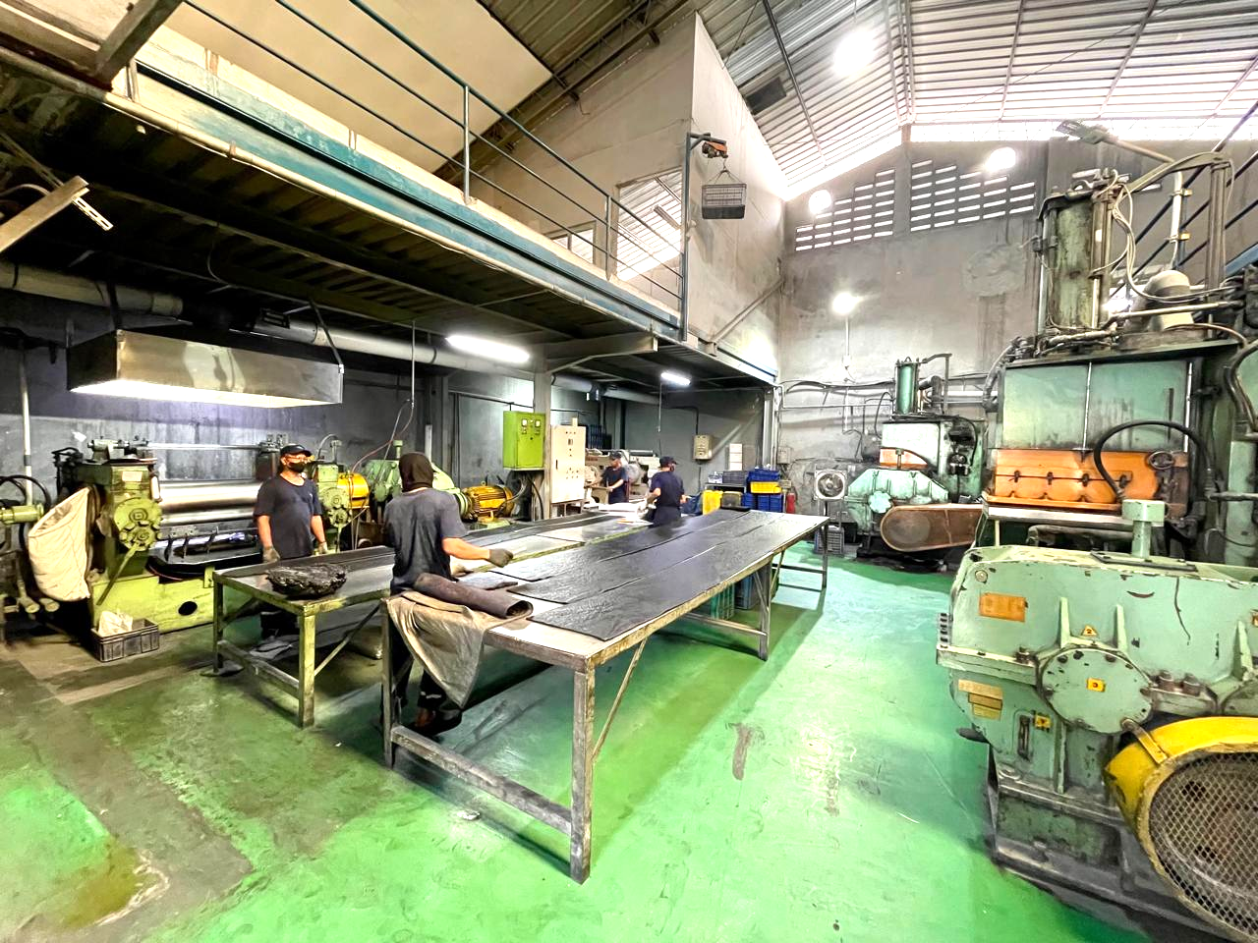
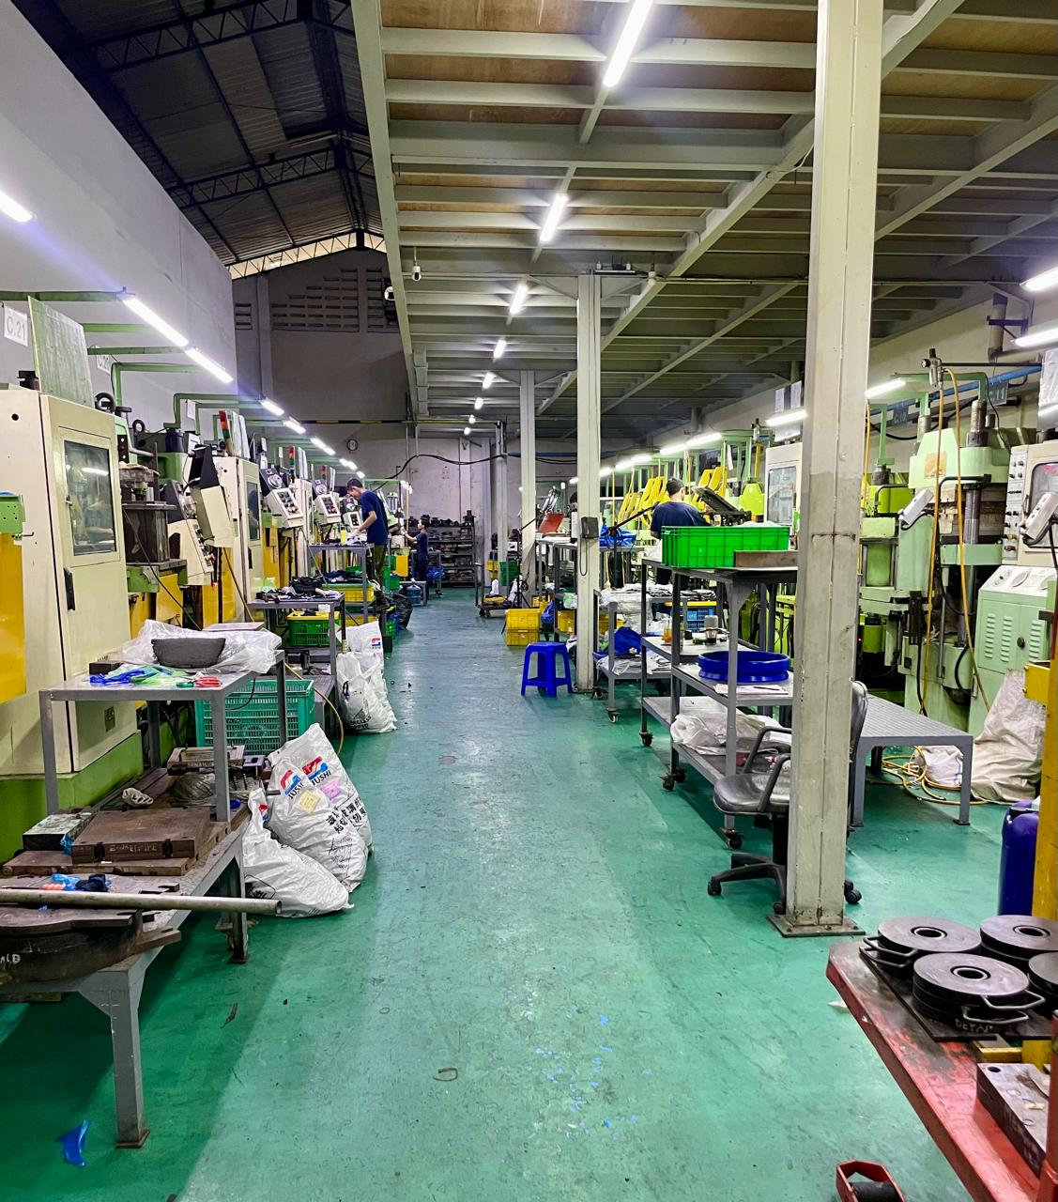
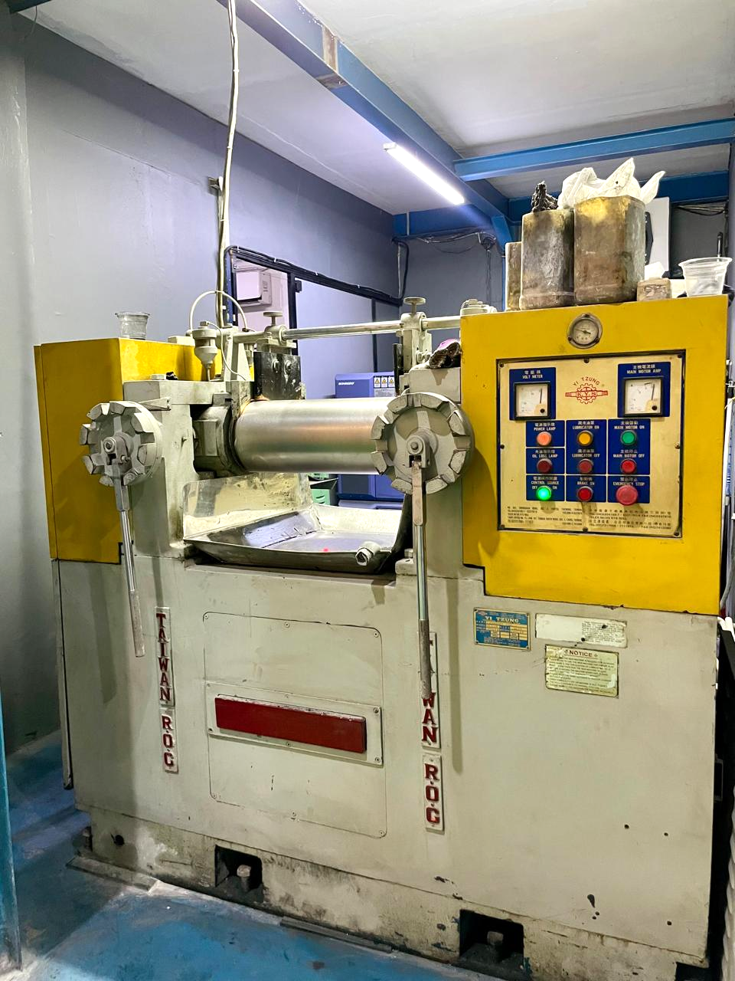
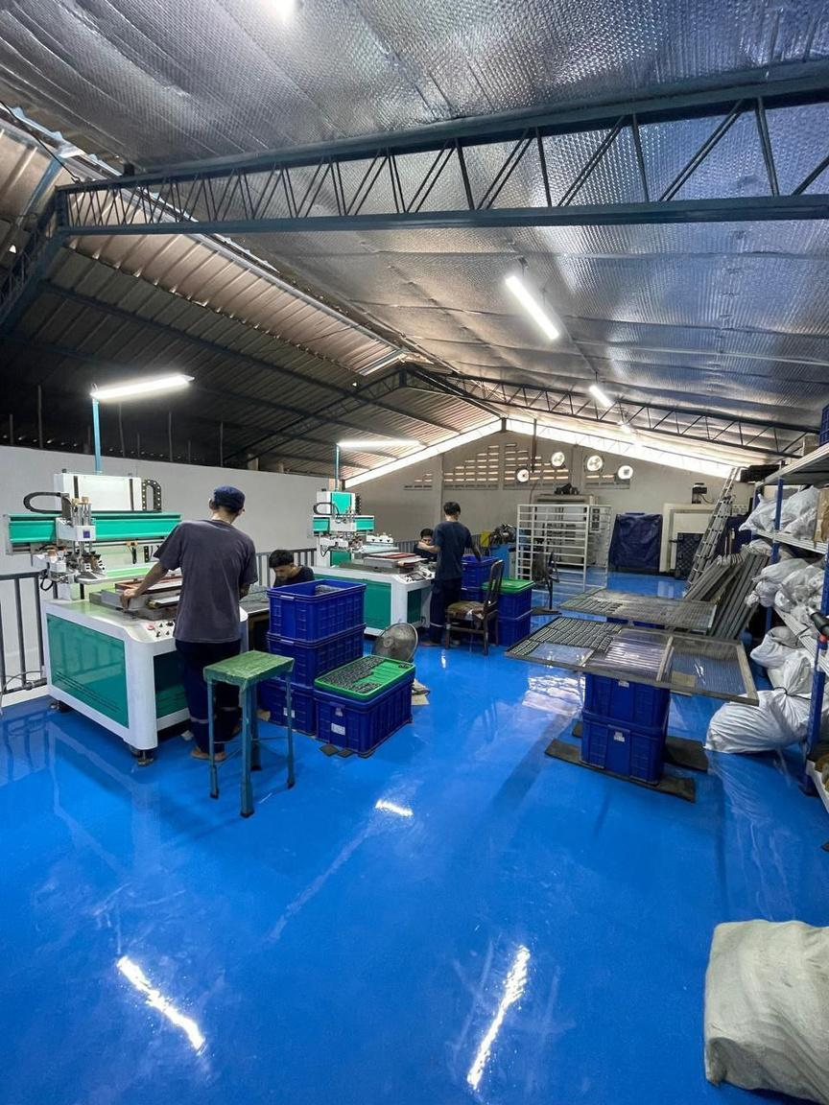
MANUFACTURING & QUALITY SUPPORT
Multiple production facilities in Jakarta and Tangerang with in-house processing and laboratory capability.
Key capabilities
• Dispersion kneaders 55 L & 75 L
• Open mills 8”,16”, 18”, 22”
• Extruders 30–120 mm
• Compression molding
• Compression vacuum molding
• Rubber injection 200 ton to 400 ton
• Post-cure ovens
• Automatic cutting
• Machining support
• Automatic rubber printing machine
• Automation chemical weighing
• MDR 2000 / ODR 2000/ Mooney / tensile / ozone / abrasion testing /density / aging / compression set
SANTO RUBBER GROUP
Custom Rubber Manufacturing Partner in Indonesia
www.industrikaret.com

