Slide 1
Smart Traffic Signal
By team #RJY

Slide 2
Problem statement:
In our traditional traffic signal system, the indicators were set for fixed time. Though the time intervals are fixed after assessing the average lane traffic, many times it is found that, vehicles in one direction have to unnecessarily wait for the Green signal even though no other vehicles in the opposite directions. This creates a problem for emergency vehicles. An intelligent traffic signal system is to be developed, that asses the real time traffic in that road/lane and control the traffic to avoid unnecessary waiting time. Through this information, we can also give directions to emergency vehicle through bot.

Slide 3
Overview:
The given problem statement is solved using machine learning techniques and with the help of some sensor results. First we will be evaluating the results of traffic density using OpenCV. Next, we will take the result from the sensors and this data will be compared with the results that we get from the above mentioned scenario. Management of the timings of traffic signal is done based on the density of traffic on its corresponding road.

Slide 4
Objectives:
* To evaluate the traffic density and manage the timings of the signal
.

Slide 5
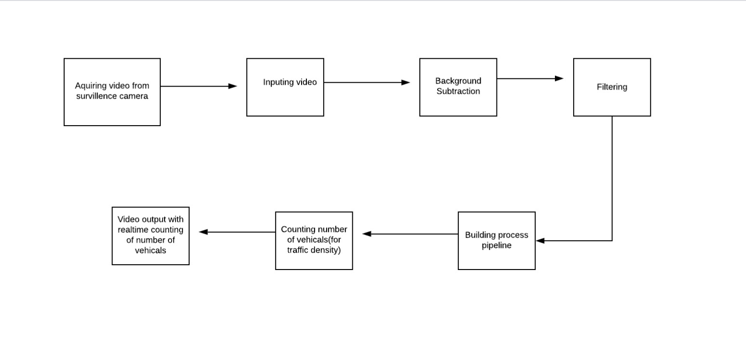
BLOCK DIAGRAM

Slide 6
Approach:
Understand the main idea of background subtraction algorithms that used for foreground detection.
OpenCV image filters.
Object detection by contours.
Building processing pipeline for further data manipulation

Slide 7
Conclusion
This approach helps us to identify the traffic density using the video snippet taken by the surveillance camera with the help of OpenCV ,we then compare this with the traffic density detected by the sensors within in a given distance.
Accordingly the traffic signals will be controlled and the denser road will be given the first preference. Thus this approach would help us build a smarter traffic signal system and reduce the waiting time for the roads with denser traffic.

