Slide 1
Crocheting Hyperbolic Surfaces
BarbaraJoy Jones

Slide 2
For God’s sake, please give it up. Fear it no less than the sensual passion, because it, too, may take up all your time and deprive you of your health, peace of mind and happiness in life.
Notes:
Wolfgang Bolyai urging his son Janos Bolyai to give up work on hyperbolic geometry

Slide 3
Gaussian curvature
Theorema Egregium: Gaussian curvature is an intrinsic property, independent of C² embedding
Spheres have constant positive curvature: (1/R²)
Planes have zero curvature
Hyperbolic planes have constant negative curvature: (-1/R²)
Notes:
Hyperbolic plane: a Riemannian manifold with constant negative Gaussian curvature
C^2 embedding: surface is differentiably embedded into 3-space by an isometry whose first and second derivatives are continuous
Circles = constant positive curvature, 1/R
R = radius of the hyperbolic plane = radius of annuli

Slide 4
Problem
The Poincaré disc and other models can be easily drawn on a Euclidean surface, but distort the geometry of the hyperbolic plane
A physical surface is much easier to study
Notes:
Distortion: theorema egregium, same issue as the Greenland effect
Spherical geometry: use the surface of a ball

Slide 5
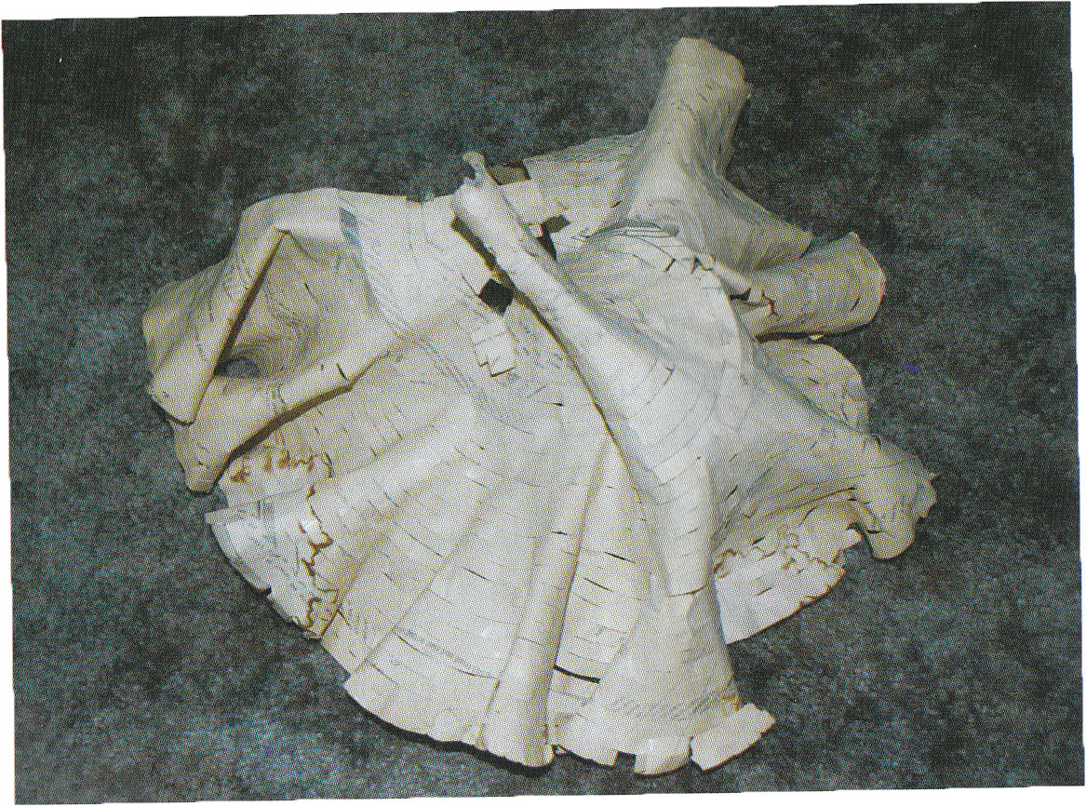
Initial solution
Notes:
Paper-and-tape model, developed by William Thurston
Very fragile

Slide 6
Basic crocheted plane
Start with a few stitches
For each row, increase every n stitches
Repeat until the model is big enough
Alternatives
Pseudosphere: work in the round
Symmetric hyperbolic plane
Notes:
work all stitches as single crochet
Ratio of n:(n+1) determines radius
My model: n = 8
Pseudosphere has the same local geometry as the hyperbolic plane, but can’t be infinitely extended (Beltrami)
Symmetric plane: do some calculations based on height/width of a stitch to be sure the curvature is constant, work in the round

Slide 7
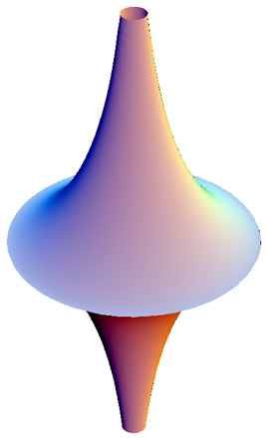
Pseudosphere

Slide 8
Limitations of the crocheted model
Cannot infinitely extend it
Exponential growth
An approximation at best
Notes:
Exponential growth: length of row/round

Slide 9
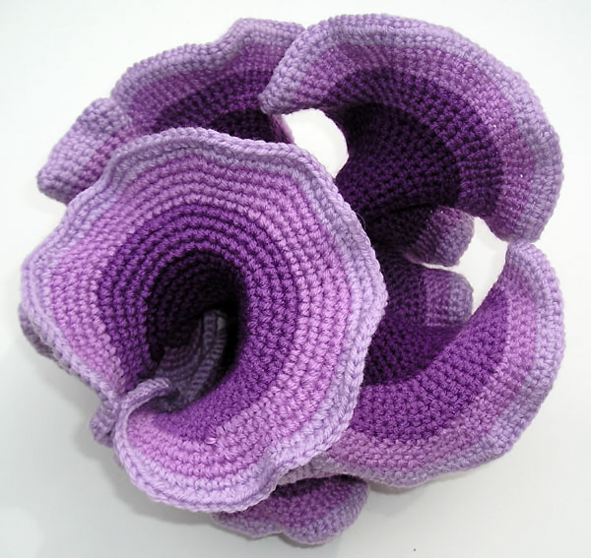
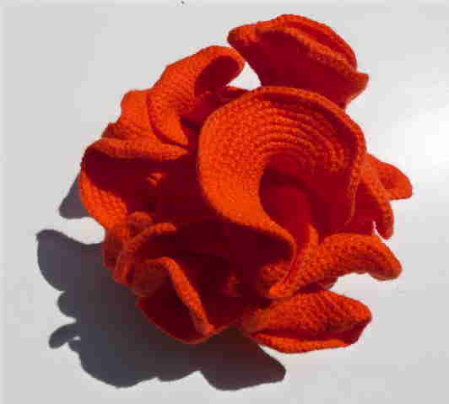
Notes:
Daina Taimina
Each shade of purple is 100m of yarn

Slide 10
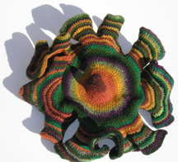
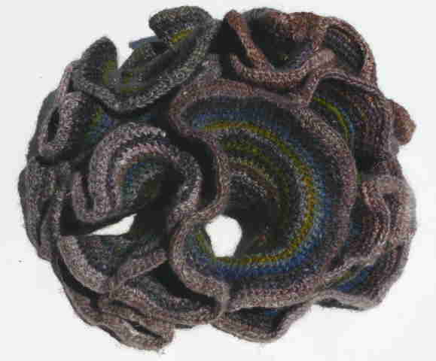
Notes:
Brown = symmetric
Rainbow = pseudosphere with 11:12 ratio

Slide 11
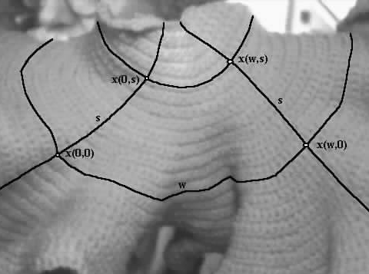
Geodesics
Hyperbolic straight lines
Coordinate system
Allow for isometries
Notes:
Radial curves = geodesics with reflection symmetry
Radial geodesics are asymptotic
New isometry (horolation)
composition of two reflections = isometry that preserves each annulus
In the plane, two reflections would be a rotation (about the center of the annulus)
Annulus has no center, isometry has no fixed point (radial geodesics don’t intersect)
Not a translation: no geodesic is preserved
Presenting… the horolation!
Annular curves = horocycles
Every pair of points is joined by a unique geodesic.
Two geodesics intersect no more than once.
Every geodesic segment has a geodesic perpendicular bisector.
Every angle (between geodesics) has a geodesic angle bisector.
Each non-radial geodesic is tangent to one annulus, and then, as you travel in both directions from that point, the geodesic approaches being perpendicular to the annuli that it crosses on the way to infinity.

Slide 12
Hyperbolic Triangles
Notes:
Triangle formed by 3 geodesics, extend the sides
Three extra lines: asymptotic at both ends to an extended side of the triangle = ideal triangle

Slide 13
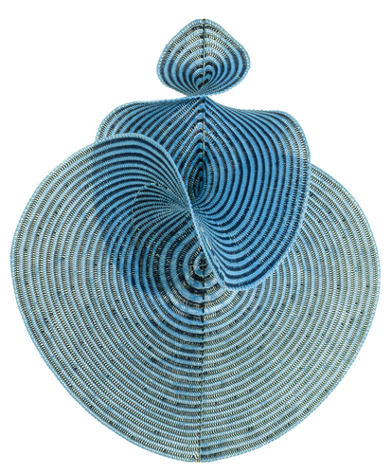
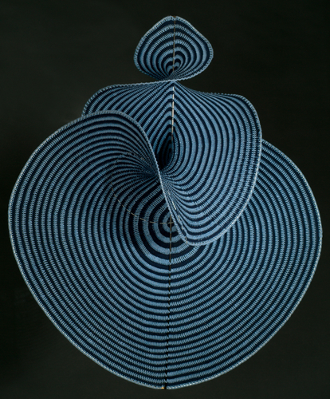
Lorenz Manifold
Notes:
Two-dimensional stable manifold of the origin of the Lorenz system
Lorenz equations describe the nature of chaotic systems
Computer generated mesh = easy to convert to a crochet pattern
Areas of positive and negative curvature

