Slide 1
Git & GitHub
Sara Cummins & BarbaraJoy Jones

Slide 2
What is Git?
Distributed version control
Cool projects use git

Slide 3
Distributed

Slide 4
Cheap local branching

Slide 5
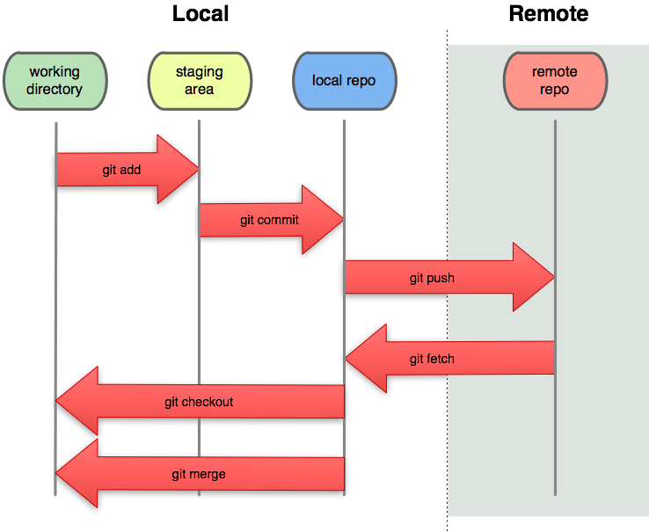
Local
Notes:
Local = fast!

Slide 6
git-svn

Slide 7

GitHub & demo
Notes:
Repo browser
Inline editing
Gist (pastebin)
Pretty graphs! (impact, network, etc)
Free/paid

