Slide 1


Sara Cummins & BarbaraJoy Jones

Slide 2

What is Git?
Distributed version control
Originally designed for Linux
Possibly short for “"Global Information Tracker"

Slide 3
Distributed
Clone entire repository
No single point of failure
Compared to SVN:
  Slightly slower checkout
  Slightly bigger directory

Slide 4
Cheap local branching
Strong support for non-linear development
Multiple local branches that can be independent of each other
Creation, merging, and deletion of these lines takes seconds
Not all branches have to be pushed at once
Notes:
In other SCM: best branch is basically a clone of the repository in a new directory
Some examples:
Create a branch to try out an idea, commit a few times, switch back to where you branched from, apply a patch, switch back to where you are experimenting, then merge it in.
Have a branch that always contains only what goes to production, another that you merge work into for testing and several smaller ones for day to day work
Create new branches for each new feature you're working on, so you can seamlessly switch back and forth between them, then delete each branch when that feature gets merged into your main line.
Create a branch to experiment in, realize it's not going to work and just delete it, abandoning the work—with nobody else ever seeing it (even if you've pushed other branches in the meantime)

Slide 5

Cheap Local Branching (continued)
Taken From: http://whygitisbetterthanx.com/
No sequential numbering

Slide 6
Staging Area
Set-up commit before committing
Stage files for commit instead of committing entire working directory
Stage portions of a file

Slide 7
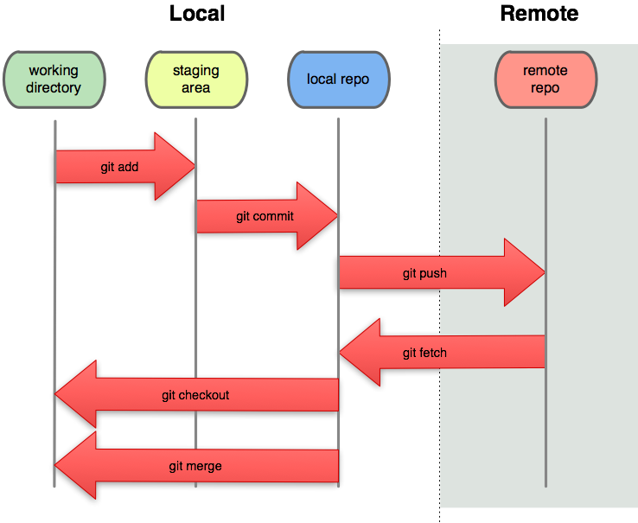
Local
Taken From: http://whygitisbetterthanx.com/
Notes:
Local = fast!

Slide 8
GitHub: MySpace for Code
“Social Coding”
Unlimited free public repositories
Inline editing
Lots of beautiful graphs
Other cool tools
API for programs/scripts
Demo: http://github.com/radiant/radiant
Notes:
Repo browser
Inline editing
Gist (pastebin), pastes are automatically git repositories
Issue tracker
wiki
Pages: publish web content by pushing to the repo
Pretty graphs! (impact, network, etc)
Free/paid: as low as $7/month
300MB disk quota (free users), soft limit – open source projects can ask for more
http://github.com/radiant/radiant

