Slide 1


Mark Caral, Sara Cummins, BarbaraJoy Jones

Slide 2

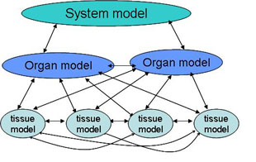
Integrating physiological models
Notes:
Human body = complex system
Multilevel & multiscale
Mathematical models of physiological processes (differential equations)
Models inherently limited to one scale
Models = insulin production, glucose levels, drug delivery, etc

Slide 3
Types of integration
Vertical: integration of models from different levels of anatomical structures and physiological processes
Horizontal: communication between physiological processes on the same level of anatomical structure
Temporal: integration of physiological processes on different time scales
Notes:
Vertical: cellular, tissue, organ, systems, entire organism
Horizontal: communication via circulatory & nervous system
Temporal: nanoseconds to years

Slide 4
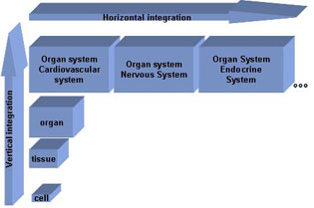
Notes:
Integration of models = better simulations

Slide 5
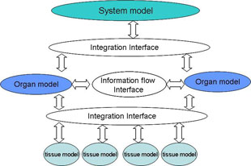
Integration interface
Notes:
Horizontal integration = information flow interface = network

Slide 6
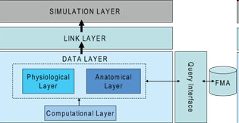
Design Structure
Notes:
-Point of this is to separate the structural and functional information from the information flow mechanism
-One directional dependency to reduce coupling
-Separate anatomical and physiological ontology from the functionality for reusability and extendability of the framework
-Example of the Observer design pattern (data layer notifies link layer notifies simulation layer of changes)

