Slide 1
Git & GitHub
Sara Cummins & BarbaraJoy Jones

Slide 2
What is Git?
Distributed version control
Cool projects use git
http://whygitisbetterthanx.com/

Slide 3
Distributed

Slide 4
Cheap local branching

Slide 5
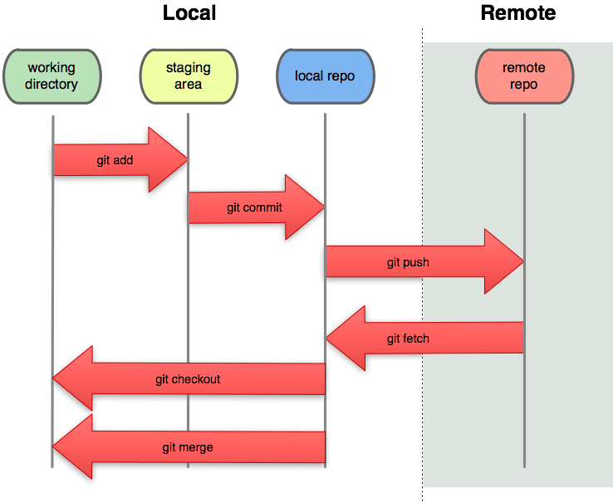
Local
Notes:
Local = fast!

Slide 6
git-svn

Slide 7
GitHub: MySpace for Code
“Social Coding”
Unlimited free public repositories
Inline editing
Lots of beautiful graphs
Other cool tools
API for programs/scripts
Demo: http://github.com/radiant/radiant
Notes:
Repo browser
Inline editing
Gist (pastebin), pastes are automatically git repositories
Issue tracker
wiki
Pages: publish web content by pushing to the repo
Pretty graphs! (impact, network, etc)
Free/paid: as low as $7/month
300MB disk quota (free users), soft limit – open source projects can ask for more
http://github.com/radiant/radiant

