Slide 1
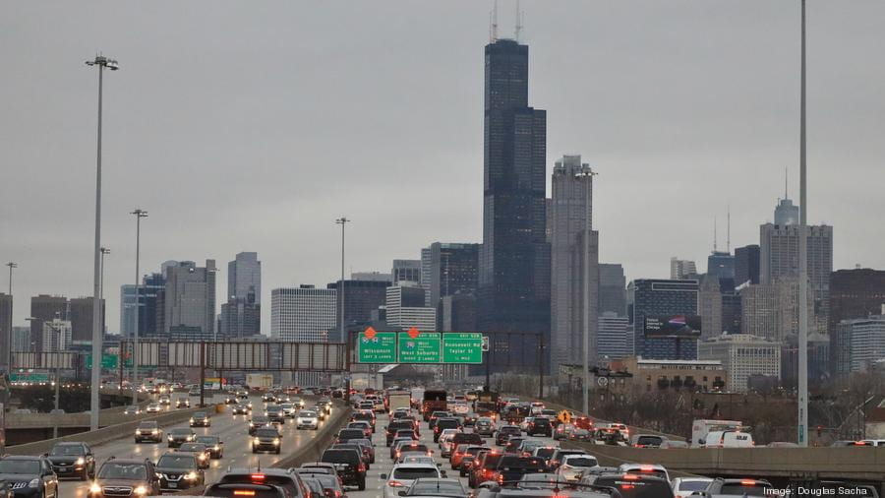
Vehicle Safety Framework
By Tyler Roth, Nathan Pak, Prathik Nair
Image Source
https://cpb-us-w2.wpmucdn.com/voices.uchicago.edu/dist/3/2230/files/2020/09/gettyimages-1088485334_900xx6720-3780-0-350.jpg

Slide 2
Executive Summary
Nearly 13 vehicle accidents occur each minute accruing > $400 billion of economic damages and yielding over 40,000 deaths in 2021¹. We aim to develop a framework for policy makers, consumers, and businesses to understand traffic crash trends in dense city environments.
Vehicle crash data is highly dynamic and economically informative to many industries. Our database concisely aggregates detailed information on the vehicles, people, and causes of the crashes. This framework is designed for the city of Chicago but can be extrapolated to other cities of the same type and can be informative not only economically but for public safety

Slide 3
Business Applications
Business examples
Insurance companies interested in crash demographics and the kinds of vehicle more likely to crash
Identify the safety of the respective cars and identify weak points in the data (e.g passenger seat riders seem to be more affected in the model noted)
Identify which cars are likely to be towed and where cars are likely to crash
Public/Consumer examples
Vehicle buyers looking for safe cars
Implementing government infrastructure to reduce crashes (red light cameras, etc)
Identify the number of hospitalizations and injuries due to traffic
Identify dangerous intersections for possible rerouting and reconstruction

Slide 4


Chicago Data Sources
Data accrued from 2017 to present
Traffic crashes from 2017 to present
People involved in traffic crashes
Vehicles involved in traffic crashes
Additional data
Speed camera violations from 2014 to present
Red light camera locations

Slide 5







Database Processing Scheme
Python
OpenRefine
Python
Data Aggregation
Data Cleaning
Data Model/Storage
Analysis
Visualization/Report
Data aggregated as separate CSV files
MySQL
Tableau
PowerPoint

Slide 6
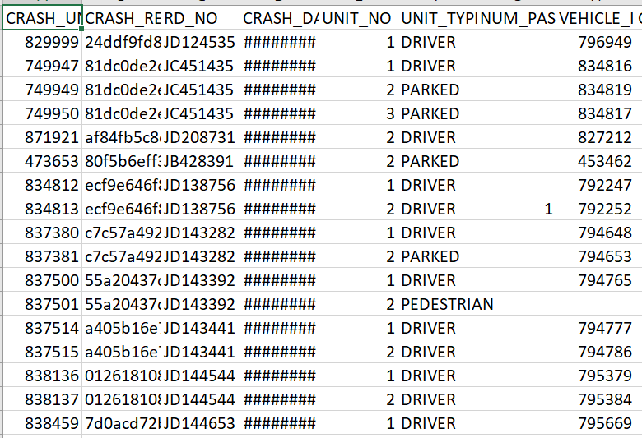
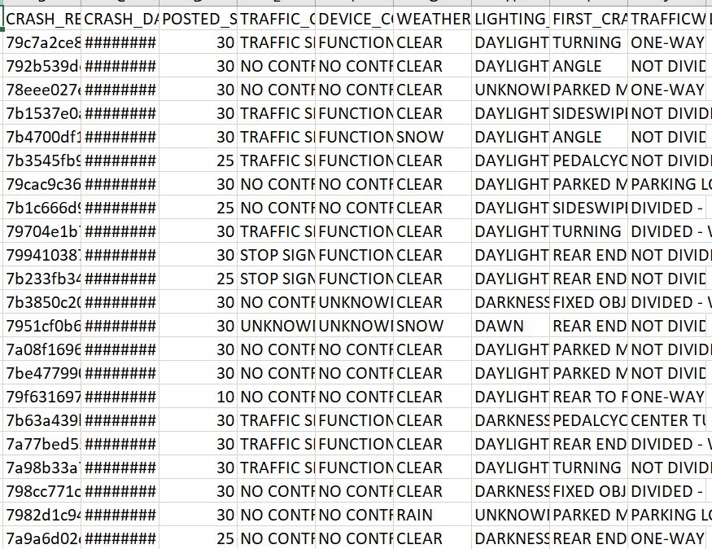
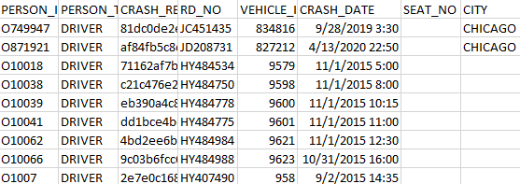
Design Considerations
Platform
Data was in a CSV format; making a relational database to store our information the logical decision.
Crash data is updated daily; relational databases support frequent queries and updates
We decided to use the popular relational database management application MYSQL, which we will host on google cloud to allow for simple collaboration
ER Model
Data consists of 3 primary tables: Crashes, Vehicles, People with pre-established keys between the tables
Create look-up tables splitting tables and normalizing where necessary.

Slide 7
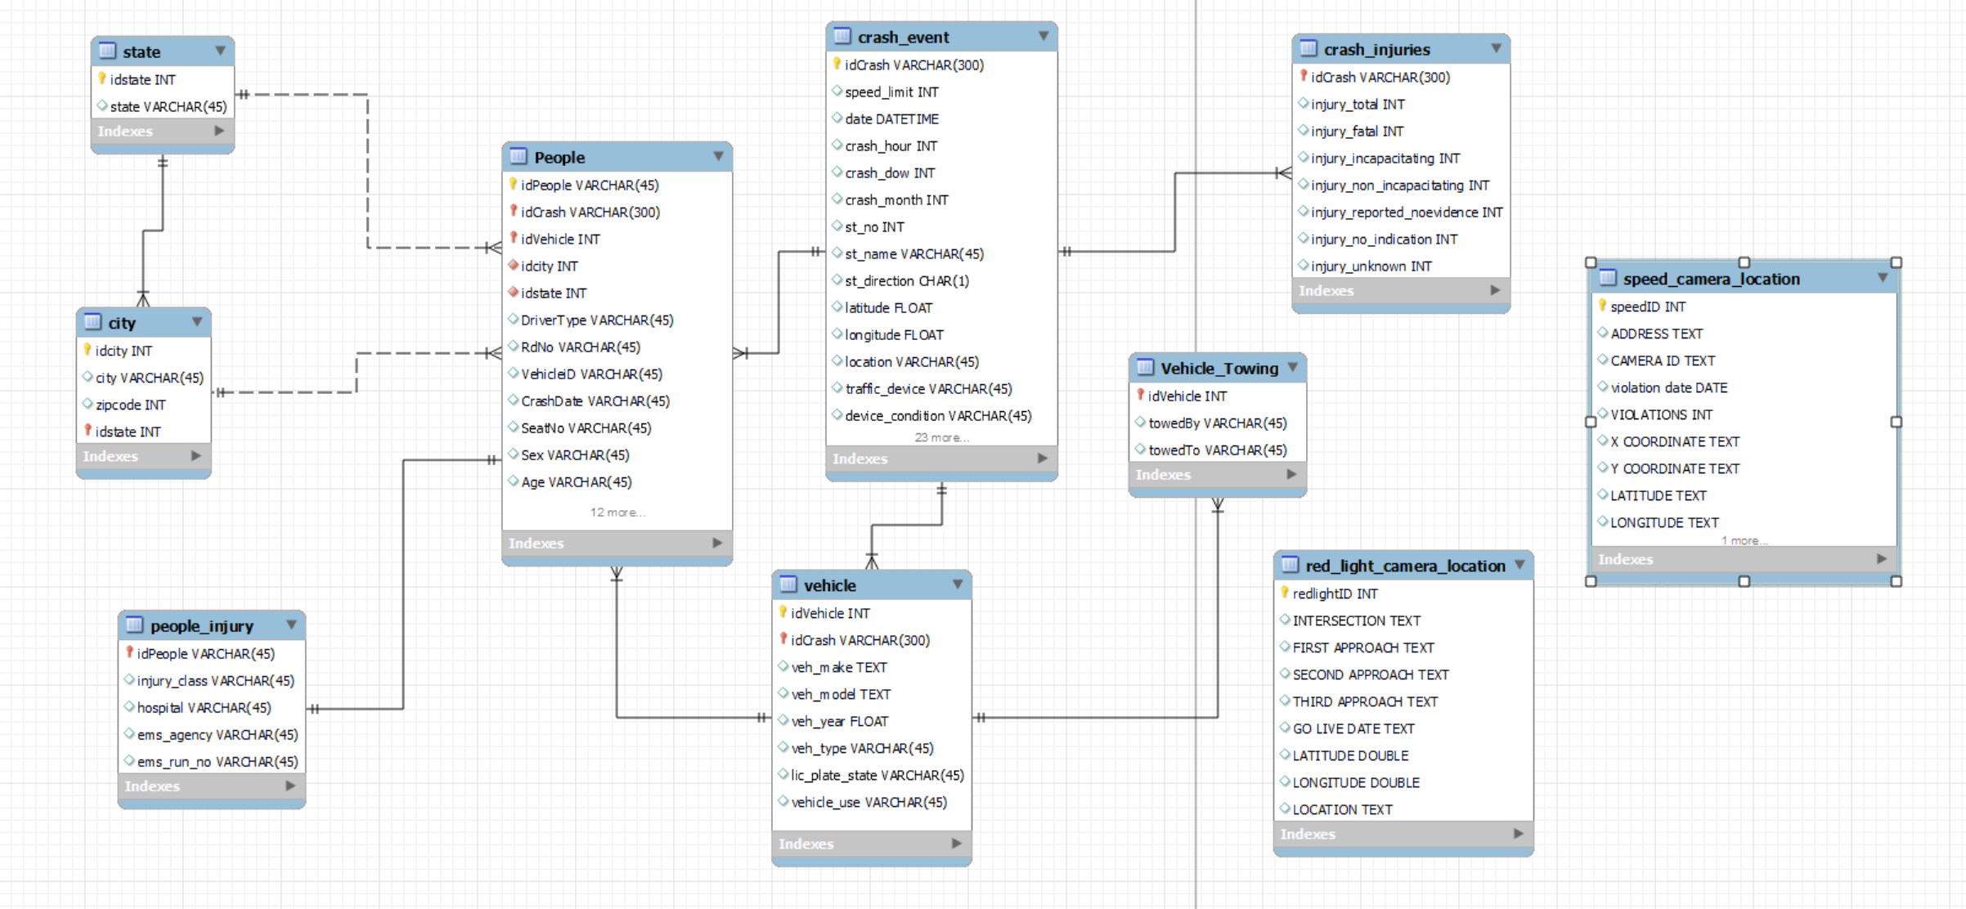
EER Diagram

Slide 8
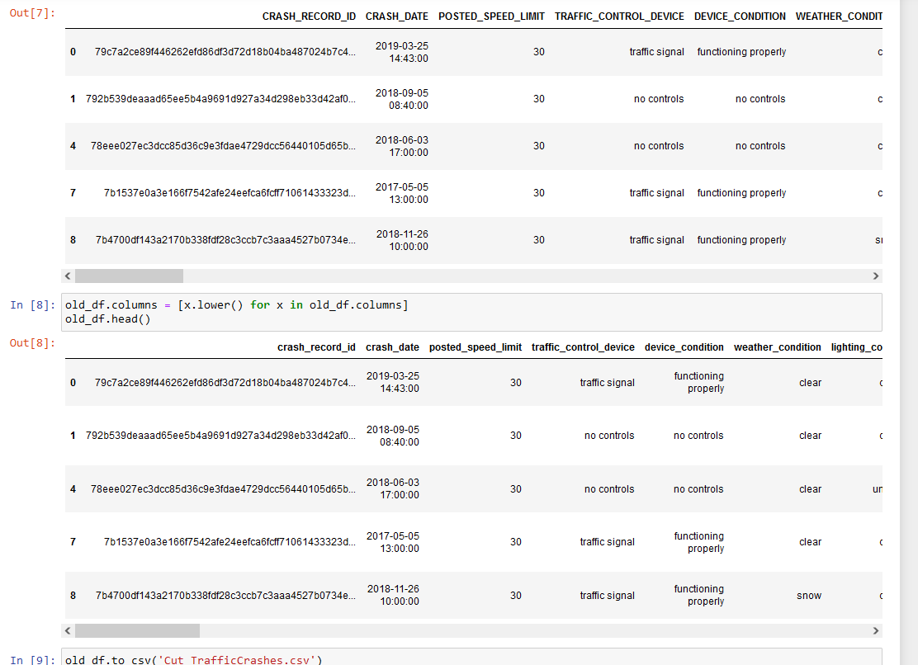
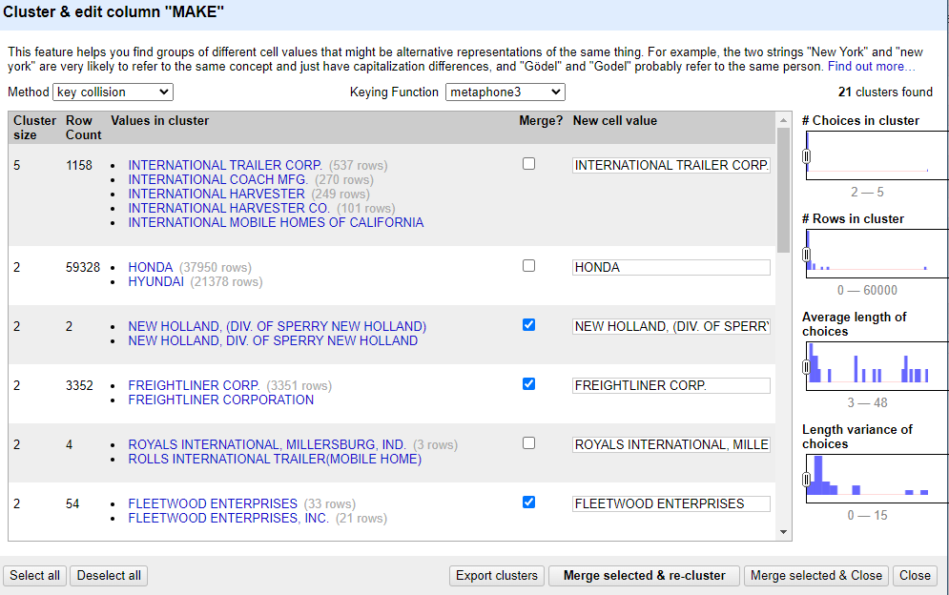
Data Preparation
Removed all data after 6/30/22 (to create a constrained dataset as data is pulled daily)
Removed all data before 7/31/22 (to create a constrained dataset as data is pulled daily)
Removed unnecessary/redundant columns (I.e column related to hazmat information)
Cleaned the data through cluster/edits in OpenRefine to remove typos and standardize rows
Standardized columns to lower case and removed white spaces using Python

Slide 9
Data Loading
5 CSV's uploaded to Google Cloud Platform buckets.
Connected MySQL Workbench to Google Cloud Platform and granted team members access
Forward engineered previous EER diagram and wrote DML script to load data
Later connected Tableau to MySQL Workbench

Slide 10
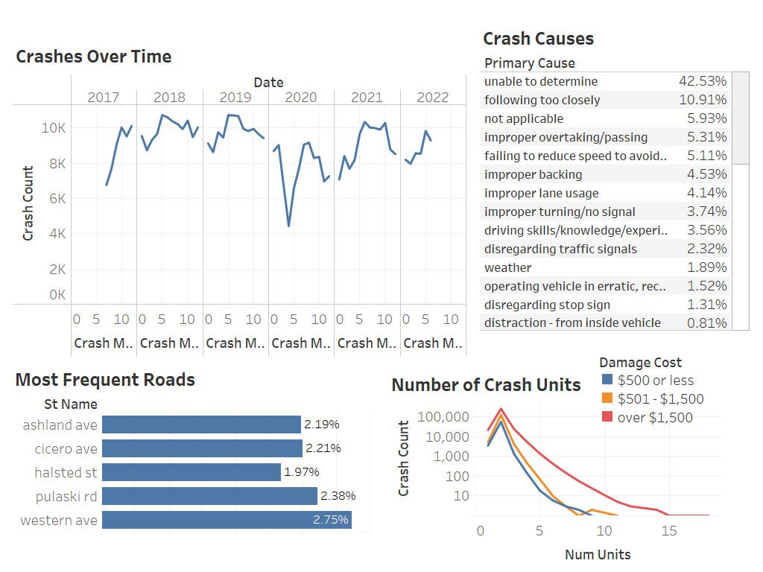
Crashes Overview

Slide 11
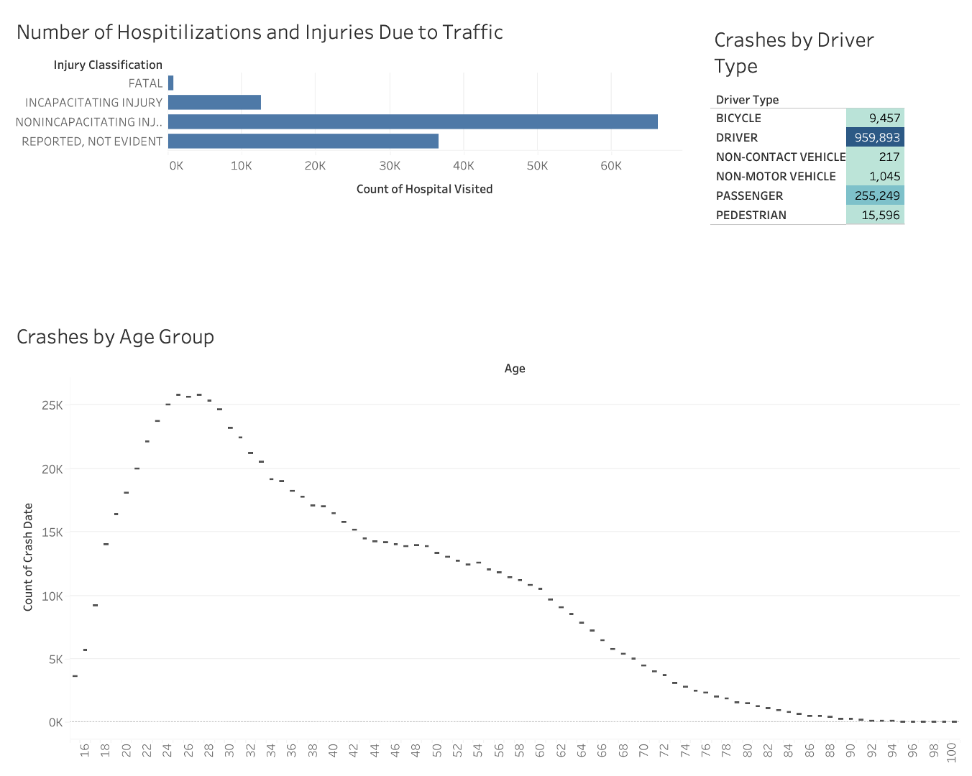
People Overview

Slide 12
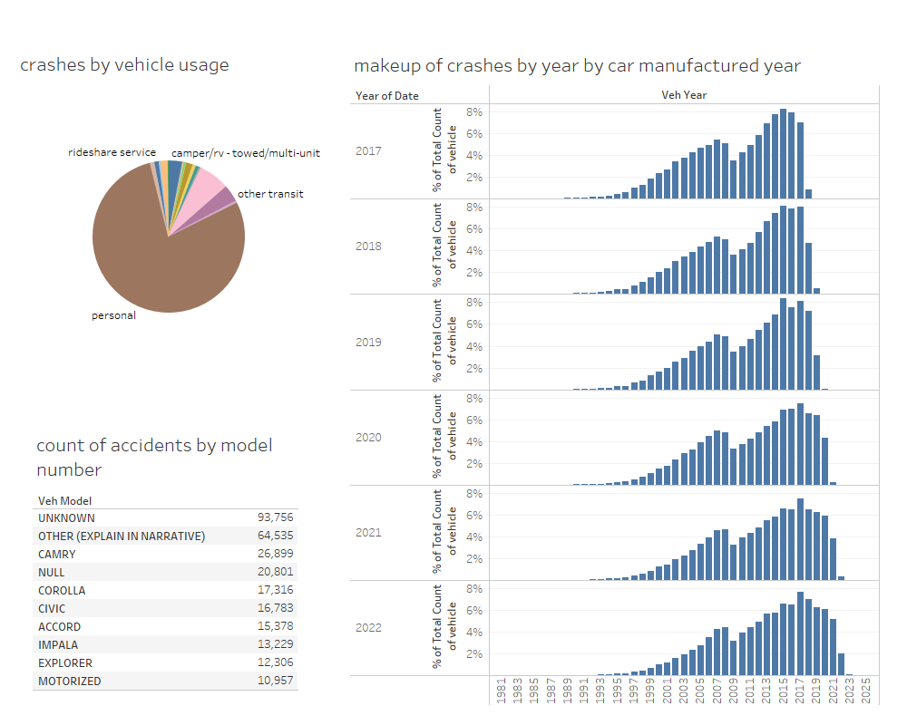
Vehicle Overview

Slide 13
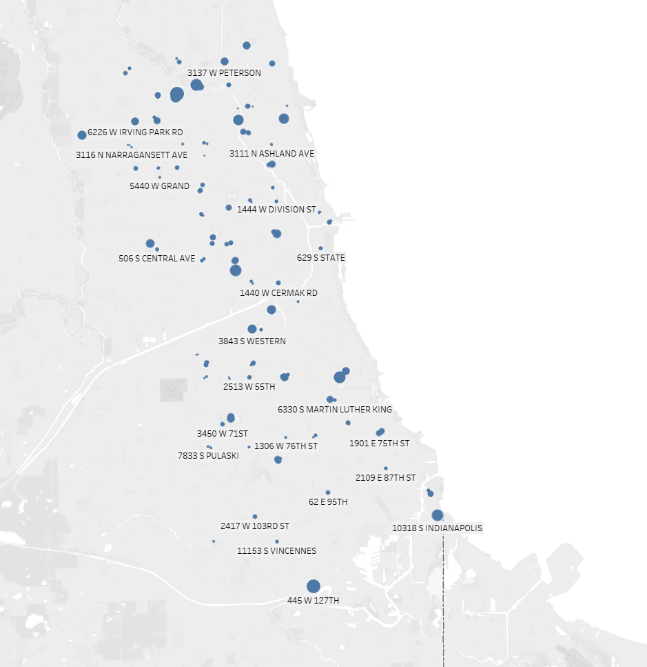
Violations by speed camera location

Slide 14
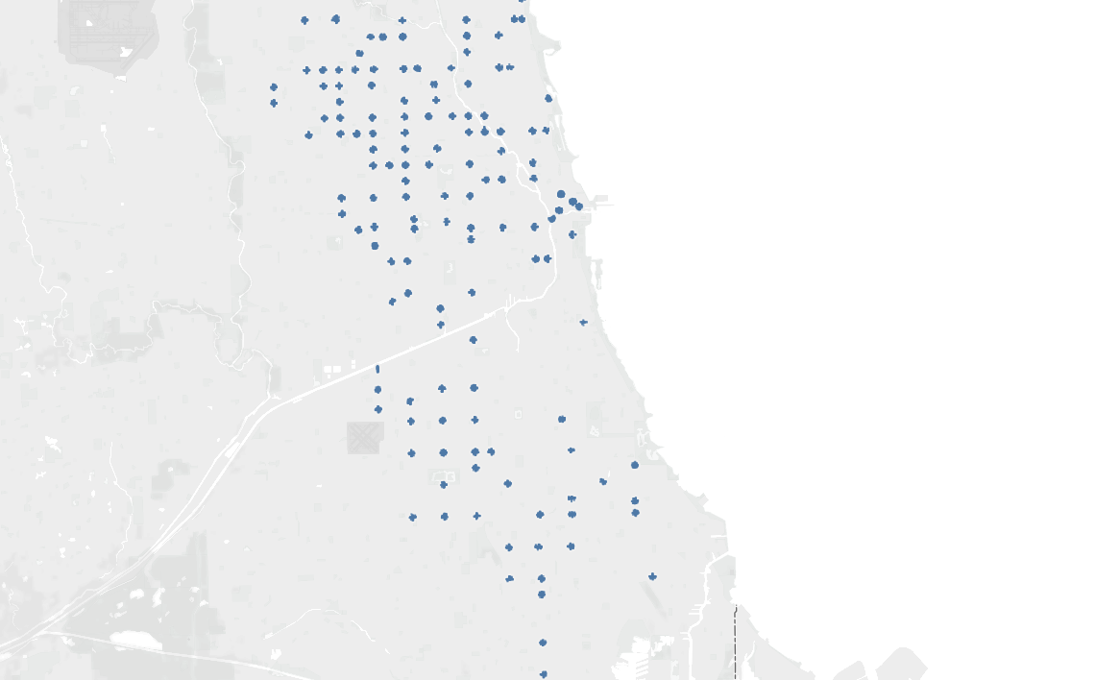
Violations by red light camera location

Slide 15
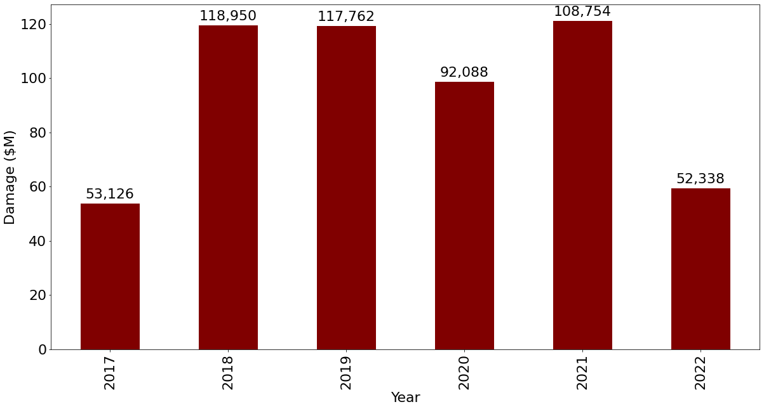
Estimated damage costs
Lower bound estimate for true damage
> Damages categorically labeled:
1. $500 or less -> $0
2. $501-$1,500 -> $501
3. Over $1500 -> $1500
SELECT YEAR(date) as year,
SUM(CASE
WHEN damage_cost = '$500 or less' THEN 0
WHEN damage_cost = '$501 - $1,500' THEN 501
WHEN damage_cost = 'over $1,500' THEN 1500
END) AS damages_cost
FROM crash_event
GROUP BY YEAR(date);

Slide 16
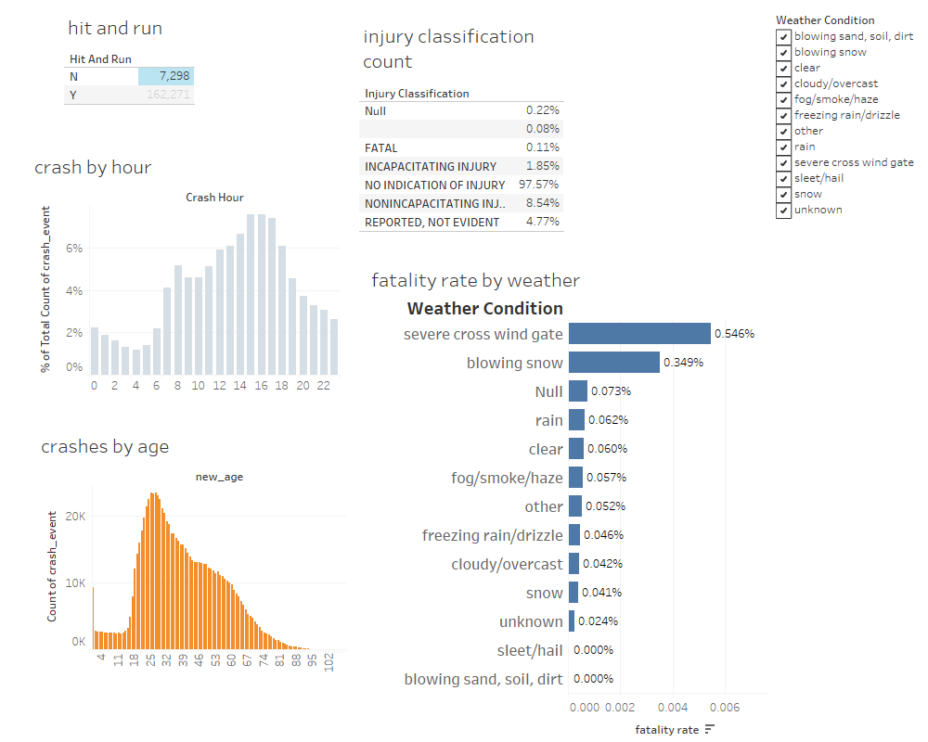
Tableau dashboards (theme weather condition)

Slide 17
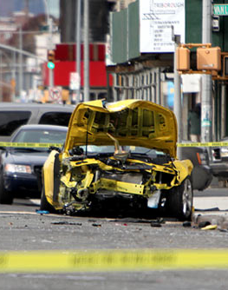
Conclusions
Since 2017 cost of crashes > $571 million (lower bound estimate)
Outside of non-determined crash causes, the majority proportion are driver related and are unrelated to road conditions, state laws, etc
Drivers between ~ 20-30 yrs old account for bulk of crashes
Vast majority of injuries aren't fatal. Account for < 0.11% of total crashes.
Our framework allows for quick access to visualizations of the dynamic crash data that can lend decision makers information to mitigate crashes or financial damages from crashes

