Slide 1

COURSE DEFENCE · 23 OCTOBER 2026
Language over demo breadcrumbs
Frozen LeWorldModel on Push-T
Words name the goal.
Demonstrations supply the steps.
A language interface for a planner
that is reliable over short hops.
Alexander Bashirov · Didar Seyidov · Faith Ogunwoye
Push-T · logged start state
Skoltech
FROZEN LeWM / PUSH-T / SKOLTECH
01

Slide 2
00 · WHAT IS NEW HERE
Four things this project adds to a frozen world model.
LeWM and its planner are used unchanged. Everything new sits around them.
01
Words name the goal
02
Routes across many demos
A sentence becomes a goal region (on target, turn by θ, push by d) instead of one goal image. A small local LLM parses it: 101/120 unseen sentences.
A graph over 427,396 demo states links different demos where they pass close by, so a route exists from starts no demo began at.
03
Short hops reach far goals
04
Words straight into the latent
The planner only ever chases a demo frame about 25 steps away. Goals 100 steps out: 10/50 → 29/50.
A text-conditioned head predicts the next subgoal latent, with no graph at test time. First signal: 18/111 vs 10/111 with shuffled words.
Prior work (Hi-LeWM) used later frames of the same demo as subgoals. Every claim here was frozen in git before its scored run.
FROZEN LeWM / PUSH-T / SKOLTECH
02

Slide 3
01 · THE PROBLEM
A short hop works. A distant goal is harder.
LeWM stays frozen: it encodes an image into 192 values and predicts latents under actions.
SHORT DEMO GOAL
LONG LIVE GOAL
IN-PLACE TURN
47/50
0/20
0/20
25 steps ahead · budget 50
5090 setup check
Random live goals · budget 50
Earlier 4090 run
Rendered +90° or +180° goal
Budget 50 · each angle
Course question: can a sentence name a goal
this existing planner can actually follow?
These are different goal settings, not a controlled horizon sweep. Earlier 4090 short-goal baseline: 45/50.
FROZEN LeWM / PUSH-T / SKOLTECH
03

Slide 4
02 · WHAT WE TRIED FIRST
The angle is encoded. Control is still the obstacle.
Reading a state from a latent does not guarantee the planner can reach that state.
1 Read the angle
2 Add a fixed Δz
3 Plan the turn
Held-out circular error
180° frames: 12.08°
Near 0°: 14.58°
One constant latent step
per command fails to fit.
Residual ratio: 0.991
Angle-cost +90°: 2/20
Strict in-place gate: 0/20
Three rendered stages: 1/20
Decision: keep LeWM frozen and change the subgoal interface.
FROZEN LeWM / PUSH-T / SKOLTECH
04

Slide 5
03 · THE IDEA
Make a long task a sequence of nearby goals.
Words choose a goal region. A graph of expert demonstrations supplies the intermediate frames.
1 SENTENCE → GOAL REGION
2 FIND A ROUTE
3 PLAN · ACT · REPEAT
Demo A
Next demo frame
“Turn the T clockwise.”
Encode frame → frozen CEM
Execute ≈25 steps
Read live state again
Qwen parser
→ turn +90°
Region: angle + drift tolerance
Switch demos near matching states.
Graph drawing is schematic.
427,396 nodes · one node every 5 demo steps · train split only
Retrieval uses simulator state; LeWM is not trained with language.
FROZEN LeWM / PUSH-T / SKOLTECH
05

Slide 6
04 · DEMO BREADCRUMBS
The biggest gain appears on the farther demo goals.
Same planner and budget within each row. Only the intermediate subgoals change.
+38 pp
at offset 100
PAIRED +100 TASKS
23 gained
4 lost
19 net / 50
Budget 300. Rows have different frozen success criteria; compare methods within each row.
FROZEN LeWM / PUSH-T / SKOLTECH
06

Slide 7
05 · WORDS AS THE GOAL
The language interface works; execution is the larger gap.
Qwen2.5-1.5B-Instruct · local, greedy · 120 held-out sentences
101/120
END-TO-END · SAME 111 ELIGIBLE TASKS
sentences parsed correctly · 84.2%
57/111
Gold command
51/111
Parsed command
Keyword baseline: 31/120 · 25.8%
Parsing costs 6 net successes (−5.4 pp).
Nine pushes excluded: gold destination outside arena. Tasks reuse 10 reset seeds; budget 300.
FROZEN LeWM / PUSH-T / SKOLTECH
07

Slide 8
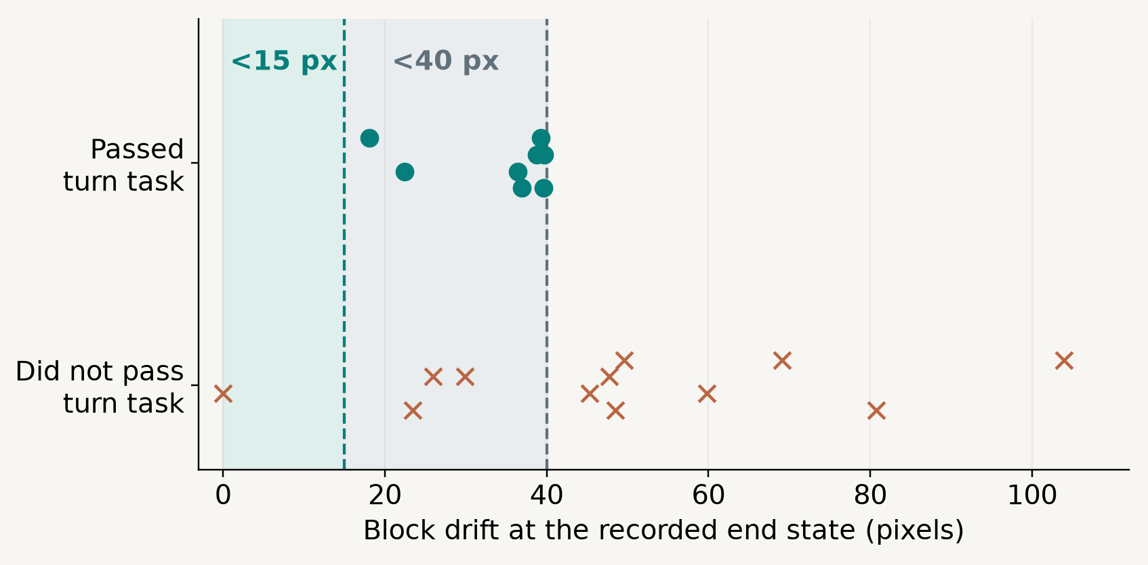
06 · TURNS ARE NOT IN-PLACE
The T turns, but it slides while turning.
A looser task success must not be presented as an in-place rotation.
BREADCRUMBS
8/20
turn tasks reached
with <40 px drift
0/20
pass the stricter
<15 px in-place gate
Flat: 4/20 turns, 1/20 strict. In-place turns exist in demos: 8,040 nodes across 1,691 episodes.
FROZEN LeWM / PUSH-T / SKOLTECH
08

Slide 9
07 · A HEAD INSTEAD OF THE GRAPH
Lower latent error did not deliver better control.
A small head predicts the next latent from start latent, current latent and a frozen text embedding.
Text → subgoal head
Graph + gold command
57/111
At test time:
no graph · no command parser
Graph + parsed command
51/111
Learned subgoal head
18/111
0.67×
Head + shuffled text
validation MSE vs copying
the current latent
10/111
Same eligible sentences and starts · budget 300
FROZEN LeWM / PUSH-T / SKOLTECH
09

Slide 10
08 · WHAT THE DEFENCE SHOULD TAKE
Words can name routes the frozen planner can follow.
01
Nearby demo frames make distant goals easier.
Offset 100: 10/50 → 29/50 with breadcrumbs.
02
Language can select the route.
101/120 parsed correctly; 57 → 51 successes after parsing.
03
Reachability is still the limiting factor.
Strict in-place turns: 0/20. Learned head: 18/111.
Frozen LeWM throughout · descriptive results on the saved task sets · no new runs for this deck
FROZEN LeWM / PUSH-T / SKOLTECH
10

Slide 11
09 · CONCLUSION
A frozen world model can follow words, one reachable hop at a time.
WHAT WE SHOWED
WHAT COMES NEXT
Demo breadcrumbs lift success by 20–38 points on demo goals.
Strict in-place turns (0/20 today)
Random live goals (3/20 today)
Free sentences work end to end: 51/111 (57 with perfect parsing).
Latent head: more data, relative commands
Words can enter the latent directly: a first signal, mainly for “put it on the target”.
The lab UR3 arm with teleoperated demos
Thank you. Questions welcome.
FROZEN LeWM / PUSH-T / SKOLTECH
11

Slide 12
BACKUP A · PAIRED EVIDENCE
Where did the extra successes come from?
Matched tasks let us count gains and losses directly. These are descriptive counts.
TASK
BOTH SUCCEED
FLAT ONLY
CRUMBS ONLY
NEITHER
Demo +50 · n=50
18
6
16
10
Demo +100 · n=50
6
4
23
17
Live goals · n=20
0
0
3
17
Templates · n=64
10
8
24
22
Offset 100: 23 gained, 4 lost → 19 net extra successes out of 50 (+38 percentage points).
FROZEN LeWM / PUSH-T / SKOLTECH
12

Slide 13
BACKUP B · ACTION BREAKDOWN
The head’s text effect is mainly on target requests.
Same 111 eligible tasks; target n=30, turns n=45, pushes n=36.
PUT ON TARGET
TURN
PUSH
Graph + parser
20/30
Graph + parser
17/45
Graph + parser
14/36
Head
11/30
Head
3/45
Head
4/36
Shuffled text
2/30
Shuffled text
3/45
Shuffled text
5/36
These are successes on the saved command sets, not evidence of general language understanding.
FROZEN LeWM / PUSH-T / SKOLTECH
13

Slide 14

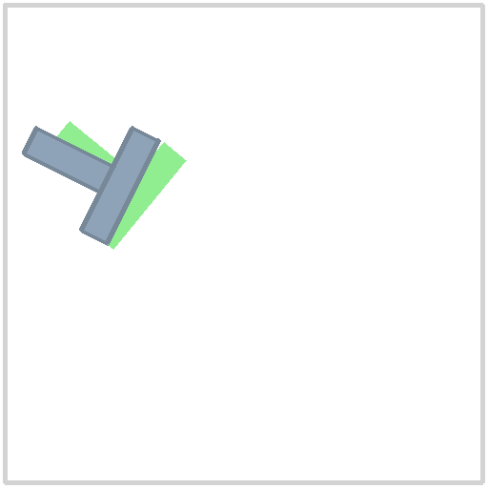
BACKUP C · A MEASURED EXAMPLE
A successful quarter-turn can miss the in-place gate.
Seed 1 · clockwise turn template · breadcrumbs · requested change: +90°
START
RECORDED END
77.2°
actual clockwise turn
22.5 px
block drift
passes <40 px, fails <15 px
Reconstructed from logged block poses; pusher omitted. Green T = requested goal. No trajectory was saved.
FROZEN LeWM / PUSH-T / SKOLTECH
14

Slide 15
BACKUP D · THE DEMO GRAPH
The graph covers demo goals, not random live goals.
Training split only. One node every 5 demo steps; nearby states from different demos are linked.
427,396
410,579
2,852,207
demo states (nodes)
“next frame” links
links between demos
DEMO GOALS, +50 STEPS
WORD COMMANDS
RANDOM LIVE GOALS
50/50
56/64
13/20
have a route · median 0.5 demo switches
start lies 9 state units from a demo state
start/command pairs have a route
every command has matching demo states
have a route, but start and goal lie
37 and 39 state units from any demo state
In-place turns do occur in the demos: 8,040 nodes in 1,691 of 16,817 episodes. State units: block/pusher px, angle at 60 per radian.
FROZEN LeWM / PUSH-T / SKOLTECH
15

Slide 16
BACKUP E · EVERY CHECK
Each claim and kill line was committed before its scored run.
Verdict: holds = claim met; between = claim missed, kill line not reached. Budget 300 on all scored runs.
Check | Claim (frozen first) | Kill line | Result | Verdict
0 · Setup reproduces the 4090 | ≈ 45/50 | ≤ 40/50 | 47/50 | holds
1a · Routes exist, demo goals | ≥ 35/50 | < 35/50 | 50/50 | holds
2b · Breadcrumbs, +50 steps | flat + 10 pp | ≤ flat + 2 pp | 68% vs 48% | holds
2c · Breadcrumbs, +100 steps | gap grows | crumbs ≤ flat | 58% vs 20% | holds
2d · Random live goals | ≥ 4/20 | ≤ flat + 1 | 3/20 vs 0/20 | between
3b · Word templates | flat + 10 pp | ≤ flat + 1 ep | 34 vs 18 of 64 | holds
3c · Turns (40 px drift allowed) | ≥ 5/20 | ≤ 2/20 | 8/20 | holds
L1 · Sentence parsing | ≥ 90% | ≤ 75% | 84.2% | between
L2 · Parsed vs gold, end to end | ≥ gold − 5 pp | ≤ gold − 15 pp | −5.4 pp | between
S1 · Head, offline error | ≤ 0.7× copy | ≥ 0.9× copy | 0.67× | holds
S2 · Head, end to end | ≥ 34/111 | ≤ 11/111 | 18/111 | between
S3 · Words matter for the head | shuffled + 10 | ≤ shuffled + 3 | +8 | between
FROZEN LeWM / PUSH-T / SKOLTECH
16

Slide 17
REFERENCES
Sources
[1]
LeCun, Y. (2022). A Path Towards Autonomous Machine Intelligence. OpenReview, v0.9.2.
[2]
Assran, M., et al. (2023). Self-Supervised Learning from Images with a Joint-Embedding Predictive Architecture (I-JEPA). CVPR.
[3]
Maes, L., Le Lidec, Q., Scieur, D., LeCun, Y., Balestriero, R. (2026). LeWorldModel: Stable End-to-End Joint-Embedding Predictive Architecture from Pixels. arXiv:2603.19312.
[4]
Caselli, Massafra, Punzo, Lo Sardo, Pantelidis, Bhethanabhotla (2026). Hi-LeWM. arXiv:2607.12547.
[5]
Florence, P., et al. (2021). Implicit Behavioral Cloning. CoRL. (Push-T task)
[6]
Rubinstein, R. Y. (1999). The Cross-Entropy Method for Combinatorial and Continuous Optimization. Methodology and Computing in Applied Probability.
[7]
Yang, A., et al. (2024). Qwen2 Technical Report. arXiv:2407.10671. Model used: Qwen2.5-1.5B-Instruct (Qwen Team, 2024).
[8]
Myers, V., et al. (2023). Goal Representations for Instruction Following (GRIF). CoRL. arXiv:2307.00117.
[9]
Chen, D., et al. (2025). VL-JEPA: Joint Embedding Predictive Architecture for Vision-Language. arXiv:2512.10942.
Code, frozen claims and all result files: github.com/velosipedistufa/JEPA · branch 5090-run-demo-breadcrumbs
FROZEN LeWM / PUSH-T / SKOLTECH
17

