Slide 1
Iptables Firewalls
  Blair Hicks
  blair@unixquest.com

Slide 2
Iptables Firewalls
Introduction
Applications
Packet Filtering
Packet Traversal
iptables Syntax
NAT
Optimization
User-defined iptables commands
Resources

Slide 3
What is a Firewall?
A set of related programs that protects the resources of a private network from users from other networks.
A mechanism for filtering network packets based on information contained within the IP header.
A means of maintaining sanity.

Slide 4
Firewall Programs
Ipfwadm : Linux kernel 2.0.34
Ipchains : Linux kernel 2.2.*
Iptables : Linux kernel 2.4.*

Slide 5
Firewall Options
Commercial Firewall Devices (Watchguard, Cisco PIX)
Routers (ACL Lists)
Linux
Software Packages (ZoneAlarm, Black Ice)
Sneaker Net

Slide 6
Applications
Complex Network Applications
Volatile environments
Internal Security
System Segregation
Local Host Protection

Slide 7
TCP Header
+-+-+-+-+-+-+-+-+-+-+-+-+-+-+-+-+-+-+-+-+-+-+-+-+-+-+-+-+-+-+-+-+
|Version| IHL |Type of Service| Total Length |
+-+-+-+-+-+-+-+-+-+-+-+-+-+-+-+-+-+-+-+-+-+-+-+-+-+-+-+-+-+-+-+-+
| Identification |Flags| Fragment Offset |
+-+-+-+-+-+-+-+-+-+-+-+-+-+-+-+-+-+-+-+-+-+-+-+-+-+-+-+-+-+-+-+-+
| Time to Live | Protocol | Header Checksum |
+-+-+-+-+-+-+-+-+-+-+-+-+-+-+-+-+-+-+-+-+-+-+-+-+-+-+-+-+-+-+-+-+
| Source Address |
+-+-+-+-+-+-+-+-+-+-+-+-+-+-+-+-+-+-+-+-+-+-+-+-+-+-+-+-+-+-+-+-+
| Destination Address |
+-+-+-+-+-+-+-+-+-+-+-+-+-+-+-+-+-+-+-+-+-+-+-+-+-+-+-+-+-+-+-+-+
| Source Port | Destination Port |
+-+-+-+-+-+-+-+-+-+-+-+-+-+-+-+-+-+-+-+-+-+-+-+-+-+-+-+-+-+-+-+-+
| Sequence Number |
+-+-+-+-+-+-+-+-+-+-+-+-+-+-+-+-+-+-+-+-+-+-+-+-+-+-+-+-+-+-+-+-+
| Acknowledgment Number |
+-+-+-+-+-+-+-+-+-+-+-+-+-+-+-+-+-+-+-+-+-+-+-+-+-+-+-+-+-+-+-+-+
| | Control | |

Slide 8
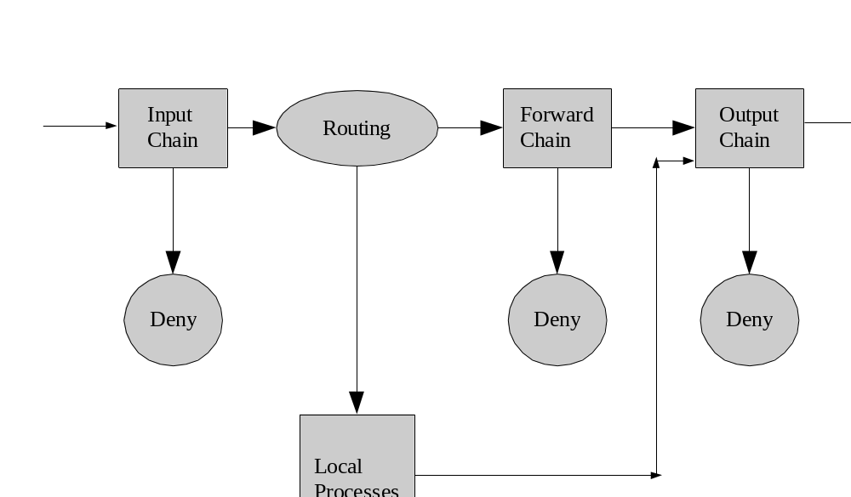
Ipchains packet traversal

Slide 9
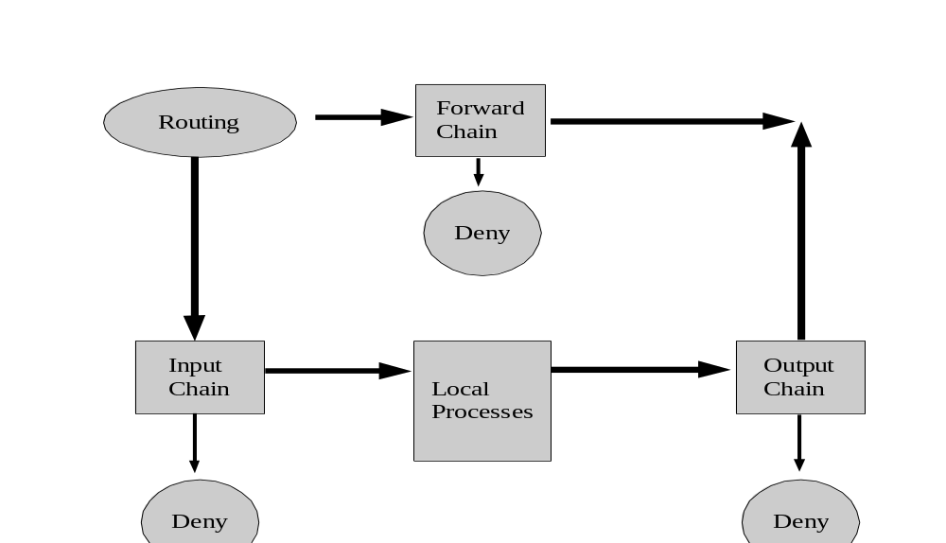
Iptables packet traversal

Slide 10
Basic iptables syntax
iptables --flush
iptables -A INPUT -i lo -j ACCEPT
iptables -A OUTPUT -o lo -j ACCEPT
iptables --policy INPUT DROP
iptables --policy OUTPUT DROP
iptables --policy FORWARD DROP

Slide 11
iptables Targets
ACCEPT
  let the packet through
DROP
  drop the packet
QUEUE
  pass the packet to the userspace
RETURN
  stop traversing this chain and resume the calling chain

Slide 12
iptables syntax
iptables -I INPUT -i eth1 -p tcp -s 192.168.56.1 \
--sport 1024:65535 -d 192.168.56.2 --dport 22 \
-j ACCEPT
iptables -I OUTPUT -o eth1 -p tcp ! --syn \
-s 192.168.56.2 --sport 22 -d 192.168.56.1 \
--dport 1024:65535 -j ACCEPT

Slide 13
Forwarding Packets
iptables -A FORWARD -i <internal interface> \
-o <external interface> -s 192.168.56.1/32 --sport \
1024:65535 -m state --state \ NEW,ESTABLISHED,RELATED -j ACCEPT
iptables -A FORWARD -i <external interface> \
-o <internal interface> -m state --state \
ESTABLISHED,RELATED -j ACCEPT
*don't forget /proc/sys/net/ipv4/ip_forward

Slide 14
iptables -L -v -n
Chain INPUT (policy DROP 280 packets, 32685 bytes)
pkts bytes target prot opt in out source destination
3300 136K ACCEPT tcp -- eth1 * 192.168.56.1 192.168.56.2 tcp dpt:22
140 51297 LOG all -- eth0 * 0.0.0.0/0 0.0.0.0/0 LOG flags 0 level 4
378K 46M LOG all -- eth1 * 0.0.0.0/0 0.0.0.0/0 LOG flags 0 level 4
140 10220 ACCEPT all -- lo * 0.0.0.0/0 0.0.0.0/0
304 35676 LOG all -- * * 0.0.0.0/0 0.0.0.0/0 LOG flags 0 level 4
Chain FORWARD (policy DROP 0 packets, 0 bytes)
pkts bytes target prot opt in out source destination
4435 1275K LOG all -- eth1 eth0 0.0.0.0/0 0.0.0.0/0 LOG flags 0 level 4
4717 882K LOG all -- eth0 eth1 0.0.0.0/0 0.0.0.0/0 LOG flags 0 level 4
13 624 ACCEPT tcp -- eth0 eth1 0.0.0.0/0 192.168.56.1 tcp dpt:22 state NEW
4379 1214K ACCEPT all -- eth1 eth0 0.0.0.0/0 0.0.0.0/0 state RELATED,ESTABLISHED
4609 877K ACCEPT all -- eth0 eth1 0.0.0.0/0 0.0.0.0/0 state RELATED,ESTABLISHED
9 396 ACCEPT tcp -- eth1 eth0 0.0.0.0/0 10.10.90.10 tcp dpt:22 state NEW
40 1832 ACCEPT tcp -- eth0 eth1 0.0.0.0/0 192.168.56.10 tcp dpt:22 state NEW
Chain OUTPUT (policy DROP 7 packets, 588 bytes)
pkts bytes target prot opt in out source destination
5687 6275K ACCEPT tcp -- * eth1 192.168.56.2 192.168.56.1 tcp spt:22
102 48836 LOG all -- * eth4 0.0.0.0/0 0.0.0.0/0 LOG flags 0 level 4
78904 8127K LOG all -- * eth1 0.0.0.0/0 0.0.0.0/0 LOG flags 0 level 4
140 10220 ACCEPT all -- * lo 0.0.0.0/0 0.0.0.0/0

Slide 15
LOG - Target Extension
LOG
  --log-level
  --log-prefix
  --log-tcp-sequence
  --log-tcp-options
  --log-ip-options
iptables -A OUTPUT -o eth0 -j LOG
iptables -A INPUT -m state --state INVALID -j LOG --log-prefix "INVALID input: "

Slide 16
Raw iptables log output
Jun 25 09:05:11 hebe kernel: IN=eth1 OUT= MAC=00:00:92:a7:df:05:02:07:01:23:5e:29:08:00
SRC=10.90.10.112 DST=10.90.10.116 LEN=44 TOS=0x00
PREC=0x00 TTL=60 ID=7276 PROTO=TCP SPT=47785 DPT=10003 WINDOW=16384 RES=0x00 SYN URGP=0
Jun 25 09:05:11 hebe kernel: IN=eth1 OUT= MAC=00:00:92:a7:df:05:02:07:01:23:5e:29:08:00
SRC=10.90.10.112 DST=10.90.10.116 LEN=44 TOS=0x00
PREC=0x00 TTL=60 ID=7276 PROTO=TCP SPT=47785 DPT=10003 WINDOW=16384 RES=0x00 SYN URGP=0
Jun 25 09:05:12 hebe kernel: IN=eth1 OUT= MAC=ff:ff:ff:ff:ff:ff:00:06:5b:d1:24:bb:08:00
SRC=10.90.50.251 DST=10.90.255.255 LEN=241 TOS=0x00 PREC=0x00 TTL=128 ID=547 PROTO=UDP
SPT=138 DPT=138 LEN=221
Jun 25 09:05:12 hebe kernel: IN=eth1 OUT= MAC=ff:ff:ff:ff:ff:ff:00:06:5b:d1:24:bb:08:00
SRC=10.90.50.251 DST=10.90.255.255 LEN=241 TOS=0x00 PREC=0x00 TTL=128 ID=547 PROTO=UDP
SPT=138 DPT=138 LEN=221
Jun 25 09:05:12 hebe kernel: IN=eth1 OUT= MAC=ff:ff:ff:ff:ff:ff:00:50:04:74:0b:81:08:00
SRC=10.90.10.6 DST=10.90.255.255 LEN=78 TOS=0x00 PREC=0x00 TTL=64 ID=44852 PROTO=UDP SPT=137
DPT=137 LEN=58
Jun 25 09:05:12 hebe kernel: IN=eth1 OUT= MAC=ff:ff:ff:ff:ff:ff:00:50:04:74:0b:81:08:00
SRC=10.90.10.6 DST=10.90.255.255 LEN=78 TOS=0x00 PREC=0x00 TTL=64 ID=44852 PROTO=UDP SPT=137
DPT=137 LEN=58
Jun 25 09:05:15 hebe kernel: IN=eth1 OUT= MAC=ff:ff:ff:ff:ff:ff:00:60:cf:20:2d:37:08:00
SRC=10.90.10.104 DST=10.90.255.255 LEN=78 TOS=0x00 PREC=0x00 TTL=1 ID=60733 DF PROTO=UDP
SPT=137 DPT=137 LEN=58
Jun 25 09:05:15 hebe kernel: IN=eth1 OUT= MAC=ff:ff:ff:ff:ff:ff:00:60:cf:20:2d:37:08:00
SRC=10.90.10.104 DST=10.90.255.255 LEN=78 TOS=0x00 PREC=0x00 TTL=1 ID=60733 DF PROTO=UDP
SPT=137 DPT=137 LEN=58
Jun 25 09:05:23 hebe kernel: IN=eth1 OUT= MAC=00:00:92:a7:df:05:02:07:01:23:5e:29:08:00
SRC=10.90.10.112 DST=10.90.10.116 LEN=44 TOS=0x00
PREC=0x00 TTL=60 ID=11698 PROTO=TCP SPT=4778

Slide 17
log_analysis output
3 Chain: input Interface: eth0 >> 211.39.225.244 1559 => 192.168.56.2 TCP 27374
4 Chain: input Interface: eth0 >> 211.44.96.76 1659 => 192.168.56.2 TCP 27374
4 Chain: input Interface: eth0 >> 24.209.129.7 2846 => 192.168.56.2 TCP 27374
4 Chain: input Interface: eth0 >> 4.41.13.124 1537 => 192.168.56.2 TCP 27374
3 Chain: input Interface: eth0 >> 61.255.229.7 3714 => 192.168.56.2 TCP 27374
3 Chain: input Interface: eth0 >> 64.231.21.254 2361 => 192.168.56.2 TCP 27374
4 Chain: input Interface: eth0 >> 65.24.46.200 1992 => 192.168.56.2 TCP 27374
4 Chain: input Interface: eth0 >> 65.33.176.170 1328 => 192.168.56.2 TCP 27374
4 Chain: input Interface: eth0 >> 65.43.103.123 3672 => 192.168.56.2 TCP 27374
4 Chain: input Interface: eth0 >> 66.188.158.191 3064 => 192.168.56.2 TCP 27374
3 Chain: input Interface: eth0 >> 80.224.203.178 4697 => 192.168.56.2 TCP 27374
3 Chain: input Interface: eth0 >> 12.220.98.42 1380 => 192.168.56.2 TCP 27374
3 Chain: input Interface: eth0 >> 193.205.135.94 2498 => 192.168.56.2 TCP 1433
3 Chain: input Interface: eth0 >> 198.83.120.42 1711 => 192.168.56.2 TCP 1433
3 Chain: input Interface: eth0 >> 202.108.234.155 3877 => 192.168.56.2 TCP 1433
3 Chain: input Interface: eth0 >> 202.140.162.42 19914 => 192.168.56.2 TCP 1433
3 Chain: input Interface: eth0 >> 205.158.95.87 1367 => 192.168.56.2 TCP 1433
3 Chain: input Interface: eth0 >> 208.2.225.43 3818 => 192.168.56.2 TCP 1433
3 Chain: input Interface: eth0 >> 212.118.71.3 1429 => 192.168.56.2 TCP 1433
4 Chain: input Interface: eth0 >> 61.85.33.8 2113 => 192.168.56.2 TCP 27374
4 Chain: input Interface: eth0 >> 61.99.45.198 4515 => 192.168.56.2 TCP 27374
3 Chain: input Interface: eth0 >> 62.90.204.2 3798 => 192.168.56.2 TCP 1433
3 Chain: input Interface: eth0 >> 63.231.101.56 61428 => 192.168.56.2 TCP 1433
3 Chain: input Interface: eth0 >> 66.28.45.209 4268 => 192.168.56.2 TCP 1433

Slide 18
NAT Overview
Source NAT
  The source address of the initial packet is modified.
  Performed on the POSTROUTING Chain.
  Includes MASQUERADE functionality.
Destination NAT
  The destination address of the initial packet is modified.
  Performed on the PREROUTING or OUTPUT chain.

Slide 19
SNAT Masquerade Example
iptables -t nat -A POSTROUTING -o eth0 -j \ MASQUERADE
iptables -A FORWARD -i eth1 -o eth0 -m state \
--state NEW, ESTABLISHED, RELATED -j ACCEPT
iptables -A FORWARD -o eth1 -m state --state \ ESTABLISHED, RELATED -j ACCEPT

Slide 20
Standard SNAT Example
iptables -t nat -A POSTROUTING -o \
<external interface> -j SNAT --to-source \
<external address>
iptables -A FORWARD -i <internal interface> \
-o <external interface> -m state --state \ NEW,ESTABLISHED,RELATED -j ACCEPT
iptables -A FORARD -o <internal interface> \
-m state --state ESTABLISHED,RELATED -j ACCEPT

Slide 21
DNAT - Host Forwarding
iptables -t nat -A PREROUTING -i <external interface> \
-p tcp --sport 1024:65535 -d <external address> --dport 80 \
-j DNAT --to-destination <local server>
iptables -A FORWARD -i <external interface> \
-o <internal interface> -p tcp --sport 1024:65535 \
-d <local server> --dport 80 -m state \
--state NEW,ESTABLISHED,RELATED -j ACCEPT
iptables -A FORWARD -i <internal interface> \
-m state --state ESTABLISHED,RELATED -j ACCEPT

Slide 22
Advanced DNAT
Port Redirection:
iptables -t nat -A PREROUTING -i <external interface> \
-p tcp --sport 1024:65535 -d <external address> --dport 80 \
-j DNAT --to-destination <local server>:81
Server Farms:
iptables -t nat -A PREROUTING -i <external interface> \
-p tcp --sport 1024:65535 -d <external WEB address> \
--dport 80 -j DNAT \
--to-destination 192.168.56.10-192.168.56.15

Slide 23
Firewall Optimization
Place loopback rules as early as possible.
Place forwarding rules as early as possible.
Use the state and connection-tracking modules to bypass the firewall for established connections.
Combine rules to standard TCP client-server connections into a single rule using port lists.
Place rules for heavy traffic services as early as possible.

Slide 24
User Defined Chains
iptables -A INPUT -i $INTERNET -d <public address> \
-j EXT-input
iptables -A EXT-input -p udp --sport 53 \
--dport 53 -j EXT-dns-server-in
iptables -A EXT-input -p tcp ! --syn --sport 53 \
--dport 1024:65535 -j EXT-dns-server-in
iptables -A EXT-dns-server-in -s $NAMESERVER_1 \
-j ACCEPT

