Slide 1
IP Multicast: Protocols, Deployment, and Management
Sanjoy Paul
sanjoy@lucent.com

Slide 2
Acknowledgment
Special thanks go to my friend and research colleague Kevin Almeroth for helping me put together this tutorial

Slide 3
Tutorial Schedule
Service model, applications, deployment status and history
Intra-domain protocols
Inter-domain protocols
Multicast deployment and mgt

Slide 4
(blank slide for pagination purposes)

Slide 5
IP Multicast:
Overview

Slide 6
Unicast
source
performs routing and forwarding at the same time, and in the source-to-receiver direction

Slide 7
Purpose of Multicast
source
Multicast Premise: avoid duplication of traffic

Slide 8
Multicast Routing (and Functions)
source
routing (path determination) [but in the reverse direction]
packet forwarding and replication
handling dynamic membership---path pruning/grafting

Slide 9
Building the Reverse Path
source

Slide 10
Building a Reverse Path Tree
source

Slide 11
Forwarding Data
source
routing (path determination) [but in the reverse direction]
packet forwarding and replication
handling dynamic membership---path pruning/grafting

Slide 12
Question for the Ages
source
source
How to find the source(s)?

Slide 13
How to Find the Sources?
broadcast everywhere
  receivers decide when they do not want the traffic
use a rendezvous point (RP)
  receivers send joins along reverse path to RP
  sources send traffic to RP
require receivers to already know source(s)
  use some out-of-band mechanism

Slide 14
Evolution of Multicast
major events coincide with major protocol breakthroughs
broadcast everywhere (“dense mode”) [1992]
  the original Multicast Backbone (MBone)
  IETF experiment… functionality programmed into a routing daemon
  experiment was successful, but scalability was a problem
  also happened to be the first “CDN”

Slide 15
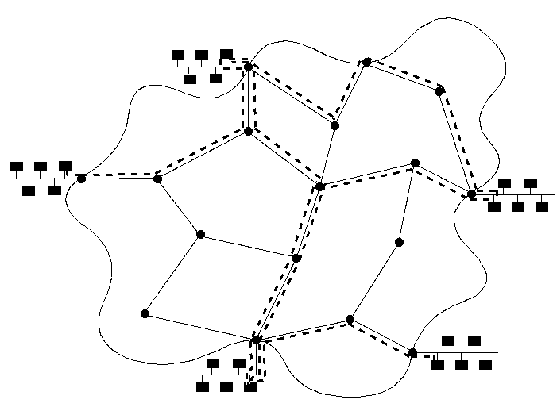
Dense Model with Tunnels

Slide 16
Evolution of Multicast (cont)
build scalability using “sparse mode” protocols [1994]
  “scalability” means not sending traffic when it isn’t requested
  use RPs locally (within an “island”)
  use dense mode tunnels to connect islands

Slide 17
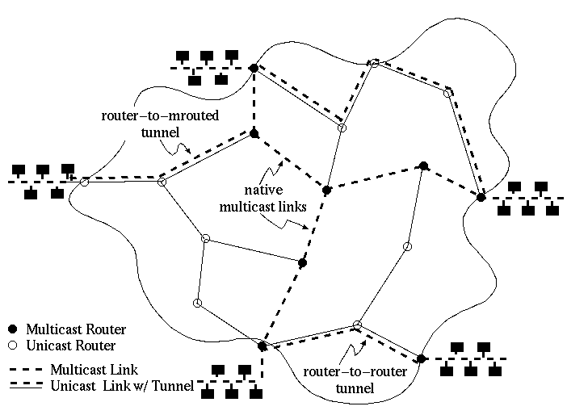
Sparse Mode Islands

Slide 18
Evolution of Multicast (cont)
development of inter-domain protocols [1997]
  multicast version of BGP, called MBGP
  sparse mode in the backbone
  use an additional protocol to announce sources between domains, called Multicast Source Discovery Protocol (MSDP)

Slide 19
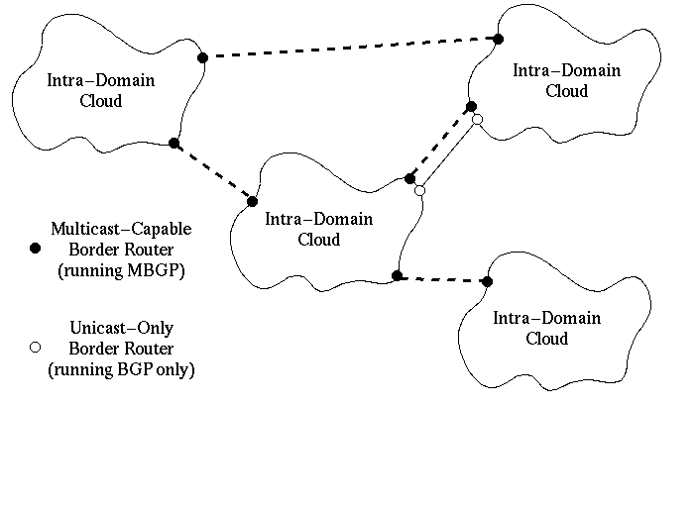
Inter-Domain Multicast

Slide 20
Evolution of Multicast (cont)
simplify the problem [2000]
  assume source can be determined out-of-band
    called Source-Specific Multicast (SSM)
    evolved from Express and Simple Multicast (SM)
  works for 9x% of applications
ongoing work to find better solutions [1998]
  good solution for IPv6 exists
    BGMP (not to be confused with MBGP)
  auto-tunneling solutions

Slide 21
Topics to Cover
Application Point-of-View
  service model, addressing, security
Status Point-of-View
  deployment, availability of content
Network Point-of-View
  multicast-related protocols

Slide 22
(blank slide for pagination purposes)

Slide 23
Application Point-of-View:
Service Model,
Addressing, and Security

Slide 24
Components of the
IP Multicast Architecture
service model
hosts
host-to-router
routers
intra-domain routing
inter-domain routing

Slide 25
Creating Groups
source
Need mechanism for grouping members:
use Class-D IP addrs and IP-style semantics

Slide 26
IP Multicast Addresses
Class D IP addresses:
in “dotted decimal” notation: 224.0.0.0 — 239.255.255.255
hosts now can have multiple IP addresses
1
1
1
0
group ID

Slide 27
Mapping IP Multicast Addresses to Link-Layer Multicast Addresses
for Ethernet and other LANs using 802 addresses:
for point-to-point links: no mapping needed
for NBMA: map to configured server address?
IP multicast address
1
1
1
0
28 bits
group bit
0
0
0
0
0
0
0
1
0
0
0
0
0
0
0
0
0
1
0
1
1
1
1
0
0
23 bits
LAN multicast address

Slide 28
Multicast Address Space
Control block (for mcast protocols) [224.0.0-1/24]
SAP/SDP block [224.2/16]
Dynamic assignment block (MALLOC WG) [225/8]
Source-Specific Multicast (SSM WG) [232/8]
GLOP block (MBONED WG) [233/8]
Administratively scoped block (local addrs) [239/8]
draft-ietf-mboned-iana-ipv4-mcast-guidelines-*.txt

Slide 29
Original IP Multicast Service Model
(RFC-1112)
each group identified by a single IP address
groups may be of any size
members of groups may be located anywhere in the Internet
members of groups can join and leave at will
senders need not be members
any join pulls traffic from all sources (*,G)
analogy: each multicast address is like a radio
frequency, on which anyone can transmit,
and to which anyone can tune-in.
Now called: Any Source Multicast (ASM)

Slide 30
IP Multicast Service — Sending
uses normal IP-Send operation, with an IP multicast address specified as the destination
  multicast is UDP based (TCP semantics are too complex)
must provide sending application a way to:
  specify outgoing network interface, if >1 available
  specify IP time-to-live (TTL) on outgoing packet
  enable/disable loopback if the sending host is a member of the destination group on the outgoing interface

Slide 31
IP Multicast Service — Receiving
two new operations:
  Join-IP-Multicast-Group ( group-address, interface )
  Leave-IP-Multicast-Group ( group-address, interface )
receive multicast packets for joined groups via normal IP-Receive operation

Slide 32
Source Specific Multicast Model
(SSM WG)
a “channel” is identified by a (S,G) pair
groups may be of any size (one sender only)
members of groups may be located anywhere in the Internet
members of groups can join and leave at will
the sender need not be a member

Slide 33
IP Multicast Service — Sending
does not change from ASM
uses normal IP-Send operation, with an IP multicast address specified as the destination
must provide sending application a way to:
  specify outgoing network interface, if >1 available
  specify IP time-to-live (TTL) on outgoing packet
  enable/disable loopback if the sending host is a member of the destination group on the outgoing interface

Slide 34
IP Multicast Service — Receiving
instead of only specifying a group, now must specify a group and a source:
  Join-IP-Multicast-Group ( source, group, interface )
  Leave-IP-Multicast-Group ( source, group, interface )
receive multicast packets for joined groups via modified IP-Receive operation

Slide 35
Multicast Service Model
Set the record straight:
multicast is one-to-many, end-to-end delivery… nothing more
All of the other services are pseudo-transport (application) layer
  reliability, congestion control, security, billing, audience management, address allocation, etc.

Slide 36
Security Issues
many of the problems related to multicast are either not specific to multicast or are myths:
  Not only mcast: all UDP traffic is dangerous
  Not only mcast: digital rights management
there are protocol weaknesses:
  Ex: multicast requires per-flow state
  Ex: weaknesses of (*,G) joins [fixed in SSM]
  These can be exploited
there are also some advantages:
  Ex: spoofing is nearly impossible (reverse path checks)

Slide 37
Security Efforts in the IRTF/IETF
IRTF Secure Multicast Research Group
  Started at 42nd IETF in August 1998.
  WWW page: http://www.ipmulticast.com/community/smug/
  Taxonomy of Multicast Security Issues
    original: draft-canetti-secure-multicast-taxonomy-*.txt
    draft-irtf-smug-framework-01.txt
  Most of the work is focused no group security and not issues like firewalls or denial-of-service
Work to start an IETF working group

Slide 38
Taxonomy of Issues
Group characteristics versus overhead
  group size and dynamics, type of traffic, etc.
Security requirements
  data secrecy, authentication, access control, etc.
Performance parameters
  overhead… join, leave, data stream, key mgt, etc.

Slide 39
Taxonomy of Issues
Two benchmark scenarios
  one-to-many broadcast, video conference
Research work in progress
  Some groups listed in the document
  Some groups listed on the WWW page
  Any commercial products out there?

Slide 40
Firewall Issues
Challenge: get firewalls to allow multicast
  well, multicast IS just UDP traffic
  most firewall administrators do not want to allow all UDP
Solutions
  tunnel all multicast through a specific port
  have firewalls snoop on PIM joins and IGMP joins
    much more reasonable now that there is SSM
    much more reasonable now that PIM is dominate
Just now beginning discussions with firewall vendors

Slide 41
(blank slide for pagination purposes)

Slide 42
Status Point-of-View:
Deployment and
Content

Slide 43
Status of the Multicast Pieces
(Support for IGMPv2 & PIM-SM/MBGP/MSDP)
network: lots of vendors support multicast routing: Cisco & Juniper then Nortel, Foundry, Lucent, others, etc.
OSs/kernel: most kernels support functions (IGMPv2)
applications:
  MBone tools (http://www-mice.cs.ucl.ac.uk/multimedia/software/)
  IPTV, Real, MediaPlayer, etc.
content:
  UofOregon (http://videolab.uoregon.edu/)
  On-the-I: (http://www.on-the-i.com/)
  Yahoo: (http://www.broadcast.com/)
  sdr sessions: (see MBone tools)

Slide 44
Status of Deployment
some commercial ISPs…
  but typically service is not announced and is not supported
  issues are beginning to be only political/financial (layers 8&9)
still, there is multicast out there…
  and many of the most successful apps are enterprise-based
to track multicast deployment and stats…
  see http://imj.ucsb.edu/mantra/
  see http://dast.nlanr.net/projects/beacon/

Slide 45
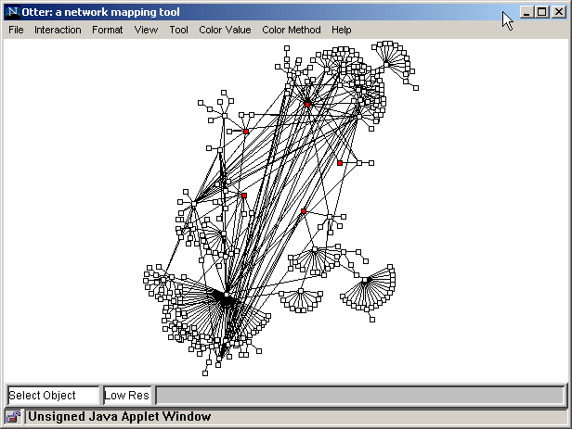
Latest Multicast Topology

Slide 46
Status of the Multicast Pieces
(Support for IGMPv3 & SSM)
network: most vendors already support it since functionality in the core has been simplified
OSs/kernel: test kernels available
  http://videolab.uoregon.edu/projects.html
applications: lots of talk, but not much action
  http://videolab.uoregon.edu/projects.html
content: without supporting software/hardware, content is not there

Slide 47
(blank slide for pagination purposes)

Slide 48
Network Point-of-View:
Protocols

Slide 49
Components of the
IP Multicast Architecture
service model
hosts
host-to-router
routers
intra-domain routing
inter-domain routing

Slide 50
Host-to-Router Multicast Protocol: IGMP

Slide 51
Components of the
IP Multicast Architecture
service model
hosts
host-to-router
routers
intra-domain routing
inter-domain routing

Slide 52
Internet Group Management Protocol
(IGMP)
the protocol by which hosts report their multicast group memberships to neighboring routers
  RFC-1112 specifies version 1, the original Standard
  RFC-2236 specifies version 2, the most widely used
  IETF draft specifies version 3, imminent deployment
occupies similar position and role as ICMP in the TCP/IP protocol stack

Slide 53
IGMP Version 1 Message Format
Vers.
Type
Reserved
Checksum
Group Address
Version 1
Type 1 = Membership Query
2 = Membership Report
Checksum standard IP-style checksum of
the IGMP Message
Group Address group being reported
(zero in Queries)

Slide 54
How IGMP Works
routers:
Q
hosts:
on each link, one router is elected the “querier”
querier periodically sends a Membership Query message
to the all-systems group (224.0.0.1), with TTL = 1
on receipt, hosts start random timers (between 0 and 10 seconds) for each multicast group to which they belong

Slide 55
How IGMP Works (cont.)
Q
G
G
G
G
when a host’s timer for group G expires, it sends a Membership Report to group G, with TTL = 1
other members of G hear the report and stop their timers
routers hear all reports, and time out non-responding groups

Slide 56
How IGMP Works (cont.)
note that, in normal case, only one report message per group present is sent in response to a query
  (routers need not know who all the members are,
  only that members exist)
query interval is typically 60—90 seconds
when a host first joins a group, it sends one or two immediate reports, instead of waiting for a query

Slide 57
IGMP Version 2
changes from version 1:
  new message and procedures to reduce “leave latency”
  standard querier election method specified
  version and type fields merged into a single field
backward-compatible with version 1
is currently a Proposed Standard
the de facto deployed standard

Slide 58
IGMP Version 2 Message Format
Type
Max Resp Time
Checksum
Group Address
Type 0x11 = Membership Query
0x12 = v1 Membership Report
0x16 = v2 Membership Report
0x17 = Leave Group
Max Resp Time in queries, max response delay
permitted, in 1/10 second units
Checksum standard IP-style checksum of
the IGMP Message
Group Address group being queried / reported / left
(zero to query all groups)

Slide 59
IGMP Version 2:
Reducing Leave Latency
when a host leaves a group, it sends a Leave Group message if it was the most recent host to report membership in that group
when querier router hears Leave Group message, it sends a couple of group-specific queries, specifying a small max-response-time
if no report heard, routing protocol assumes group is no longer present on the link

Slide 60
IGMP Version 2:
Querier Election
performed by each multicast router on each of its attached interfaces:
  initially assume the querier role, and emit
  periodic Query messages
  if Query messages heard from a router with a lower address, yield the querier role
  if current querier stops emitting Query messages, reassume the querier role

Slide 61
IGMP Version 3
still at the design stage, but advancing rapidly
changes from version 2:
  extension of service interface and protocol to enable
  hosts to:
    listen to only a specified set of hosts sending to a group
    listen to all but a specified set of hosts sending to a group
  additional protocol to inform a source host when no one is listening, to suppress unnecessary first hop transmission
to be backward-compatible with versions 1 & 2

Slide 62
IP Multicast Meets Bridged LANs
LANs are no longer just rings and “yellow hoses”!
classic Ethernet bridges forward all multicasts to all segments, in case any receivers are there.
current/Proposed ways to do better:
  IGMP Snooping
  CGMP (Cisco Group Management Protocol)
Notes:
1

Slide 63
IGMP Snooping
bridges look inside received multicast frames for:
  IGMP Reports, to learn in which direction(s) group members reside
  IGMP Queries, DVMRP Probes, MOSPF Hellos, PIM Hellos to learn in which direction(s) multicast routers reside
multicast data packets forwarded only towards group members and multicast routers.
IGMP Report suppression done “per branch” rather than “per LAN”
Notes:
1

Slide 64
Problems with IGMP snooping
doesn’t work for non-IP multicasts
stops working if new multicast routing protocol deployed
performance cost of snooping inside of every multicast frame
Notes:
3

Slide 65
CGMP
Cisco proprietary approach
designed to eliminate need for bridge to snoop multicast frames
multicast routers send CGMP control messages to bridges, informing them of group membership
Notes:
4

Slide 66
For More Information on IGMP
Specifications
  IGMPv1: RFC 1112
  IGMPv2: RFC 2236
  IGMPv3: draft-ietf-idmr-igmp-v3-*.txt
WWW page
  http://www.ietf.org/html.charters/idmr-charter.html
Mailing list
  Subscribe to: idmr-request@cs.ucl.ac.uk
Notes:
3

Slide 67
(blank slide for pagination purposes)

Slide 68
Intra-Domain
Multicast Routing Protocols

Slide 69
Components of the
IP Multicast Architecture
service model
hosts
host-to-router (IGMP)
routers
intra-domain routing
inter-domain routing

Slide 70
The First Intra-Domain Routing Protocol: DVMRP

Slide 71
Distance-Vector Multicast Routing Protocol
DVMRP consists of two major components:
  (1) a conventional distance-vector routing protocol (like RIP) which builds, in each router, a routing table like this:
  (2) a protocol for determining how to forward multicast packets, based on the routing table and routing messages of (1)
subnet
shortest dist
via interface
a
1
i1
b
5
i1
c
3
i2
…
…
…

Slide 72
Example Topology
g
g
s
g

Slide 73
(blank slide for pagination purposes)

Slide 74
Phase 1: Truncated Broadcast
g
g
s
g

Slide 75
(notes for slide above)
first packet from source s to multicast group g is forwarded using Reverse Path Forwarding (RPF) algorithm:
  if a multicast packet arrives from the interface that, according to the routing table, is on the shortest path back to the source,
  then forward the packet on all* other interfaces
  else drop the packet
*exceptions:
  when more than one router attached to a link, only the router with the shortest distance back to the source forwards onto that link (or, in case of a tie, the router with lowest IP address)
  on a “leaf” link (relative to the source) do not forward the packet if there are no group members on that link

Slide 76
Phase 2: Pruning
g
g
prune (s,g)
s
prune (s,g)
g

Slide 77
(notes for slide above)
when a packet reaches a router for whom there are no permitted outgoing interfaces, that router sends a prune message to its predecessor on the path back to the source
if the reception of a prune message causes predecessor now to have no remaining outgoing interfaces, it then sends a prune message to its predecessor
routers keep state remembering what prunes they have sent and received; the state is discarded after a (relatively long) timeout

Slide 78
Steady State
g
g
g
s
g

Slide 79
(notes for slide above)
now, packets flow down only those branches that lead to members of the multicast group
when the prune-state times out, if there is still multicast traffic from s to g, truncated broadcast happens again, triggering prunes again;
if the traffic has stopped, nothing more happens and no state remains for traffic from s to g

Slide 80
Grafting on New Receivers
g
g
g
report (g)
graft (s,g)
s
graft (s,g)
g

Slide 81
(notes for slide above)
if a new group member appears on a pruned-off link (as detected by IGMP), the upstream router for that link sends graft messages to undo the effect of any prune messages sent, regarding that group

Slide 82
Steady State after Grafting
g
g
g
s
g

Slide 83
(notes for slide above)
after the graft message has undone the pruning, multicast packets can now flow down the branch to the new member
there are, of course, many more details; if you are interested, please read the current spec: draft-ietf-idmr-dvmrp-v3-08.txt (not RFC-1075!), which can be found via the IETF web page, http://www.ietf.org

Slide 84
Distinguishing Properties of
IP Multicast Routing Protocols
(1) how delivery trees are established between multicast senders and receivers
  broadcast data, then prune
  broadcast membership
  use one of more rendezvous points

Slide 85
Distinguishing Properties of
IP Multicast Routing Protocols (cont.)
(2) types of delivery trees
  unidirectional, per-source, per-group trees
  unidirectional, per-group trees, shared by all sources
  bidirectional, per-group trees, shared by all sources

Slide 86
Topology to Illustrate Types of
Delivery Trees
S1
R3
R4
R2
R1
S2

Slide 87
Unidirectional Tree,
One Tree Per Source
S1
R3
R4
R2
R1
S2/R5

Slide 88
Unidirectional Tree,
Shared by All Sources
S1
R3
R4
R2
R1
S2/R5

Slide 89
Bi-directional Tree,
Shared by All Sources
S1
R3
R4
R2
R1
S2/R5

Slide 90
Distinguishing Properties of
IP Multicast Routing Protocols (cont.)
(3) topology database (routing table) construction
  build own routing table
  use unicast routing table

Slide 91
Current IP Multicast Routing Protocols
DVMRP — Distance-Vector Multicast Routing Protocol
  broadcast-and-prune,
  unidirectional per-source trees,
  builds own routing table
MOSPF — Multicast Extensions to Open Shortest-Path
First Protocol
  broadcast membership,
  unidirectional per-source trees,
  uses OSPF routing table

Slide 92
Current IP Multicast Routing Protocols (cont.)
PIM-DM — Protocol-Independent Multicast, Dense-Mode
  broadcast-and-prune,
  unidirectional per-source trees,
  uses unicast routing table
PIM-SM — Protocol-Independent Multicast, Sparse-Mode
  uses meeting places (“rendezvous points”),
  unidirectional per-group or shared trees,
  uses unicast routing table
CBT — Core-Based Trees
  uses meeting places (“cores”),
  bidirectional shared trees,
  uses unicast routing table

Slide 93
(blank slide for pagination purposes)

Slide 94
Multicast Routing: MOSPF

Slide 95
Multicast OSPF (MOSPF)
an extension to OSPF (Open Shortest-Path First),
a link-state, intra-domain routing protocol
  specified in RFCs 1584 & 1585
multicast-capable routers indicate that capability with a flag in their link-state messages
routers include in their link-state messages a list of all groups that have members on the router’s directly-attached links (as learned through IGMP)

Slide 96
Link state: each router floods link-state advertisement
Multicast: add membership information to “link state”
Each router then has a complete map of the topology, including
which links have members of which multicast groups
S1
Z
X
R1
Y
R2
Notes:
10

Slide 97
Z has network map, including membership at X and Y
Z computes shortest path tree from S1 to X and Y
Z builds multicast entry with one outgoing interface
W, Q, R, each build multicast entries
S1
Z
W
Q
X
R
R1
Y
R2
Notes:
11

Slide 98
Link-state advertisement with new topology may require
recomputation of tree and forwarding entry
S1
Z
W
Q
X
R
R1
Y
R2
Notes:
12

Slide 99
Link state advertisement (T) with new membership (R3) may require incremental computation and addition of interface to outgoing interface list (Z) (Similarly, disappearance of a membership may cause deletion
an interface from an outgoing interface list)
S1
Z
R3
W
Q
T
X
R
R1
Y
R2
Notes:
13

Slide 100
Multicast Routing: PIM

Slide 101
Protocol Independent Multicast (PIM)
“Protocol Independent”
  does not perform its own routing information exchange
  uses unicast routing table made by any of the existing unicast routing protocols
PIM-DM (Dense Mode) - similar to DVMRP, but:
  without the routing information exchange part
  differs in some minor details
PIM-SM (Sparse Mode), or just PIM - instead of directly building per-source, shortest-path trees:
  initially builds a single (unidirectional) tree per group , shared by all senders to that group
  once data is flowing, the shared tree can be converted to a per-source, shortest-path tree if needed
Notes:
73

Slide 102
PIM Protocol Overview
Basic protocol steps
  routers with local members send Join messages towards a Rendezvous Point (RP) to join shared tree
  routers with local sources encapsulate data to RP
  routers with local members may initiate data-driven switch to source-specific, shortest-path tree
IETF PIM WG started in Aug’98 to standardize PIM
  http://www.ietf.org/html.charters/pim-charter.html
Notes:
76

Slide 103
Phase 1: Build Shared Tree
Shared tree after
R1,R2,R3 join
Join message
toward RP
RP
Join G
R1
R4
R2
R3
Notes:
77

Slide 104
Phase 2: Sources Send to RP
S1
unicast encapsulated
data packet to RP
RP decapsulates,
forwards down
Shared tree
S2
RP
R1
R4
R2
R3
Notes:
78

Slide 105
Phase 3: Stop Encapsulation
S1
(S1,G)
(S1,G)
(S2,G)
S2
Join G for S2
Join G for S1
(*.G)
RP
R1
R4
R2
R3
Notes:
78

Slide 106
Phase 4: Switch to Shortest Path Tree
S1
shared tree
S2
Join messages
toward S2
RP
R1
R4
R2
R3
Notes:
79

Slide 107
Phase 5: Prune (S2 off) Shared Tree
S1
Prune S2 off Shared tree
where iif of S2 and
RP entries differ
S2 distribution tree
Shared tree
S2
RP
R1
R4
R2
R3
Notes:
81

Slide 108
RP Mechanism
end-systems only need multicast address to send or receive
routers use algorithmic mapping of group address to RP from manageably-small set of RPs known throughout region
consistent RP mapping and adaptation to failures is CRITICAL
  all routers (within PIM region) must associate a single active RP with a multicast group
optimal RP location not necessary
Notes:
89

Slide 109
RP Mechanisms — Overview
each candidate RP periodically indicates liveness to Bootstrap Router in the PIM region
Bootstrap Router periodically distributes set of reachable candidate RPs to all PIM routers in region
  like unicast routing—track liveness continuously, not on demand
each PIM router uses the same hash function and set of RPs to map a particular multicast group address to that group’s RP.
Notes:
90

Slide 110
Bootstrap Router
Bootstrap Router function
  construct set of RPs (RP set) based on Candidate RP advertisements
  periodically distribute RP set in Bootstrap messages to all routers in region by hop-by-hop flooding
Bootstrap Router should be well-connected for stability, and dynamically elected for robustness
Notes:
93

Slide 111
Bootstrap Router Election
simple bridge-like spanning-tree election algorithm
candidate Bootstrap Routers originate PIM hop-by-hop Bootstrap messages with IP address and configurable preference value.
Bootstrap messages exchanged by all PIM routers within region
most preferred (or highest numbered) reachable candidate Bootstrap Router elected
sent periodically and triggered
Notes:
94

Slide 112
All routers use hash function to map Group Address to RP
hash function
  input: group address G and address of each candidate RP in RP set (optional Mask)
  output: Value computed per candidate RP in RP set
  RP with highest value is the RP for G
desirable characteristics
  minimize remapping when RP reachability changes — remap only those that lost RP
  load spreading of groups across RPs
Notes:
95

Slide 113
Another RP solution
“Anycast RP”
  draft-ietf-mboned-anycast-rp-*.txt
  Allows arbitrary number of RPs per group
    “but we said this was bad”
  Works by running MSDP between RPs INTRA-domain
    MSDP is “source discovery” protocol
  Go to closest RP and then use MSDP to share source information with other RPs
Notes:
95

Slide 114
Dense Mode/Sparse Mode
Protocol Interoperability

Slide 115
PIM Interoperability with
Dense-Mode Backbone
PIM Multicast Border Router connects to PIM region with some interface(s) and dense-mode region (e.g., MBone) with other interface(s)
Border Router functions:
  export packets originated in PIM region to the MBone
  import packets originated in dense-mode backbone to RP in PIM region
Notes:
101

Slide 116
Exporting PIM Packets to the MBone
Border Routers pull out all internally-generated packets for broadcast into the MBone
  Border Routers generate Join messages to each RP indicating “all sources for all groups that map to that RP”: PIM routers build aggregated Shared tree entries (*,*,RP)
  intermediate PIM routers forward multicast packets for groups that map to the indicated RP, and pass RPF check
DVMRP
MBone
Packets
injected
into MBone
RP
aggregated
Shared tree
PIM region
Notes:
102

Slide 117
Importing Packets from the MBone to PIM
Border Routers Register-encapsulate MBone packets to RP for the group
RP sends Register-Stop messages to Border Routers to eliminate duplicate Registers, or if no internal receivers on Shared tree
packet from MBone arrives at all Border Routers for region
Register
DVMRP
MBone
RP
PIM region
Notes:
103

Slide 118
Border Router Functions with
PIM Transit and DVMRP Stubs
If PIM region is transit while DVMRP is still backbone protocol
  PIM cloud must propagate DVMRP routing information
If PIM is backbone
  DVMRP stubs must generate Domain Wide Reports to notify Border Routers of internal members (or use sender-as-member hack)
  Border Routers won’t need to use aggregated Shared trees (*,*,RP) and Border-bit/Border Router field
Notes:
105

Slide 119
(blank slide for pagination purposes)

Slide 120
Inter-Domain Multicast
Routing Protocols

Slide 121
Components of the
IP Multicast Architecture
service model
hosts
host-to-router (IGMP)
routers
intra-domain routing
inter-domain routing

Slide 122
What Exactly is Needed?
inter-domain route exchange protocol
mechanism for connecting domains
  two models:
    discover sources using “source announcing” protocol
    know the source(s) a priori
Notes:
2

Slide 123
Inter-Domain Route Exchange
Exchange multicast reachability between Autonomous Systems (AS)
  Just like unicast routes are exchanged with BGP
  Protocol is “Multiprotocol extensions to BGP” (RFC 2283)
    Also known as “Multicast” BGP (MBGP)
    Also known as BGP4+
MBGP is available and deployed today.
  Multiple vendors: Juniper, Cisco, Nortel, etc.
Note: Not to be confused with BGMP
Notes:
2

Slide 124
MBGP Protocol Details
Add Subsequent Address Family Identifier (SAFI) to:
  MP_REACH_NLRI
  MP_UNREACH_NLRI
Option is:
  unicast only
  multicast only
  unicast/multicast
Allows congruent/different unicast/multicast topologies
Notes:
2

Slide 125
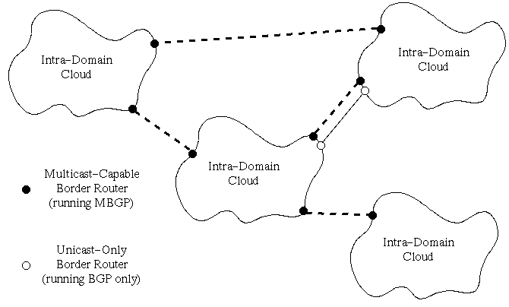

Slide 126
What Exactly is Needed?
inter-domain route exchange protocol
mechanism for connecting domains
  two models:
    discover sources using “source announcing” protocol
    know the source(s) a priori
Notes:
2

Slide 127
The Internet Solution
Re-use existing protocols/solutions
  Use PIM-SM in the inter-domain
The challenge is to avoid “root dependencies”
  A root/RP/core is one domain but no active group participants (sources or receivers) in the domain
  Root dependencies can lead to political problems and inefficiencies

Slide 128
The Internet Solution (cont)
The key: Establish a root/RP/core per domain
  No “root dependencies”
Remember the problem:
  Connecting sources and receivers
  Solution is to use Multicast Source Discovery Protocol (MSDP)
MSDP is the last piece of the puzzle; is simple to implement; and yields an interim solution to inter-domain multicast

Slide 129
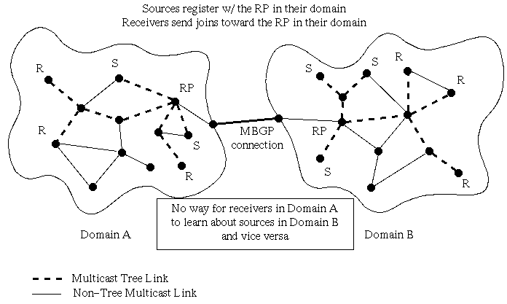

Slide 130
MSDP -- Basic Idea
MSDP advertises multicast sources to other domains
Other domains decide if group members are active and find a way to get the data
“MSDP connects shared-trees together”
MSDP typically runs in the RP

Slide 131
MSDP - Elements of Operation
Receivers in a domain join the shared-tree
The RP is known only to routers in the domain
When a source goes active in a domain, it’s packets get to the RP in that domain
The RP sends a Source-Active (SA) message identifying the source and group it sends to

Slide 132
MSDP - Elements of Operation (cont)
How to get SA messages to all MSDP peers?
  Need MSDP topology flooding protocol
  The RP’s address is also in the SA message to accommodate “peer-RPF” like flooding
  Each MSDP peer receives SA message and forwards away from the originating RP

Slide 133
MSDP - Elements of Operation (cont)
Each MSDP speaking RP will examine SA message to see if any local members are joined to the group
If so, the RP joins to source described in SA message
Otherwise, the SA message is ignored (Flood-and-Join model)

Slide 134

How MSDP works with PIM-SM
A
SA
RP
Source
C
D
SA
Join
RP
B
Join
RP
Join
Receiver
Join
Join
RP
SA
MSDP peer
PIM message
Physical link
MSDP message

Slide 135
What Exactly is Needed?
inter-domain route exchange protocol
mechanism for connecting domains
  two models:
    discover sources using “source announcing” protocol
    know the source(s) a priori—SSM model
Notes:
2

Slide 136
Source Specific Multicast (SSM)
Basic idea:
  Assumes receiver knows the source(s)
  Reverse SPT join to source
    No RPs or MSDP
  About as straightforward as you can get!
Notes:
2

Slide 137
How SSM Works
A
Source
C
D
Join
B
Join
Join
Join
Join
Receiver
Join
PIM message
Physical link

Slide 138
Source Specific Multicast
Advantages
  Minor changes to existing infrastructure—still use PIM-SM
  No PIM-SM RP, or MSDP
Limitations
  Requires modifications (last hop routers) and IGMPv3
  May be difficult to support some applications
Thoughts
  Works for 9x% of killer-apps -- need mechanism (WWW) to let receivers know who sources are
  Success will depend on seamless migration strategy
Notes:
2

Slide 139
Source Specific Multicast (SSM)
VERY recent (and rapid) work:
  First started 46th IETF – December 1999
  Big push at 47th IETF – March 2000
  48th IETF: Architecture doc, mods to IGMPv3 and PIM
  49th IETF: Working out the bugs, looking for deployment
  50th IETF: Could be the last meeting
Notes:
2

Slide 140
SSM Working Group Documents
Source Specific Multicast for IP
  Architectural document: draft-ietf-holbrook-ssm-arch-*.txt
A Framework for Source-Specific IP Multicast Deployment
  draft-bhattach-ssm-framework-*.txt
Notes:
2

Slide 141
Other SSM-related Docs
PIMv2 revised
  includes SSM operation: draft-ietf-pim-sm-v2-new-*.txt
IGMPv3
  necessary component: draft-ietf-idmr-igmp-v3-*.txt
IGMPv3 for SSM
  “IGMPv3 lite”: draft-holbrook-idmr-igmpv3-ssm-*.txt
Source-Specific Protocol Independent Multicast in 232/8
  Rules for 232/8 space: draft-shepherd-ssm232-*.txt
Notes:
2

Slide 142
Miscellaneous
Inter-Domain Solutions

Slide 143
Other Inter-Domain Choices
Root Addressed Multicast Architecture (RAMA)
  this was once known as “Simple Multicast”
  a special case of RAMA is “Express Multicast”
Border Gateway Multicast Protocol (BGMP)
  Not to be confused with MBGP
Notes:
2

Slide 144
Root Addressed Multicast Architecture
Uses “extended addressing”
  Combines 4 byte source addr and 4 byte destination addr
  Multicast address becomes (Core,Group) = (C,G)
    Solves limited-address problem
    Also solves address allocation problem
  (C,G) uniquely identifies group
Use bi-directional shared trees
Notes:
2

Slide 145
BGMP
Relies on multicast addresses being rooted in some domain
  Can use MASC or GLOP or ???
Creates a single bi-directional tree across domains
  Attempts to aggregate routing (if domains are allocated address ranges)
  Different from PIM-SM is bi-directional trees
BGMP is considered protocol of the future
  Offers routing scalability not found in existing protocols
Notes:
2

Slide 146
Site Deployment:
Getting Started and
Using Multicast

Slide 147
Issues to Consider
multicast is not a “turn it on and forget about it” type of service
but you can experiment with it very easily
the difference is between deploying an experimental service and a production service
  look how long we’ve taken to be confident about unicast service

Slide 148
Where to Start
start small
  local area network
  free software (http://www-mice.cs.ucl.ac.uk/multimedia/software/)
  streaming audio/video and whiteboard
keys to deployment
  most operating systems support at least IGMPv1
  free tools allow both content reception and generation
  avoid routing which (today) requires pro-active steps

Slide 149
Where to Start (cont)
Ideal environment
  Ethernet connected by hub or switch
  any kind of end system (PC or UNIX-based)
  free tools
    see MBone tools demonstration section
  start with whiteboard
    no hassling with microphones or cameras
    http://www-mice.cs.ucl.ac.uk/multimedia/software/

Slide 150
Learn About Multicast Routing
try and get between two LANs
  can be either via a switch or via a router
this can be a major hurdle
  will likely need to configure router, but...
  ...switches are usually multicast transparent
    modern switches do IGMP snooping
    older switches simply broadcast across all interfaces
      watch out for bugs in really old equipment

Slide 151
How to Configure a Router
simple topologies are easiest to configure
all vendors typically have reasonable docs
  Cisco has some of their stuff online
  ftp://ftpeng.cisco.com/ipmulticast/
basic set of router commands

Slide 152
Connecting to the Outside World
establish a private connection or connect to the public multicast infrastructure (MBone)
1st choice: talk to your service provider
  eventually this will be the only choice (“almost is now”)
  the “right” way to connect
2nd choice: find someone willing to create a tunnel
  ask on the mbone@isi.edu mailing list
  the “easiest” way to connect
  what set of ISPs support multicast?

Slide 153
Tunneling Basics
two machines that exchange multicast packets across non-multicast capable links by encapsulate multicast IP packets in unicast IP packets
packets are sent over point to point links
routing information also sent over point to point links
  a virtual multicast topology is created
  this was how the MBone was established

Slide 154
Tunneling Requirements
need a machine to terminate a local endpoint
  machine will re-distribute traffic internally
  can be hot spot for traffic (traffic doubling)
need someone willing to create other endpoint
tunnels are IP-in-IP (UDP)
  typically do not operate across firewalls

Slide 155
Tunneling Code
not available for Windows operating systems
information, binary images and source code
  ftp://ftp.parc.xerox.com/pub/net-research/ipmulti/beta-test/
  latest version is 3.9beta3
also includes some basic utilities
  mrinfo: tool to query tunnel endpoints

Slide 156
Example Configuration
tunnel <local-addr> <remote-addr> [srcrt] [metric <m>] [threshold <t>] [rate_limit <b>] [boundary (<boundname>|<scoped-addr>/<mask-len>)]
tunnel <local> <remote> metric 1 threshold 64 rate_limit 500 boundary 239.254.0.0/16

Slide 157
Native Multicast Routing
native support in routers and switches is growing
almost all vendors support at least some protocols
  UNIX/LINUX: DVMRP (mrouted), PIM (gated)
  Cisco: interoperable-DVMRP, PIM, MBGP, MSDP
  Juniper: PIM, MBGP, MSDP
  Foundry: PIM, not sure about MBGP/MSDP
  Nortel: DVMRP, MOSPF, PIM + MBGP (soon), MSDP (soon)
  Others: Lucent, Packet Engines, Proteon, Alantec, Cabletron

Slide 158
Code Example
Lots of code examples:
  ftp://ftpeng.cisco.com/ipmulticast/config_examples.html
ip multicast-routing
ip sdr cache-timeout 180
ip dvmrp route-limit 7000
ip multicast cache-headers
interface <interface>
ip pim sparse-dense-mode
ip mroute-cache
ip sdr listen <NOTE: only on one interface>
ip multicast boundary 10

Slide 159
How to Dig Deeper
ftp://ftpeng.cisco.com/ipmulticast/
  directory of lots of useful documents
    briefings, guides, tutorials, command descriptions
    recommended configurations and settings
    interoperability notes, deployment strategies (ATM)
http://www.cisco.com/warp/public/732/multicast/
3Com info: do site search
  http://www.3com.com/nsc/501303.html (Maufer book)

Slide 160
Sometimes Solutions Aren’t Pretty
tunnels may be the only solution…
  … because of production software/hardware limitations
  industry has not dealt with all hardware (terminal servers)
other mechanisms to tunnel are available
  application-layer tunneling
  exploders
    makes multicast advocates nervous -- too transparent of a work-around

Slide 161
Other Solutions
liveGate (http://www.live.com/liveGate/)
  uses machine connected to the MBone as an exploder for providing dynamic point-to-point connections
  uses UDP Multicast Tunneling Protocol (UMTP)
  coupled with multikit (http://www.live.com/multikit/)
    sdp-style (sdr-like) session browser
as of the 50th IETF in Minneapolis, there was discussion about “auto-tunneling” solutions

Slide 162
Summarizing the Steps to Deployment
experiment with multicast on a local network
try one- or few-hop multicast topology
connect to external sites with tunnels or natively
experiment with advanced applications
transition to production service

Slide 163
(blank slide for pagination purposes)

Slide 164
Managing Multicast:
Challenges, Tools, and the Future

Slide 165
What Does it Mean to Manage?
Lack of management tools are being used as the next chicken-and-egg excuse for lack of deployment
white paper on multicast management
  http://www.cs.ucsb.edu/~almeroth/publish/IPMI-MGT.ps.gz

Slide 166
Two Classes of Mgt Concerns
those interested in deploying multicast:
  concerns about impact
  issues of how (at what level) to support users
  configuration management
multicast is deployed, manage it as a service:
  performance monitoring
  fault detection, isolation, and prevention.
  accounting services

Slide 167
Pre-Production Concerns
what happens when multicast is turned on?
  impact analysis is critical step
  understand requirements
  develop a deployment strategy
be prepared for what happens next
  transition from Evaluation Phase to Production Service
  someone needs to understand operation in significant detail

Slide 168
Operational Concerns
multicast is similar to unicast
  operation monitoring
  fault detection, isolation, and prevention
  performance monitoring
multicast is different than unicast
  multicast routers do different things
  power of scalability is tough to encircle
  be careful of overwhelming bad news
Notes:
SDP was really only designed for SAP - the other uses stretch it a little beyond its design space.
Sometimes this shows.

Slide 169
Differences in Perspective
deployment-style management
  dependent on significant expertise
  goal: initial functionality and short-term operation
NOC-style management
  broader base of knowledge
  goal: long-term monitoring of service
Evolution has had large impact on development of existing strategies and tools.

Slide 170
Basic Management Mechanism
RTCP packet collection
mtrace-based tools
Link monitoring tools
SNMP-based tools
Reachability monitoring

Slide 171
Using RTCP for Management
Advantages
  carries group participation and quality information
  transmitted to entire group
  has tight scalability mechanisms
Disadvantages
  only carries end-to-end information
  scales too well (very limited info for large groups)
  it IS multicast to all group members

Slide 172
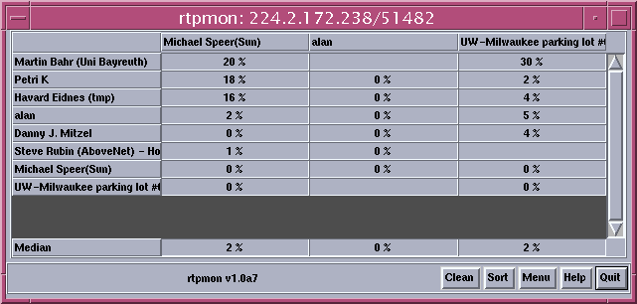
rtpmon

Slide 173
Using mtrace for Management
End-user tool to query routers about path and packet transmission rates
Advantages
  useful for verifying multicast connectivity
  identifies location of congestion/loss
Disadvantages
  requires significant expertise to use
  only works well when there are no problems

Slide 174
Uses of mtrace
identify routers on path
identify routing loops or inconsistencies
identify points of packet loss along path
TTL-threshold discovery
measure propagation delays
route aggregation information from each hop

Slide 175
Unicast Traceroute
sends packets with increasing TTL to evoke ICMP Time Exceeded messages
inappropriate for multicast
  Implosion of responses from each router at edge of the TTL scope
  want receiver-driven trace capability

Slide 176
mtrace
trace from receiver to sender since most algorithms have routes to senders
single packet walks path up tree and returns to querier (which may or may not be one of nodes being traced)
no need to send multiple packets or get packet implosions

Slide 177
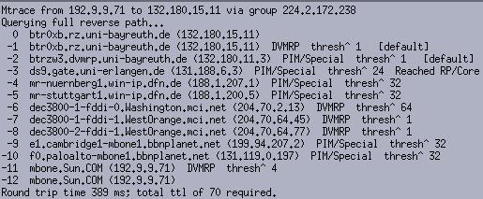
mtrace path determination

Slide 178
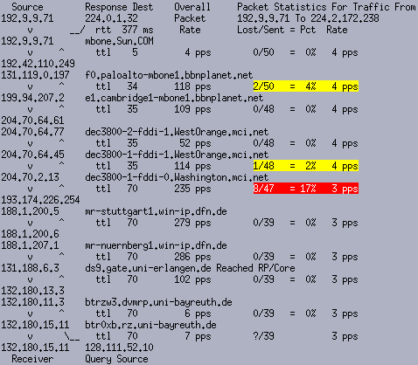

Slide 179
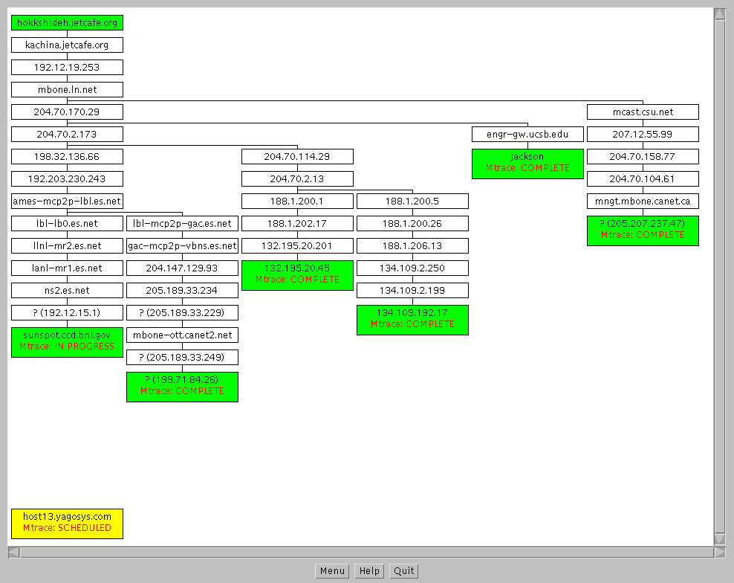

Slide 180
Using Link Monitoring Tools for Management
Monitor links using TCPdump style process
Advantages
  lots of information about what is happening on a link
  similar functionality can be handled by existing tools
Disadvantages
  no multicast-specific tools that are easy to use
  does not give group-wide information

Slide 181
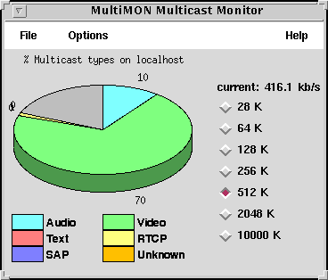
multiMON

Slide 182
Using SNMP for Management
Advantages
  proven useful for managing network resources
  can gather routing, tunnel, and RTP statistics
  well understood paradigm and interface
Disadvantages
  deployed MIBs are not particularly up-to-date
  may not be helpful outside enterprise
  has potential scaling problems

Slide 183
mstat, mrtree, mview, and now mmon
mstat -- simple SNMP-based query tool
mtree -- uses IGMP and SNMP to discover multicast tree
mview
  similar to MHealth but based on SNMP queries
  visualizes topology, collects data, helps in locating problems
mmon – new commercial tool being developed by HP
  NOC-style management tool for non-experts

Slide 184
Dr. Watson
not just for multicast
works by sending packets on the local network
  IGMP (v1/v2), RTCP, RTP, mtrace, SNMP
spoof packets to evaluate network operation

Slide 185
Reachability Monitoring
Multicast Reachability Monitor (MRM)
  Protocol under development
    http://www.cs.ucsb.edu/~almeroth/research.html#mrm
  Router-based protocol
  MRM Manager, Test Senders (TSs), and Test Receivers (TRs)
SDR-monitor
  http://www.cs.ucsb.edu/~almeroth/sdr-monitor/
Access Grid Beacon
  http://dast.nlanr.net/projects/beacon/

Slide 186
Guide to Debugging Multicast
Handbook that outlines strategies, tools, and solutions for debugging multicast problems
Written for people with significant multicast experience
Currently an IETF internet draft
Turning it into a WWW site: http://imj.ucsb.edu/mdh/
ftp://ftp.ietf.org/internet-drafts/draft-ietf-mboned-mdh-*.txt

Slide 187
Publicly Available Tools
mtrace: multicast traceroute
  ftp://ftp.parc.xerox.com/pub/net-research/ipmulti/
RTPmon: active RTCP and passive mtrace
  ftp://mm-ftp.cs.berkeley.edu/pub/rtpmon/
MHealth: active RTCP and mtrace
  http://imj.ucsb.edu/mhealth/

Slide 188
Publicly Available Tools (cont)
Multimon
  http://www.merci.crc.ca/mbone/MultiMON/
SNMP-based tools (mstat, mrtree, and mview)
  http://www.merit.edu/net-research/mbone/.index.html
  http://www.merit.edu/~mbone/mviewdoc/Welcome.html
HP’s mmon
  http://www.hpl.hp.com/mmon/
Dr. Watson
  http://www.cavebear.com/dwtnda/

Slide 189
(blank slide for pagination purposes)

Slide 190
Wrap Up:
Additional Resources,
The Future of Multicast, and Questions

Slide 191
Multicast Textbooks
Beau Williamson, Developing IP Multicast Networks (The Cisco Press Design and Implementation Series), 2000.
Tom Maufer, Deploying IP Multicast in the Enterprise, Prentice Hall, 1997.
Ken Miller, Multicast Networking and Applications, Addison Wesley, 1998.

Slide 192
The Future of Multicast
???

Slide 193
Questions?!?

