Slide 1
Linux Monitoring
Mark Veltzer
mark@veltzer.net

Slide 2
Monitoring: definition
Monitoring: The act of observing an application to find out what it is doing.
Monitoring can be used for debugging (e.g. it should not be doing that!)
Monitoring can be used for performance enhancing an application (e.g. this part is taking to long, lets optimize it)
Monitoring can be used for understanding what an application does (e.g. I didn't know it opened that file!)

Slide 3
Monitoring in Linux
Linux has hundreds of tools for monitoring and has enough facilities to enable you to easily build your own.
Tools range from GUI tools (much like Windows task manager) which are OK for beginners, to console GUI tools which are more sophisticated, to much more sophisticated command line tools that put to shame anything you find in windows, to make it on your own scripts that take data from /proc and other sources.

Slide 4
GUI monitoring tools
gnome-system-monitor (gnome), ksysguard (KDE), xfce-task-manager (xfce) and probably more.
The one for your desktop is probably already installed. If not, you may install any of those using your package manager.
These can be located in your “start” menu or could be launched from the command line with the names above.

Slide 5
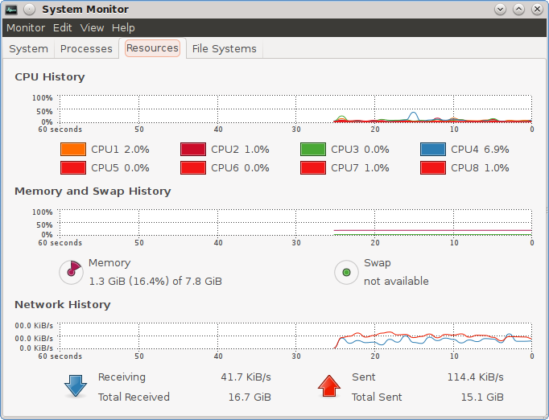
gnome-system-monitor

Slide 6
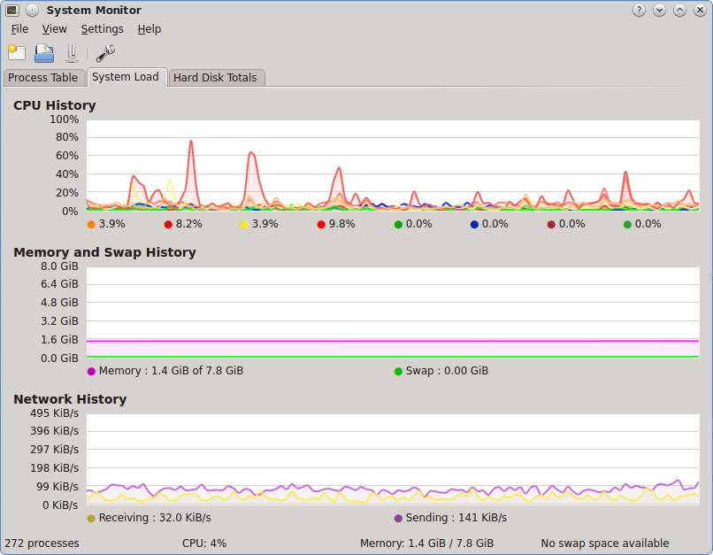
ksysguard

Slide 7
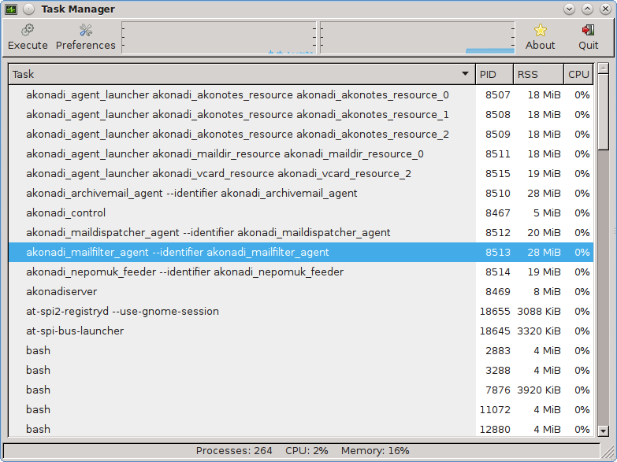
xfce-taskmanager

Slide 8
The GUI tools
In all of these you can configure which columns to see for each task (many columns are available).
In some of these you can install “plug-ins” that show other views (like disk usage on each disk in ksysguard).
In most of these you can kill processes or the like.

Slide 9
Console GUI monitoring tools
GUI console are applications that have a GUI but run inside the console.
This means that you can use them over a terminal when connecting to a remote machine.
This makes them favorite amongst system administrators and programmers since you can monitor the production environment and your own environment using the same tool chest.

Slide 10
top(1)
Top is the most well known monitoring application for Unix and Linux.
It is also the one whose hidden features are the most unknown.
By default, top shows you the applications consuming the most CPU at any given point in time.
But it can be used for other measurements as well...

Slide 11
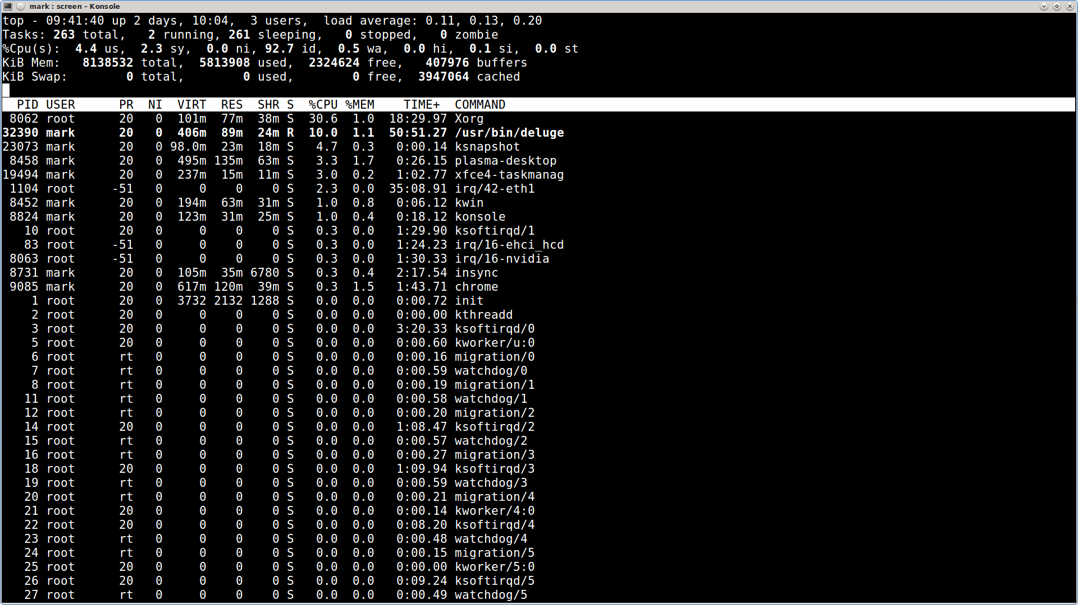
top

Slide 12
Top (features)
k,r: kill or re-nice processes.
d,s: set update interval.
n,#: set number of tasks displayed.
1,I: control multi-cpu view mode.
f,F: select fields to be shown and field to sort by.
?: show you many more options

