Slide 1
Building Custom Embedded Images with the Yocto Project
Saul Wold / Tom Zanussi
Intel Corporation
April 13th, 2011

Slide 2
Overview
Some basic background (images, recipes, etc)
Customizing images with layers
  BSP Layers
    Enabling a new machine
    Dive into a couple key components, the kernel and X
  Application Layers
    Media Server Demo
Future
  Image Creator
Q & A

Slide 3
The Yocto Project in a Nutshell
Tools and metadata for creating custom embedded systems
  Images are tailored to specific hardware and use cases
  But metadata is generally arch-independent
  Unlike a distro, 'kitchen sink' is not included (we know what we need in advance)
An image is a collection of 'baked' recipes (packages)
A 'recipe' is a set of instructions for building 'packages'
  Where to get the source and which patches to apply
  Dependencies (on libraries or other recipes, for example)
  Config/compile options, 'install' customization
A 'layer' is a logical collection of recipes representing the core, a board support package (BSP), or an application stack

Slide 4
The Yocto Project Build System
bitbake + metadata (Poky)
  bitbake - a task executor and scheduler
  metadata – task definitions in recipes, classes + config
configuration (.conf) – global definition of variables
  build/conf/local.conf (local user-defined variables)
  distro/poky.conf (Yocto 'distro' config variables)
  machine/beagleboard.conf (machine-specific variables)
classes (.bbclass) – encapsulation and inheritance of logic
recipes (.bb) – the logical unit of execution, software/images to build

Slide 5
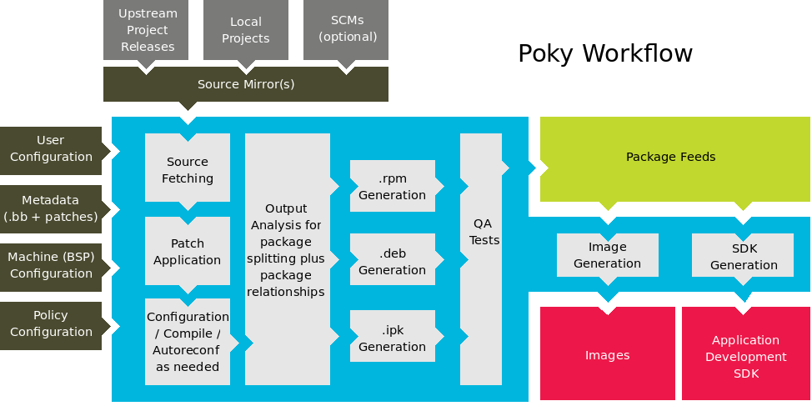
The Yocto Project and Poky

Slide 6
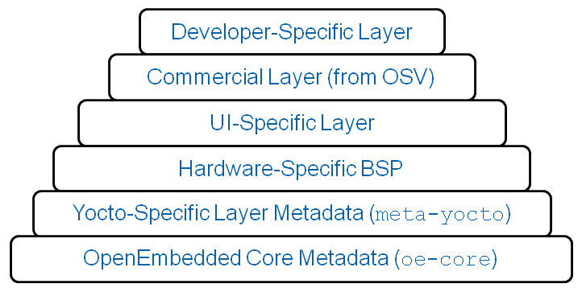
Layers

Slide 7
BSP 'Layers'
Image contents can be modified by 'layers'
Layers specialize images by adding or modifying recipes
  Really just another directory to look for recipes in
  Added to the BBLAYERS variable in build/conf/bblayers.conf
BSPs are layers that add machine settings and recipes
Machine settings are specified in a layer's conf/machine/xxx.conf file(s)
Examples:
  Sandy Bridge + Cougar Point:
    meta-intel/meta-sugarbay/machine/sugarbay.conf
  Beagleboard (arm)
    yocto/meta/conf/machine/beagleboard.conf

Slide 8
Practical Requirements for a BSP
A BSP developer's task is to create a machine layer
  Define a machine configuration to match hardware
  Add machine-specific recipes or extend existing recipes
Very few hard requirements, but there are some
  All BSPs must select and configure a kernel
  Machines with graphics capabilities probably also want to select and configure graphics recipes
  Custom recipes can be added for special hardware
  Most other things covered by standard recipes
  New BSPs should follow a standard layout

Slide 9
The Layout of a BSP Layer
trz@elmorro:/usr/local/src/yocto/snb/meta-intel$ find ./meta-sugarbay
./meta-sugarbay
./meta-sugarbay/recipes-bsp
./meta-sugarbay/recipes-bsp/formfactor/formfactor/sugarbay
./meta-sugarbay/recipes-bsp/formfactor/formfactor/sugarbay/machconfig
./meta-sugarbay/recipes-bsp/formfactor/formfactor_0.0.bbappend
./meta-sugarbay/COPYING.MIT
./meta-sugarbay/recipes-kernel
./meta-sugarbay/recipes-kernel/linux/linux-yocto_git.bbappend
./meta-sugarbay/README
./meta-sugarbay/recipes-graphics
./meta-sugarbay/recipes-graphics/xorg-xserver/xserver-xf86-config_0.1.bbappend
./meta-sugarbay/recipes-graphics/xorg-xserver/xserver-xf86-config
./meta-sugarbay/recipes-graphics/xorg-xserver/xserver-xf86-config/xorg.conf
./meta-sugarbay/recipes-graphics/xorg-xserver/xserver-xf86-lite_1.9.3.bbappend
./meta-sugarbay/binary
./meta-sugarbay/conf
./meta-sugarbay/conf/machine/sugarbay.conf
./meta-sugarbay/conf/layer.conf

Slide 10
A Machine Configuration (meta-sugarbay/conf/machine/sugarbay.conf)
TARGET_ARCH = "x86_64"
MACHINE_FEATURES = "kernel26 screen keyboard pci usbhost ext2 ext3 x86”
KERNEL_IMAGETYPE = "bzImage"
PREFERRED_PROVIDER_virtual/kernel = "linux-yocto"
PREFERRED_PROVIDER_linux-libc-headers ?= "linux-libc-headers-yocto"
PREFERRED_PROVIDER_virtual/libx11 ?= "libx11-trim"
PREFERRED_PROVIDER_virtual/libgl ?= "mesa-dri"
PREFERRED_PROVIDER_virtual/xserver ?= "xserver-xf86-dri-lite"
PREFERRED_PROVIDER_virtual/xserver-xf86 ?= "xserver-xf86-dri-lite"
XSERVER ?= "xserver-xf86-dri-lite \
xf86-input-mouse \
xf86-input-keyboard \
xf86-video-intel"
MACHINE_EXTRA_RRECOMMENDS = "kernel-modules eee-acpi-scripts"
GUI_MACHINE_CLASS = "bigscreen"
IMAGE_ROOTFS_SIZE_ext3 = "2000000"
IMAGE_FSTYPES ?= "ext3 cpio.gz"
MACHINE_ESSENTIAL_EXTRA_RDEPENDS = "grub"
PREFERRED_VERSION_grub ?= "1.98"
SRCREV_machine_pn-linux-yocto_sugarbay ?= "41ec30ddc42912fec133a533b924e9c56ecda8f9"
SRCREV_meta_pn-linux-yocto_sugarbay ?= "5a32d7fe3b817868ebb697d2d883d743903685ae"

Slide 11
Selecting and Configuring a Kernel
The Yocto Project supports several kernels (recipes in meta/recipes-kernel)
  linux-yocto is the current release's kernel (2.6.37)
  linux-yocto-stable is the previous release's kernel (2.6.34)
  linux-yocto-dev is the cutting edge (2.6.39-rc1)
  All kernels used by the Yocto Project are kernel.org based (plus patches)
No 'single-kernel' lock-in – you can use any kernel you want
  You can provide a kernel recipe for any kernel and use it (see e.g. laverne)
  You can create a git repo usable by the Yocto Project's kernel tools
The -yocto kernels are contained in standalone git repos
  The kernel recipes reference the git repos via SRC_URIs:
SRC_URI = "git://git.pokylinux.org/linux-yocto-2.6.37;branch=${KBRANCH}
The kernel for a given machine is actually built from two git branches
  The 'machine' branch (KBRANCH above), and the 'meta' branch

Slide 12
The 'Machine' Branch
The machine branch is a base kernel plus patches
  Branch names reflect an inheritance hierarchy
yocto/base
yocto/standard/base
yocto/standard/beagleboard
yocto/standard/common-pc-64/base
yocto/standard/common-pc-64/sugarbay
yocto/standard/common-pc/atom-pc
yocto/standard/common-pc/base
yocto/standard/crownbay
You derive your machine branch from one of the */base branches
Commit machine-specific patches on top of that
$ git checkout -b yocto/standard/mymachine yocto/standard/base
$ patch -p1 < mypatch.patch
$ git commit -a -s

Slide 13
The 'meta' Branch
The meta branch defines 'feature descriptions'
  These are compiled and executed to produce the kernel .config
For example, here are the elements of the 'logbuf' feature:
The size-normal.cfg file contains a 'config fragment':
CONFIG_LOG_BUF_SHIFT=16
The size-normal.scc file contains a feature command to execute:
kconf non-hardware size-normal.cfg
The top-level .scc file adds it by including the feature:
include features/logbuf/size-normal.scc
Each 'include features/x' appends another cfg fragment
The config options up the inheritance hierarchy are also added
The end result is the .config used to build the kernel

Slide 14
Tying It All Together
The final step is to tell the BSP about the machine branch
Recall the SRC_URI from the kernel recipe:
KBRANCH = ${KMACHINE}
SRC_URI = "git://git.pokylinux.org/linux-yocto-2.6.37;protocol=git;
branch=${KBRANCH},meta;name=machine,meta
In the layer, 'append' the machine branch to the recipe:
$ cat meta-sugarbay/kernel-recipes/kernel/linux-yocto_git.bbappend
COMPATIBLE_MACHINE_sugarbay = "sugarbay"
KMACHINE_sugarbay = "yocto/standard/common-pc-64/sugarbay"
The actual machine branch is named by KMACHINE
The kernel tools know where in 'meta' to start .config
  At the top-level feature .scc with a matching scc_leaf
Machine + meta + kernel recipe + bitbake + kernel tools --> kernel

Slide 15
Adding Graphics Capabilities
Yocto provides an extensive set of X recipes
Enabling X means selecting the right components
  The machine configuration defines its set of XSERVER components:
XSERVER ?= "xserver-xf86-dri-lite xf86-input-mouse xf86-input-keyboard \
xf86-video-intel mesa-dri mesa-dri-driver-i915"
  There are several possible implementation choices for each component
  'virtual/xserver-xf86' - several different implementation choices for each component
    xserver-xf86-dri-lite is one implementation, which adds –enable-dri
    xserver-xf86-lite is another 'lite' implementation that removes dri
    xserver-kdrive is yet another, that uses –enable-kdrive
  Need matching kernel graphics options
  As with any other kernel option, use or create a kernel feature
include features/i915/i915.scc
Now that we have Yocto running on our machine, let's build our application!

Slide 16
Layers

Slide 17
Application Layer on the BSP layer
Suppose we're working on a project to create a Media Server Demo
We're going to use the Yocto Project Build System
We know we'll need a custom image definition for our product, and a layer to keep our changes in, let's start there

Slide 18

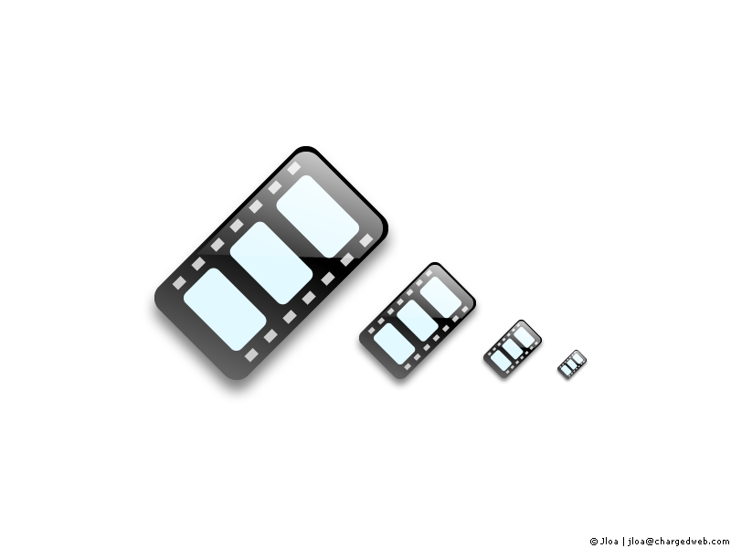
Media Server Layer Demo
Network Attached Storage
Router Station Pro
MIPS 24Kc
NFS
uPnP
Audio Renderer
Content Directory
Video Renderer
Beagleboard
OMAP ARMv7
Rygel (uPNP)
PPC 8513
E300
MediaTomb
SandyBridge
Atom e660
Rygel (uPNP) / Clutter
Control Point
Acer Netbook
Atom N270
Rygel / Sato
Yocto running on 4 architectures
Streams audio & video from NAS over uPnP
Runs Yocto 1.0 with the Demo Layer out of the box

Slide 19
conf/layer.conf
# Default to first disk/first partition on the Router Station Pro
RSP_ROOT ?= "sda1"
#RSP_ROOT ?= "sda2"
# We have a conf and classes directory, add to BBPATH
BBPATH := "${BBPATH}:${LAYERDIR}"
# We have an images and various recipe-* directories, add to BBFILES
BBFILES := "${BBFILES} ${LAYERDIR}/images/*.bb ${LAYERDIR}/images/*.bbappend ${LAYERDIR}/recipes-*/*/*.bb ${LAYERDIR}/recipes-*/*/*.bbappend"
BBFILE_COLLECTIONS += "demo"
BBFILE_PATTERN_demo := "^${LAYERDIR}/"
BBFILE_PRIORITY_demo = "6"
# Setup the audio mixer for the Beagleboard xM
MACHINE_EXTRA_RRECOMMENDS_append_beagleboard += " bbxm-audio"

Slide 20
Configure bblayers.conf
The build/conf/bblayers.conf needs to know where to find the new layer
# LCONF_VERSION is increased each time build/conf/bblayers.conf
# changes incompatibly
LCONF_VERSION = "4"
BBFILES ?= ""
BBLAYERS = " \
/yocto/poky/meta \
/yocto/elc/layers/bsp \ # BSP Layer
/yocto/elc/layers/demo \ # Demo Layer
"

Slide 21
DLNA Library – gupnp-dlna_0.5.0.bb
DESCRIPTION = "A utility library for various DLNA-related functionality useful for DLNA MediaServer implementations."
HOMEPAGE = "http://www.gupnp.org/"
LICENSE = "LGPLv2.1+"
LIC_FILES_CHKSUM = “ \
file://COPYING;md5=4fbd65380cdd255951079008b364516c \
file://libgupnp-dlna/gupnp-dlna-discoverer.c;endline=20;md5="
DEPENDS = "gupnp gstreamer gst-plugins-base"
PR = "r0"
SRC_URI = "http://gupnp.org/sites/all/files/sources/${PN}-${PV}.tar.gz"
SRC_URI[md5sum] = "c97ffbada5cb9f700d910995fab6ab46"
SRC_URI[md256sum] = “<sha256 sum>”
inherit autotools pkgconfig

Slide 22
MediaTomb - mediatomb_0.12.1.bb
DESCRIPTION = "MediaTomb - UPnP AV MediaServer for Linux"
HOMEPAGE = "http://mediatomb.cc/"
LICENSE = "GPLv2"
LIC_FILES_CHKSUM = "file://COPYING;md5=0b609ee7722218aa600220f779cb5035 \
file://src/main.cc;beginline=14;endline=25;md5=<md5sum>"
DEPENDS = "expat ffmpeg sqlite3 libexif js zlib file id3lib ffmpegthumbnailer curl”
PR = "r1"
SRC_URI = "${SOURCEFORGE_MIRROR}/mediatomb/mediatomb-${PV}.tar.gz \
file://youtube_warning.patch \
file://init \
file://default \
file://config.xml \
"
inherit autotools pkgconfig update-rc.d
INITSCRIPT_NAME = "mediatomb"
INITSCRIPT_PARAMS = "defaults 90"

Slide 23
MediaTomb (cont)
EXTRA_OECONF = "--disable-mysql –disable-rpl-malloc --enable-sqlite3 –enable-libjs \
--enable-libmagic --enable-id3lib --enable-libexif --enable-inotify \
--enable-db-autocreate --disable-largefile --with-sqlite3-h=${STAGING_INCDIR} \
--with-sqlite3-libs=${STAGING_LIBDIR} \
--with-magic-h=${STAGING_INCDIR} \
--with-magic-libs=${STAGING_LIBDIR} \
--with-exif-h=${STAGING_INCDIR} \
--with-exif-libs=${STAGING_LIBDIR} \
--with-zlib-h=${STAGING_INCDIR} \
--with-zlib-libs=${STAGING_LIBDIR} \
--with-js-h=${STAGING_INCDIR}/js \
--with-js-libs=${STAGING_LIBDIR} \
--with-id3lib-h=${STAGING_INCDIR} \
--with-id3lib-libs=${STAGING_LIBDIR} \
--with-ffmpeg-h=${STAGING_INCDIR} \
--with-ffmpeg-libs=${STAGING_LIBDIR} \
--with-search=${STAGING_DIR_HOST}${prefix}/local \
ac_cv_header_sys_inotify_h=yes"
SRC_URI[md5sum] = "e927dd5dc52d3cfcebd8ca1af6f0d3c2"
SRC_URI[sha256sum] = "31163c34a7b9d1c9735181737cb31306f29f1f2a0335fb4f53ecccf8f6
2f11cd"

Slide 24
Creating an Image
IMAGE_INSTALL
  List tasks and packages to install to create image
IMAGE_FEATURES
  Used to further customize what's installed in the image
  Maps to additional tasks or packages
    -dev or -dbg packages
Tasks - arbitrary groups of software, useful when creating several similar images. i.e.
  A companies proprietary/value-add software
  All software from a project
    Graphics / UI
    Standards

Slide 25
Task Example – task-poky-nfs.bb
DESCRIPTION = "NFS tasks for Poky"
LICENSE = "MIT"
LIC_FILES_CHKSUM = "file://${POKYBASE}/LICENSE;md5=<md5sum> \
file://${POKYBASE}/meta/COPYING.MIT;md5=<md5sum>"
PR = "r0"
PACKAGES = "\
task-poky-nfs-server \
task-poky-nfs-server-dbg \
task-poky-nfs-server-dev \
"
ALLOW_EMPTY = "1"
RDEPENDS_task-poky-nfs-server = "\
nfs-utils \
"
# rpcinfo can be useful but only with glibc images
GLIBC_DEPENDENCIES = "glibc-utils"
RRECOMMENDS_task-poky-nfs-server_append_linux = "${GLIBC_DEPENDENCIES}"
RRECOMMENDS_task-poky-nfs-server_append_linux-gnueabi = "${GLIBC_DEPENDENCIES}"

Slide 26
MediaTomb Image - poky-image-mediatomb.bb
#
# Copyright (C) 2010 Intel Corporation.
#
require recipes-core/images/poky-image-minimal.bb
SRC_URI = "file://interfaces"
IMAGE_INSTALL += "dropbear mediatomb task-poky-nfs-server"
LICENSE = "MIT"
ROOTFS_POSTPROCESS_COMMAND += "setup_target_image ; "
# Manual workaround for lack of auto eth0 (see bug #875)
setup_target_image() {
install -m 0644 ${WORKDIR}/interfaces ${IMAGE_ROOTFS}/etc/network/interfaces
}

Slide 27
poky-image-mediatomb-live.bb
DESCRIPTION = "Bootable Live Media Renderer Image"
require recipes-core/images/poky-image-live.inc
LABELS += "boot install"
ROOTFS = "${DEPLOY_DIR_IMAGE}/poky-image-mediatomb-${MACHINE}.ext3"
LICENSE = "MIT"
do_bootimg[depends] += "poky-image-mediatomb:do_rootfs"

Slide 28
Layers Summary
3 image recipes built for any architecture
All share same set of recipes, just compiled for the target
Created Layer which contains
  Recipes
  Tasks
  Images

Slide 29
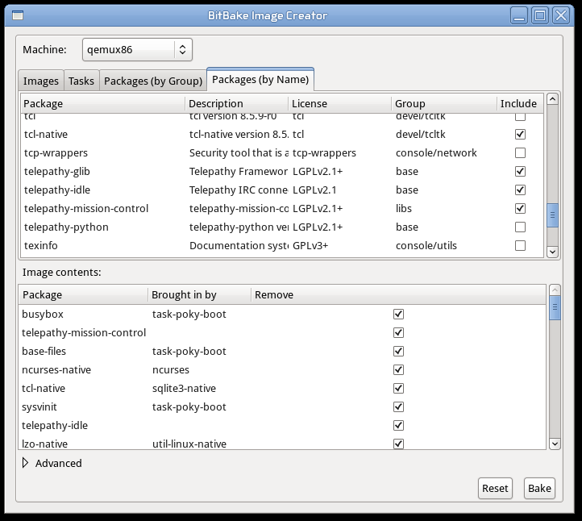
An Image Creator GUI

Slide 30
What does it do?
Select and review software to include in an image
Change some configuration options without having to edit conf files
  MACHINE
  Disable GPLv3 recipes
Future
  Policy management (distributions, licenses, package format)
  Layer management
  Build cross-compiler toolchains and development images
  Save/load customized configurations

Slide 31
Q & A

Slide 32
Resources
http://www.yoctoproject.org
http://wiki.yoctoproject.org

Slide 33
Legal Information
INFORMATION IN THIS DOCUMENT IS PROVIDED IN CONNECTION WITH INTEL® PRODUCTS. EXCEPT AS PROVIDED IN INTEL'S TERMS AND CONDITIONS OF SALE FOR SUCH PRODUCTS, INTEL ASSUMES NO LIABILITY WHATSOEVER, AND INTEL DISCLAIMS ANY EXPRESS OR IMPLIED WARRANTY RELATING TO SALE AND/OR USE OF INTEL PRODUCTS, INCLUDING LIABILITY OR WARRANTIES RELATING TO FITNESS FOR A PARTICULAR PURPOSE, MERCHANTABILITY, OR INFRINGEMENT OF ANY PATENT, COPYRIGHT, OR OTHER INTELLECTUAL PROPERTY RIGHT.
Intel may make changes to specifications, product descriptions, and plans at any time, without notice.
All dates provided are subject to change without notice.
Intel is a trademark of Intel Corporation in the U.S. and other countries.
*Other names and brands may be claimed as the property of others.
Copyright © 2009, Intel Corporation. All rights are protected.

Slide 34


