Slide 1
Zero-Copy TCP/IP
Nikos Kontorinis
Dustin McIntire
EE201A Spring 2003

Slide 2
Zero-Copy TCP/IP Overview
Part I: Optimizing TCP/IP software performance
  Eliminate data copy functions in TCP/IP software stack
Part II: Creating TCP hardware
  When software optimization is not enough

Slide 3
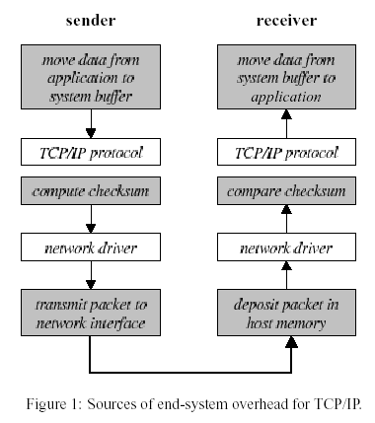
Where do copies occur?

Slide 4
Why copy is “needed”?
Application->OS buffers
  Sender: protect from modification before sending
  Receiver: arbitrary virtual addresses specified by the application
OS->Network interface
  Sender: Many NICs support simple DMA (data alignment required)
  Receiver: Fragmentation may “hide” recipient until packet is reassembled

Slide 5
To eliminate copies…
Main idea: Pass data by reference all the way down through the protocol stack
We need:
  Advanced Network devices: scatter/gather DMA
  Modification of OS kernel

Slide 6
The role of Network devices
Scatter/gather DMA : Send packets from a list of memory references
Allow header to be constructed separately from packet payload
Receiver: Too complicated, but we don’t care! (server implementation)

Slide 7
Page remapping
Packet data in linked chains of buffers (external mbufs in FreeBSD)
      Note:In FreeBSD send/receive path based on variable-size kernel network buffers (mbufs)
Implementation: Change I/O read-write system call
      Sender:Create new External mbuff and pass it down the stack (headers attached separately)
      Receiver: New virtual translation for the data page frame
Avoid overwriting from application: “copy-on-write” flag

Slide 8
TCP/IP Hardware
Why specialized TCP/IP hardware?
    Speed, Power, Size
Two basic design applications
  High performance applications (Speed)
    Used in:
      Internet routers
      VoIP call centers
      Intelligent network interface cards (I-NIC)
  Embedded applications (Power,Size)
    Used in:
      Internet Appliances
      Embedded web servers
      PDA’s and web tablets

Slide 9
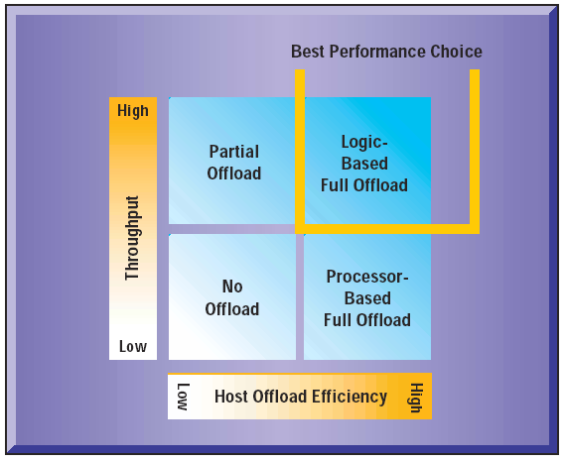
High Performance TCP/IP
Designed to maximize throughput by speeding up the common path protocol processing via dedicated TCP/IP hardware
Termed “Transport Offload” technology
Offload Terminology
Partial Offload: Involves offloading TCP/IP tasks that handle data movement from the host CPU. Also known as “data path offload”.
Full Offload: Involves offloading the entire TCP/IP stack from the host CPU. The network may run autonomously from the host CPU.
Source: iReady Offload Whitepaper

Slide 10
High Performance Implementations
  From the familiar design motivation…
Specification: Matlab, SPW, C++, Java
Floating Point
Fixed Point
Algorithm Transformations
Special
Purpose
Retargetable
Coprocessor
DSP
DSP extentions
for μP
ASIC
High performance TCP/IP Hardware

Slide 11
High Performance Implementations
Multiple architectural implementations
  Retargetable coprocessors (network processors)
    Usually contain 1 supervisor CPU + several general purpose programmable μEngines
    Examples:
      LevelOne (Intel) IXP1200 family
      SiByte (Broadcom) SB family
  Special purpose HW (dedicated IP routers, VoIP)
    Usually contain 1 supervisor CPU + dedicated function blocks (checksums, CAM, hash tables, DES, etc.)
    Examples:
      Agere NP family
      Navaro Networks (Cisco)
  Custom ASICs
    May have entire networking protocols in dedicated hardware. (IPv6, IPsec, iSCSI, etc.)
    Examples:
      iReady EthernetMAX

Slide 12
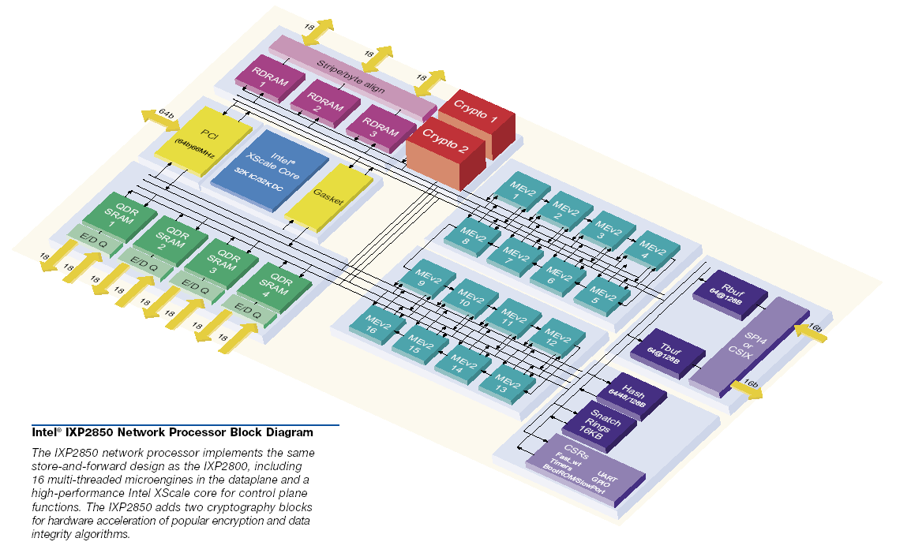
High Performance Example–IXP2850
Sixteen programmable μEngines
Dedicated crypto engines and hash table
Large number of data bus channels
Source: Intel IXP2850 Whitepaper

Slide 13
Embedded TCP/IP
Embedded TCP/IP hardware usually targeted for high volume, price sensitive applications.
The ‘internet toaster’ application
Embedded TCP/IP designs optimized for:
  low power
  low cost
  small size
  robustness

Slide 14
Embedded Implementations
  Again the design motivation…
Specification: Matlab, SPW, C++, Java
Floating Point
Fixed Point
Algorithm Transformations
Special
Purpose
Retargetable
Coprocessor
DSP
DSP extentions
for μP
ASIC
Embedded TCP/IP Hardware

Slide 15
Embedded Implementations
Two main architectural implementations
  Simple 8 bit or 16 bit microcontrollers
    Limited TCP functionality (no SACK or fragmentation support)
    Typically no operating system, just a single polling loop
    Examples:
      Zilog eZ80 “Internet Engine”
      UMass iPIC based on Microchip PIC
      University of Washington Hydra
  Custom ASIC hardware
    May be used in extremely high volume markets
    Limited programmability
    Examples:
      Seiko iChip S-7600 and S-7601A
      University of Oulu WebChip

Slide 16
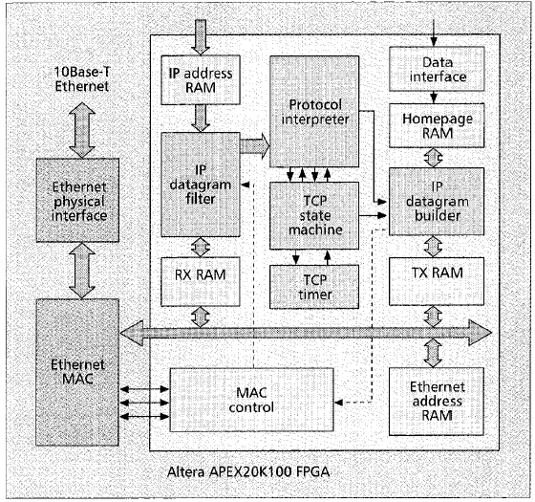
Embedded Example - WebChip
Designed as research project at University of Oulu in Finland
Implemented in an Altera APEX 20K100 FPGA (100K gates max.)
Total Logic size: 10K gates
Memory Size: 4KB for HTML homepage and HTTP header
Processing time per IP packet: 60μs @ 20Mhz gives 150Mb/s performance
May be extended in the future to include Ethernet MAC or PPP cores.
Source: Providing Network Connectivity for Small Appliances

Slide 17
Embedded Example - WebChip
WebChip components
  IPv6 Packet Filter
    Filters IP packets from promiscuous MAC devices
    No IPv6 extensions, fragmentation, or IPsec
  TCP Connection Handler
    Tracks current TCP connection status. (max 1 active)
    No congestion control (backoff), window management, or retransmissions
    Starts in LISTEN state waiting for request.
    Connections automatically closed after HTTP reply sent
    Errors force immediate reset of connection
  TCP Connection Timer
    Resets lost connections
  ICMPv6 protocol interpreter
    Responds to basic ICMP messaging requests
    Neighbor solicitation only (ARP message replies)
  HTTP memory
    Contains received HTTP header information of last packet
  HTTP protocol interpreter
    Processes HTTP packet data to build reply messages
    Requests and replies must fit in a single minimum sized segment
  HTML home page memory
    Contains the data sent by HTTP replies

Slide 18
References
“Evaluation of a Zero-Copy Protocol Implementation” by Karl-Andre Skevic, Thomas Plagemann, and Vera Goebel, IEEE, 2001
“End-System Optimizations for High-Speed TCP” by Jeff Chase, Andrew Gallatin, and Ken Yocum, IEEE, 2000
Intel Server Adapters http://developer.intel.com
ConnectOne http://www.connectone.com
iReady http://www.iready.com
“Internet toasters as a Capstone Design Project” by Bill Lovegrove, Don Congdon and Stephen Schuab, IEEE Frontiers in Education, Oct. 2000.
UW Hydra http://portolano.cs.washington.edu/projects/hydra/
Seiko USA http://www.seiko-usa-ecd.com/intcir/products/rtc_assp/s7600a.html
“The eZ80 Webserver” by James Antonakos, Circuit Cellar Magazine, Jan. 2002
“Providing Network Connectivity for Small Appliances: A Functionally Minimized Embedded Web Server” by Janne Riihijärvi and Petry Mähönen, IEEE Communications, Oct. 2001, pp 74-79.

