Slide 1
  Extending Wireshark For A New Protocol
  Varun NotiBala
  CISC 856 – University of Delaware
  2nd Dec 2008
  Acknowledgements
  Dr. Paul Amer

Slide 2
Agenda
Wireshark Introduction
Extending Wireshark Code
Homework Explanation
Hands on with Wireshark

Slide 3
What is Wireshark ?
Network packet/protocol analyzer
Captures network packets (Link Layer PDUs)‏
Displays PDU infomration as detailed as possible.
One of the best open source packet analyzer available today for UNIX and Windows.

Slide 4
Why use wireshark ?
Troubleshoot network problems
  Network administrators
Debug protocol implementations
  Protocol developers
Learn network protocol internals
  ?

Slide 5
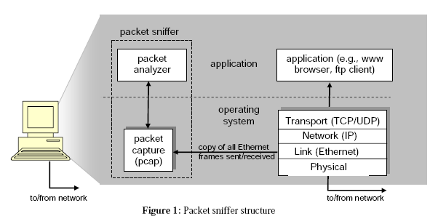
Packet Analyzer
Is Wireshark a Packet Analyzer or Packet Capturer
Wireshark
Windows
Linux
libpcap
Winpcap

Slide 6
Extend Wireshark
Goal
  Extend Wireshark to decode an application FOO
Steps
  Understand FOO
  Understand Wireshark's architecture
  Follow step by step guide to write code for Wireshark plugin

Slide 7
FOO Protocol
FOO A-PDU
UDP T-SAP = 25000
UDP PDU
IP PDU
ETHERNET PDU
Physical Layer

Slide 8
FOO PDU
1 Byte
1 Byte
2 Bytes
4 Bytes
PDU Type
Flags
Sequence Number
Source IP Address
PDU Type - 8 Bits (unsigned int)‏
  1 – Connection Initiate
  2 – Connection Terminate
  3 – Data
Flags – 8 Bits
  1 – Start Data Packet
  2 – End Data Packet
  4 – Priority Data Packet
Sequence Number – 16 Bits (unsigned int)‏
Source IP Address – 32 Bits (unsigned int)‏

Slide 9
Wireshark Architecture
1) Decode a specific protocol PDU
2) Hand off decoding to subsequent
dissector for encapsulated PDUs
3) Display protocol PDU details in
Wireshark User Interface
Wireshark
libwireshark
Display filters
Dissectors (Plugin / Built-in)‏
libwiretap
dumpcap
libwiretap
WinPcap / libpcap
Ethernet PDUs
Capture file

Slide 10
Dissector – Plugin vs Built-in
Plugin dissector
  Decodes protocols that are newly added, Example – FOO
  Faster rebuilds and bug correction. (Due to stand alone libraries generated for each plugin dissector)‏
  Location : <wireshark home directory>/plugins/
Built-in dissector
  Decodes well known protocols that are in existence for some time.
    Examples – TCP, UDP, HTTP, GNUTELLA
  Any change to built-in dissector needs a rebuild of the entire libwireshark package.

Slide 11
Steps To Incorporate A New Plugin Dissector In Wireshark

Slide 12
Step 1 : Install Prerequisites
Prerequisites – Latest linux installation
  My setup - Linux 2.6.24-21-generic #1 SMP Tue Oct 21 23:43:45 UTC 2008 i686 GNU/Linux (UBUNTU 8.01)‏
Compilers – gcc
Libraries – Libpcap, glib, GTK+
Support Tools – Python, Perl

Slide 13
Step 2 : Download Source Code
Download wireshark-1.0.4.tar.gz from the
  http://www.sourceforge.net
  http://sourceforge.net/project/showfiles.php?group_id=255
Untar => tar -xvf wireshark-1.0.4.tar.gz

Slide 14
Step 3 : Understand Source Code
root (wireshark-1.0.4) – common code and command line applications
doc – readme and man pages
Epan – Ethereal Packet ANalyzer
  /epan/dissectors – built-in dissector
plugins – plugin dissectors
gtk – User interface
Wiretap - used to read/write capture files

Slide 15
Step 4 : Create A New Plugin For FOO
Create new folder under plugins directory
  mkdir <wiresharkroot>/plugins/foo
Copy below files from an existing plugin folder : /plugins/agentx to the new plugin folder : foo
  moduleinfo.h – Version information header
  Makefile.common - Contains file names of plugin
  Makefile.am - Linux make file template
  plugin.c

Slide 16
Step 4 : Create A New Plugin For FOO
Create a source file for the new plugin dissector
  <wiresharkroot>/plugins/foo/packet-foo.c
Copy boiler plate code containing common include and #defines taken from packet-agentx.c (existing plugin)‏
Modify Makefile.am and Makefile.common for FOO plugin.
  This involves adding packet-foo.c to the make file and updating some variables

Slide 17
Add Plugin Code To packet-foo.c

Slide 18
Step 5 : Protocol Registration
Active ”member” of current step
Protocol Registration Routine
static int proto_foo = -1;
void proto_register_foo(void)‏
{
if (proto_foo == -1) {
proto_foo = proto_register_protocol (
"FOO Protocol", /* name */
"FOO", /* short name */
"foo" /* abbrev */ );
}
}
Result of previous step used in current step
Integer handle to FOO protocol in the current instance of wireshark

Slide 19
Step 6 : Dissection Handoff and T-SAP Registration
Register FOO protocols T-SAP with wireshark
void proto_reg_handoff_foo(void)‏
{
static gboolean initialized = FALSE;
if (!initialized) {
foo_handle = create_dissector_handle(dissect_foo, proto_foo);
dissector_add("udp.port", global_foo_port , foo_handle);
initialized = TRUE;
}
}
Dissector Function – Parses the raw bits to decode FOO PDU
?
25000

Slide 20
Step 7 : Protocol Dissection
Buffer contaning FOO PDU bytes (IN)‏
The tree structure contains details about how the tvb buffer is to be dissected
static void
dissect_foo(tvbuff_t *tvb, packet_info *pinfo, proto_tree *tree)‏
{
if (check_col(pinfo->cinfo, COL_PROTOCOL))
col_set_str(pinfo->cinfo, COL_PROTOCOL, "FOO");
/* Clear out stuff in the info column */
if (check_col(pinfo->cinfo,COL_INFO))‏
col_clear(pinfo->cinfo,COL_INFO);
}
Informational Data about FOO Protocol (IN / OUT)‏

Slide 21
Step 8 : Data Structure Registration
static gint ett_foo = -1; static int hf_varuns_pdu_type = -1;
static hf_register_info hf[ ] = {
{ &hf_foo_pdu_type,
{ "FOO PDU Type", "foo.type",
FT_UINT8, BASE_DEC,
NULL, 0x0,
NULL, HFILL }
}
};
/* Setup protocol subtree array */
static gint * ett[ ] = {
&ett_foo
};
  - hf_foo_pdu_type - Index
  - FOO PDU Type - Label
  - foo.type - Filter string
  - FT_UNIT8 – 8 bit unisgned int
  - BASE_DEC – Display as decimal
  - (VALS), (MASKS FOR BOOLEAN)‏
Node expansion in the tree is controlled by ett_foo

Slide 22
Step 8 : Data Structure Registration
Update Protocol Registration Routine (refer Step 5)‏
/* Register the protocol datastructures */
proto_register_field_array(proto_varuns, hf, array_length(hf));
proto_register_subtree_array( ett, array_length(ett));

Slide 23
Step 9 : Protocol Dissection Tree
proto_item *ti = NULL; // Pointer to root of tree that holds entire data
proto_tree *foo_tree = NULL; // Subtree FOO to be added to root
gint offset = 0; // OFFSET
ti = proto_tree_add_item(tree, proto_foo, tvb, 0, -1, FALSE); // Initialize root of tree
foo_tree = proto_item_add_subtree(ti, ett_foo); // Subtree FOO attaached to root
// Structural information (METADATA) added to FOO subtree
proto_tree_add_item(foo_tree, hf_foo_pdu_type, tvb, offset, 1, FALSE); offset += 1;
proto_tree_add_item(foo_tree, hf_foo_flags, tvb, offset, 1, FALSE); offset += 1;
proto_tree_add_item(foo_tree, hf_foo_sequenceno, tvb, offset, 2, FALSE); offset += 2;
proto_tree_add_item(foo_tree, hf_foo_initialip, tvb, offset, 4, FALSE); offset += 4;

Slide 24
Step 10 : Enhance Display
{ &hf_foo_pdu_type,
{ "FOO PDU Type", "foo.type",
FT_UINT8, BASE_DEC,
VALS(packettypenames), 0x0,
NULL, HFILL }
}
where packettypenames is
static const value_string packettypenames[] = {
{ 1, "Initialise" },
{ 2, "Terminate" },
{ 3, "Data" },
{ 0, NULL } };
Refresh memory : Step 8 Data-structure registration

Slide 25
Step 11 : Compile Plugin Code
In the FOO plugin directory (<wiresharkroot>/plugins/foo) execute ”make” and ”make install”
New plugin module needs to be added to make files in <wireshark>, <wiresharkroot>/plugins/ folder before first make

Slide 26
Summary Of Coding Steps
Protocol Registration
Dissection Handoff / TSAP Registration
Datastructure Registration
Protocol Dissection
Display Enhancement

Slide 27
Some useful resources
Wireshark Developer's Guide
http://www.cacetech.com/SHARKFEST.08/
Google :)‏

Slide 28
Questions ??
Thank You

Slide 29
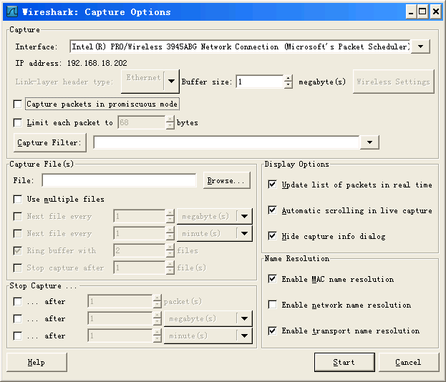
Promiscuous mode
This checkbox puts the interface in promiscuous mode when capturing, else Wireshark only captures packets going to or from your computer (not all packets on your LAN segment).

Slide 30
Additional slide
Core - Main "glue code" that holds the other blocks together. Source code can be found in the root directory.
Wiretap - The wiretap library is used to read/write capture files in libpcap and a lot of other file formats.
Win-/libpcap - Capture filter engine. That's the reason why we still have different display and capture filter syntax, as two different filtering engines are used.

Slide 31
Epan
Epan - Ethereal Packet ANalyzer the packet analyzing engine.
  Protocol-Tree - Keep data of the capture file protocol information
  Dissectors - The various protocol dissectors in epan / dissectors.
  Plugins - Some of the protocol dissectors are implemented as plugins. Source code can be found at plugins.
  Display-Filters - the display filter engine at epan/ dfilter.

Slide 32
Our new protocol - FOO
A packet type - 8 bits, possible values: 1 - initialisation, 2 - terminate, 3 - data.
A set of flags stored in 8 bits, 0x01 - start packet, 0x02 - end packet, 0x04 - priority packet.
A sequence number - 16 bits.
An IP address.

Slide 33
Packet analyzer vs Packet Capture module
Packet Sniffer = Packet Analyzer + Packet Capture module
Packet Capture module
  Receives a copy of every link-layer frame that is sent from or received by your computer
Packet Analyzer
  Displays the contents of all fields within a protocol message
  Understands the structure of all messages exchanged by protocols

Slide 34
Installation
Download and install the Wireshark binary
Download the Wireshark user guide
  http://www.wireshark.org/download.html

Slide 35
Other features
Filters can be setup to capture or display the packets of the desired patterns
Captured packets can be stored in disk for later re-loading and analyzing
Supported OS: Win32, Linux, FreeBSD, Solaris, Mac OS

Slide 36
Packet sniffer
Captures messages being sent/received
Store and/or display the contents of the various protocol fields in these captured messages.
A packet sniffer itself is passive.
Packets are never explicitly addressed to the packet sniffer.

Slide 37
Dissector
Decodes a specific protocol PDU.
Hands off decoding to subsequent dissectors for an encapsulated protocol.
Displays protocol PDU details in the wireshark user interface

Slide 38
Dissector - Plugin vs Built-in
Plugin dissector for FOO PDU
Dissectors can be built in or plugin
Built in dissector
  Modify packet-<protocolname>.c file in the epan/dissectors/ folder.
  Example - packet-gnutella.c
  Use epan/plugins/<example-dissector> as a template to create epan/plugins/foo dissector.
  Advantage - Smaller rebuild cycle.

Slide 39
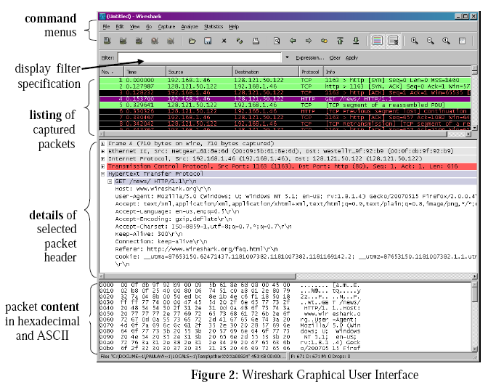
Wireshark User Interface

Slide 40
Datastructure registration
hf_foo_pdu_type - the index for this node.
FOO PDU Type - the label for this item.
foo.type - this is the filter string. It enables us to type constructs such as foo.type=1 into the filter box.
FT_UNIT8 - this specifies this item is an 8 bit unsigned integer. This tallies with our call above where we tell it to only look at one byte.
BASE_DEC - for an integer type, this tells it to be printed as a decimal number. It could be BASE_HEX or BASE_OCT if that made more sense.

