Slide 1
Linux Firewalls

Slide 2
Overview
Firewall Rulesets
  • A Rule defines how a firewall should process a
  packet and what the final action taken on that packet
  should be.
Potential Actions:
    Allow
    Block
    Filter
    Log
IBSS (ad hoc) mode
BSS (infrastructure) mode

Slide 3
TCP Header
+-+-+-+-+-+-+-+-+-+-+-+-+-+-+-+-+-+-+-+-+-+-+-+-+-+-+-+-+-+-+-+-+
|Version| IHL |Type of Service| Total Length |
+-+-+-+-+-+-+-+-+-+-+-+-+-+-+-+-+-+-+-+-+-+-+-+-+-+-+-+-+-+-+-+-+
| Identification |Flags| Fragment Offset |
+-+-+-+-+-+-+-+-+-+-+-+-+-+-+-+-+-+-+-+-+-+-+-+-+-+-+-+-+-+-+-+-+
| Time to Live | Protocol | Header Checksum |
+-+-+-+-+-+-+-+-+-+-+-+-+-+-+-+-+-+-+-+-+-+-+-+-+-+-+-+-+-+-+-+-+
| Source Address |
+-+-+-+-+-+-+-+-+-+-+-+-+-+-+-+-+-+-+-+-+-+-+-+-+-+-+-+-+-+-+-+-+
| Destination Address |
+-+-+-+-+-+-+-+-+-+-+-+-+-+-+-+-+-+-+-+-+-+-+-+-+-+-+-+-+-+-+-+-+
| Source Port | Destination Port |
+-+-+-+-+-+-+-+-+-+-+-+-+-+-+-+-+-+-+-+-+-+-+-+-+-+-+-+-+-+-+-+-+
| Sequence Number |
+-+-+-+-+-+-+-+-+-+-+-+-+-+-+-+-+-+-+-+-+-+-+-+-+-+-+-+-+-+-+-+-+
| Acknowledgment Number |
+-+-+-+-+-+-+-+-+-+-+-+-+-+-+-+-+-+-+-+-+-+-+-+-+-+-+-+-+-+-+-+-+
| | Control | |

Slide 4
Available Firewalls
Commercial firewall devices( e.g. Cisco PIX, Watchguard)
Routers (ACL Lists)
Linux firewalls
Software packages (Zonealarm, Black Ice)

Slide 5
Linux firewalls
Ipfwadm: Linux kernel 2.0.34
Ipchains: Linux kernel 2.2.*
Iptables: Linux kernel 2.4.*

Slide 6
Ipchains
A chain is a set of rules
Three default chains
  INPUT
  FORWARD
  OUTPUT
Chains allow coherent sets of rules to be grouped and
shared. For example the rules for a FTP service could be
grouped into a chain and then used on several different
firewalls to apply the same policy to each.
  Rules can be added, inserted, deleted etc. in a chain
Every packet has to pass through each chain before let in (if default policy for each chain is ACCEPT)

Slide 7
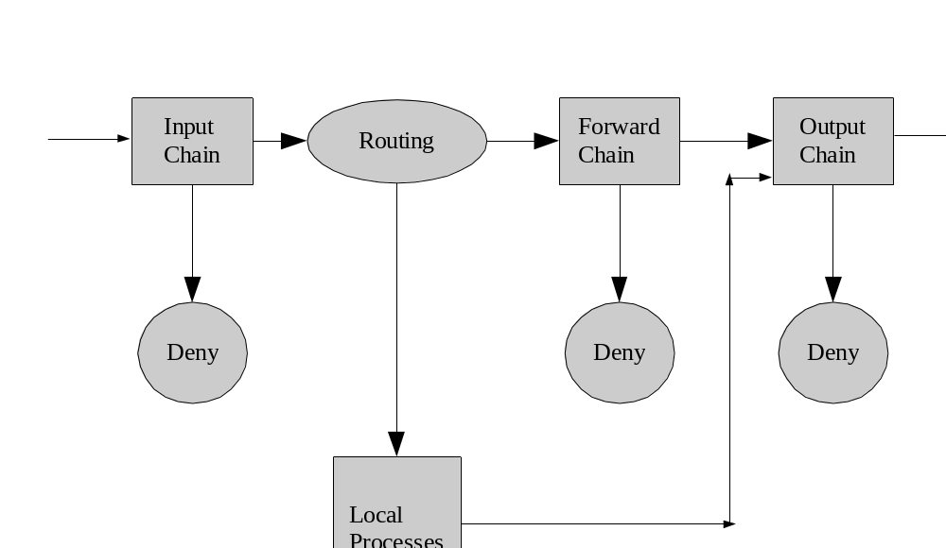
IP Chains packet traversal

Slide 8
How packets traverse the filters
When a packet reaches a circle, that chain determines the fate of the packet
  The chain can say to DROP the packet or ACCEPT it.
  If no rules match in chain, the default policy is used (usually to DROP)

Slide 9
Iptables
Improved version of Ipchains
Collection of chains is a Table
  Filter table – we normally deal with this one
  Nat table – handles packet transformations for Network Address Translation
  Mangle table – handles changes to TOS fields and marking packets for Inter processing
  Or we can create our own table too

Slide 10
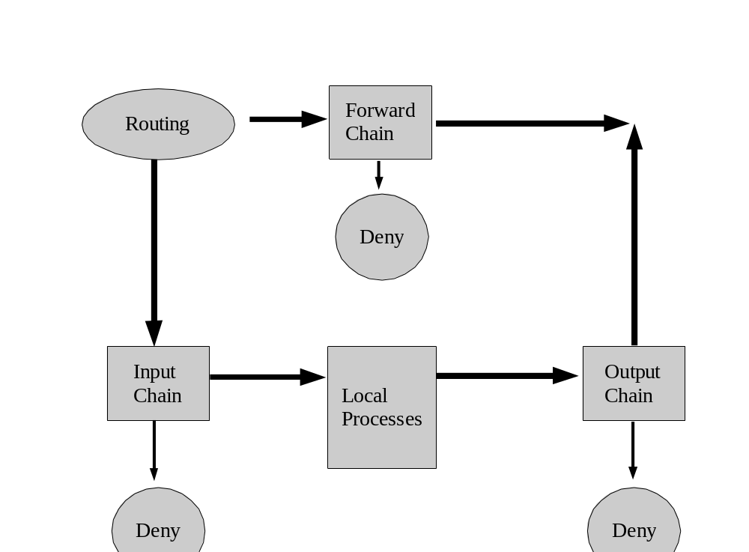
IP Tables packet traversal

Slide 11
Iptables setup and loading
Each Linux Distribution takes a slightly different approach on managing firewall
In RedHat-based Linux all the rules are stored in the
file
  /etc/sysconfig/iptables
You can turn on the firewall by running as root:
  /sbin/service iptables on
To save or load the currently running set of rules you
do:
  /sbin/service iptables save
  /sbin/service iptables load

Slide 12
Iptables syntax and features
Supports many protocols including TCP/IP
Iptables commands
  Add (-A), delete (-D), replace (-R), insert (-I) rules.
  Create new chains (-N), delete chains (-X) and attach chains (-j).
  Set a default policy for a chain (-P)
  Load protocol specific modules (-m <proto>).

Slide 13
Iptables policy and chains
Flush any existing rules out of a chain. This clears the set
so new rules are the only ones in it.
– iptables -F INPUT
– iptables -F OUTPUT
– iptables -F FORWARD
• Set default policy on the INPUT chain to DROP. -P sets the default action of the specified chain.
– iptables -P INPUT DROP
• Set policy for any packets from loopback interface.
– iptables -A INPUT -i lo -j ACCEPT

Slide 14
Continued…
• Action to take if a match occurs is set by -j. It stands for “jump” meaning that if a packet matches the rules then processing will jump to what follows. The options after –j are:
– ACCEPT: Allow the transmission of the packet
– DROP: Drop the packet
– QUEUE: Pass the packet to a program for processing
– RETURN: Returns the packet to the end of rule chain
– OTHERCHAIN: Follow OTHERCHAIN rules

Slide 15
View status of rules
You can see the list of rules currently applied on the system by typing:
  iptables –L
  For more details use –v (for verbose)
Packet counts attached to rules can be zeroed to reset the coutners:
  Iptables –Z >chainname>

Slide 16
Creating your own rules
Adding/Deleting rules:
– Append a new rule to an existing chain:
iptables –A <chain>
iptables -A PREROUTING -t nat -p tcp -d 1.2.3.4 -- dport 80 -j DNAT --to 192.168.1.1:80
– Deleting a rule from an existing chain:
iptables –D <chain> <rule info>
iptables -D INPUT --dport 80 -j DROP, iptables -D INPUT 1
• Changing chains:
– Creating a new chain:
iptables –N <name>
iptables –N PERMISSION

Slide 17
Combining match conditions
Match conditions are ‘and’ed by default
Network masks allow single rules to match large number of sources/destinations
  Avoiding need for multiple rules
Negation can be used
  Invert any rule using the ‘!’
  E.g. iptables –A INPUT –p !tcp

Slide 18
State matching
Recall “stateless” and “stateful” firewalls
  Is Windows firewall stateful?
Different states can be checked on packets
Iptables allows to check:
  NEW: A packet that creates a new connectoin
  ESTABLISHED: A packet belonging to an existing connection (reply or outgoing packet).
  RELATED: A packet that is related to, but not part of an existing connection (ICMP error).
  INVALID: A packet that could not be identified.

Slide 19
Defending against ping flooding and logging
Ping flooding defense
  iptables –A INPUT –p icmp –-icmp-type echo-request –m limit –-limit 1/s –-limit-burst 5 –j ACCEPT
Logging:
  E.g. logging pings
  iptables =A INPUT –p icmp –m icmp –icmp-type 0 –j -LOG

Slide 20
References
Most of this slide material from
  Jonathan Stanton, George Washington University, Dept of Computer Science, CS 192/286, Spring 2006.
  http://www.ensl.cs.gwu.edu/cs-netsec/CS-NetSec?action=AttachFile&do=get&target=lecture8.pdf
Some slides from
  Blair hicks, unixquest.com
  www.uniforum.chi.il.us/slides/iptables_talk2/iptables_talk2.ppt
Anti-hacker tool kit, 3rd edition, 2006.

