Slide 1

Android Internals
Mark Veltzer
CTO, Hinbit
mark.veltzer@gmail.com

Slide 2
Who am I?
CTO of Hinbit which is a service company for open source platforms.
We move people from legacy (Windows, big UNIX) to future (Linux) platforms.
I do kernel coding, driver development, real time design and more.
I teach lots of languages and technologies.
Free source (as opposed to open source) evangelist.
http://veltzer.net, mailto:mark.veltzer@gmail.com

Slide 3
Introduction

Slide 4
We will cover:
Android overview
Smart phones
Android versions
Which version should I develop to?
What makes Android special?
Google Android strategy
Android features
Examples of Android applications

Slide 5
Android Overview
Mobile OS, with middle ware and key applications based on Linux kernel and open source stack.
Initially developed by Android INC, which was acquired by Google in 2005, and later by the Open handset alliance.
Android lets developers to write code in the Java programming language, controlling the mobile device.
Most of the Android code was released by Google under the Apache 2 license.

Slide 6
Smart phones
There is no industry definition regarding what a smart phone is.
The best one is “miniature computer which can also be used as a phone”.
Once a phone is used as a computer security becomes a big concern.
Once a phone is used as a computer reliability and OS level protection becomes a big concern (embedded kernels are no longer an option).

Slide 7
Applications, applications
The key to smart phones are the applications.
Much like Bill Gates in the 90's success is creating a new ecosystem around building applications to the device.
Backwards compatibility becomes a major issue if the ecosystem is to thrive.
The higher the programming language, the easier it is to maintain backwards compatibility.

Slide 8
Other smart phones in the industry
Nokia - Symbian
Research In Motion – BlackBerry
Apple – IPhone
Microsoft/Nokia – Windows Mobile
Other Linux based Operating Systems.
All are protected operating systems

Slide 9
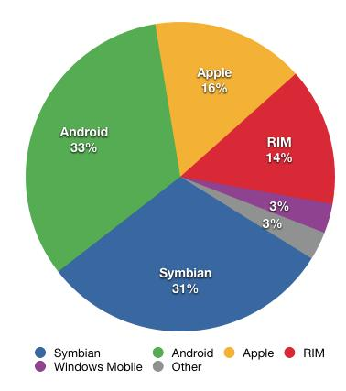
Sales – Q4 2010

Slide 10
Android versions
1.5, Cupcake, Apr 2009, API level 3
1.6, Donut, Sep 2009, API level 4
2.0/2.1, Eclair, Jan 2010, API level 7
2.2, Froyo, May 2010, API level 8
2.3, Gingerbread, Dec 2010, API level 9
3.0, Honeycomb, Feb 2011, API level 11
3.1, Honeycomb, Mar 2011, API level 12
3.2, Honeycomb, Apr 2011, API level 13

Slide 11
Version 1.5 - Highlights
User Interface Refinements
  System-wide:
    Refinement of all core UI elements
    Animated window transitions (off by default)
    Accelerometer-based application rotation
  UI polish for:
    In-call experience, Contacts, Call log, Favorites, SMS & MMS, Browser, Gmail, Calendar, Email, Camera & Gallery, Application management

Slide 12
Version 1.5 - Highlights
Performance improvements
  Faster camera start-up and image capture
  Much faster acquisition of GPS location
  Smoother page scrolling in Browser
  Speedier Gmail conversation list scrolling
New Features
  On-screen soft keyboard, Home screen (Widgets, Live folders), Camera & Gallery, Blue tooth, Browser, Contacts, System, Google applications.

Slide 13
Version 1.5 - Highlights
New APIs and Manifest Elements:
  UI framework
  AppWidget framework
  Media framework
  Input Method framework
  Application-defined hardware requirements
  Speech recognition framework
  Miscellaneous API additions
Platform Highlights: http://developer.android.com/sdk/android-1.5-highlights.html

Slide 14
Version 1.6 - Highlights
New User Features:
  Quick Search Box for Android
  Camera, Camcorder and Gallery
  VPN, 802.1x, allows users to configure and connect to:
    L2TP/IPSEC pre-shared key based VPN
    L2TP/IPSEC certificate based VPN
    L2TP only VPN
    PPTP only VPN
  Battery usage indicator
  Accessibility

Slide 15
Version 1.6 - Highlights
Android Market Updates
  Improved overall user experience.
  Makes it easier for users to discover apps & games from developers:
    At the home-screen, users can choose among Apps, Games and Downloads.
    Inside a category, users can explore titles that are top paid, top free and just in.
    For each title, users can see screenshots submitted by developers in addition to reviews by other users.

Slide 16
Version 1.6 - Highlights
New Platform Technologies:
  Expanded Search Framework
  Text-to-speech engine
  Gestures
  Accessibility
  Expanded support for screen densities and resolutions
  Telephony support for CDMA
  New version of OpenCore
  2.6.29 Linux kernel
  New Framework APIs
Platform Highlights: http://developer.android.com/sdk/android-1.6-highlights.html

Slide 17
Version 2.0/2.1 - Highlights
New User Features:
  Contacts and accounts
  Email
  Messaging
  Camera
  Android virtual keyboard
  Browser
  Calendar

Slide 18
Version 2.0/2.1 - Highlights
New Platform Technologies:
  Media Framework
  Bluetooth
  New Framework APIs
Platform Highlights: http://developer.android.com/sdk/android-2.0-highlights.html

Slide 19
Version 2.2 - Highlights
New User Features:
  Home Screen Improved (tips widget, browser+phone shortcuts)
  Exchange Support
  Camera Application Improved
  Portable Wi-Fi hot spot
  Improved Performance

Slide 20
Version 2.2 - Highlights
New Platform Technologies:
  Media Framework
  Bluetooth, voice dialing and contact sharing
  2.6.32 kernel upgrade
Platform Highlights: http://developer.android.com/sdk/android-2.2-highlights.html

Slide 21
Version 2.3 - Highlights
New User Features:
  Home Screen Improved (black notification bar)
  Improved soft keyboard
  Copy and Paste support
  Improved power management
  Multiple cameras support
  Near Field Communication support
  Downloads management

Slide 22
Version 2.3 - Highlights
New Platform Technologies:
  SIP Stack
  New audio/video support (+sound effects)
  Support for extra large screen
  New sensors support
  Concurrent garbage collector
  2.6.35 kernel upgrade
Platform Highlight: http://developer.android.com/sdk/android-2.3-highlights.html

Slide 23
Version 3.0 - Highlights
New User Features:
  UI designed from the ground up for tablets
  System bar for global status and notification
  Action Bar for application control
  Customizable Home screens
  Recent Apps, for easy visual multitasking
  Redesigned keyboard
  Improved text selection, copy and paste
  New connectivity options
  Updated set of standard apps

Slide 24
Version 3.0 - Highlights
New Developer Features:
  New UI Framework for creating tablet apps
  Activity fragments
  Resigned UI widgets
  Expanded Home Screen widgets
  Persistent Action Bar
  Richer notification
  Multi select, clipboard and Drag-and-drop.
  New animation framework
  Hardware accelerated 2D graphics
  Renderscript 3D graphics engine
  Support for multicore processor architectures
  Enterprise features
  Pluggable DRM framework
  Digital media file transfer
  Bluetooth connectivity improvements
Platform Highlights: http://developer.android.com/sdk/android-3.0-highlights.html

Slide 25
Version 3.1 - Highlights
New User Features:
  UI refinements
  Connectivity for USB accessories
  Expanded Recent Apps list
  Resizeble Home Screen widgets
  Support for external keyboards and pointing devices
  Support for joysticks and gamepads
  Robust wi-fi networking
  Updated set of standard apps

Slide 26
Version 3.1 - Highlights
New Developer Features:
  Open Accessory API
  USB Host API
  Input from mice, joysticks and gamepads
  Resizable Home Screen widgets
  MTP API for external cameras
  RTP API for streaming audio
  Performance optimizations
Platform Highlights: http://developer.android.com/sdk/android-3.1-highlights.html

Slide 27
Version 3.2 - Highlights
New User Features:
  Optimization for a wider range of tablets
  Compatibility zoom for fixed-sized apps
  Media sync from SD card
New Developer Features:
  Extended API for managing screens
Platform Highlights: http://developer.android.com/sdk/android-3.2.html#highlights

Slide 28
Which version should I develop to? - distribution
A major factor in the decision is platform distribution amongst users.
This could be either at the present or projections about the future (when your project will be ready).
Statistics could be found at: http://developer.android.com/resources/dashboard/platform-versions.html
These statistics are collected by Google in “real time” and represent the market at any point in time. You can also see graphs of trends there.

Slide 29
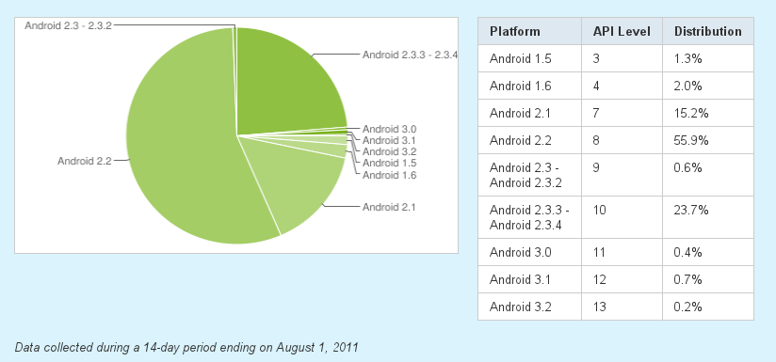
Which version should I develop to? - Snapshot

Slide 30
Which version should I develop to? - Application vendors
At the Java level the platforms are (mostly) backwards compatible for application developers.
Application developers would choose the lowest API level that can carry their application in order to reach the widest audience.
Testing on all platform should still be conducted but in practice, for standard applications, is sometimes skipped for some versions.
Still, newer versions carry new API and performance and hardware support that may be required by new applications.

Slide 31
Which version should I develop to? - native coders
NDK (user space C/C++ support) is also improving and expanding with each new version. New codecs are supported, new openGL features, new version of bionic (important for every native coder) and more.
New versions are much less backwards compatible for native code writers than for Java application writers.
This partly stems from the fact that C and C++ are worse at backwards compatibility.
Partly because the Android platform cares more about compatibility at the Java layer (which the majority of it's application coders need) and less about compatibility for native coders (who are a minority).
Native code writers may choose a version for other reasons. For instance: some C++ exception handling for user space was added in version 2.0.
Sometimes native coders would switch versions because some kernel feature is required and since changing kernel means changing Android version the native layer switches too.
You may be forced to use #ifdef or other tricks in your code to support multiple Android versions.

Slide 32
Which version should I develop to? - platform vendors
Platform vendors usually want latest since they want to deliver cutting edge features and outdo their competition.
Kernel version is very important for platform vendors since newer kernel versions utilize more hardware features at the platform level and carry more drivers.
Platform vendors are the most sensitive to Android version and must compile, test and QA each version.
Because kernel coding is the most sensitive to changes platform vendors may even have a fork of their kernel code per Android version.

Slide 33
What makes Android special?
Not tied to a specific hardware platform (this is a benefit of Linux and the Open Source stack) – well, sort of...
Open Source.
Can be modified by the platform vendors.
Development can be tracked by the platform vendors (well, until latest versions).
Lots of development power split over the industry.
Very high level of abstraction for applications.
Not owned by anyone which makes everyone less scared to jump aboard.

Slide 34
What makes Android special? (cont)
Allows root access (or at least does not block it).
Is not inherently protected by various DRM mechanisms (although vendors may choose to use DRM). This makes it much more user friendly.
Is a much more open platform in terms of application vending.
Is much more open in terms of end user usage (playing mp3 and using Android as USB storage, for example).
Vendors have access, are allowed, and sometimes must, change the OS kernel to adjust it to new devices, pieces of hardware and more.
Is based on Linux and therefore keeps advancing at rapid pace even if Google doesn't put a cent into kernel development.

Slide 35
What makes Android special? - The killer reasons
Threatens to unify the mobile market like no other operating system.
Threatens to drive costs of appliances down down down down like no other operating system.

Slide 36
Google Android strategy
Some of the services (like Google maps) are money makers for Google.
Browser is WebKit based which helps Google in the browser wars (chrome) which, in turn, help Google in the remote application (cloud) market which also helps Google in the operating system market (chrome OS)
Part of the idea is to benefit from the tension between application vendors and the platform makers
Control of popular image, audio and video codecs (along with you-tube and Picasa) which has patent and hardware income possibilities.

Slide 37
Android features
Application Framework
  Enabling reuse and component placement
Java VM Optimized for Mobile Devices (Dalvik)
Integrated Browser, Based on WebKit.
  Like Chrome and Safari
Graphic libraries
SQLite Database
Media support (audio, video, image files)
GSM Telephony
Bluetooth, EDGE, 3D, Wi-Fi
Camera, GPS, Compass, Accelerometer
IDE (Eclipse Based)

Slide 38
Examples of Android applications
Seesmic: twitter application better than twitters own version
Facebook for Android: obvious
Astro: File management. Really allows you to drag and drop files.
AppBrain: Allows to queue applications to be installed on your mobile device from your PC
Google sky map: point it at the sky and it will tell you what stars you are looking at and stats about them

Slide 39
Examples of Android applications (cont)
Foursquare: Twitter on a map.
Wordpress for Android: manage wordpress blogs from an Android device.
Google googles: show it a photo and it will try to tell you what you are looking at.
AppMonster: lets you manage your applications more easily and gives you one click backup of all your applications to your SD card.
Task Manager/Advanced Task Killer: let you monitor and kill tasks easily.

Slide 40
Examples of Android applications (cont)
Evernote: note, image, file or audio note taking application.
Google Maps Navigation: GPS navigation via Google maps.
Astrid Task/Todo list: GTD type apps
Skifta: turns your Android phone into an official DLNA device.
Dropbox: well, dropbox.
Meebo IM: instant messaging.

Slide 41
Examples of Android applications (cont)
Amazon Kindle: read your Amazon books on your Android phone or tablet.
RD Mute: shuts your phone up when you've turned it upside down (uses accelerometer).
EasyTether (paid): lets you use your phone as a 3G modem
Beautiful Widgets (paid): obvious
Vignette (paid): makes the photos you take look beautiful.

Slide 42
Android Framework

Slide 43
We will cover...
Overview of the Android framework
The Linux kernel at the heart of Android
The NDK – Native libraries
The NDK – tools
The NDK – Native applications
Overview of the Android runtime environment
The Dalvik VM (overview)
The Application framework
What is an Android application?

Slide 44
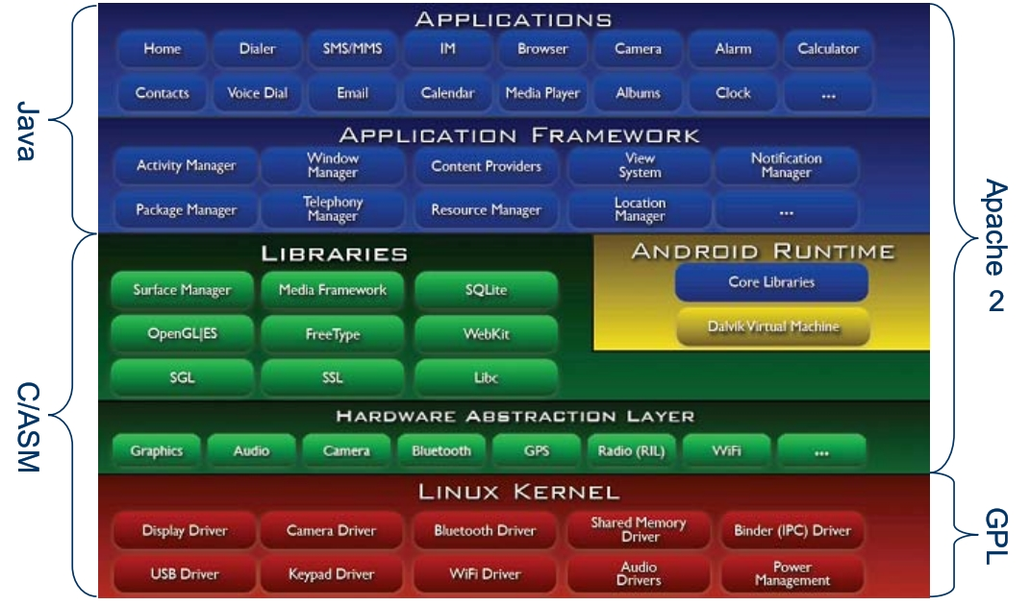
Android framework

Slide 45
Android Stack – Linux kernel
Based on the 2.6 (and now the 3.0) version.
Used for platform/hardware independence (Linux is a portable operating system)
Security.
Hardware abstraction (/dev).
Networking.
Memory management.
Process management.
Storage and file system.
Driver model.
Standard Android application vendors never access this layer directly.

Slide 46
A few notes about the Linux kernel...
The Linux kernel is not, contrary to public opinion, an operating system kernel.
It is the source code from which many many many different operating system kernels can be built, for many different hardware platforms and many different end uses...
The difference is huge.
Some kernels that come out from building a Linux kernel do not even qualify as UNIX systems! (Android is one, BTW!)
Demo of building the Linux kernel.

Slide 47
Android Stack – NDK – Native Libraries
Wraps the kernel API (this is needed since the kernel API is quite hard to deal with).
Exposes API to the java layer via JNI.
Written in C and C++.
Various abstractions in the form of open source libraries
Bionic: a super fast and small BSD libc library optimized for embedded use.
Surface Manager: for composing window manager with off-screen buffering
2D and 3D graphics using opengl/es: hardware support or software simulation.
SQLite database
Media codecs
webkit (fast HTML rendering engine)
FreeType, font and bitmap rendering.
Lots more

Slide 48
Android Stack – NDK – tools
The NDK also supplies you the toolchain that enables you to code native libraries and executables for the Android target platform.
These tools include gdbserver which enables you to remote debug an application running on a remote device/target.
These tools are accompanies by documentation ins the /docs folder.

Slide 49
Android Stack – NDK – Native applications
The NDK also include more infrastructure in the form of native applications (scripts, binaries) that run in real Android devices and supply core services on the platform.
Examples could be ueventd (that handles kernel->userspace events), adbd (that allows you to inspect and debug the platform), init (that initializes the system)

Slide 50
Android runtime
The heart is the Dalvik VM which runs the applications.
Lots of other natives services are also included like remote access, debugging, logging, event handling and more.
You can see all of these by using the adb shell and looking at the processes running on the android machine.

Slide 51
Dalvik
Google's implementation of a Java virtual machine.
Sun Java has a problematic license and quite on the heavy side.
One of the most innovative aspects of the Android platform.
Register based versus stack based.
Leaner byte code.
Runs .dex (Dalvik Executable) files instead of .jar files.
The .dex format was optimized for small memory footprint.

Slide 52
Dalvik - cont
The set of libraries of Dalvik is much more compact and targeted for embedded.
Implements the core of the Java programming language API (IO, Collections and more).
AWT/Swing is gone, new UI framework is in.
Requires another step to compile/translate Java bytecode to Dalvik bytecode.
Don't worry – Eclipse or some other IDE will do this step for you.
So Dalvik is not a Java compiler (that is too big a job )
This means you can use any Java compiler.

Slide 53
Dalvik - cont
Dalvik relies on the Linux Kernel for underlying functionality like threading and low-level memory management
Every Android application runs in it's own VM process and every application has it's own Dalvik VM instance. This ensure stability.
This does not consume much ram since all the Dalvik instances are “forks without exec” one of the other which means that in RAM Dalvik lives only once.

Slide 54
Application framework
Arguably, the most important part of Android.
Mostly Java API that make application development easy.
Many services – location manager, resource manager, window manager, Wi-Fi services, Notification manager for events, GSM and more
Applications consume these services and may provide their own.
Content providers encapsulate data fetching and provisioning between applications.
Some content providers are provided out of the box.
As a developer of an Android application you have access to the same services and the same content providers that the vendors of the platforms have.

Slide 55
Application framework - cont
Some of the more important components are:
  Activity Manager: manages the life cycle of applications and provides common application back-stack
  Notification Manager: enables all applications to display alerts in the status bar
  Resource Manager: provides access to non-code resources (strings, graphics, audio/video etc.)
  Content Providers: Enable applications to access data from other applications

Slide 56
Application Layer
Is where your Java based Android applications live
Contains many built-in applications:
  Email, phone, web-browser, calendar, contacts, home screen and more
The set of built-in application vendors can change not only between various Android versions but also between various Android platform vendors.

Slide 57
The Application framework and the application vendor code
If you write Android applications the application framework is both on top of you and below you.
This means that regular UI based Android applications are callback based which means that the framework is on top of you.
But when you want to do something you call some API which below you. This API will call some Java code, which will call some C code, which will call some kernel code, which will access the hardware.
You can run your own threads in an Android application using regular Java threading API and in your own threads you are “the boss” (topmost layer). But this can also lead to problems (how to terminate the thread gracefully, CPU over utilization) and is not advisable for regular applications.
In any case the platform protects itself from abuse in various ways: allows users to kill application that consume too many resources, lowmemorykiller and more.

Slide 58
An Android Application
Is an .apk file
An android market is thousands of apk files made by a multitude of Android app developers.
Usually generated automatically for you by development environments. Eclipse+ADT with put it usually in the bin folder of your project.
Comprised of 3 things:
  Dalvik exe (.dex) which are basically classes.
  Resources (strings, layout, icons, xml files, audio, video)
  Native libraries (optional)
It is actually a zip file and can be manipulated with zip tools.

Slide 59
The Android Java SDK

Slide 60
We will cover...
A note about Eclipse
Setting up the Environment.
Eclipse Plug-ins
SDK Tools hightlights

Slide 61
A note about Eclipse
Eclipse is not, contrary to public opinion, a development environment.
Eclipse is a scalable software delivery platform.
One of it's most common incarnations is a Java development environment.
Every time you are using Eclipse you are using hundreds of plug-ins made by dozens of organizations and integrated using the Eclipse framework.
That is also why Android uses Eclipse for development: Eclipse can be easily customized and most stuff that you need in a development environment are already in Eclipse.

Slide 62
Setting up the development environment - basics
If you are going to do NDK or lower level development also then I recommend Linux as the environment. But for regular Java applications windows will work just as well (well, at least as well as Microsoft defines the word “well”).
You'll need Eclipse versions 3.4, 3.5 or 3.6 (later is usually better)
Sun's JDK5 or JDK6.
  On Linux simply install the relevant packages, for instance on Ubuntu use:
  sudo apt-get install sun-java6-jdk
  On Windows download an installer, yes, yes, I agree, reboot, reboot again, and you're done (reboot just in case).
  You can also use openjdk but sun is preferred.

Slide 63
Setting up the development environment - ADT
ADT – Android Development Tools, a special eclipse plug-in
  To install ADT, just use the Eclipse plug-in installation facility and point it to:
  https://dl-ssl.google.com/android/eclipse
  If you have no Internet connection download the plug-in as a zip file and install it as an archive (in previous versions of eclipse it was better to just unzip it into the eclipse folder).

Slide 64
Setting up the development environment - SDK
Download the SDK from:
http://developer.android.com/sdk/index.html and install it.
The downloaded packages are per platform.
After installation of the SDK tools, run the SDK setup tool.
  Under windows “SDK Setup.exe”.
  Under Linux “$SDK/tools/android”.
When you first run it – it is empty.

Slide 65
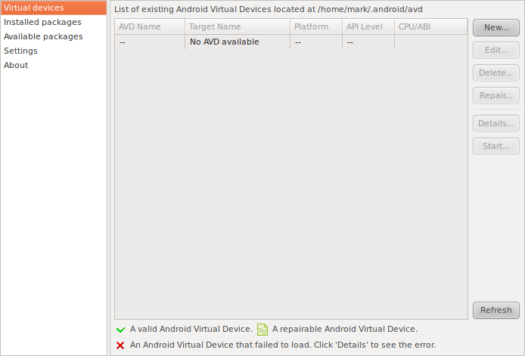
Setting up the development environment – SDK empty image

Slide 66
Setting up the development environment - SDK
Just select the Android repository and install support for the versions of the Android platforms that you need.
Go drink some coffee.
You can install as many “different emulated Android platforms” as you like. These are called AVD (Android Virtual Device).
After installing selected platforms you need to define some virtual devices.
Each virtual device is based on an Android platform + a few definitions.
After you have a virtual device just select it and click “start” to run it. You will get a phone. It takes some time. Be patient.
You also have to tell ADT where your SDK is at (some versions of ADT also require that you restart Eclipse after you do that...).

Slide 67
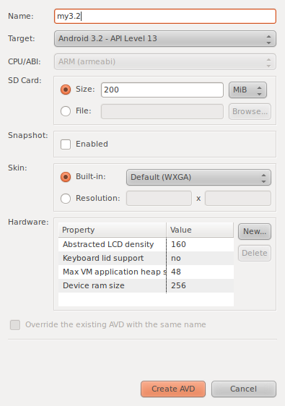
Setting up the development environment - SDK

Slide 68
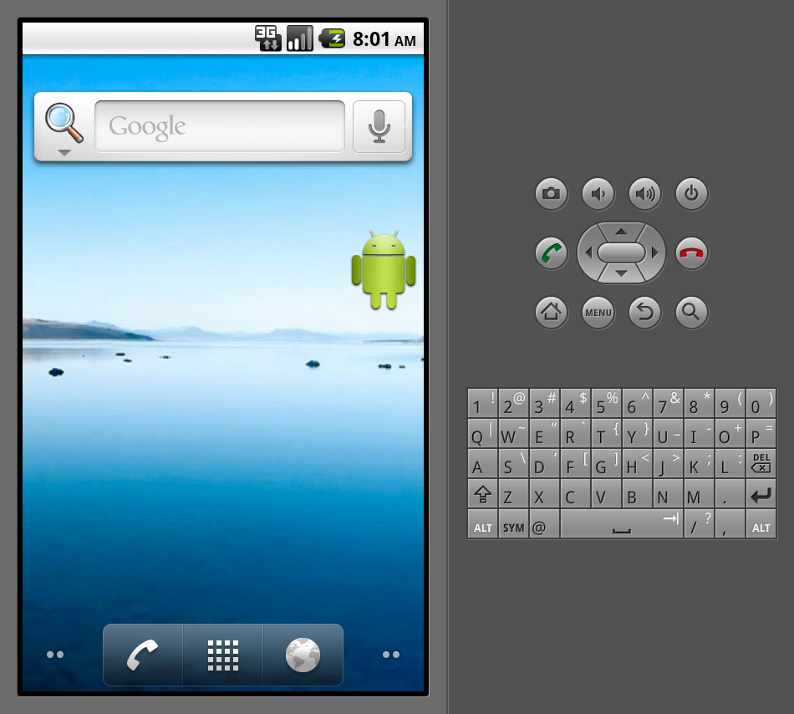
The emulator (first run)

Slide 69
The emulator
During your development you will test your work on an emulator.
  The emulator knows how to emulate the entire Android handset or device with or without additional features like GPS/PC connectivity and more.
The emulator knows how to emulate different versions of the Android platform.
Always test your application on several versions of the Android platform (different emulator setups).
Always test your application on real devices as well – this is especially true if your application is not a “pure data” application and has some integration with hardware or with other application (in the form of content providers for instance).

Slide 70
Deploying to a real device
In order to deploy, run and debug an application on a real device you'll want to connect to it. This is done via USB.
On the host you will need some USB configuration:
  On Windows you will need USB drivers from:
  http://developer.android.com/sdk/oem-usb.html
  On Linux you don't need drivers but you may need to tweak permissions of the USB device
  http://developer.android.com/guide/developing/device.html#setting-up
On the device/target you will need to:
  Allow debugging.
  Allow installing applications from “unknown sources”.

Slide 71
The ADT Eclipse Plug-in
ADT: Android Development Tools
It is a “meta” eclipse plug-in much like the JDT or CDT.
As of July 2011 it's version is 12.0.0.
Makes Eclipse a development environment for Android applications.
  Add a new “Android project” project type
  Adds an Android XML file editor and creator wizard
  Add a WYSIWYG UI design tool
  Has DDMS integration which allows you to Debug, profile and see the logs of your Android applications, both on the emulator or on a real device.

Slide 72
SDK tools
The Android SDK comes with a large set of tools
Most of them are at $ANDROID_SDK/tools/*
Emulator: emulates an Android device.
Hierarchy viewer: shows the layout hierarchy of a user interface in real time.
Draw 9-patch: drawing application for 9-patch images (images used in the Android UI).

Slide 73
SDK tools (cont)
mksdcard: creates an image to emulate sdcard in the emulator.
dx: generate Dalvik byte-code from Java byte-code.
aidl: Android Interface definition language tool used to create remote interfaces for Android application that want to provide new services on the Android platforms.
aapt: asset packaging tool used to create Android packages.
There are some more tools but the ones covered are the most important.

Slide 74
IDE
The main tool used to develop Android application is Eclipse.
With ADT Eclipse becomes a powerful environment.
ADT adds Android related perspectives, views and XML editors to Eclipse.
See the demo.

Slide 75
The Emulator
Part of the SDK. Resides in $ANDROID_SDK/tools and is called emulator.
The idea is for you to be able to run a full Android device without needing a physical one, as a process in your own operating system.
In order to launch it from the command line you have to give it an AVD (Android Virtual Device) name: ./tools/emulator my2.2. This requires you to prepare an AVD beforehand. You can also launch an image directly (for professionals).
Could also be launched and configured graphically from the android UI tool in $ANDROID_SDK/tools.
Usually there is no need to launch it directly since both Eclipse and the android command line tools give a graphical UI to launch it.
When it is launched directly it is either by experts during development or to do automatic testing.

Slide 76
The Emulator - technical
Supports many command line arguments, too many to cover here. Some of them are:
  Limiting resources (memory, network bandwidth)
  Cache configuration.
  Code profiling.
  Enable/Disable hardware (audio, gps).
  Configure hardware (screen resolution).
  Configure timezone.
  Debug and networking.
  Passing arguments to underlying qemu (it has tons of arguments too!)

Slide 77
The Emulator - technical
The emulator is built on top of qemu which is a platform emulator.
It emulates everything up to CPU core.
This means that after running the emulator you have a full android system.
That runs at the speed of an elderly turtle.
That is very far from real time performance.
And which lacks in hardware.

Slide 78
The Emulator - technical
The SDK provides two underlying CPU emulators: one for x86 and one for ARM.
They are called emulator-x86 and emulator-arm.
emulator is just a gateway to one of these and so is the UI (according to the selection of the AVD).
Qemu has support for other architectures (PowerPC, microblaze) but these are not supported by the SDK.
Its demo time again.

Slide 79
ADB: Android Debug Bridge
“versatile command line tool that lets you communicate with an emulator instance or connected Android-powered device”.
Is provided with the SDK at $ANDROID_SDK/platform-tools/adb.
adb funny in that it is both a client and a server on your host machine. When you first run it, it spawns the server part, so it has persistent state and keeps the connection with the targets.
On the target machine (or emulator) it has a server counterpart /sbin/adbd.
The adb command line actually talks via a TCP port (5037) to the adb server that was run the first time. The server talks to the clients in pairs of ports: one for console and one for adb.

Slide 80
ADB (cont)
adb devices – lists all devices you are monitoring.
Each device is listed by it's console port.
The adb server finds the devices auto magically by scanning ports 5555 to 5585 (the standard ports used by Android devices and emulators).
adb supports many command.
Direct a command to a specific target using: adb -s <serialNumber> <command>

Slide 81
ADB: capabilities
With adb you can:
  Drop into a shell (adb shell). This is a low capability shell but is enough to explore the file system and do basic debugging. You can also go into SQLite databases using the sqlite3 command.
  Issue one shell command.
  View device log.
  Install/uninstall applications (apk files) on the device.
  Get info from the device for bug reports.
  Wait until the device is on-line.
  Reboot the device.
  Start/stop/restart the adb daemon on the target.
  Copy files from/to the device.
  Much more.

Slide 82
ADB: uses
Common every-day debug, explore, code/run/debug cycles.
Writing testing scripts.
Automating development tasks.
Understanding the platform.
Low level debugging (/proc, /sys, …).
Viewing logs on the command line at host.
Demo time again.

Slide 83
DDMS
DDMS: Dalvik Debug Monitor Server.
“provides port-forwarding services, screen capture on the device, thread and heap information on the device, logcat, process, and radio state information, incoming call and SMS spoofing, location data spoofing, and more”
Is both integrated into Eclipse and a standalone application.
Is provided with the SDK at $ANDROID_SDK/tools/ddms
Preferences for ddms are saved to $HOME/.ddmsrc.
DDMS provides a File Explorer tab that allows you to view, copy, and delete files on the device.
The Threads tab in DDMS shows you the currently running threads for a selected process.
You can also see logcat (logs) from DDMS.

Slide 84
DDMS: finding memory leaks
First, what type of memory leaks does Java have?
Second, how do you find them?
In the Devices tab, select the process that you want to see the heap information for.
Click the Update Heap button to enable heap information for the process.
In the Heap tab, click Cause GC to invoke garbage collection, which enables the collection of heap data. When the operation completes, you will see a group of object types and the memory that has been allocated for each type.
Click on an object type in the list to see a bar graph that shows the number of objects allocated for a particular memory size in bytes.

Slide 85
DDMS: Heap view
In the Devices tab, select the process that you want to see the heap information for.
Click the Update Heap button to enable heap information for the process.
In the Heap tab, click Cause GC to invoke garbage collection, which enables the collection of heap data. When the operation completes, you will see a group of object types and the memory that has been allocated for each type.
Click on an object type in the list to see a bar graph that shows the number of objects allocated for a particular memory size in bytes.

Slide 86
DDMS: Case Study Methodology
In the Devices tab, select the process that you want to enable allocation tracking for.
In the Allocation Tracker tab, click the Start Tracking button to begin allocation tracking.
Click Get Allocations to see a list of objects that have been allocated since you clicked on the Start Tracking button.
To stop tracking or to clear the data and start over, click the Stop Tracking button.
Click on a specific row in the list to see more detailed information such as the method and line number of the code that allocated the object.

Slide 87
DDMS: Profiling
Warning: 1.5, 2.0/2.1 devices have issues with profiling – read the docs.
On the Devices tab, select the process that you want to enable method profiling for.
Click the Start Method Profiling button.
Interact with your application to start the methods that you want to profile.
Click the Stop Method Profiling button.
A Traceview UI is started which shows method run times (inclusive and exclusive).

Slide 88
DDMS: Misc
DDMS can also be used to:
  Change network state (on/off), speed and latency.
  Trigger a call or SMS.
  Change the location of the phone.
These are more rarely used by people who build applications that respond to such triggers or who are sensitive to location or networking state or latency.
Its demo time again.

Slide 89
The Android native layer - NDK

Slide 90
We will cover...
A word of warning...
A little bit of git.
Who should work with the NDK.
Toolchain issues.
The Android kernel and how to build it (+demo).
How to build a standalone module for the Android kernel (+demo).
How to build the entire Android platform (+demo, sort of).
How to build a native library or application will be explained in a later chapter.

Slide 91
A word of warning
Anything that can be done at the Java layer should be done at the Java layer.
This means that for 99% of Android application vendors the Java layer is the right choice.
So no NDK knowledge needed, no C, no C++, no kernel, no problems, no heartache, no weird bugs that crash your system once every two weeks and you don't know why.
Hardware devices in Android are exposed to the Java layer with carefully thought of API that provide utilization of the hardware but keep it running efficiently. This means that accessing the hardware is not a good excuse to go native.
Consider yourself warned!

Slide 92
A few notes about git...
Git is a beautiful source management application developed by Linus Torvalds for the Linux kernel.
It is distributed, small, full featured, fast and reliable.
It made a revolution in source management thinking.
Github and other, much more strange, services are based on it.
It is what is used for Android development.
It is a good idea to use git for low level Android development and the Linux kernel.
You may need it if you want to submit patches to the Android system or kernel.
In any case it is a good idea to get to know git.
Demo video or git now

Slide 93
Who should work with the NDK?
People who believe they can get higher speed by utilizing lower level facilities (GPU, specialized machine instructions, the speed of C/C++)
People who write implementations for core Android services which are missing or not implemented in the Android stack and are appropriate to code natively.
Kernel developers who would like to add features to the Android kernel.
Platform vendors that see like to wrap kernel device drivers they write in user land sugar.
Platform vendors for which the Android platform does not provide support in user land.

Slide 94
Toolchain - definition
Toolchain is the complete set of tools that enable one to build software for the target platform.
This usually includes: compiler, linker, assembler, remote debugger and more.
In Linux it is usually a folder in which you have a set of binaries.
The name of the folder as well as the name of the binaries reflect the architecture for which these are made.

Slide 95
Toolchain - notes
In Linux, because of ABI changes between compilers, the compiler version is an integral part of the platform name.
In plain terms it means that saying architecture x86 in Linux is not enough. Instead you have to say x86 with gcc 4.3.2 compatibility. Together these make up the platform.
In Linux (and Android here is a prime example of Linux), all user space binaries should be compiled using the same or ABI compatible compiler.

Slide 96
What can I do with a toolchain?
You use the toolchain on the host.
(On the host) Build libraries and applications to run on the target platform.
(On the host) Debug the remote target platform using a debugger.
(On the host) Analyze profile information from the target.
(On the host) Analyze core dumps from the target.

Slide 97
How do I get a toolchain?
A couple of options:
  Conventional: You install a downloaded pre built NDK from the Android developers site. You use one of the pre built tool chains. (the download and installation part will be explained later).
  Conventional: You download the source for the entire Android platform. You get pre built tool chains with it.
  Unconventional: You build you own tool chain (will not be explained)
  Unconventional: You just download a compiler to the target (apt-get install in Ubuntu) and use it. Don't forget to make sure that it is ABI compatible with the Android ABI.

Slide 98
The Android kernel
Is 2.6 based.
Quite heavily hacked.
Technically, a Linux kernel fork.
A lot of controversy about Google's policy regarding the Android source code.
Version 2.6.36 in latest version but contains code from 37 and 38. 3.0 stuff already in development.
Each different Android platform uses a different kernel version.
All layers of the kernel are modified.
New modules added.
New kernel features added.
Lots of kernel features removed.

Slide 99
Building the Android kernel
Is very similar to building standard Linux kernels
The kernel is not part of the Android source code (although it once was)
Because it is huge and complicated to build
And because most user land developers (Java and C) do not need it
Android source does provide kernel headers which are pretty standard and required for userspace.
This means that if you build your own kernel you have to make sure that you don't break standard features
Only do this on Linux!

Slide 100
Building the Android kernel – why?
Adding module support and modules (module support is enabled in later versions of the android kernel but not in earlier ones).
Change boot code.
Port to another platform.
Doing core Android development.
Doing core system changes.
Making a kernel to run under an emulator (eases development).

Slide 101
Building the Android kernel – how?
mkdir kernel; cd kernel
git clone git://android.git.kernel.org/kernel/common.git android-kernel
Go for coffee
cd android-kernel
Optionally: export ARCH=arm
Optionally use a predefined configuration and bring it over to .config.
make menuconfig
Optionally: export CROSS_COMPILE=[your cross compiler]
make

Slide 102
Building the Android kernel - configuration
Stick with defaults unless you know what you are doing
Tune to your specific hardware (add, remove drivers to fit your hardware precisely)
Keep any configuration you build with in source control
Changing configuration should be regarded as a trigger to redo QA all over

Slide 103
Building the Android kernel – toolchain
For cross compilation make sure you have a cross compiler installed
Android sources provide you with a cross compiler under: $ANDROID_SOURCES/prebuilt/linux-x86/toolchain/arm-eabi-4.4.0/bin/arm-eabi-*
Android downloaded NDK gives you cross compilers under: $ANDROID_NDK/toolchains/arm-linux-androideabi-4.4.3/prebuilt/linux-x86/bin/arm-linux-androideabi-*

Slide 104
Building the Android kernel – toolchain
You can also use your own cross compiler.
For instance, on Ubuntu you can use:
sudo apt-get install gcc-4.5-arm-linux-gnueabi gcc-4.4-arm-linux-gnueabi
Once you install this you get /usr/bin/arm-linux-gnueabi-* executables which are you arm toolchain.
This is not recommended but is used by some advanced users.

Slide 105
Building the Android kernel - demo
It's demo time

Slide 106
Building an Android kernel module
Earlier Android kernels did not support loadable modules. Currently they do.
You will need kernel headers to build a module so compiling a kernel (covered previously) will do the trick.
Some make(1) knowledge is good to have
Assume that you have a toolchain
Create your own kernel module (assume main.c).
Create a makefile in which you point to your toolchain and the kernel directory for that toolchain.
Build (make)

Slide 107
Building Android from source
Android is an open source platform.
All source code is available from android.git.kernel.org.
Only do this on Linux!
Have 10-15 GB of free space for the build folder.
Install the sun JDK:
  $ sudo add-apt-repository "deb http://archive.canonical.com/ lucid partner"
  $ sudo add-apt-repository "deb-src http://archive.canonical.com/ubuntu lucid partner"
  $ sudo apt-get update
  $ sudo apt-get install sun-java6-jdk
In oder for the build to work you have to have lots of tools that are needed by the long build process.
These include: git-core gnupg flex bison gperf build-essential zip curl zlib1g-dev libc6-dev lib32ncurses5-dev ia32-libs x11proto-core-dev libx11-dev lib32readline5-dev lib32z-dev libgl1-mesa-dev g++-multilib mingw32 tofrodos
The above list is possibly incomplete (sorry...).
If any of the tools are missing then the long build will fail in the middle (ergh!).

Slide 108
Building Android from source
mkdir ~/bin
PATH=~/bin:$PATH
curl http://android.git.kernel.org/repo > ~/bin/repo
chmod a+x ~/bin/repo
mkdir WORKING_DIRECTORY
cd WORKING_DIRECTORY
repo init -u git://android.git.kernel.org/platform/manifest.git
repo sync
Get coffee
gpg --import (imported the huge key)
source build/envsetup.sh
Lunch (select target)
make/make -j4
Coffee time again (about 200 cups of coffee)

Slide 109
Building Android from source
It's demo time
After the build the results are in $ANDROID_SOURCE/out/target/product/generic/*.img
Now you can either run the emulator to emulate the target that you created by running emulator.
Or you can flash a device with the new images.

Slide 110
Flashing a device
To flash the device you need to put it in fastboot mode in which it will receive an image to flash.
This could be done by key combination ([Hang Up] + [Sound Down] + [Power] on some models → check yours).
Or if the device is currently running Android and an adb server (usually it does and it will be discussed later) then issue: adb reboot bootloader to put the device into fastboot mode.
To flash the device: fastboot flashall -w
-w will erase the /data folder and could be skipped in most instances. Use only if you really want a 'clean' device.

Slide 111
Application fundamentals

Slide 112

Application Fundamentals
  Application Fundamentals Overview
  Main Types
  Activities
  Services
  Broadcast Receiver
  Content Provider
  Intents
  Context
  Application Lifecycle
  Components Lifecycle

Slide 113
Application Fundamentals
  Application Fundamentals Overview
  Main Types
  Activities
  Services
  Broadcast Receiver
  Content Provider
  Intents
  Context
  Application Lifecycle
  Components Lifecycle

Slide 114

Application Fundamentals Overview
Android Applications are written in the Java Programming Language
The compiled code along with the resources files are bundled into Android package (.apk file)
All code in one android package is considered as one application

Slide 115
Application Fundamentals Overview
Each application live in his own Linux process, by default
Each Linux process has it's own VM. so two applications are isolated.
By default each application has it's own unique user id – relate to permissions

Slide 116
Application Fundamentals
  Application Fundamentals Overview
  Main Types
  Activities
  Services
  Broadcast Receiver
  Content Provider
  Intents
  Context
  Application Lifecycle
  Components Lifecycle

Slide 117

Main Types
Android application have four primary building blocks components:
  Activities
  Services
  Broadcast Receivers
  Content Providers

Slide 118
Main Types
Activities:
  The part that usually interact with the user through visual user interface
Services:
  Background services that can continue running in the background even when the user is working on another application

Slide 119
Main Types
Broadcast receivers:
  Components that “listen to events”
Content Providers:
  Component that make application data available for other applications
Intent:
  Asynchronous messaging system
  Activities, services and broadcast receivers are triggered by intents

Slide 120
Application Fundamentals
  Application Fundamentals Overview
  Main Types
  Activities
  Services
  Broadcast Receiver
  Content Provider
  Intents
  Context
  Application Lifecycle
  Components Lifecycle

Slide 121
Activities
Activities:
  A visual user interface component that interact with the user
  Activity is the “window” or the “view” or the “form” that the user is working on
  Application can have more then one activity, and although usually they work together to form application cohesive user interface, each activity is independent from the other.

Slide 122
Activities
One of the activities typically marked as the “main” activity (the first one that should be presented to the user)
  note that android application doesn't have a main method, instead we have activities that can be launched, one of the will be launched by default.
  Activity extends the android.app.Activity class

Slide 123
Application Fundamentals
  Application Fundamentals Overview
  Main Types
  Activities
  Services
  Broadcast Receiver
  Content Provider
  Intents
  Context
  Application Lifecycle
  Components Lifecycle

Slide 124
Services
A service that doesn't have visual user interface
  runs in the background for indefinite period of time
  Service extends the android.app.Service class

Slide 125
Application Fundamentals
  Application Fundamentals Overview
  Main Types
  Activities
  Services
  Broadcast Receiver
  Content Provider
  Intents
  Context
  Application Lifecycle
  Components Lifecycle

Slide 126
Broadcast Receiver
A component that the receives and react to broadcast announcements from other applications or from android system services
  For instance, android system can announce (raise event) about low-battery or phone call started, or user changed preferences and more
  Receiver extends the android.content.BroadcastReceiver class.

Slide 127
Application Fundamentals
  Application Fundamentals Overview
  Main Types
  Activities
  Services
  Broadcast Receiver
  Content Provider
  Intents
  Context
  Application Lifecycle
  Components Lifecycle

Slide 128
Content Provider
A component that make specific set of data from one application available for other applications
  A content provider uses a URI to identify the provider
  for instance: content://contacts/people
  Content Provider extends the android.content.ContentProvider class
  When component want to activate content provider it use a ContentResolver

Slide 129
Application Fundamentals
  Application Fundamentals Overview
  Main Types
  Activities
  Services
  Broadcast Receiver
  Content Provider
  Intents
  Context
  Application Lifecycle
  Components Lifecycle

Slide 130
Intents
To Activate Activity, Service of Broadcast Receiver in android, we use the Intent Object.
  Intent is an object that extends the android.content.Intent class
  Intent holds the message information regarding what is it that we would like to activate
  Intents are asynchronous mechanism
  If one activity would like to start a service, or to display a different activity to the user,

Slide 131
Intents
Intents – cont.
  The created intent is passed to methods from the Context class (explained in the next slide).
  Intent extends the android.content.Intent class.

Slide 132
Application Fundamentals
  Application Fundamentals Overview
  Main Types
  Activities
  Services
  Broadcast Receiver
  Content Provider
  Intents
  Context
  Application Lifecycle
  Components Lifecycle

Slide 133
Context
Both Activity and Service extends the android.content.Context class.
  The Context class is implemented by the Android system.
  It allow access to application specific resources and classes.
  It allow sending intents to activities, services and broadcast receivers

Slide 134
Application Fundamentals
  Application Fundamentals Overview
  Main Types
  Activities
  Services
  Broadcast Receiver
  Content Provider
  Intents
  Context
  Application Lifecycle
  Components Lifecycle

Slide 135
Application Lifecycle
Android application doesn't have a main() method
The system can instantiate one of the main four components
  For instance, when the user open the launch the application, one of the activities is instantiate
Application Components have a lifecycle, start when Android instantiate them (due to an intent) and ends when the system doesn't instance is destroyed.

Slide 136
Application Lifecycle
Between, they can be activated or deactivated, become visible or invisible, start and stop etc
lifecycle of components in android is reflected in the component API, we have lifecycle methods for the components

Slide 137
Application Fundamentals
  Application Fundamentals Overview
  Main Types
  Activities
  Services
  Broadcast Receiver
  Content Provider
  Intents
  Context
  Application Lifecycle
  Components Lifecycle

Slide 138
Components Lifecycle
Components Lifecycle – Activity Lifecycle
Components Lifecycle – Service Lifecycle
Components Lifecycle – Broadcast Receiver Lifecycle
LifeCycle Methods
Components Lifecycle – content providers

Slide 139
Components Lifecycle
Activity Lifecycle:
Activity have 3 states
  Active or running, when the activity is in the foreground (and in focus)
  Paused, if it lost focus – another activity is on top of it, but part of it can still be seen
  Stopped, no longer visible to the user

Slide 140
Components Lifecycle
Activity Lifecycle:
  The transition between these states is reflected in the lifecycle methods
  onCreate and onDestory, entire lifetime of the activity
  All initialization and destroy of references are created in these methods
  onStart and onStop (onRestart), visible lifetime of the activity, between these methods the user can see the activity
  onResume and onPause, foreground lifetime of the activity, between these methods the activity is in-front of all other activities, and the user can interact with it

Slide 141
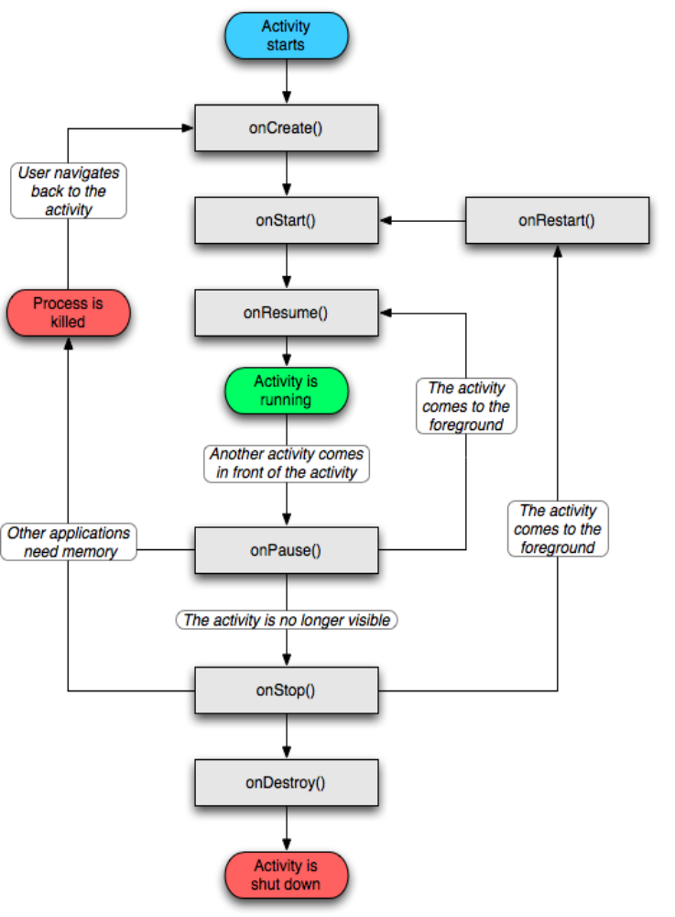
Components Lifecycle
Activity Lifecycle:
  The following diagram explain it

Slide 142

Components Lifecycle
Service Lifecycle:
  Service also have lifecycle methods
  onCreate & onDestory, entire lifetime of the service.
  onStart, service is running
    service doesn't have a corresponding onStop method
  onBind, onUnbind, when clients bind and unbind to the service (will be explain later)

Slide 143
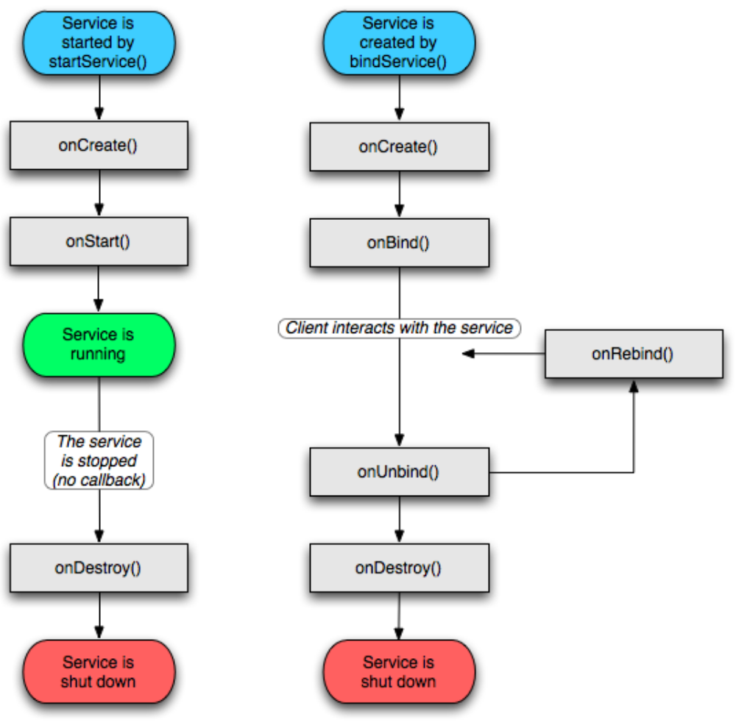
Components Lifecycle
Service Lifecycle:

Slide 144
Components Lifecycle
Broadcast Receiver Lifecycle:
  Broadcast receiver has on one lifecycle method
  onReceive, when broadcast messaged arrive to the receiver android calls onReceive with the intent information

Slide 145
Components Lifecycle
LifeCycle Methods:
  Important, when you implement lifecycle method, don't forget to call super.on<Method> first!

Slide 146
Components Lifecycle
content providers:
  Content providers are activated when they're targeted by a request from a ContentResolver
  Will be discussed in later chapters

Slide 147
Key Points
Activity, UI related
Service, background process
Each as a life-cycle reflected in the class methods.
Intent, start activity or service

Slide 148
The NDK in depth

Slide 149
Bionic
Is a standard C library which is needed on Linux (why?)
Originally developed by Google for Android.
Has Linux specific features (hard to port to other systems).
Currently is an independent project.
Small size compared to other standard C libraries and especially compared to glibc (273K in Android 9/arm).
Has more arbitrary limits and less features than glibc.
As a result is faster to initialize and do the things which are needed in Android.

Slide 150
Bionic (cont)
Designed for CPUs at relatively low clock frequencies
BSD licensed which protects you from Linux kernel license (not really needed)
Android core developers usually change Bionic via the Android building process rather than via the Bionic project itself (reasons?)
Source at $ANDROID_SRC/bionic
Products at $NDK/platforms/$ANDROID_VERSION/$ARCH/usr/{lib,include}

Slide 151
Bionic (cont)
Made up of several libraries: c, m, dl, pthread_db, stdc++
SYSV IPC is not implemented (denial of service issue, size of library). Neither is pipe(2).
Growing in size with each version of Android
Some real time support as well (timers etc).
See $BIONIC/docs for info

Slide 152
Bionic (cont)
Once did not support wide characters. Today it does.
Some parts are built using Jamhttp://www.perforce.com/documentation/jam
Supplies clean kernel header files to user land applications (in addition to standard headers)
Only a subset of the standard Linux system calls are supported.

Slide 153
Bionic - architectures
Today (2011) supports 3 architectures: sh, arm and x86
Other ports do exist but not in the main tree
Parts of the architecture code is written in assembly for speed (memcpy, memmove etc)
Look under $BIONIC/libc/arch-$ARCH/

Slide 154
Bionic - pthread
Subset of pthread API is supported in libc.so and not in pthread.so
Does not support pthread cancellation (why?)
Futexes are supported (yes!)
No process shared mutexes and no condition variables
Readers/writer locks recently added.

Slide 155
Bionic – C++ support
Traditionally did not support C++ exceptions.
Current exception support is better.
You may use exceptions in pure C++ code but in some cases if you call C code exceptions will be lost.
In practice this means that writing C++ with exceptions is difficult.
Traditionally no support for STL.
Latest version of Android provide STLPort (beta). Use at your own risk.
You may supply STL with your application (SGI implementation is freely available)
Other C++ API also lacking (c++0x for instance).

Slide 156
cutils
Is a user space library provided by the NDK to help in various topics.
Most importantly it wraps some of the peculiar kernel level features of android (binder, ashmem, logger and more).
Also provides general programming utils: strings, unicode, configuration, process name, scheduling policy setting, hashmap implementation, a little multi-threading support, utilities to help with java to/from C string conversion, abortable socket and more.
Resides in $ANDROID_SOURCE/system/core/include/cutils

Slide 157
Android kernel peculiarities

Slide 158
Android kernel
Fork of the Linux kernel.
Has some embedded features.
Most interesting changes can be found in $ANDROID_KERNEL/drivers/staging/android/
The reason for this mess is the assumption that the standard kernel is not good enough for embedded systems.
This assumption is challenged by the standard kernel developers.

Slide 159
Binder
Android kernel does not support SYSV IPC.
Binder is quite an advanced IPC replacement and also handles remote method invocation.
Code is in: $ANDROID_KERNEL/drivers/staging/android/binder.{c,h}
Java communication goes through binder (ActivityManager, Intents and more).
cutils offers mq.h which is a native level API for a message queue.
Binder allows passing of file descriptors between unrelated processes (much like BSD sockets).

Slide 160
Binder - layers
If you are a Java level coder then the Intent concept is easy to use and good enough for most cases.
If you want more power you can go down to the AIDL layer but then you need to handle multi-threading concerns.
Binder is below AIDL and requires C or IO programming.
Interface is via /dev/binder and is done via ioctls (not reads or writes).

Slide 161
Binder - design
Binder is somewhat like COM in that it allows method invocation between processes.
Binder is not an easy to use API but rather a low level kernel driver which can be used as the basis of higher level API.
It is targeted to C++ and C as base-line languages.
The idea is to have bindings to other (scripting) languages as well.
It is not network aware. The communication is just within processes on the same machine.
It has references counting features and debugging built in.

Slide 162
ashmem - design
The problems with SYSV IPC shared memory...
Implemented in $ANDROID_KERNEL/mm/ashmem.c and $ANDROID_KERNEL/include/linux/ashmem.h.
Has a file based API (simple?) via /dev/ashmem.
Has reference counting and automatic destruction.
Better supports low memory devices because it can discard shared memory units under memory pressure.
ashmem sources claim that SYSV IPC is prone to denial of service attacks.

Slide 163
ashmem – direct usage
open(“/dev/ashmem”)
mmap(2) it (size is the size you want).
Use various ioctls on the file descriptor:
  ASHMEM_SET/GET_NAME
  ASHMEM_SET/GET_SIZE
  ASHMEM_SET/GET_PROT_MASK
  ASHMEM_PIN/UNPIN
  ASHMEM_GET_PIN_STATUS
  ASHMEM_PURGE_ALL_CACHES

Slide 164
ashmem – cutils
Example:
  fd = ashmem_create_region("my_shm_region", size);
  if(fd < 0)
  return -1;
  data = mmap(NULL, size, PROT_READ | PROT_WRITE, MAP_SHARED, fd, 0);
  if(data == MAP_FAILED)
  goto out;
Now you pass the fd to the other process via binder and the other processes mmaps the same way and you have shared memory.

Slide 165
pmem - design
Process memory allocator
Not to be confused with some other older drivers that were called pmem.
Sources at $ANDROID_KERNEL/drivers/misc/pmem.c and $ANDROID_KERNEL/include/linux/android_pmem.h.
The idea is to allow user space applications to allocate large physically contiguous memory.
This is usually used to communicate with hardware via large DMA transfers for performance or to deal with hardware that cannot cope with scatter-gather DMA.
Has file based API.

Slide 166
pmem – direct usage
open(“/dev/pmem_{camera|adsp}”)
Ioctl it:
  PMEM_GET_PHYS
  PMEM_MAP
  PMEM_UNMAP
  PMEM_GET_SIZE
  PMEM_ALLOCATE
  PMEM_CONNECT
  PMEM_GET_TOTAL_SIZE
  PMEM_CACHE_FLUSH

Slide 167
logger – design
The problems with printk.
  printk is not available to user space.
  Requires extra daemon for log to reach final destination.
  Only has one log.
  Designed primarily for kernel use.
  Can lose messages because of that.
Embedded systems need a log that:
  Survives application crashes.
  Could be slower than printk at the cost of reliability.
  Possibly more than one log buffer.
  Does not lose message.
  Could be controlled, cleared, trasmitted from user space.
Logger was designed to solve all of these.

Slide 168
logger – design (cont)
The source is at $ANDROID_KERNEL/drivers/staging/android/logger.{c,h}
The code supports 4 logging buffers, named "main", "events", "radio", and "system" for different types of events.
The are device nodes /dev/log/{main,events,radio,system}
API is regular open(2),write(2),close(2)
A command line called logcat(1) is supplied which is the Android equivalent of “tail -f /var/log/syslog”.
The adbd daemon also knows how to read the log and supply it to a remote adb client.

Slide 169
logger – design (cont)
The four log buffers are:
  main – the main application log.
  events – for system event information.
  radio – for radio and phone-related debugging.
  system – a log for low-level system messages and debugging.
All of these are textual except events which consists of binary data for compactness.

Slide 170
logger – native logging
liblog.so is a library to encapsulate writing to the log.
Source is at $ANDROID_SOURCE/system/core/liblog
Header is in $ANDROID_SOURCE/core/include/android/log.h
API is very similar to syslog(3).
You can also print to standard output or error in which case your messages do not reach kernel land log buffers.

Slide 171
logger – Java layer
Application or Java layer programmers use android.util.{Log,EventLog,Slog} classes to log.
Messaged are accompanied by severity levels.
Log messages are passed to the liblog library and from there onto the kernel.

Slide 172
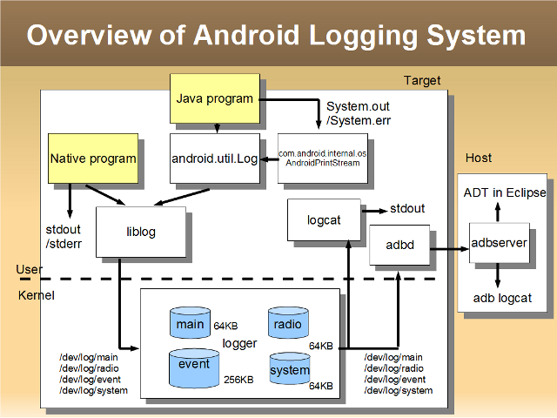
Logging system overview

Slide 173
logger – capturing stdout
It is sometimes useful to capture stdout from native applications into a log.
logwrapper(1) does this for you.
It allows you to run a native application which is supplied to it on the command line and captures it's standard output turning it into a log messages.
Source is at $ANDROID_SOURCE/system/core/logwrapper/logwrapper.c.

Slide 174
Wake locks - definition
Wake locks are locks which keep the system awake.
Actually, because there are different ways in which the system can go to sleep there are different types of wake locks to prevent these different types of sleep.
The standard Linux kernel also has some of these features but the Android people went ahead and wrote them anyway.
The code is in $ANDROID_KERNEL/kernel/power/wakelock.c and $ANDROID_KERNEL/include/linux/wakelock.h

Slide 175
Wake locks – types of sleep
System suspend: Entire system is suspended, CPU turns off, power consumption is down, only hardware (button) can wake it up.
System idle: Some interrupts are disabled, some may wake the system, CPU power consumption is down, even if an interrupt occurs it is handled with large latency.
These are also the types of wake locks.

Slide 176
Wake locks – kernel usage
#include <linux/wakelock.h>
wake_lock_init(struct wakelock *lock, int type, const char *name);
void wake_lock(struct wake_lock *lock);
void wake_lock_timeout(struct wake_lock *lock, long timeout);
void wake_unlock(struct wake_lock *lock);

Slide 177
Wake locks – user space usage
Only suspend locks can be taken from user space.
Writing a name to /sys/power/wake_lock establishes a lock with that name.
Writing the same name to /sys/power/wake_unlock releases the lock.

Slide 178
Wake locks – Java API
PowerManager pm = (PowerManager) getSystemService(Context.POWER_SERVICE);
PowerManager.WakeLock wl=pm.newWakeLock(PowerManager.SCREEN_DIM_WAKE_LOCK, "My Tag");
wl.acquire();
..screen will stay on during this section..
wl.release();

Slide 179
Wake locks - controversy
Documentation says: “Device battery life will be significantly affected by the use of this API. Do not acquire WakeLocks unless you really need them, use the minimum levels possible, and be sure to release it as soon as you can.”
The Jury is still out on whether this API should be given to developers at all...

Slide 180
Lowmemorykiller
Kernel feature allowing kernel to kill processes which consume too much memory.
Originally developed by Google (Android) deveoper Arve Hjonevag.
Initial values set in /etc/init.rc by utilizing /proc.
Code in Java adjusts the parameters at run time (see ActivityManagerService.java).
Linux has such a feature too...:(

Slide 181
alarm
Kernel implementation to support Java level AlarmManager API.
Essential since if system goes to sleep no wake up would be possible (remember that user space cannot prevent all power downs).
Source is in $ANDROID_KERNEL/drivers/rtc/alarm.c.
Header is in $ANDROID_KERNEL/include/linux/android_alarm.h.

Slide 182
timed output/timed gpio
$ANDROID_KERNEL/drivers/staging/android/timed_{gpio,output}.{c,h}
Allows user space to access GPIO registers.
Sort of uncomplicated driver in user space solution.
Controversy also surrounds this API because it gives too much power to user space.
The timed version ensures that the register value returns to it's original state after a certain time has passed and is considered safer to use.

Slide 183
ram_console
Intended to ease kernel development.
ram_console allows kernel printk message to be saved to a buffer in RAM.
This is useful for crash debugging.
After the system reboots you can find the log in /proc/last_kmsg.
Some developers go further and rewrite printk to deliver all messages to external hardware...

Slide 184
Android file system

Slide 185
File system implementation
Most Android devices used YAFFS – Yet Another Flash File System (actually most used YAFFS2).
This file system is light weight, single threaded, and optimized for flash storage.
This means it cannot make use of dual core devices.
It is also not very scalable (long explanation here...).
Platform vendors were free to choose other file systems but rarely did so.
SD card is usually vfat to allow sharing data between devices.
Some devices, like Samsung Galaxy S, use proprietary file systems (Samsung RFS in this case). Why? Well – because they can and they are allowed to.

Slide 186
File system implementation
Starting with Gingerbread Android was shipped with ext4 support as well.
Ext4 is much more scalable (explanation here...).
Ext4 is multi-threaded (kernel thread per CPU).
Ext4 has sync issue (intentionally) but that is rarely a problem for application developers.
If you are a C developer remember to fsync(2) if you want to guarantee your data reaches it's destination.

Slide 187
Mount points - virtual
Obviously there are many virtual file systems even in Android:
  /dev, /sqlite_stmt_journals → tmpfs
  /dev/pts → devpts
  /proc → proc
  /sys → sys
  /dev/cpuctl → cgroup
These are standard Linux virtual file systems.

Slide 188
Mount points - physical
Usually these exist:
  /system, /data, /cache → yaffs2
  /sdcard → vfat
Again, yaffs2 is not always the case.
/system is where the, well, system is.
/data is for applications.
/cache is for application caches which are non essential.

Slide 189
Data for applications
Applications running in Android may save data to persistent storage.
Several API exist:
  File system access using standard java.io packages or Android wrappers.
  SD card storage.
  Preferences system.
  Database API (SQLite).
  Cache.
  Network connections (this is not really storage on your own system).
  Content providers.
The first 4 methods discussed above store data in: /data/data/package.of.the.application
This directory is private to the application – this means that only the application can read and write this folder (and of-course the system).
The fifth method stores data in: /cache/cache/package.of.the.application

Slide 190
Applications and files
Applications do not need any special permissions to write to their own storage folder.
Standard java.io interfaces exist for application to read and write files from their own application data directory.
The SDK provides some sugar wrappers for regular java.io interfaces for easy access of an application to it's own files.
The permission system is quite simple: every file is either MODE_PRIVATE, MODE_WORLD_READABLE, MODE_WORLD_WRITABLE or MODE_WORLD_READABLE | MODE_WORLD_WRITABLE
This means you don't have lots of permission control.
When the application is un installed it's data directory goes away.
This is also why some basic applications cannot be removed (so that users don't loose their contacts/photos/videos by mistake).

Slide 191
SD card access
First, remember that the SD card is not always there physically.
Even if the SD card is there, when the device is connected via USB to a computer the SD card is not available (the idea is to prevent concurrent access issues).
All files and directories on the SD card are readable and writable by all applications.

Slide 192
SD card access
To write to the SD card applications need the android.permission.WRITE_EXTERNAL_STORAGE permission.
To check if the SD card is there use: Environment.getExternalStorageState().equals(Environment.MEDIA_MOUNTED).
To get the path to the SD card use: Environment.getExternalStorageDirectory().
After all this you use standard java.io or Android wrappers to write to the SD card.

Slide 193
The cache
Application authors may want to store data which is not crucial to their correct working but which may take lots of space.
The right way to store these files is in the application cache.
To get the path to the cache use: getCacheDir()
Then use standard java.io or Android wrappers to do io in that folder.
This folder is private to your application and usually lives in: /cache/cache/package.of.your.application.
The application cache folder goes away when the application is un installed.
Files in the application cache may be removed by the system when it's running low on internal storage space.

Slide 194
Sharing data between applications
Several ways exists:
  File system data.
  SD card.
  Content providers.
Each method has it's own distinct advantages and disadvantages.
Best way is probably content providers.

Slide 195
Sharing data between applications – file system
Applications can create sub folders in their own data folder.
On these sub folders applications may grant read or even write access as discussed.
No fine grained access control.
There is no lock protecting against concurrent access by two applications, or even two threads of the same application, to the same file at the same time.
On the other hand this means that an application can access another applications data when that application is not alive.
This method is usually used for large pieces of data: photos, videos, music which do not have lots of structure to them and rarely need lots of concurrent access protection.

Slide 196
Sharing data between applications – database
When an application creates an SQLite database it is saved under it's application folder, in a directory called “databases”.
This directory is readable and writable only by the creating application.
It is a bad practice to change these permissions (although you are allowed to do so).
This means that sharing databases directly is not recommended.

Slide 197
Android init
On the target the init configuration is at /init.rc.
The init language itself is documented at: $ANDROID_SOURCE/system/core/init/readme.txt.
At the heart of android

Slide 198
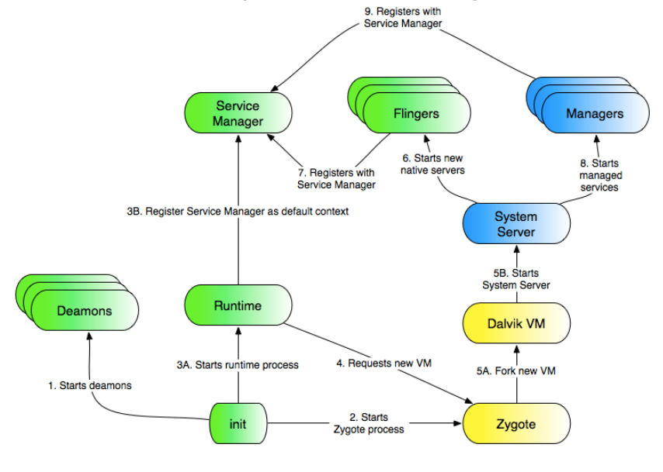
Android initialization

Slide 199
Android built-in native services

Slide 200
ueventd
User space daemon handling kernel notifications about devices connect/disconnect and other messages in user space.
Does it by polling a netlink socket.
Is run early in the Android boot process from init.rc
Configuration is in $ROOT/ueventd.rc
Quite simple configuration file format
Is the Android lightweight version of udev which is
See files $ROOT/init.rc, $ROOT/ueventd.rc.

Slide 201
Advanced JNI
Java Native Interface

Slide 202
Chapter Contents
JNI Recap
Local & Global References
Memory Management & GC
Threads
Handling Exceptions
Encoding & Internationalization
Ten JNI Best Practices

Slide 203
JNI Recap
JNI allows Java code to operate with applications and libraries written in other languages, such as C, C++, and assembly.
JNI Allows Java programmers to integrate with native (not Java) components and applications.

Slide 204
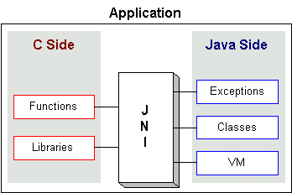
JNI Recap
JNI is the glue between Java and native applications.

Slide 205
Java App with Native Methods
The following steps are needed (in this example, Java + C):
Write the Java code.
Compile the Java class (using javac).
Create a header file (using javah).
Write the native code (C).
Create a shared library (using native compiler).
Run the Java application that calls the native code.

Slide 206
Mapping Java and Native Types
Java primitives mapping:
Java Type
Native Type
Size in bits
boolean
jboolean
8, unsigned
byte
jbyte
8
char
jchar
16, unsigned
short
jshort
16
int
jint
32
long
jlong
64
float
jfloat
32
double
jdouble
64
void
void
n/a

Slide 207
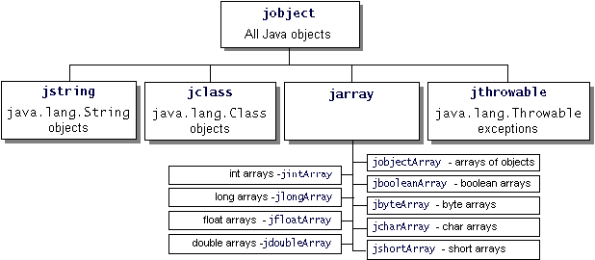
Mapping Java and Native Types
All objects are passed by reference.
All references have a super type of jobject.

Slide 208
Mapping Java and Native Types
Example:
public native String
loopPrint(String name,int num)
JNIEXPORT jstring JNICALL
Java_MyClass_loopPrint(JNIEnv*,jobject ,jstring, jint)

Slide 209
Chapter Contents
JNI Recap
Local & Global References
Memory Management & GC
Threads
Handling Exceptions
Encoding & Internationalization
Ten JNI Best Practices

Slide 210
Local & Global References
JNI supports three types of references:
  Local references
  Global references
  Weak global references
These types behave differently with regards to garbage collection and lifetimes

Slide 211
Local References
A local reference is valid only:
  Within the context of the native method that creates it and within a certain invocation of the method.
  In the thread that creates the reference.
Once the native method returns, all local references will be freed.
Never store a local reference in a static variable. The reference might not be valid.

Slide 212
Local References - Example
Never keep local references in static variables
jstring MyNewString (JNIEnv *env, jchar*chars, jint len)
{
static jclass stringClass = NULL; //this is wrong
if(stringClass == NULL)
{
stringClass = (*env)->findClass(env, “java/lang/String”);
if (stringClass == NULL)
{
return NULL;
}
}
cid = (*env)->GetMethodID(env, stringClass ...
Any use of the stringClass here is problematic since it may be invalid. The stringClass might have been freed, so the call might lead to memory corruption or system crashes

Slide 213
GC & Local References
A local reference keeps the referenced object from being garbage-collected until the local reference is invalidated.
If you wish to invalidate the local references beforehand, you may explicitly do it using the JNI function: “DeleteLocalRef”.
jcharArray elemArr = (*env)NewCharArray(env, len);
result = (*env)->NewObject (env, stringClass, cid, elemArr);
(*env)->DeleteLocalRef(env, elemArr);

Slide 214
Global References
Global references can be used
  Across multiple invocations
  Across multiple threads
A global reference ensures that the referenced object will not be GC.
Global references are Created by the JNI function:
  jobject NewGlobalRef(JNIEnv *env, jobject obj);
Global references are deleted by the JNI function:
  void DeleteGlobalRef(JNIEnv *env, jobject globalRef);

Slide 215
Global References - Example
Creating a global reference
jstring MyNewString (JNIEnv *env, jchar*chars, jint len)
{
static jclass stringClass = NULL; //this is OK now
if(stringClass == NULL)
{
jclass localRefClass = (*env)->findClass(env, “java/lang/String”);
stringClass = (*env)->NewGlobalRef(env, localRefClass);
(*env)->DeleteLocalRef(env, localRefClass); //free local reference
if(stringClass==NULL){
return NULL;
}
}
cid = (*env)->GetMethodID(env, stringClass ...
Creates a global reference

Slide 216
Weak Global References
Like Global references, remain valid across method calls and threads.
Unlike Global references, Weak Global References do not keep the underlying object from GC.
Use Weak Global References when a reference cached by the native code must not keep the underlying object from being garbage collected.

Slide 217
Weak Global References - Example
Creating a weak global reference
...
static jclass cachedClass = NULL;
if(cachedClass == NULL)
{
jclass localRefClass = (*env)->findClass(env, “ClassToCreate”);
cachedClass = (*env)->NewWeakGlobalRef(env, localRefClass);
(*env)->DeleteLocalRef(env, localRefClass); //free local reference
}
cid = (*env)->GetMethodID(env, stringClass ...
Creates a weak global reference

Slide 218
Chapter Contents
JNI Recap
Local & Global References
Memory Management & GC
Threads
Handling Exceptions
Encoding & Internationalization
Ten JNI Best Practices

Slide 219
Memory Management
Each JNI reference consumes a certain amount of memory in addition to the memory taken by the referred object.
You must be aware of the number of references your program uses at a given time.
Don’t count on the automatic clearing of local references – excessive reference creation can lead to memory exhaustion!

Slide 220
Memory Management
Freeing local references is crucial in the following scenarios:
  Creating a large number of local references in a single local method – may result in an overflow in the internal JNI local reference table.
  Within a native method that does not return (for example, goes to infinite loop).
  A local reference to a large object (keeping it longer than needed prevents the object from being GC).

Slide 221
Lifetime functions
Each native method can create at least 16 local references.
If there is a need to create additional local references, a native method may call:
  jint EnsureLocalCapacity(JNIEnv *env, jint capacity);
This function ensures that at least a given number of local references is created in the current thread.
The function Returns 0 on success; otherwise returns a negative number and throws an OutOfMemoryError.

Slide 222
EnsureLocalCapcaity - Example
Suppose we need to create objects in a loop:
if((*env)->EnsureLocalCapacity (env, len)) < 0){
//this is an OutOfMemory situation
}
for (i=0;i<len;i++){
jstring jstr = (*env)->GetObjectArrayElement(env,arr, i);
//DeleteLocalRef is not necessary here
}
Remember, however, that it is preferred to free local references inside loops

Slide 223
PushLocalFrame & PopLocalFrame
PushLocalFrame Creates a new local reference frame, in which at least a given number of local references can be created
  jint PushLocalFrame(JNIEnv *env, jint capacity);
PopLocalFrame destroys the topmost scope, freeing all local references in that scope
  jobject PopLocalFrame(JNIEnv *env, jobject result);
The use of these functions lets you free a bulk of references, without worrying about every single reference that might have been created.

Slide 224
EnsureLocalCapcaity - Example
Suppose we need to create objects in loop:
#define NUMBER_OF_REFERENCES 30
...
for(i=o;i<len;i++){
if ((*env)->PushLocalFrame (env, NUMBER_OF_REFERENCES) < 0){
//out of memory
}
jstr = (*env)->GetObjectArrayElement (env, arr, i);
...work with jstr
(*env)->PopLocalFrame(env, NULL);
}
If the computation that processes jstr creates additional local references, these local references will be freed after PopLocalFrame returns
The call to PopLocalFrame should be done in all function exit paths

Slide 225
Memory Management Rules
Be careful about excessive local reference creation.
It is acceptable to leave up to 16 local references to be deleted by the virtual machine.
Native method calls must not cause global references to accumulate.
When possible, manage the lifetime of local references by using Push/PopLocalFrame.

Slide 226
Memory Management Rules
Utility functions rules (functions that don’t directly implement native methods):
  A utility function should free all the local references it creates.
  A utility function that returns a reference must:
    Not accumulate any extra reference.
    Return always the same type of reference (local, global…), so the caller will manage it correctly [call DeleteLocalRef, DeleteGlobalRef…]

Slide 227
Caching Field and Method IDs
Obtaining field and method IDs uses lookups, which are relatively expensive.
You might cache these IDs to reduce the overall overhead.
Caching can be done in static variables so the IDs need not be recomputed upon each invocation of the method.

Slide 228
Caching field id - Example
...
static jfieldID field_id = NULL; //this is the cache
jclass the_class = (*env)->GetObjectClass(env,obj);
Jstring jstr;
if(field_id == NULL){
field_id=(*env)-> GetFieldID(env,the_class,”fieldToAccess”,”Ljava/lang/String;”);
if(field_id==NULL){
return; //exception
}
}
jstr = (*env)->GetObjectField(env, obj, field_id);
...
The GetFieldId is called only if we did not cache the id before
Caching might be done for method IDs as well.

Slide 229
Chapter Contents
JNI Recap
Local & Global References
Memory Management & GC
Threads
Handling Exceptions
Encoding & Internationalization
Ten JNI Best Practices

Slide 230
JNI &Threads
One must always assume the possibility of multiple threads of control executing a native method at any given time (unless it is definitely known not to be the case).
Native methods must not modify sensitive global variables in unprotected ways.

Slide 231
Thread Constrains
JNI interface pointer (JNIEnv *) is only valid in the current thread.
You must not pass local references from one thread to another.
Check the use of global variables carefully. Multiple threads might be accessing these global variables at the same time. Make sure you put in appropriate locks to ensure safety.

Slide 232
Monitor Entry and Exit
The synchronized block in Java:
synchronized(obj){
..protected code goes here
}
The equivalent JNI monitor functions are :
if ((*env)->MonitorEnter (env, obj) != JNI_OK){
...error hanling
}
..protected code goes here
if ((*env)->MonitorExit(env,obj) != JNI_OK){
...error hanling
}

Slide 233
Monitor Entry and Exit
The MonitorEnter operation takes a jobject as an argument and blocks if another thread has already entered the monitor associated with the jobject.
Never call MonitorExit when the current thread does not hold the monitor (IllegalMonitorStateException will be raised).
Failure to call MonitorExit will most likely lead to deadlocks.
It is preferable to use “static synchronized native” methods (inside Java) for simplicity.

Slide 234
Monitor Wait and Notify
No JNI functions correspond directly to wait(), notify() and notifyAll() methods in the Object class.
Native code may use the JNI method call mechanism to invoke the methods in the java API.
void JNU_MonitorWait (JNIEnv *env, jobject object, jlong timeout){
(*env)->CallVoidMethod(env,object, MID_Object_wait, timeout);
}
The method id has been calculated elsewhere

Slide 235
Thread Models
JNI programmers must pay attention to the thread model of the operating system.
Different JVM’s may implement different thread models:
  Native thread model – The operating system manages all the essential thread operations.
  User thread model – The application code implements the thread operations.

Slide 236
Thread Models
Native supporting JVMs - You can use the native thread synchronization primitives (such as mutex_lock), or other thread functions (such as creating threads - thr_create on solaris).
User thread model JVMs - Native code should either link with the JVM package or use thread operations within java code.

Slide 237
Chapter Contents
JNI Recap
Local & Global References
Memory Management & GC
Threads
Handling Exceptions
Encoding & Internationalization
Ten JNI Best Practices

Slide 238
Exceptions Handling
Two types of errors exist when dealing with native code:
  Errors that occur as result of issuing JNI function calls.
  Regular errors that happen in native code.
This chapter will focus on the first type: JNI related errors.

Slide 239
Exceptions Handling
A pending exception raised through JNI does not immediately disrupt the native method execution.
Notice – This behavior is different from exceptions’ behavior in Java – immediate transfer of the flow control to the catch block.
You must explicitly implement the control flow after an exception has occurred.

Slide 240
Exceptions Handling
The JNI provides functions that allow your native methods to throw Java exceptions:
jint ThrowNew (JNIEnv *env, jclass clazz, const char* message);
Most JNI functions use a combination of error codes and Java exceptions to report error conditions.
  For example, to check an error condition after invoking “GetFieldID“ function, you might:
    Check if the return value is 0.
    Call the JNI function ExceptionOccurred.

Slide 241
Exceptions Handling - Example
Check for the return code
...
jclass cls = (*env)->GetObjectClass(env, obj);
jmethodID mid = (*env)->GetMethodID(env, cls, "callback", "()V");
jthrowable exc;
if (mid == 0) {
return; //error occurred
}

Slide 242
Exceptions Handling - Example
Use ExceptionOccurred
(*env)->CallVoidMethod(env, obj, mid);
exc = (*env)->ExceptionOccurred(env);
if (exc) {
jclass newExcCls;
(*env)->ExceptionDescribe(env);
(*env)->ExceptionClear(env);
newExcCls = (*env)->FindClass(env,"java/lang/IllegalArgumentException");
if (newExcCls == 0) {
return;
}
(*env)->ThrowNew(env, newExcCls, "thrown from C code");
}
Print a Debug Message

Slide 243
Exceptions Handling
When the native code catches and handles an exception, it can either:
  Clear the pending exception (Exception clear) – and execute its own handling code.
  Return immediately.
It is extremely important to check, handle and clear a pending exception before calling any subsequent JNI functions. Failure to do so leads to unexpected results.

Slide 244
Exceptions Handling
Functions for checking exceptions:
  ExceptionCheck(env) – returns JNI_TRUE when there is a pending exception (or JNI_FALSE).
  ExceptionOccured(env) – Returns a reference to the exception objec.t
jboolean hasException = (*env)->ExceptionCheck(env);
jthrowable exc = (*env)->ExceptionOccurred(env);
*hasException = exc != NULL;
(*env)->DeleteLocalRef(env, exc); //local reference management

Slide 245
Chapter Contents
JNI Recap
Local & Global References
Memory Management & GC
Threads
Handling Exceptions
Encoding & Internationalization
Ten JNI Best Practices

Slide 246
Encoding & Internationalization
The Java Virtual Machine represents strings in Unicode format.
Most native platforms represent strings in locale specific encoding.
In order to convert properly between strings certain rules apply:
  Use GetStringUTFChars and GetStringUTFRegion to convert between jstrings and locale-specific strings, only if UTF-8 happens to be the native encoding on the platform.

Slide 247
Creating jstrings from Native Strings
For converting a native string into a jstring use this String constructor:
  public String (byte[] bytes)
jstring JNU_NewString (JNIEnv *env, const char *str)
{
jstring result;
jbyteArray bytes = 0;
int len;
len = strlen(str);
bytes = (*env)->NewByteArray(env, len);
if(bytes != NULL){
(*env)->SetByteArrayRegion (env, bytes, 0, len, (jbyte*)str);
result = (*env)->NewObject (env, Class_java_lang_String, MID_String_init, bytes);
(*env)->DeleteLocalRef(env, bytes);
return result;
}
return NULL;
}
A global reference to java.lang.String class
The method id of the String constructor

Slide 248
Translating jstrings to Native Strings
For converting a jstring into the native encoded string use the String.getBytes method.
char * JNU_GetStringNativeChars (JNIEnv * env, jstring jstr)
{
jbyteArray bytes = 0;
char * result = 0;
bytes = (*env)->CallObjectMethod(env, jstr, MID_String_getBytes);
jint len = (*env)->GetArrayLength(env, bytes);
result = (char*)malloc(len+1);
(*env)->GetByteArrayRegion(env,bytes,0,len,(jbyte*)result);
result[len] = 0; /*Null termination*/
return result;
}
Error handling code
was removed for
clarity

Slide 249
Converting to UTF-8 Strings
Unicode strings represent characters as 16-bit values, whereas UTF-8 strings use an encoding schema that is upward compatible with 7-bit ASCII strings.
GetStringUTFChars function converts the jstring reference (Unicode) into a C string (UTF-8).
GetStringUTFChars might throw an OutOfMemoryError when the allocation failed.

Slide 250
UTF-8 Strings - Example
jbyte* Convert (JNIEnv *env, jobject obj, jstring prompt)
{
char buf[128];
const jbyte *str;
str = (*env)->GetStringUTFChars (env, prompt,NULL);
if(str==NULL)
{
return NULL; //OutOfMemory already thrown
}
(*env)->ReleaseStringUTFChars (env, prompt, str);
return str;
}
Indicates that the native method no longer needs the UTF-8 string

Slide 251
Construct a New String
To construct a new java.lang.String you can use the JNI function NewStringUtf.
This function works only on UTF-8 format.
The newly constructed java.lang.String represents the same sequence of Unicode characters as the given UTF-8 string.
Notice – if the operating system supports Unicode as the native string format, you can use: GetStringChars, ReleaseStringChars functions.

Slide 252
Chapter Contents
JNI Recap
Local & Global References
Memory Management & GC
Threads
Handling Exceptions
Encoding & Internationalization
Ten JNI Best Practices

Slide 253
1. Don’t Forget Error Checking
JNI does not rely on any particular native exception mechanism.
Programmers are required to perform explicit checks after every JNI function call that could possibly raise an exception.
Exception checks are necessary to ensure that the application is robust.

Slide 254
2. Cache Field and Method IDs
Native code obtains field and method IDs from the virtual machine.
However, Field and method lookups using name and type strings are slow.
Caching IDs may lead to a performance gain.

Slide 255
3. Check the Validity of Arguments
JNI functions do not attempt to detect or recover from invalid arguments.
Passing NULL or oxFFFFFFFF to a JNI function that expects a reference leads to incorrect results or virtual machine crashes.
Code that uses the library is responsible to make sure that all the arguments are valid.

Slide 256
4. Terminate Unicode Strings
Unicode strings obtained from GetStringChars or GetStringCritical are not NULL terminated.
In order to know the number of 16-bit Unicode characters call GetStringLength.
Notice – some operating systems, like Windows NT, expect two trailing zero byte values to terminate Unicode strings.

Slide 257
5. Don’t Violate Access Control Rules
JNI does not enforce access control restrictions that are expressed in java through the use of modifiers such as private, final…
Native code may bypass these access checks (it might modify any memory).
However, bypassing might lead to undesirable results (like changing immutable objects).

Slide 258
6. Pay Attention to Encoding
Strings in the JVM consist of Unicode characters.
Native strings are usually in a local-specific encoding.
Use dedicated functions to translate between Unicode jstrings and locale specific native strings.

Slide 259
7. Free Virtual Machine Resources
Forgetting to free JVM resources may cause objects to be pinned indefinitely.
This might lead to memory fragmentation or to a memory leak.
Be particularly careful in code paths that are only executed when there is an error.

Slide 260
8. Avoid Excessive Local References
Excessive local reference creation causes the program to hold memory unnecessarily.
An unnecessary local reference wastes memory both for the referenced object and the reference itself.
Pay special attention to long running native methods, loops, and utility functions.

Slide 261
9. Use the JNIEnv in It’s Thread
The JNIEnv can be used only in the thread with which it was associated.
Never use the pointer from one thread by another thread.

Slide 262
10. Avoid Using Invalid References
Local references are valid only inside a single invocation of a native method.
Native code should not store a local reference in a global variable and expect to use it in a later invocations of the native methods.
Local references are valid only within the thread in which they are created.

Slide 263
Key Points
JNI enables a JVM-independent integration of Java and native code.
For using JNI properly you must take care of these issues:
  Exception handling.
  Multiple threads.
  Memory management.
  Encoding issues.

