Slide 1

Ext JS
Basics of
JavaScript Framework
ikhwanhayat@gmail.com

Slide 2
(1) INTRODUCTION

Slide 3
What is JavaScript ?
Client script, ran at web browser
Make web sites interactive and programmable
Manipulate page elements
DOM manipulations
Events
<script type="text/javascript">
alert("Hello");
</script>

Slide 4
What are JavaScript Frameworks ?
Collection of reusable codes to help you code JavaScripts.
Better DOM manipulations, event handling, etc.

Slide 5
Basic Useful methods, DOM, event, AJAX...
Widgets UI components like panels, grids, tabs...
Prototype
script.aculo.us
jQuery
MooTools
YUI
Dojo
jQuery UI
Ajax.org
Ext JS
Ext Core

Slide 6
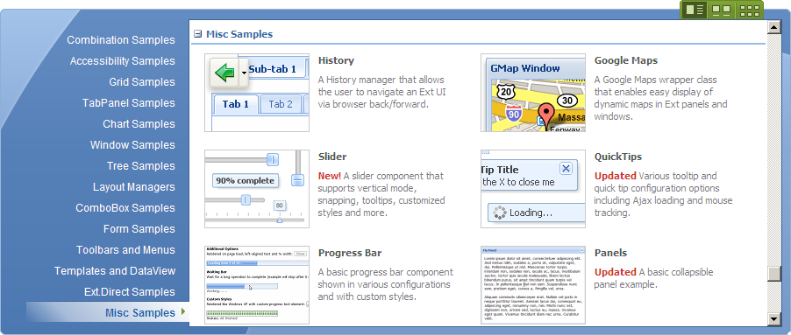
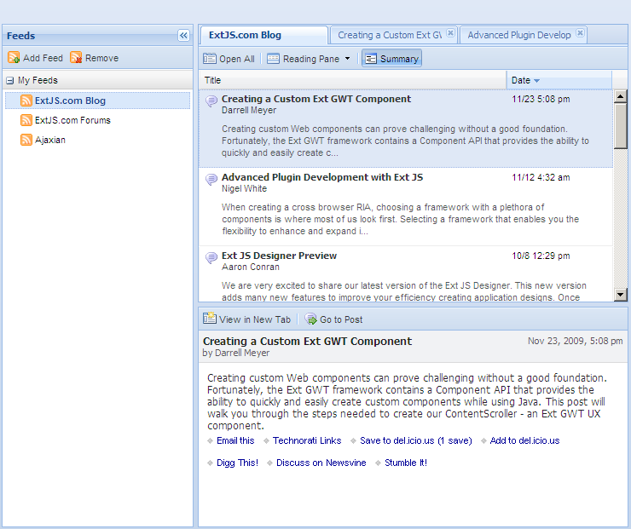
Why Ext JS ?
Mature and stable.
Lots of widgets available.
Consistent look and feel (and good lookin’ too!)
Good documentation and community support.
Backed by a commercial company (but still open source!)

Slide 7
Where ?
Website: http://www.extjs.com/products/extjs/
Samples: http://www.extjs.com/deploy/dev/examples/samples.html
Documentation: http://www.extjs.com/deploy/dev/docs/
Forums: http://www.extjs.com/forum/
Wiki: http://www.extjs.com/learn/Main_Page
Screencast: http://www.extjs.tv http://www.extjs.com/learn/Screencasts

Slide 8
Download
http://www.extjs.com/products/extjs/download.php
FREE!

Slide 9
(2) FUNDAMENTALS

Slide 10
Components
Buttons, ComboBox, DateField, Slider, Quicktip, Tree, ListView...
var btn = new Ext.Button({
text: ‘Click me!‘,
width: 200,
height: 100
});
CONFIG OPTIONS

Slide 11
Panel
Panel, GridPanel, TabPanel, FormPanel, Window, ...
var pnl = new Ext.Panel({
title: 'A Panel',
border: true,
tbar: [ 'Tool 1' ],
items: [
new Ext.Panel({
title: 'A child panel!'
})
]
});

Slide 12
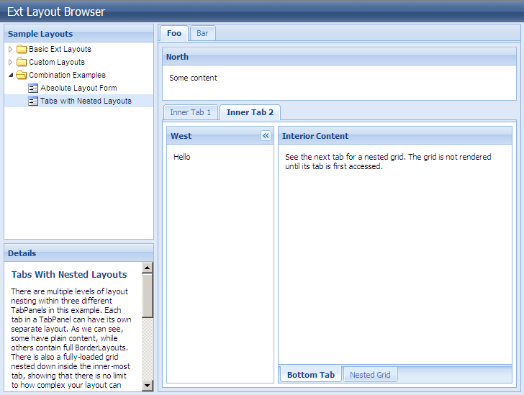
Layout
Fit, Border, Form, Accordion, Card
http://www.extjs.com/deploy/dev/examples/layout-browser/layout-browser.html

Slide 13
Events
var btn = new Ext.Button({
text: 'Click me!',
width: 200,
height: 100,
listeners: {
'click': function() {
alert('Clicked!');
}
}
});
btn.on('mouseover', function() {
alert('Hovered!');
});
listeners
on()
handler

Slide 14
Fire up your editor,
and let’s get our hand dirty!

Slide 15
Common stuff
Fundamentals
We learned...
Components,
Panel,
Layout
onReady(),
config opts,
xtype, applyTo,
contentEl...
Debugging
The good ‘ol alert()
Firebug console.log(), console.dir()

Slide 16
(3) WORKING WITH DATA

Slide 17
AJAX - Asychronous JavaScript and XML
Clean separation of presentation and data.
Thin client which connects to web services.
Data encapsulated in JSON/XML
{
person: {
name: 'Ali',
age: 15,
isCitizen: true
}
}
<data>
<person>
<name>Ali</name>
<age>15</age>
<isCitizen>true</isCitizen>
</person>
</data>

Slide 18
JSON/
XML
Backend
Web Browser
WS

Slide 19
Ext.data
Store
DataReader
DataProxy
Record

Slide 20
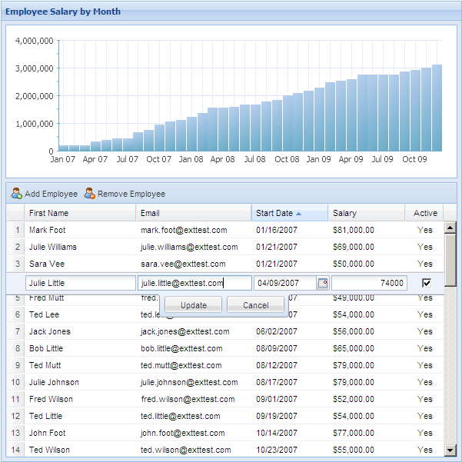
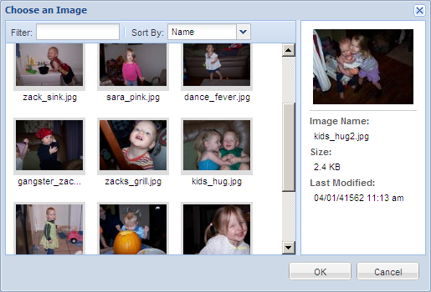
Store manage data
Fetch from a web service, or
using loadData()
Kept as Record
WS
JSON/XML
Store
Record
UI Components displays the data

Slide 21
Ext.Ajax.request()
Wraps XMLHttpRequest to do async request
BasicForm.load() and submit()
Load and submit form values asynchronously
Element.load()
Replace content of an element with response
from an async request.

Slide 22
Let’s get our hand dirty (again)!

Slide 23
Separate presentation and data
We learned...
Client and web service
How to work with data
JsonStore,
load(), AJAX,
request(),
submit()

Slide 24
Next ?
Ext.extend Inherits existing components and add your own functionality
Ext.Direct Better way to work with web services and remote procedure calls.
...other advance stuff

Slide 25
That’s all folks,
Thanks for watching!

