Slide 1
Beginning ExtJS with ASP.Net
A simplified guide
By NithyaVidhyaarthi

Slide 2
What is ExtJS
ExtJS is a javascript framework (client-side) that enables developers to develop Rich Internet Application (RIA) (static websites or data-driven applications) with a plethora of options.

Slide 3
How do we begin?
Download the latest copy of ExtJS from www.extjs.com/download
Unzip using any file compression utility (Winzip / WinRAR).
It is strongly recommended that you create a virtual directory for the unzipped folder (since certain examples work only if accessed via website / virtual directory).

Slide 4
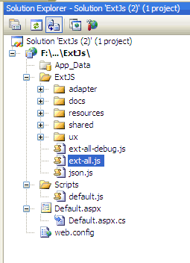
Walking the first step…
Launch the Visual Studio IDE and create a new website (Do not worry about the framework version).
Add the ExtJS files into a folder named say “ExtJS” within the newly created website.

Slide 5
Important
Start editing the default.aspx & remove form elements with “runat = server” attribute.
Make sure that no form elements within body has “runat = server” attribute.
Add a javascript file. Name it “default.js” and place it within a folder named “Scripts” within the root directory.

Slide 6
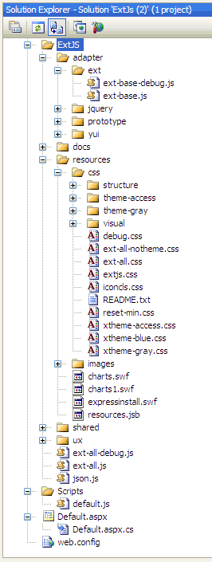
Files to be linked
Add links to all the highlighted files. These files are very much important to set-up the ground work for our application.
Next add your custom files.
Example (in default.aspx):
<link href="ExtJS/resources/css/ext-all.css" rel="stylesheet" type="text/css" />
<script type="text/javascript" language="javascript" src="ExtJS/adapter/ext/ext-base.js"></script>
<script type="text/javascript" language="javascript" src="ExtJS/ext-all.js"></script>
<script type="text/javascript" language="javascript" src=“Scripts/default.js"></script>

Slide 7
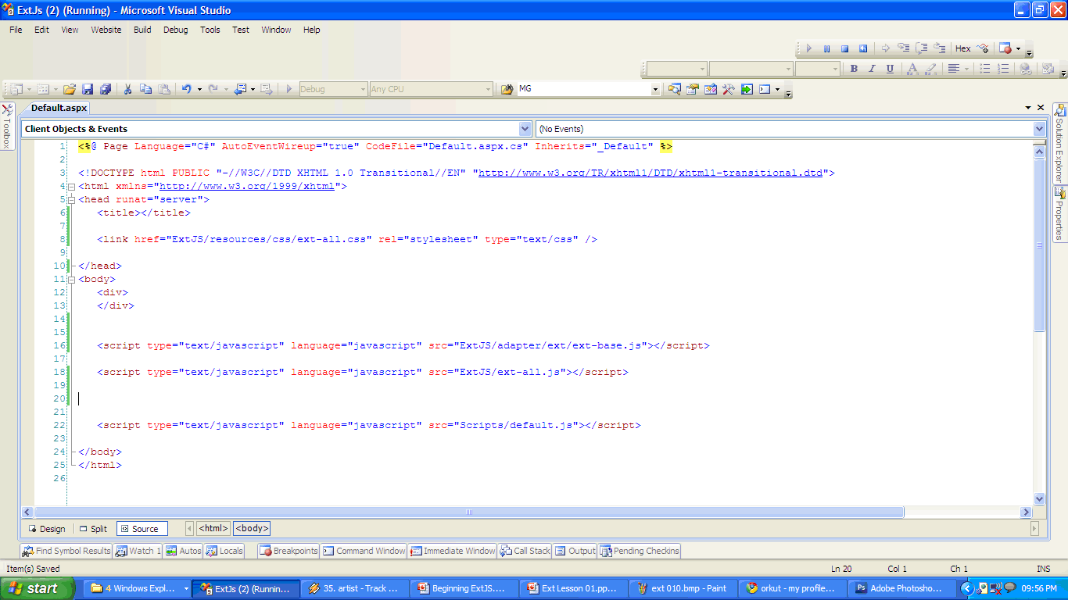
Finishing up links…
Link the ext-all.css at header.
Add ext-base.js & ext-all.js
Our custom .js file.

Slide 8
Our first Hello Ext!!!
Start editing your default.js file and add / copy & paste the following contents.
Ext.onReady(function(){
Ext.MessageBox.show({
title:’My Message’
, msg:’My first Hello world using Ext…’
, buttons: Ext.MessageBox.OK
, icon: Ext.MessageBox.INFO
});
});

Slide 9

Run towards Hope…
Verify again, whether you had added the links to the java-script files and CSS files correctly.
Now press the F5 key (or) the “debug” icon to execute the application.
If everything is right, you would certainly see the image as in the next slide.

Slide 10
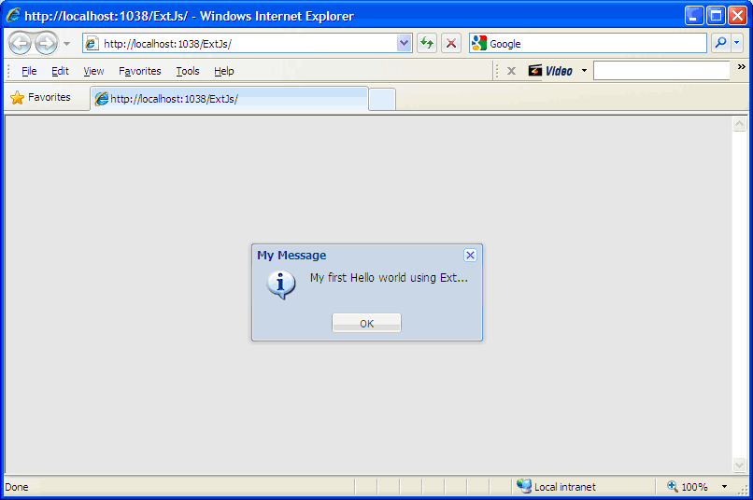
Hello World with ExtJS…
Eureka!!!, there we go… ☺

Slide 11
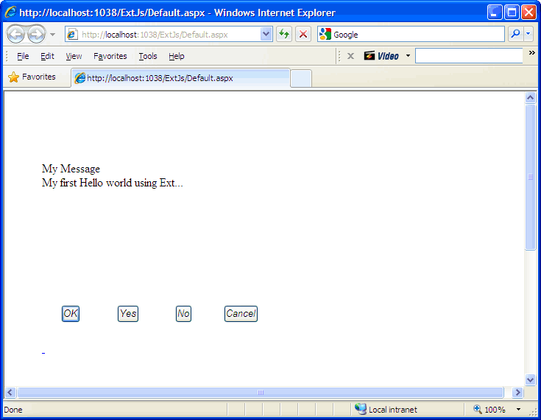
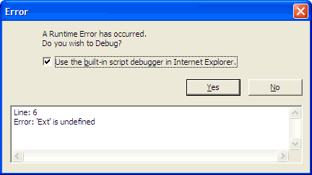
What if anything had went wrong?
If Ext java-script files are not linked properly, you would see this.
If CSS files are not linked properly, you would see this.

Slide 12
Fixing & Wrapping it up all…
In case if you face any troubles as in the previous images, kindly correct the links (refer slide-6) and re-execute the application till you succeed.
And there by “Congratulations” on making your first step with ExtJS. Check out for further releases on tutorial.

Slide 13
With Thanks…
Hi there!, thank you so much for watching this tutorial. I’d made this too simple so it reaches out the mass with much ease. Kindly let me know your feedback and help me to help you better.

Slide 14
Contact me via
arun85prasad@gmail.com
arun85prasad@live.com
arun85prasad@yahoo.com
arunprasadvidhyaarthi – skype
Arunprasadvidhyaarthi – slideshare.com
Arun85prasad – twitter
Arunprasad – scribd.com

