Slide 1
Beginning ExtJS with ASP.Net
Lesson 01 – Part two
A simplified guide
By NithyaVidhyaarthi

Slide 2
Purpose & Pre-requisites
This tutorial is intended to help developers who would like to take up ExtJS as their major tool for web application development.
This tutorial uses Ext 3.1.1 version for visual clarifications. While most contents are still appropriate, it is strongly suggested for the observer to pay attention to the “changes.html” bundled with every release to cross-verify new updates/ deprecation(s) if any.
Beginning ExtJS with ASP.NET - Lesson 01 - Part two

Slide 3
Purpose & Pre-requisites
This tutorial assumes that you have basic knowledge over java-script, HTML, CSS, DOM, XML HTTP Requests (XHR), Internet Information Services (IIS).
Should you feel that you fell short in any of above the mentioned, kindly have a good look at those technologies / concepts, to have better & improved understanding of Ext.
Beginning ExtJS with ASP.NET - Lesson 01 - Part two

Slide 4
How this tutorial is organized?
Introduction
Subject
Conclusion
Glossary
Disclaimer
Note: You would find words with superscripts like “IDE¹”. You can find the meaning for such words with reference to the number in the “Glossary” section.
TIP
Beginning ExtJS with ASP.NET - Lesson 01 - Part two

Slide 5
Introduction to ExtJS
ExtJS is a java-script framework (client-side¹) that enables developers to develop Rich Internet Applications² (RIA) (static websites or data-driven³ applications) with a plethora of options.
ExtJS has a huge collection of controls (ranging from textboxes to highly sophisticated UI Controls) along with a brilliant demo + examples.
Beginning ExtJS with ASP.NET - Lesson 01 - Part two

Slide 6
Points to remember
Since ExtJS is a java-script framework, all of the java script rules are applicable for ExtJS.
ExtJS makes excellent & extensive use on DOM⁴, CSS⁵ etc. It is highly recommended at-least to have a look at basic HTML, DOM, CSS & XML HTTP Requests (XHR).
ExtJS is case-sensitive, i.e., a != A
ExtJS is “Asynchronous” by default.
Beginning ExtJS with ASP.NET - Lesson 01 - Part two

Slide 7
How do we begin?
Download the latest version of ExtJS from www.extjs.com/download
Unzip the downloaded file using any file compression utility (Winzip / WinRAR).
It is strongly recommended that you create a virtual directory for the unzipped folder (since certain examples work only if accessed via website / virtual directory).
Beginning ExtJS with ASP.NET - Lesson 01 - Part two

Slide 8
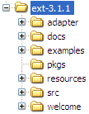
Exploring Folder structure of ExtJS
The unzipped files look like this (the folder structure might slightly differ based on the version of ExtJS you download).
adapter: This folder contains the core engine files (basic foundation) of ExtJS. Also provides interaction with other libraries like YUI, jQuery etc.
docs: This contains the complete UI⁷ documentation for ExtJS. This is an excellent source of information.
Beginning ExtJS with ASP.NET - Lesson 01 - Part two

Slide 9
Exploring Folder structure…
examples: A must-see list of well categorized brilliant demo of Ext examples.
resources: Contains all CSS, images, sprites required by Ext.
src: Contains all the source files of ExtJS. (Altering & playing with these (“src”) files are strictly for advanced professionals ☺)
Beginning ExtJS with ASP.NET - Lesson 01 - Part two

Slide 10
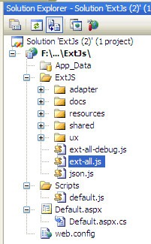
Walking the first step…
Launch the Visual Studio IDE⁶ and create a new website (Do not worry about the framework version).
Add the ExtJS files into a folder named say, “ExtJS” within the newly created website.
Note: You can create a folder with any name of your preference, not necessarily “ExtJS” as depicted here. Name of website & this folder need not be similar (No correlation exists).
Beginning ExtJS with ASP.NET - Lesson 01 - Part two

Slide 11
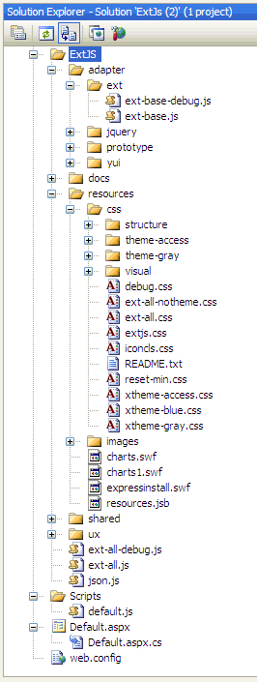
Files to be linked
Add links to all the highlighted files. These files are very much important to set-up the ground work for our application.
Example (in default.aspx):
<link href="ExtJS/resources/css/ext-all.css" rel="stylesheet" type="text/css" />
<script type="text/javascript" language="javascript" src="ExtJS/adapter/ext/ext-base.js"></script>
<script type="text/javascript" language="javascript" src="ExtJS/ext-all.js"></script>
<script type="text/javascript" language="javascript" src=“Scripts/default.js"></script>
Beginning ExtJS with ASP.NET - Lesson 01 - Part two

Slide 12
Explaining the files to be linked …
ext-base.js: This file is the driving engine of Ext. This file is very important & cannot be skipped.
ext-all.js: This file contains all the defined UI elements (like textbox, combo, button, grid etc…) found in the samples & demo link (except ux⁵ type controls). Using this file is highly recommended for beginners. Advanced professionals can replace this with a custom build file.
ext-all.css: Responsible for the default blue theme of ExtJS.
Beginning ExtJS with ASP.NET - Lesson 01 - Part two

Slide 13
Order of linking the files…
CSS:
  Link the “ext-all.css” at the header section of the aspx page.
Java script files:
  ext-base.js must be linked at the first place.
  ext-all.js (or) your custom build file should follow next.
  Additional *.js files, as required by your application can follow next.
Beginning ExtJS with ASP.NET - Lesson 01 - Part two

Slide 14
Can I add more files?
Of course, you can. You are free to add as many files required by your application. Also kindly make sure that, the files you create does not affect the existing CSS class definitions (or) java script variables, xtype, etc.
    When you add more & more JS files & CSS files, it is also recommended to have a look at Website optimizations techniques for CSS & java script. Those tips are potential information for all web application developers.
TIP
Beginning ExtJS with ASP.NET - Lesson 01 - Part two

Slide 15
Important
Start editing the default.aspx & remove form elements with “runat = server” attribute.
Make sure that no form elements within body has “runat = server” attribute.
This attribute removal step is applicable to all web forms you add to your web application.
Beginning ExtJS with ASP.NET - Lesson 01 - Part two

Slide 16
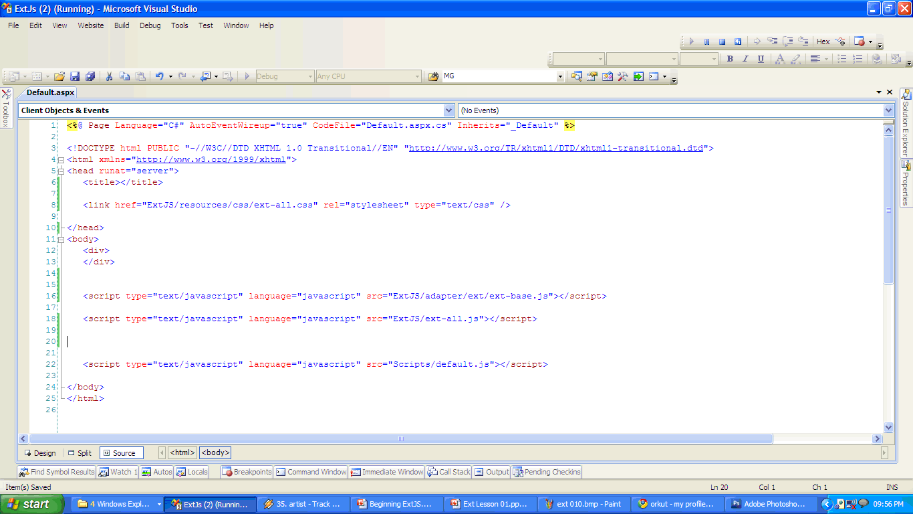
Finishing up links…
Link the ext-all.css at header.
You can add your custom *.css files, if required.
Add ext-base.js, followed by ext-all.js
Our custom .js file.
You can still add *.js files, if required.
Beginning ExtJS with ASP.NET - Lesson 01 - Part two

Slide 17
Our first Hello Ext!!!
Add a java script named “default.js” and place it within a folder named “Scripts” within the root directory.
Start editing your default.js file and add / copy & paste the following contents.
        Ext.onReady(function(){
        Ext.MessageBox.show({
        title: ’My Message’
        , msg: ’My first Hello world using Ext…’
        , buttons: Ext.MessageBox.OK
        , icon: Ext.MessageBox.INFO
        });
        });
Beginning ExtJS with ASP.NET - Lesson 01 - Part two

Slide 18

Run towards Hope…
Verify again, whether you had added the links to the java-script files and CSS files correctly.
Now press the F5 key (or) the “debug” icon in the Visual Studio Standard Toolbar, to execute the application.
If everything is right, you would certainly see the image as in the next slide.
Beginning ExtJS with ASP.NET - Lesson 01 - Part two

Slide 19
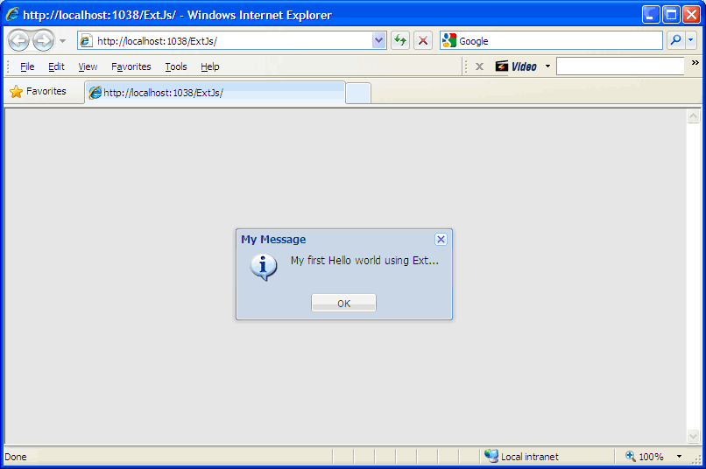
Hello World with ExtJS…
Eureka!!!, there we go… ☺
Beginning ExtJS with ASP.NET - Lesson 01 - Part two

Slide 20
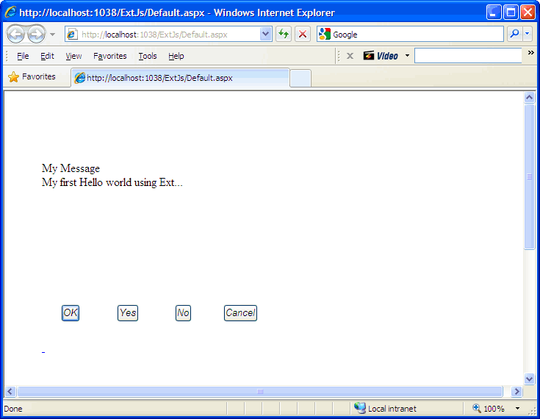
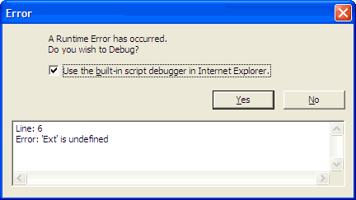
What if anything had went wrong?
If Ext java-script files are not linked properly, you would see this.
If CSS files are not linked properly, you would see this.
Beginning ExtJS with ASP.NET - Lesson 01 - Part two

Slide 21
Fixing & Wrapping it up all…
In case if you face any troubles as in the previous images, kindly correct the links (refer slide-9) and re-execute the application till you succeed.
Following slides would show more information on Ext.
Beginning ExtJS with ASP.NET - Lesson 01 - Part two

Slide 22
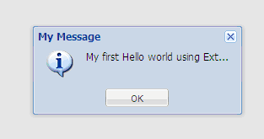
A close look at our code & output
Our code
Output
Ext.MessageBox.show({
title:’My Message’
, msg:’My first Hello world using Ext…’
, buttons: Ext.MessageBox.OK
, icon: Ext.MessageBox.INFO
});
(edited image generated as output).
The values we specified appear as expected in the output. Kindly correlate the input values & output in the “name: value” format.
Beginning ExtJS with ASP.NET - Lesson 01 - Part two

Slide 23
Analyzing code & output...
Unlike the traditional alert box, Ext Messagebox can be highly customized. This is the flexibility ExtJS offers for developers. It is recommended to take a look at the Message box example in the Ext virtual directory you configured for Ext.
And, as you might have observed, displaying a message box requires you to specify every piece of information, in the “name: value” format (Example:- title:’ My Message’). This “name: value” would be followed through out Ext programming.
Beginning ExtJS with ASP.NET - Lesson 01 - Part two

Slide 24
Analyzing code…
In our Ext.MessageBox example, all the four “name: value” pairs are passed within a pair of curly braces “{ }” to the .show() method of Ext.
Ext.MessageBox.show( { title:’Hello World’ } );
The yellow highlighted part is called as “config” object (or) “configuration object”, since this is the deciding authority & instructs Ext, as how to render (display) the Ext Message box.
Beginning ExtJS with ASP.NET - Lesson 01 - Part two

Slide 25
Additional Info on config objects
TIP
More than one items within a config object are comma “,” delimited (separated using a comma).
Almost all Ext components have config objects, mostly passed as constructors. Nesting of config objects are permitted.
Take care to close the curly braces / square braces in the descending order in which they are opened, i.e., last opened bracket is closed first.
Beginning ExtJS with ASP.NET - Lesson 01 - Part two

Slide 26
Looking at an Asynchronous Ext!
As denoted at the beginning of this lesson, Ext is asynchronous (by default).
The code within the function would execute only after the “onReady” event.
Understanding the async nature makes a long step in programming with Ext.
Ext.onReady(function(){
// rest of code follows
});
What is Ext.onReady() ?
Is is an event. “onReady” is the first event that fires when the DOM is constructed by the browser.
Beginning ExtJS with ASP.NET - Lesson 01 - Part two

Slide 27
When Ext.onReady() fires?
Client browser
Web Server
ASP.Net Life Cycle
1
2
3
On after generation, Ext.onReady() fires
Browser generates the page
Parsed contents
6
5
4

Slide 28
Explaining the sequence…
1 to 2: The client browser makes a request to a web page at the web-server.
2 to 3: Web server acknowledges the request, loads the page & executes it. Execution includes all server side application logic (making DB calls / file IO etc) in .net compliant language.
@ stage 3: This shows the life cycle of any web-form from “PreInit” event to “Unload” event.
Note: Explaining the ASP.Net life cycle here, is considered as “out of scope” with this tutorial. While the life cycle has less impact on ExtJS applications, it is good to have knowledge about the ASP.net life cycle.
Beginning ExtJS with ASP.NET - Lesson 01 - Part two

Slide 29
Explaining the sequence…
@ stage 4: Once all server-side events are fired and execution is completed, web server constructs the output form with all required CSS, js files and sends the contents to the browser.
@ stage 5: Browser receives the contents sent by server, parses & generates the page, and finally renders to the user.
Once all the HTML elements are generated, the DOM is said to be ready. All the js files linked with the page, are cached in the local machine.
Beginning ExtJS with ASP.NET - Lesson 01 - Part two

Slide 30
Explaining the sequence…
@ stage 6: Once all the js files are completely cached locally & the DOM is ready, the Ext.onReady() event fires.
It is at this stage, the ExtJS code is loaded from the js files and the UI is rendered / front end execution begins.
ExtJS codes are loaded & executed in the order in which the js files are linked in the aspx page.
Beginning ExtJS with ASP.NET - Lesson 01 - Part two

Slide 31
onReady & Async nature
Like any Ext application, in our “Hello world” example, the message box code executes only after Ext.onReady() event.
Thereby care must be taken as to know & understand, when the components are rendered and when & how they are available for accessibility.
Failing to do this, would throw “Ext.getCmp(‘’) is null or not an object” script error message.
Beginning ExtJS with ASP.NET - Lesson 01 - Part two

Slide 32
Exploring Async nature with VS2008
Microsoft Visual Studio 2008 offers great support for debugging java script files. Kindly make a breakpoint in the java script file (“default.js” in our case) and observe how the program execution is sequenced.
It is strongly recommended that you take your time to settle yourself with this asynchronous nature. It would be greatly helpful in the long run.
Beginning ExtJS with ASP.NET - Lesson 01 - Part two

Slide 33
Conclusion
Hi, I’m happy to have you attention till now and am all the more happy if you let me know me how far this tutorial had helped you grasp the basics of ExtJS, and let me know how the information can be conveyed in an improved, easy-to-read & understand format, how can I adjust my way of conveying information so that no vital info is missed.
Thank you once again.
Beginning ExtJS with ASP.NET - Lesson 01 - Part two

Slide 34
Glossary
client-side: Client-side scripting generally refers to the type of computer programs on the web that are executed client-side, by the user's web browser, instead of server-side (on the web server).
RIA (Rich Internet Application): RIAs are web applications that have many of the characteristics of desktop applications, typically delivered either by way of a site-specific browser, via a browser plug-in, or independently via sandboxes or virtual machines
Beginning ExtJS with ASP.NET - Lesson 01 - Part two

Slide 35
Glossary
Data-driven applications: An application / website that stores/ retrieves/ manipulates data and the nature of output depends on the value of data, and subjected to change with time.
DOM: Document Object Model. The layout of web form constructed by the browser (using / not using output generated by web-server).
CSS: Cascading Style Sheets. A document that contains all the style definitions for a website.
Beginning ExtJS with ASP.NET - Lesson 01 - Part two

Slide 36
Glossary
IDE: Integrated Development Environment: Denotes a single application / program that is suitable for more than one development activity. Example: Visual Studio
UI: User Interface
ux: User Extensions. These files are either user defined plugins (or) custom/value added controls created by Ext users / community. These files also ship with Ext.
Beginning ExtJS with ASP.NET - Lesson 01 - Part two

Slide 37
Glossary
9. xtype: “xtype” means control type. This specifies the controls (like textfield, button, label, combobox, etc )we use in our application.
  example: xtype: ‘textfield’
Beginning ExtJS with ASP.NET - Lesson 01 - Part two

Slide 38
With Thanks…
Hi, I’m happy to have you attention till now and am all the more happy if you let me know me how far this tutorial had helped you grasp the basics of ExtJS, and just let me know how the information can be conveyed in an improved, easy-to-read & understand format, how can I adjust my way of conveying information so that no vital information is missed.
Thank you once again.
Beginning ExtJS with ASP.NET - Lesson 01 - Part two

Slide 39
Past & Present
Past: “Beginning ExtJS with ASP.Net”
Present: “Beginning ExtJS with ASP.Net” (Part two)
Unlike the previous tutorial, the 14 slide tutorial, which is the part one of this series, I had tried to convey additional information wherever possible.
Though conscious efforts are made as not to slip away from the actual approach, I would really appreciate any such notifications from you.
Beginning ExtJS with ASP.NET - Lesson 01 - Part two

Slide 40
Next in the Series…
Designing a user login panel with Ext.
Tentative date: 30-04-2010
The next tutorial would explain how to use controls like textboxes, buttons to create and use a simple login form.
Check out for further releases…
This date is an approximate estimation and is subjected to change without prior notification.
Beginning ExtJS with ASP.NET - Lesson 01 - Part two

Slide 41
Contact me via
Mail:
arunprasadnva@gmail.com
arun85prasad@gmail.com
Social network(s) / Services:
  arunprasadvidhyaarthi – skype, slideshare.com
  Arun85prasad – twitter, gmail, live, yahoo.com
  Arun Prasad - facebook, orkut
  Arunprasad – scribd.com
Mobile:
+91 93446 20159
Beginning ExtJS with ASP.NET - Lesson 01 - Part two

Slide 42
Disclaimer
The names of Technologies, Product(s), Companies, Application(s), Tool(s), Utilities, etc provided with this material are intended to reference only. The name(s), brand name(s), trademark(s), registered trademark(s), logo(s), slogan(s) belong to their respective owners in the respective countries.
Beginning ExtJS with ASP.NET - Lesson 01 - Part two

