Slide 1
Navigating the DOM with ExtJS
By Aaron Conran

Slide 2
Document Object Model
The Document Object Model or DOM is a standard to represent HTML, XHTML and other XML formats.
The DOM is represented as a tree within the browser and provides access to all node’s on the current page

Slide 3
DOM Nodes
DOM Nodes can be of various types
The type of node can be determined by a property called nodeType
The most frequently used nodeType’s are:
  document.ELEMENT_NODE (1)
  document.TEXT_NODE (3)
  document.DOCUMENT_NODE (9)
From here on we will refer to DOM node’s with a nodeType of ELEMENT_NODE as an HTMLElement.

Slide 4
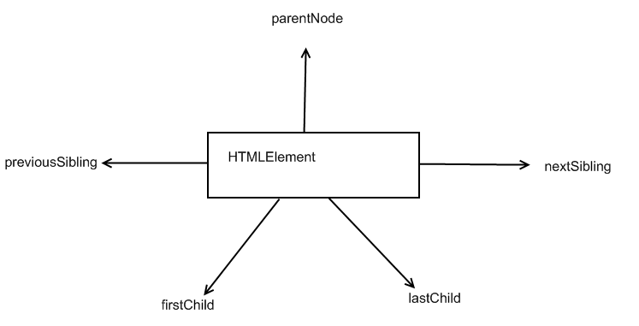
DOM Pointers
Each dom node has 5 pointers which allow you to navigate through the DOM
  parentNode
  previousSibling
  nextSibling
  firstChild
  lastChild
These pointers will return null if there is no associated dom node

Slide 5
DOM Pointers
Finding related elements with only DOM pointers may prove frustrating
ExtJS allows you to find related elements much easier by
  eliminating cross-browser inconsistencies
  ignoring empty textnodes created by formatted markup
  implementing CSS/XPath selection

Slide 6
Retrieving an HTMLElement
With standard JavaScript we would retrieve an HTMLElement by:
var myEl = document.getElementById(‘myID’);
With Ext we can retrieve the same HTMLElement by:
var myEl = Ext.getDom(‘myID’);

Slide 7
Ext.Element
Ext.Element is a wrapper class around HTMLElement which provides functionality for manipulating, creating and finding other Elements
Ext.Element maintains cross-browser compatibility
Ext.Element has an HTMLElement property named dom
  ‘has’ signifying that Ext.Element uses aggregation rather than inheritance

Slide 8
Getting an Element
To retrieve an Ext.Element:
  var myEl = Ext.get(‘myID’);
To directly access the HTMLElement of myEl use the dom property:
myEl.dom.innerHTML

Slide 9
Searching for
Related Elements
Given the following markup:
<fieldset>
<legend>Email</legend>
<div>
<input type="text" name="email" id="email" />
</div>
</fieldset>
Task: Find the fieldset element with only a reference to the ‘email’ element.
Code:
var el = Ext.get(‘email’).up(‘fieldset’);
Input’s ID
CSS Selector

Slide 10
up or findParentNode
up
public function up( String selector, [Number/String/HTMLElement/Element maxDepth] )
Walks up the dom looking for a parent node that matches the passed simple selector (e.g. div.some-class or span:first-child). This is a shortcut for findParentNode() that always returns an Ext.Element.
Parameters:
  selector : StringThe simple selector to test
  maxDepth : Number/String/HTMLElement/Element(optional) The max depth to search as a number or element (defaults to 10 || document.body)
Returns:
  Ext.Element The matching DOM node (or null if no match was found)
This method is defined by Element.

Slide 11
CSS/Xpath Selectors
ExtJS supports most CSS3 Selectors and Xpath
Examples
  div.myClass
  body
  a.window
  Div:only-child
  div:last-child
  div > div

Slide 12
Methods for Searching the DOM
child
contains
down
findParent
findParentNode (or up)
getNextSibling
getPrevSibling
is
query
select
up

