Slide 1

Developing Components and Extensions for Ext JS
2011 Mats Bryntse

Slide 2
About me
presenter = {
name : ”Mats Bryntse”,
from: ”Helsingborg, Sweden”,
usingExtSince : 2007,
website : ”www.bryntum.com”,,
twitter : ”@bryntum”
};

Slide 3
Before we start...
Let’s do a raise of hands

Slide 4

How many has heard of:
jQuery?
Ext JS?

Slide 5


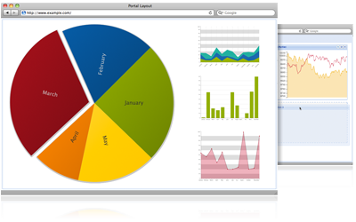
If you haven’t seen/heard
www.sencha.com

Slide 6
How I met Ext JS
Stumbled upon Ext 2007 at SEMC
Mission: Internal portal application
Data-heavy application
Lots of data input, forms etc.
Lots of tables to display
Had to run on the best, most awesome browser in the world

Slide 7
Can you guess which one?

Slide 8
Requirements
Solid grid – Lots of data lists
Architechture – data stores, widgets
Polished UI without requiring deep HTML or CSS knowledge.

Slide 9



We prototyped
Microsoft Ajax
jQuery
Ext JS

Slide 10
Scoreboard
Framework | Fancy Grid | Architecture | Polished UI
MS Ajax | No | No | No
jQuery | Could work | No | No UI
Ext JS | Yes | Yes | Yes

Slide 11
Result
Ext JS worked out well!
Customer happy
But... one feature we couldn’t solve using pure Ext JS at that time
A visual scheduling widget

Slide 12
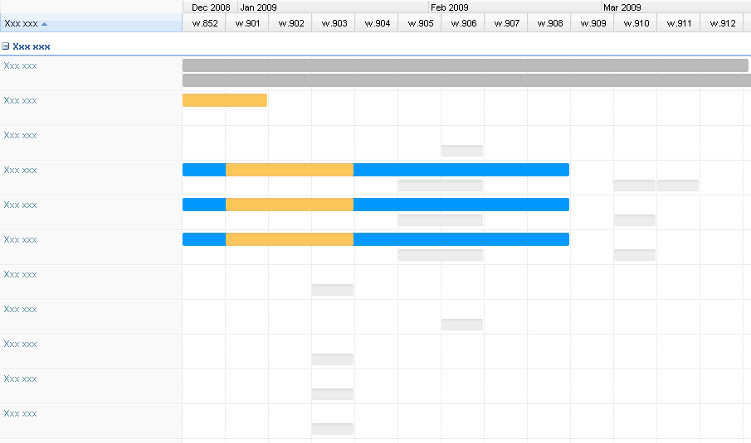
Customer wants:

Slide 13
Search began
Found a few flash ones, not allowed to use
No JavaScript based ones, hardly any web based either
But after serious Googling research we did find something...

Slide 14

”Widget X”
Image blurred to protect you

Slide 15


Widget X review
Is it JavaScript based?
So, is it interactive?
Is it at least beautiful?
Implement it anyway?
ASP.NET
No, sir
No
Hell Yeah!

Slide 16
Customer wanted
Customer got
#FAIL

Slide 17
Fast forward to 2009
>>

Slide 18
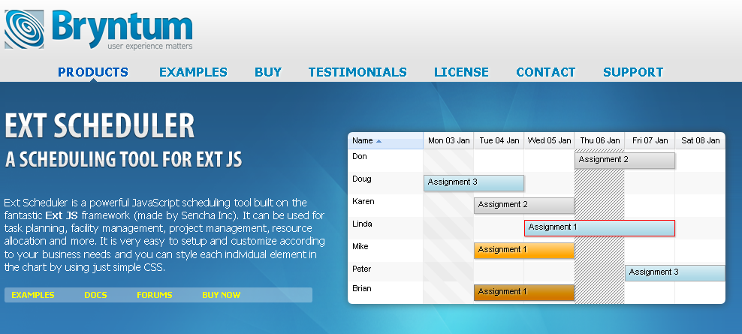
I decided to write my own

Slide 19
Conclusion
Writing Ext JS components is a lot of fun (and addictive)

Slide 20
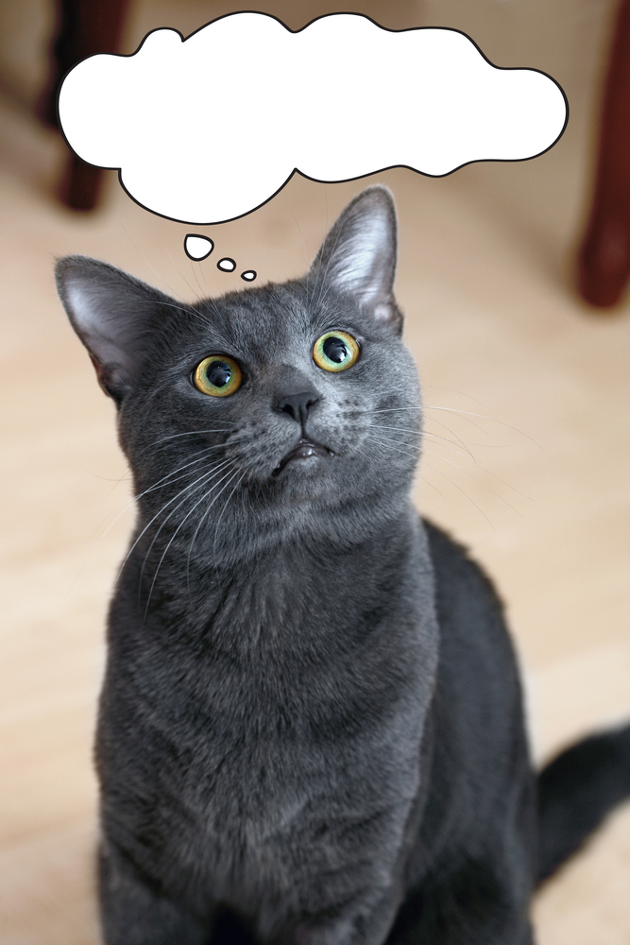
So where do I start?
WTF??

Slide 21
Visit www.sencha.com
Get Ext JS SDK
sencha.com/learn

Slide 22
Ext JS Terminology & Concepts
Ext Component
Ext Container
Extension
Plugin
Mixin

Slide 23
Ext.Component
Base class for most popular Ext widgets
(GridPanel, TabPanel, TextField etc...)
Can be part of any layout structure as a child of a Container.
All subclasses of Component has a managed lifecycle (creation, rendering and destruction) which is provided by the Container class.

Slide 24
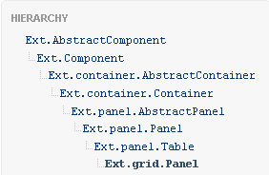
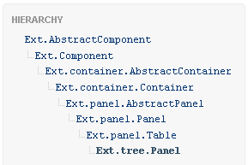
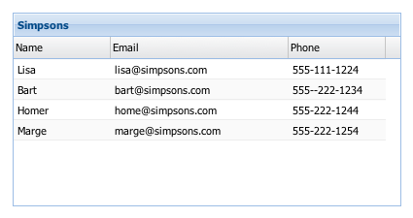
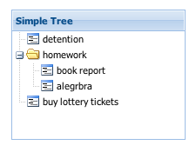
Ext.Component: Base class for most popular Ext widgets

Slide 25
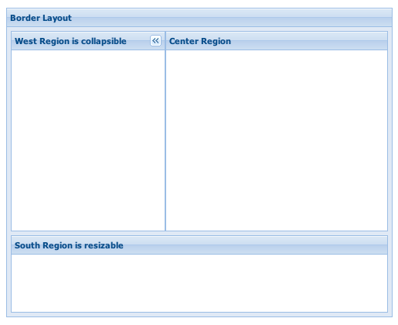
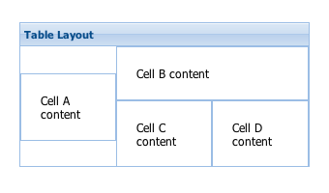
Ext.Component
Can be part of any layout structure as a child of a Container.

Slide 26
Ext.Component lifecycle
All subclasses of Component has a managed lifecycle (creation, rendering and destruction) which is provided by the Container class.
Constructor
Initialize
Render
Destroy

Slide 27
Ext.Component lifecycle and template methods
* Initialization (constructor, initComponent)
- Configuration, setup etc...
* Rendering (onRender, afterRender)
- Add additional elements and markup
* Layout (afterLayout)
- Executed after the component has been laid out
* Destruction (onDestroy)
- Clean up after yourself, destroy elements etc.

Slide 28
Ext.Container
Base class for any Component that needs to contain other Components.
Handles the basic behavior of containing items: adding, inserting and removing items.
The most commonly used Container classes are Panel, Window and TabPanel.

Slide 29
What is an Ext JS extension?
?

Slide 30
Ext JS extension
Subclassing an Ext JS ”class”
Doesn’t have to be UI-related
Reusable throughout your app

Slide 31
Simple extension
Ext.define('MyClass', {
extend: ’Ext.TabPanel’,
constructor: function() {
alert(”Look ma, I have tabs”);
this.callParent();
}
});

Slide 32
Class properties
The properties and methods you define for your class are added to the prototype of your class.
Ext.define('MyClass', {
extend: ’Ext.TabPanel’,
favoriteTab : 3,
someFunction : function() { ... }
});
console.log(MyClass.prototype.favoriteTab); // => 3

Slide 33
Instantiating your class
var foo = Ext.create('MyClass', {
// Config properties
});
// Or just use classic ’new’
var bar = new MyClass({
// Config properties
});

Slide 34

Mixins

Slide 35
Mixins
Brand new concept when it comes to Ext JS 4. A mixin is just a set of functions (and sometimes properties) that are merged into a class.
Mixins are really useful when a class needs to inherit multiple traits but can’t do so easily using a traditional single inheritance mechanism

Slide 36
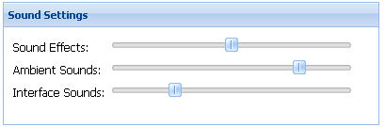
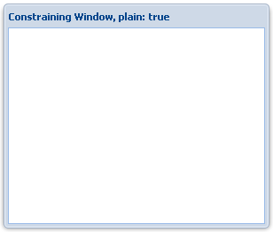
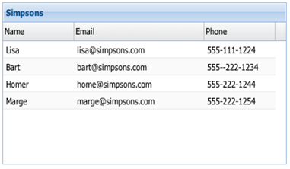
Mixins - example
Ext.Window is a draggable component, as are Sliders, Grid headers, and many others

Slide 37
Mixins - example
Because this behavior is desired in many different places it’s not feasible to work the draggable behavior into a single superclass
Creating a Draggable mixin solves this problem – anything can now be draggable very easily.

Slide 38
Mixins
// We can define some mixins at definition time
Ext.define('MyClass', {
mixins: {
observable: 'Ext.util.Observable'
}
});
// It’s easy to add more later too
MyClass.mixin('draggable', 'Ext.util.Draggable');

Slide 39

Plugins

Slide 40
Plugins
A plugin augments a single instance of an Ext Component. Any object with an init method.
Used to add a feature to a component, for example adding cell-editing to a GridPanel.
During its initialization phase, the host component calls the init method of all its plugins, and passes itself as the only argument

Slide 41
Defining a plugin
// Simplest possible plugin
var mySillyPlug = {
init : function(host) { alert(’Hello world’); }
};

Slide 42
Using a plugin
// Adding inline editing support to grid cells
Ext.create(’Ext.grid.Panel', {
plugins: Ext.create('Ext.grid.plugin.CellEditing', { clicksToEdit: 1
})
});

Slide 43
Let’s create a simple extension
!

Slide 44
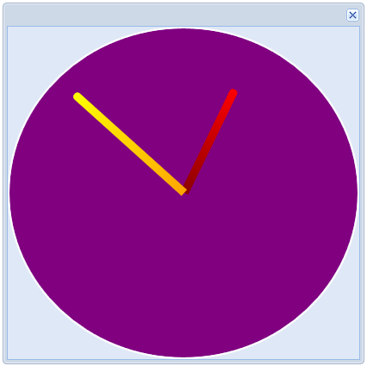
A simple CSS 3 clock component

Slide 45
Step 1. Identify suitable
base class

Slide 46
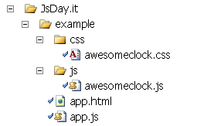
Step 2. Create a simple HTML page and JS files

Slide 47
Step 3. Create extension skeleton class
Ext.define(”AwesomeClock”, {
extend : ”Ext.Component”,
cls : “myclock”, // A CSS class for styling
afterRender : function() {
// Call superclass
this.callParent(arguments);
}
});

Slide 48
Step 3.5: simple app.js
application file
new AwesomeClock({
width : 320,
height : 320,
renderTo : Ext.getBody()
});

Slide 49
Step 3.99: HTML file
<html>
<head>
<!-- Ext JS CSS -->
<link rel="stylesheet" type="text/css" href="ext-4.0.0/ext-all.css" />
<!-- Our CSS for the extension -->
<link href="css/awesomeclock.css" rel="stylesheet" type="text/css" />
<!-- Ext JS Library -->
<script src="ext-4.0.0/bootstrap.js" type="text/javascript"></script>
<!--Our own classes-->
<script type="text/javascript" src="js/awesomeclock.js"></script>
<!--Simple Test App File-->
<script type="text/javascript" src="app.js"></script>
</head>
<body></body>
</html>

Slide 50

Step 4. Does it run?

Slide 51
Step 5. Let’s add some code
afterRender : function() {
this.callParent(arguments);
this.hourHand = this.el.createChild({...});
this.minuteHand = this.el.createChild({...});
this.date = new Date();
setInterval(Ext.Function.bind(this.updateHands, this), 1000);
Ext.Function.defer(this.updateHands, 100, this);
},
updateHands : function() { ... }

Slide 52
Step 6. Does it still run?

Slide 53
Step 7. Let’s add some CSS(3)
.myclock
{
background:-moz-linear-gradient(bottom, blue, navy);
border-radius: 100%;
position:relative;
border:2px solid white;
-moz-transition: all 0.4s ease-in-out;
}
.myclock-hand
{
width : 10px;
position:absolute;
left:49%;
-moz-transition: all 1s ease-in-out;
border-radius: 10px 10px 0 0;
}

Slide 54
Step 8. Are we done?

Slide 55
Now another developer Bob can use this extension...
As a child item in one of his Ext panels
He can also extend our extension to add his own custom features
He can create plugins to add functionality

Slide 56

So what does Bob want to do?

Slide 57
Bob has a vision!
Create a new Window extension ”AwesomeWindow”
BobsWindow will contain an AwesomeClock
Adds controls to change time

Slide 58
Let’s make Bob happy!

Slide 59
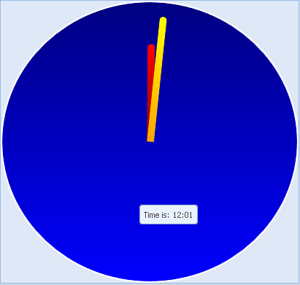
Adding behaviour through a plugin
Plugin

Slide 60
Plugin skeleton
Ext.define('MyPlugin', {
init : function(hostClock) {
this.clock = hostClock;
// TODO, do something cool
}
}

Slide 61
Let’s write it!

Slide 62
To sum it up:
We created our own AwesomeClock class
We could then include it in another class
We also wrote a simple plugin for our component
Was it cool?

Slide 63

No - your example sucks, and it’s really boring too btw. #fail

Slide 64
We built a very ”low level” extension
Let’s see a few advanced extensions built with Ext JS

Slide 65
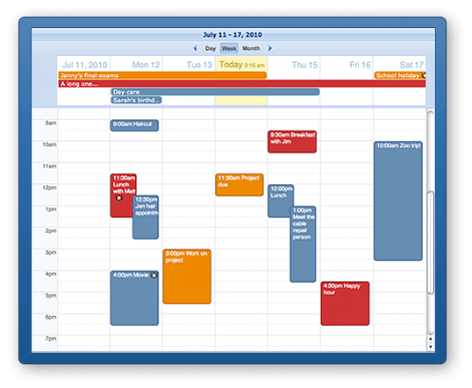
Ext Calendar Pro
www.ext-calendar.com

Slide 66
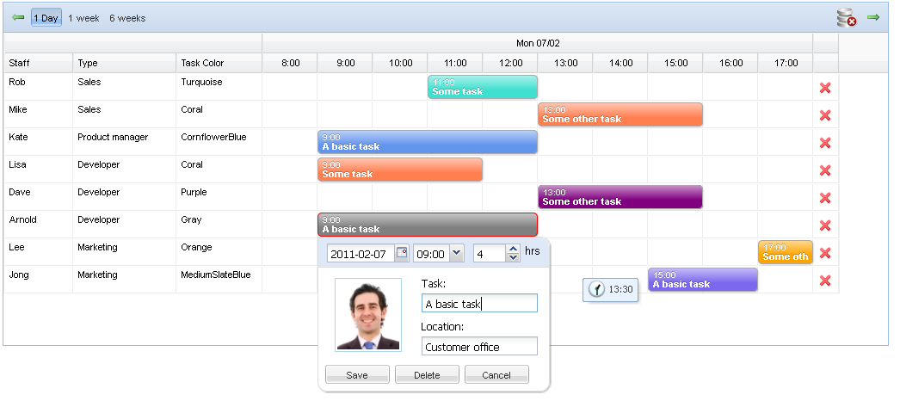
Ext Scheduler

Slide 67


This is the nice thing about the Sencha products: if I can think of it I can build it

Slide 68


@bryntum
mats@bryntum.com

