Slide 1

CRUD with Dojo
The bread and butter of IT
Eugene Lazutkin
ClubAJAX, 2009

Slide 2
What is CRUD?
Common database operations:
  Create
  Read
  Update
  Delete

Slide 3
CRUD in IT
Common forms:
  Data entry.
  Looking for records.
  Editing existing records.
  Drilling down.
  Calculators.

Slide 4
Our goals
  Improve scalability.
  Improve usability.
  Reduce complexity.

Slide 5
Improved scalability
Try to move to the client-side:
  Presentation logic.
  Error processing.
  Internationalization (i18n).
  Localization (l10n).
  Accessibility (a11y).
The goal is to off-load servers as much as possible.

Slide 6
Improved usability
  Immediate validation.
  Dynamic hints, helpers.
  Consistent L&F.
  Present only relevant choices.

Slide 7
Reduced complexity
Make advanced forms possible:
  Validate several fields at once.
  Assemble form from several sources.
  Save form to several sources.
  Get additional data asynchronously.
    Asynchronous calculations.
    Asynchronous server-side validation.

Slide 8
Come to the Client Side, Luke.

Slide 9
What Dojo offers
Low-level plumbing:
  XHR (asynchronous I/O).
  Event normalization.
  DOM traversal and manipulations.
Practically all major JavaScript libraries offer these facilities.

Slide 10
What Dojo offers
Two major projects:
  Dijit
    UI components.
  DojoX
    Advanced components.

Slide 11
Dijit and DojoX for CRUD
Hard to implement components:
  Extensible rich text editor.
  Flexible grid.
  Tree.
  Charts.
  Alternative widgets:
    Calendar, color picker, spinners, sliders, progress bars, menu...

Slide 12
Dijit and DojoX for CRUD
Two major groups:
  Layout widgets:
    Used to layout a page when you cannot do it with CSS.
    Dialogs and tooltips.
  Form widgets:
    Can be used instead of regular form elements.

Slide 13
Dijit and DojoX for CRUD
Two major groups:
  Layout widgets:
    Used to layout a page when you cannot do it with CSS.
    Dialogs and tooltips.
  Form widgets:
    Can be used instead of regular form elements.

Slide 14
Form widgets
How they improve on form elements:
  Skinnable.
  Unified API.
  Validation-aware.
They play nice with regular forms, keyboard, i18n, l10n, a11y.

Slide 15
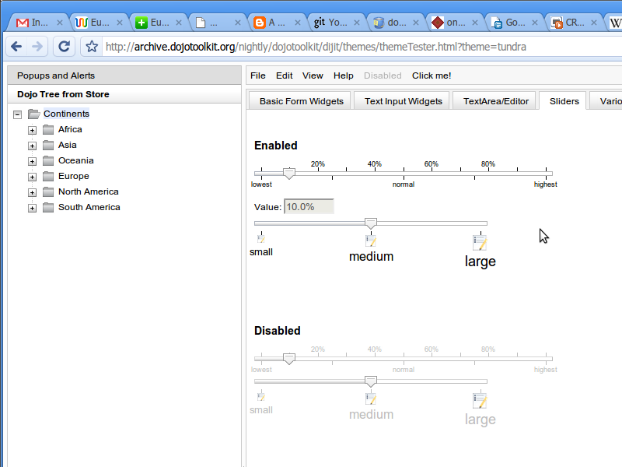
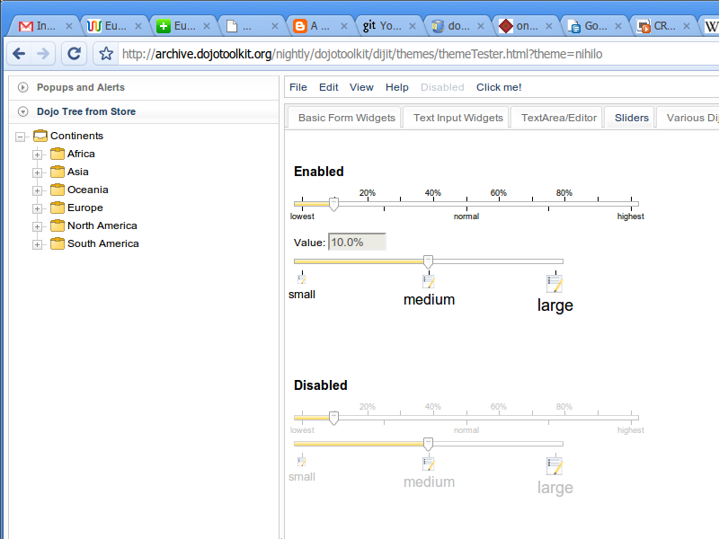
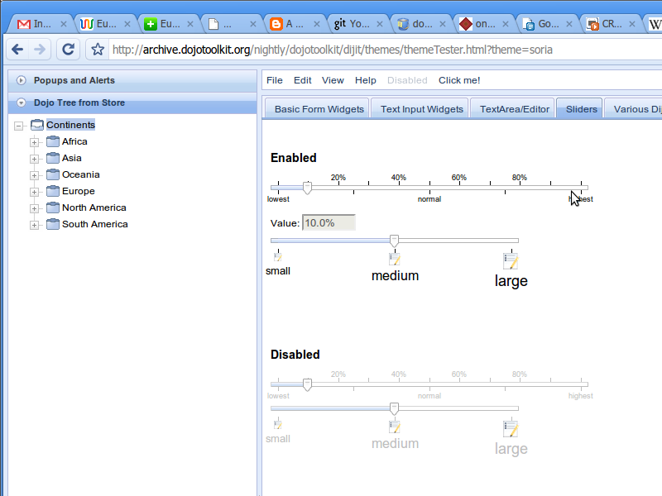
Skins: Demo
http://archive.dojotoolkit.org/nightly/dojotoolkit/dijit/themes/themeTester.html

Slide 16
Unified API
All form elements look the same from the server side:
  name1=val1&name2=val2...
  exceptions:
    <input type=image>
    <input type=file>
What is the problem?

Slide 17
Unified API
What is wrong with form elements?
API depends on element:
  Getting state.
  Setting state.
  Processing change events.

Slide 18
Example: <select>
Getting state:
  select.value, if singular.
  All <option> values with selected="selected".
Setting state:
  Go over all <option> and select/deselect accordingly.

Slide 19
Example: value changed
onkeyup:
  ﻿<textarea>, <input type=text>, <input type=password>
onchange:
  <select>
onclick:
  the rest.

Slide 20
Problem: not flexible
Real life case of UI redesign:
  Initially a field was a validated text box.
  Later on it was replaced with a select + fixed set of values.
  Based on user's feedback the select was replaced with a set of radio buttons.

Slide 21
Problem: not flexible
All UI redesigns would be painful:
  We need to rewrite our code.
  We may introduce new bugs.
We need an abstraction to cover the differences.

Slide 22
Solving the problem
There are two ways to go about it:
  Let's provide better building blocks.
  Let's work with forms using higher-level tools.
Dojo provides both solutions.

Slide 23
Better building blocks
Form widgets are better building blocks:
  Unified API.
  UI widgets beyond the standard set.
All form widgets are based on dijit.form._FormWidget. Let's look at it in details.

Slide 24
Form widget: props
Exposed properties:
  Normal:
    name, value, disabled, tabIndex.
  Advanced:
    intermediateChanges: fire on every change, or onblur.
    scrollOnFocus: show the whole widget when focused.

Slide 25
Form widget: methods
Exposed methods:
  attr(): get/set attributes including value and disabled.
  focus(): set a focus on this widget.
  onChange(): callback for change notifications.
  onClick(): callback for button clicks.

Slide 26
Example: form widget
var widget = new dijit.form.SomeWidget(...);
...
dojo.connect(widget, "onChange",
function(newValue){
console.log("value changed: ", newValue);
});
...
widget.attr("value", "42");
widget.focus();
...
var val = widget.attr("value");

Slide 27
Available form widgets
dijit.form:
  Button, CheckBox, ComboBox, ComboButton, CurrencyTextBox, DateTextBox, DropDownButton, FilteringSelect, HorizontalRule, HorizontalRuleLabels, HorizontalSlider, MappedTextBox, MultiSelect (continued).

Slide 28
Available form widgets
dijit.form:
  NumberSpinner, RadioButton, RangeBoundTextBox, Select, SimpleTextarea, Slider, Textarea, TextBox, TimeTextBox, ToggleButton, ValidationTextBox, VerticalRule, VerticalRuleLabels, VerticalSlider.

Slide 29
Available form widgets
dojox.form:
  BusyButton, CheckedMultiSelect, DateTextBox, DropDownStack, FileInput, FileInputAuto, FileInputBlind, FilePickerTextBox, FileUploader, ListInput, MultiComboBox, PasswordValidator (continued).

Slide 30
Available form widgets
dojox.form:
  RadioStack, RangeSlider, Rating, TimeSpinner.
Even more widgets can be found in dojox.widget.

Slide 31
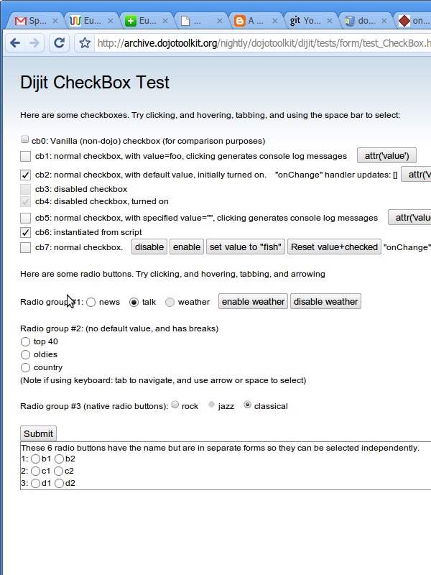
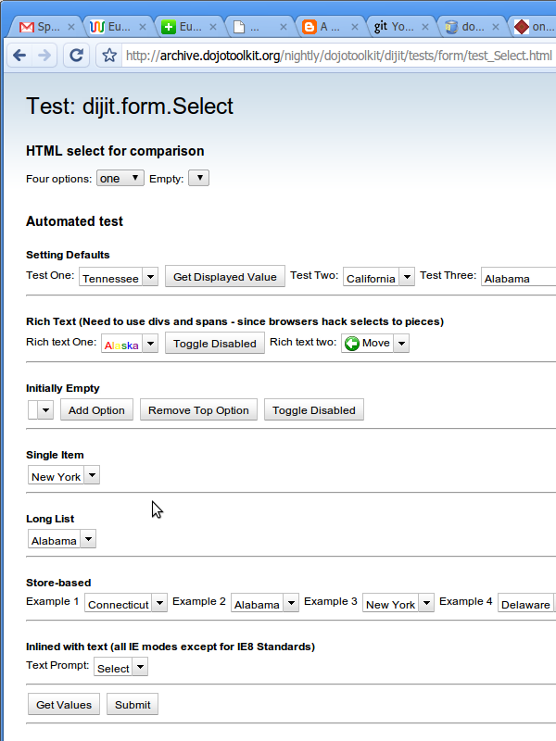
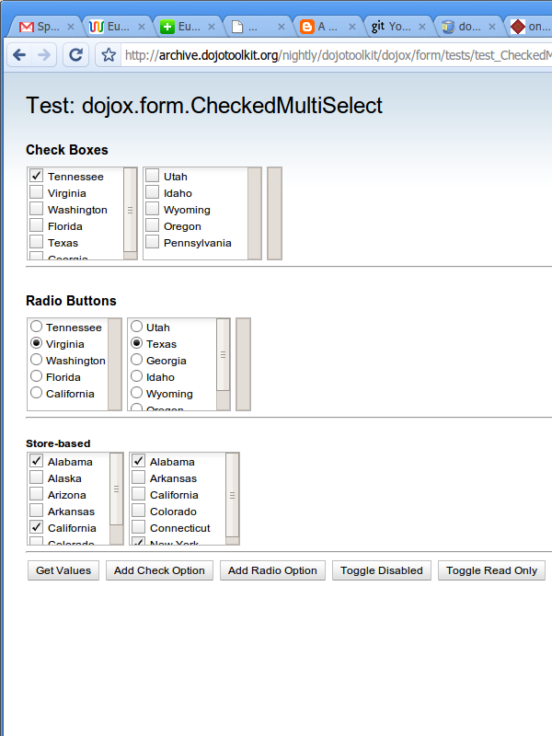
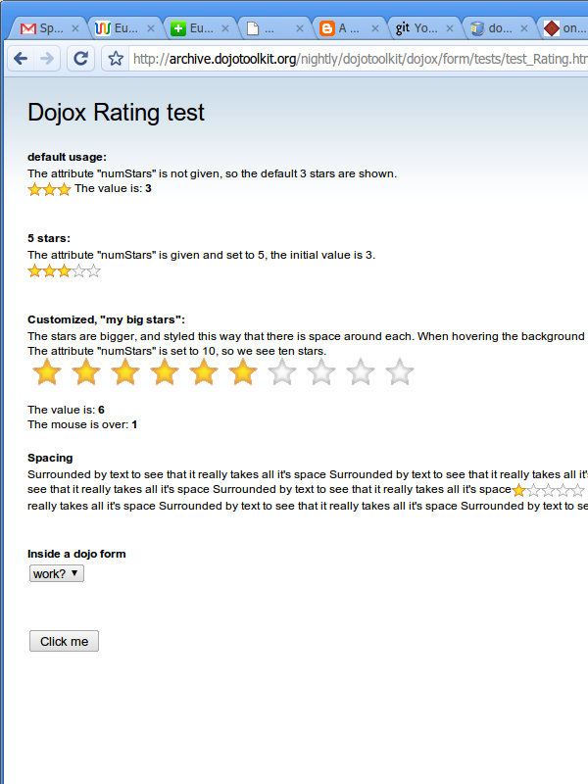
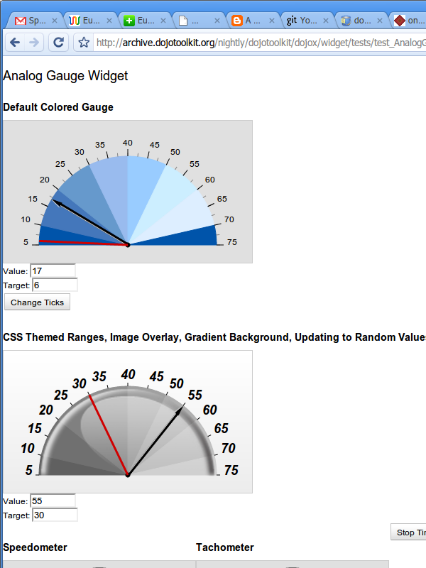
Form widgets: Demo
http://archive.dojotoolkit.org/nightly/dojotoolkit/dijit/tests/form/
http://archive.dojotoolkit.org/nightly/dojotoolkit/dojox/form/tests/
http://archive.dojotoolkit.org/nightly/dojotoolkit/dojox/widget/tests/

Slide 32
Validation
Special group of widgets based on <input> with helpers and validators:
  Value can be edited manually.
  Visible value and "real" value can be different.
  Visible value can be formatted.

Slide 33
Validation
More:
  Constraints.
  Integrated visual cues.
  Tooltip hints.
  "Required" flag.

Slide 34
Constraints
dijit.form.RangeBoundTextBox:
  min, max
dijit.form.NumberTextBox:
  places
  locale (e.g., "en-us")
  pattern (e.g., "0#.##")

Slide 35
Constraints
dijit.form.CurrencyTextBox:
  all numeric constraints
  currency code, symbol
  fractional (include fractions or not)

Slide 36
Constraints
dijit.form.DateTextBox, dijit.form.TimeTextBox:
  overriding AM and PM.
  range, increment.
  locale, selector, patterns, format.

Slide 37
Example: validation
<input type="text" name="age">
<!-- can be decorated: -->
<input type="text" name="age"
dojoType="dijit.form.NumberTextBox"
constraints="{min: 0, max: 150, places: 0}"
promptMessage="Enter your age"
maxLength="3" required="true">

Slide 38
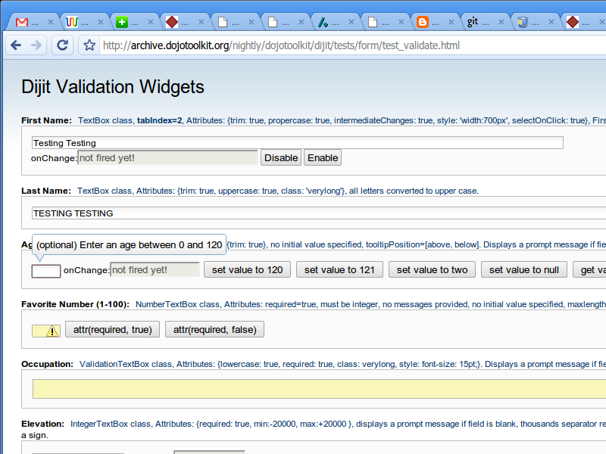
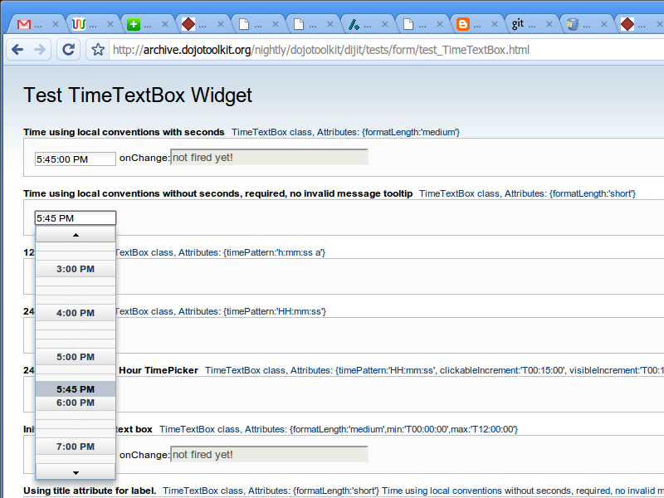
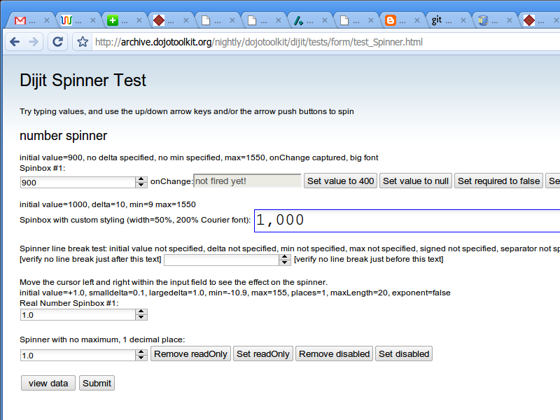
Validation: Demo
http://archive.dojotoolkit.org/nightly/dojotoolkit/dijit/tests/form/test_validate.html
http://archive.dojotoolkit.org/nightly/dojotoolkit/dijit/tests/form/test_TimeTextBox.html
http://archive.dojotoolkit.org/nightly/dojotoolkit/dijit/tests/form/test_Spinner.html

Slide 39
dijit.formForm
Simple form helper:
  Augments <form>.
  Validates all fields on submit.
  Gets/sets form fields as a dictionary (key-value pairs).

Slide 40
Beyond static forms
We want more:
  Validation rules involving several fields at once.
  Depending on user choices:
    Get/set CSS classes.
    Enable/disable fields.
    Hide/show parts of a form.

Slide 41
Form orchestration
dojox.form.manager:
  Declarative form definition.
  Seamless key-value access to:
    Form widgets.
    DOM form elements.
    Attached DOM nodes.

Slide 42
Form orchestration
dojox.form.manager:
  Use observers to watch for controlled form fields.
  Implemented as a set of mixins.
    Pay only for what you use.
    Write your own widgets.

Slide 43
Example: simple form
<form action="/sink" id="myForm">
<input type="text" name="name">
...
<textarea name="notes"></textarea>
</form>

Slide 44
Example: adding manager
<form action="/sink" id="myForm"
dojoType="dojox.form.Manager">
<input type="text" name="name">
...
<textarea name="notes"></textarea>
</form>

Slide 45
Example: using manager
var mgr = dijit.byId("myForm");
// read a field, modify it, write it back
var name = mgr.elementValue("name");
if(name == "Mike") { name = "Bob"; }
mgr.elementValue("name", name);

Slide 46
Example: using manager
// read all fields
var values = mgr.gatherFormValues();
values.name = "Bob";
// read some fields
values = mgr.gatherFormValues(
["name", "notes"]);
// write all back
mgr.setFormValues(values);

Slide 47
Example: adding observers
<form action="/sink" id="myForm"
dojoType="dojox.form.Manager">
<input type="text" name="name"
observer="onNameChange">
...
<textarea name="notes"></textarea>
</form>

Slide 48
Example: using observers
// this function should be added
// to our custom form manager
onNameChange: function(value, field){
console.log("changed field: ", field);
console.log("new value: ", value);
};

Slide 49
Example: using observers
// let's do something more complex
onNameChange: function(value){
// "this" is our form manager
var notes = this.elementValue("notes");
if(value == "Bob" && !notes){
this.elementValue("notes", "Likes JS");
this.disable(["notes"]);
}
};

Slide 50
Example: controlling nodes
<form action="/sink" id="myForm"
dojoType="dojox.form.Manager">
<input type="text" name="name">
...
<div dojoAttachPoint="optional">
<textarea name="notes"></textarea>
</div>
</form>

Slide 51
Example: controlling nodes
// hiding example
onNameChange: function(value){
// "this" is our form manager
if(value == "Mike"){
this.hide(["optional"]);
}
};

Slide 52
Example: controlling nodes
// more complex hiding example
onNameChange: function(value){
// "this" is our form manager
this.show({optional: value != "Mike"});
};

Slide 53
Reduced complexity
Make advanced forms possible:
  Validate several fields at once.
  Assemble form from several sources.
  Save form to several sources.
  Get additional data asynchronously.
    Asynchronous calculations.
    Asynchronous server-side validation.

Slide 54
Beyond callbacks
Asynchronous operations

Slide 55
Next time...
Stay tuned...

Slide 56
Documentation links
dijit.form:
  http://docs.dojocampus.org/dijit/form
Constraints:
  http://docs.dojocampus.org/quickstart/numbersDates
dojox.form.manager:
  http://docs.dojocampus.org/dojox/form/manager

Slide 57
About me
My web site:
  http://lazutkin.com/

