Slide 1
Creating Elements with Ext.DomHelper
By Aaron Conran

Slide 2
Creating Elements with the DOM
The DOM provides us with methods such as document.createElement and HTMLElement.setAttribute as well as the innerHTML property to create elements
Creating elements strictly through DOM methods can be tedious and verbose

Slide 3
Cross-browser Support
Cross-browser inconsistencies eliminated
ExtJS knows when to set properties, use setAttribute or use innerHTML depending on the browser
Creating elements with only the DOM can be slow in certain browsers and using innerHTML is not allowed in others

Slide 4
ExtJS DomHelper
The Ext.DomHelper class is a convenient utility class for working with the dom.
It supports using both HTML fragments and the dom
We’ll look at a comparison between strictly using the DOM and Ext’s DH
Then we’ll go over the various config options of DH

Slide 5
Comparison
// Using DOM methods
var myEl = document.createElement('a');
myEl.href = 'http://www.yahoo.com/';
myEl.innerHTML = 'My Link';
myEl.setAttribute('target', '_blank');
document.body.appendChild(myEl);
// Using Ext’s DomHelper (DH) for short
Ext.DomHelper.append(document.body, {tag: 'a', href: 'http://www.yahoo.com/', html: 'My Link', target: '_blank'});

Slide 6
DomHelper config
DH Configs are used throughout the Ext library
Such as:
  autoCreate attribute of a ContentPanel or BasicDialog (Ext 1.x)
  html attribute of a Panel or Window (Ext 2.x)

Slide 7
DH Configs
DH Configs support the following custom attributes:
  tag – this is the HTMLElement to create
  cls – this is the CSS class to use
  style – this is any inline CSS style info. This can be either an object literal or a quoted string
  htmlFor – this is the HTMLElement’s for attribute
  html – this is the inner html of the new element
  cn/children – this is an array of children elements which also use DH configs

Slide 8
DH Configs
DH configs also support all other HTML attributes
Ex:
  target
  name
  id
  value
  href

Slide 9
Ext.DomHelper
DomHelper provides us methods to put our newly created elements in the DOM
  append
  insertAfter
  insertBefore
  insertFirst
  overwrite

Slide 10
Ext.DH
All of these methods have the same signature
( String/HTMLElement/Element el, Object/String o, [Boolean returnElement] )
  el – is the context element
  o – is the DH config object
  returnElement – is an optional boolean value to return an Ext.Element instead of an HTMLElement

Slide 11
DH
append – adds the new element as the last child of the context element
insertAfter – adds the new element directly after the context element
insertBefore – adds the new element directly before the context element
insertFirst – adds the new element as the first child of the context element
overwrite – overwrites the inner html of the context element

Slide 12
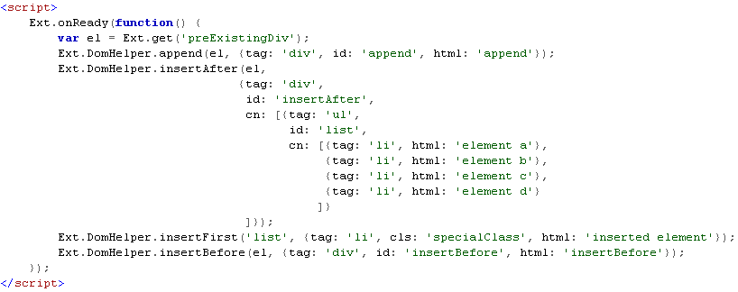
DH Complex Example
Code:
Existing markup:
<div id="preExistingDiv">
<div id="preExistingFirstChild"></div>
</div>

Slide 13
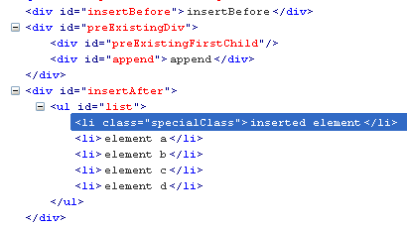
DH Complex Example
Result:

