Slide 1

Developing Components and Extensions for Ext JS
2010 Mats Bryntse

Slide 2
About me
{
name : ”Mats Bryntse”,
extForumAlias: ’mankz’,
age : 33,
from: ”Helsingborg, Sweden”,
usingExtSince : 2007,
creatorOf: [”Ext Scheduler”, ”Ext Gantt”],
twitter : ”@extscheduler”
}

Slide 3
Agenda
* What is an Ext extension?
* Extension vs override vs plugin.
* Solve a simple silly problem in 3 ways
* Create a clock plugin, Ext.ux.Clock
* 10 Do’s and Dont’s when creating a UX

Slide 4
What is an Ext JS extension?
?
An extension is a reusable component, normally derived from an existing Ext JS class.
Let’s look at some popular community extensions.

Slide 5
Some popular community extensions
// By Saki
Ext.ux.form.LovCombo = Ext.extend(Ext.form.ComboBox, { });
// By MindPatterns
Ext.ux.grid.livegrid.GridPanel = Ext.extend(Ext.grid.GridPanel, { });
// By Condor
Ext.ux.data.PagingStore = Ext.extend(Ext.data.Store, { });
Extensions don’t have to involve UI.

Slide 6
Terminology
* Extension : Create a new class with added or modified behavior
* Override : Globally alter the behavior of an existing class (useful for patching etc).
* Plugin : Augment and add behavior to an Ext.Component instance (but not tied to a class)

Slide 7

Real world scenario
Buttons that explode
when clicked are
way cool !!!
Client:

Slide 8
Client is always right
3 ways of solving this ”real world problem”:
* Create an extension (a new class)
* Override Ext.Button globally
* Create a plugin

Slide 9
Let’s create a simple extension!
Using Ext.Button as the base class seems reasonable.
First let’s take a look at Ext.extend

Slide 10

Ext.extend
Ext.extend(Function superclass, Object overrides ) : Function
* The overrides end up on the prototype of your new class (shared between all instances).

Slide 11
PuffButton extension
PuffButton = Ext.extend(Ext.Button, {
constructor: function(config) {
// Remember to call base class method
PuffButton.superclass.constructor.apply(this, arguments);
// Add listener for the button ’click’ event
this.on('click', function() { this.el.puff(); }, this);
}
});

Slide 12
Let’s try it out in Firebug!
PuffButton = Ext.extend(Ext.Button, {
constructor: function(config) {
// Must call base class method
PuffButton.superclass.constructor.apply(this, arguments);
// Add listener for the button ’click’ event
this.on('click', function() { this.el.puff(); }, this);
}
});
new PuffButton ({width:130, text: "Puff", renderTo : Ext.getBody()});

Slide 13
Ext.extend review
We extended an existing Ext class to create our own class encapsulating new behaviour.

Slide 14
Let’s do the same with an override
// Will affect all Buttons globally
Ext.override(Ext.Button, {
onClick : Ext.Button.prototype.onClick.createSequence(function(){
this.el.puff();
})
});
new Ext.Button ({width : 130, text: "Override Puff", renderTo : Ext.getBody()});

Slide 15
Ext.override review
* We used Ext.override to alter the behavior of an existing class.
* Any instances created before or after our override are affected.

Slide 16
Last step, let’s do the same with a plugin
A plugin is any type of object that has an init method.
var myPlugin = {
init : function(cmp) {
alert(’Hello world’);
}
};

Slide 17
Let’s do the same with a plugin
Puffable = function() {
this.init = function(cmp) {
cmp.on("afterrender", function() {
this.el.on("click", this.el.puff, this.el);
});
};
};
// Augment a button
new Ext.Button ({text: "Plugin Puff", renderTo : Ext.getBody(), plugins : new Puffable() });
// Augment a Panel
new Ext.Panel({ height : 300, width: 300, title : "Puff Plugin", renderTo : Ext.getBody(), plugins : new Puffable()});

Slide 18
Plugin review
We used the plugin concept to add functionality to a single instance of an existing class.
Note: The plugin itself is not tied to a specific class (though will only work on an Ext.Component)

Slide 19
Let’s create something useful instead
Goal: Create an analog clock extension.
We’ll use Raphael to visualize the clock hands
Download the source from the Ext forums:
http://www.sencha.com/forum/showthread.php?115907

Slide 20
Step 1 – Choose a suitable base class
* We want to be able to use the clock inside a Panel or Window etc. => Ext.Component.
* We want the clock to be able to have any size
=> Ext.BoxComponent
* We don’t really need support for toolbars, headers, buttons etc. => Ext.Panel.

Slide 21
Introduction to Ext.BoxComponent
* Base class of most UI widgets in Ext JS (GridPanel, TabPanel, TextField etc...)
* Base class for any Component that is to be sized as a box, using width and height.

Slide 22
Ext.Component Life Cycle & Template Methods
* Initialization (constructor, initComponent)
- Configuration, setup etc...
* Rendering (onRender, afterRender)
- Add additional elements and styling here
* Destruction (onDestroy)
- Clean up after yourself, destroy elements etc.

Slide 23
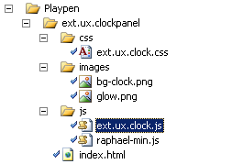
Step 2 – Create folders and a simple skeleton

Slide 24
Step 3 – Create a simple skeleton with stubs
ext.ux.clock.js
Ext.ns('Ext.ux');
Ext.ux.Clock = Ext.extend(Ext.BoxComponent, {
afterRender : function() {
// Call superclass
Ext.ux.Clock.superclass.afterRender.apply(this, arguments);
},
onDestroy : function() {
// Call superclass
Ext.ux.Clock.superclass.onDestroy.apply(this, arguments);
}
});

Slide 25
Step 4 – Create simple example HTML page
index.html
<html>
<head>
<!--Ext lib and UX components-->
...
<script type="text/javascript">
Ext.onReady(function(){
var clock = new Ext.ux.Clock({
height:150,
width:150
});
clock.render(Ext.getBody());
});
</script>
</head>

Slide 26
Step 5 – Create elements
afterRender : function() { // The component is now rendered and has an ’el’
var size = Math.min(this.getHeight(), this.getWidth());
// Background image of an empty clock with no hands
this.bgEl = this.el.createChild({
tag : 'img',
cls : 'ext-ux-clock-img',
src : this.clockBgUrl,
width : size,
height : size
});
// Initialize a Raphael canvas for drawing the hands
this.canvas = Raphael(this.el.dom, size, size);
this.drawHands();
this.on('resize', this.handleResize, this);
this.timer = setInterval(this.drawHands.createDelegate(this), 1000);
Ext.ux.Clock.superclass.afterRender.apply(this, arguments);
}

Slide 27
Step 6 – Draw hands
drawHands : function() {
var size = Math.min(this.getHeight(), this.getWidth())
date = new Date(),
secs = date.getSeconds(),
mins = date.getMinutes(),
hrs = date.getHours(),
canvas = this.canvas;
canvas.clear();
canvas.path(...); // Draw minute hand
canvas.path(...); // Draw hour hand
canvas.path(...); // Draw second hand
}

Slide 28
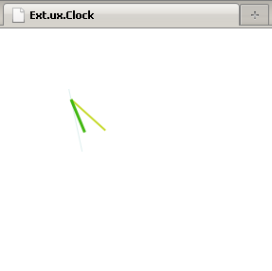
Let’s run it

Slide 29
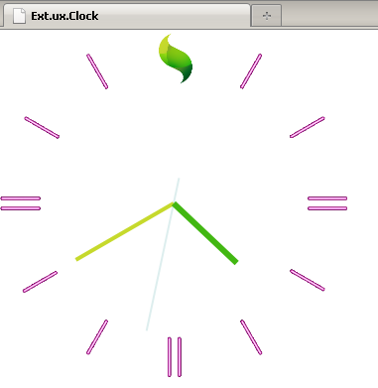
Step 7 – Use a background image

Slide 30
Step 8 – Polish with CSS3
.ext-ux-clock-img
{
border:3px solid lightgrey;
-moz-border-radius:100%;
-webkit-border-radius: 100%;
-o-border-radius: 100%;
border-radius: 100%;
-moz-box-shadow:1px 1px 13px rgba(114, 114, 114, 0.8);
-webkit-box-shadow:1px 1px 13px rgba(114, 114, 114, 0.8);
-o-box-shadow:1px 1px 13px rgba(114, 114, 114, 0.8);
box-shadow:1px 1px 13px rgba(114, 114, 114, 0.8);
background:#222333 url(../images/glow.png) no-repeat center center;
}

Slide 31
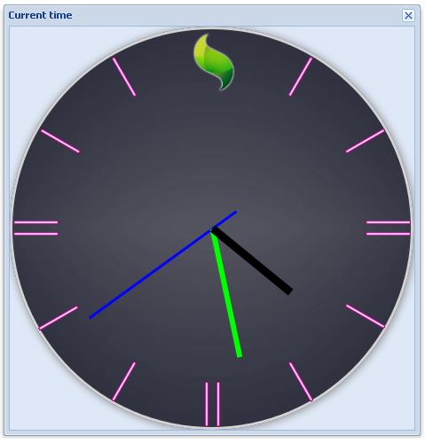
Step 8 – Polished result

Slide 32
Step 9 – Resize Support
Let’s make sure the clock is resizable.
handleResize : function(me, newWidth, newHeight) {
var size = Math.min(newWidth, newHeight);
this.bgEl.setSize(size, size, true); // true to animate
this.canvas.setSize(size, size); // Resize Raphael canvas
this.drawHands(); // Clears canvas and redraws
}

Slide 33
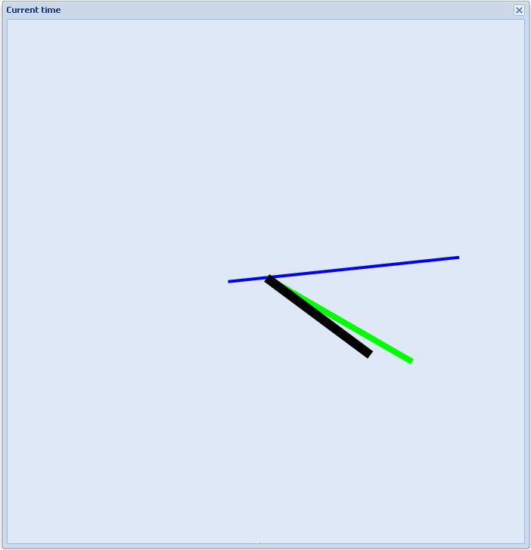

Step 9 – Let’s try out the resizing in an Ext.Window

Slide 34
Step 10 – Don’t forget to clean up after yourself!
onDestroy : function() {
clearInterval(this.timer);
this.canvas.clear();
Ext.destroy(this.bgImg, this.innerEl);
// Call superclass
Ext.ux.Clock.superclass.onDestroy.apply(this, arguments);
}

Slide 35
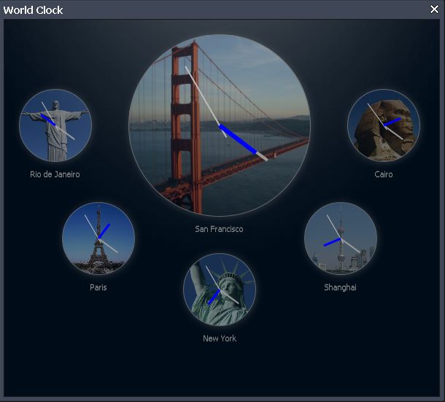
Bonus step: World Clock

Slide 36


10 Do’s and Don’ts when creating an Ext extension
10
Here is a list of some things to think about when creating your extension.

Slide 37
1. Follow Ext JS coding patterns
? Why?
! Other developers will have a better chance of understanding (and maintaining) your code. Additionally, the Ext JS source contains lots of best practices.

Slide 38
1. Follow Ext JS coding patterns
var w = 100;
var h = 40;
var s = 0;
if (doCalculate)
s = w * h;
var width = 100,
height = 40,
area = 0;
if (doCalculate) {
area = width * height;
}

Slide 39
2. Design classes for configurability
? Why?
! It will allow your class to be easily configured without the use of huge overrides. This concept is seen throughout all of Ext JS.

Slide 40
2. Design classes for configurability
MyTip = Ext.extend(Ext.Tooltip, {
onMouseLeave: function(){
this.el.fadeOut(200);
}
}
MyTip = Ext.extend(Ext.Tooltip, {
fadeDuration: 200,
onMouseLeave : function(){ this.el.fadeOut(this.fadeDuration);
}
}

Slide 41
3. Make key functionality easily overridable
? Why?
! It will allow your class to be easily altered without the use of huge overrides. This concept is seen throughout all of Ext JS.

Slide 42
3. Make key functionality easily overridable
initComponent : function(){
this.tpl = new Ext.XTemplate(
”<div>{foo}</div>”
);
// ....
}
initComponent : function(){
if (!this.tpl) {
this.tpl = new Ext.XTemplate(
'<div>{foo}</div>”
);
}
// ....
}

Slide 43
4. Make classes localizable
? Why?
! Because you know your boss will ask about localization support at some point.

Slide 44
4. Make classes localizable
MyClass = Ext.extend(Ext.Toolbar, {
constructor: function() {
this.add({
text : 'No data to display’
});
....
});
MyClass = Ext.extend(Ext.Toolbar, {
noDataText : 'No data to display’,
constructor: function() {
this.add({
text : this.noDataText
});
});
});

Slide 45
5. Use a syntax checker
? Why?
! Helps you find global variable leaks, extra commas etc. Use JsLint or JavaScriptLint (beware, JsLint WILL hurt your feelings).

Slide 46
6. Clean up after yourself
? Why?
! Because noone likes memory leaks. Override the onDestroy method to clean up any additional elements, event listeners etc...

Slide 47
6. Clean up after yourself
MyPanel = Ext.extend(Ext.Panel, {
constructor: function() {
this.someEl = new Ext.Element();
},
....
});
MyPanel = Ext.extend(Ext.Panel, {
constructor: function() {
this.someEl = new Ext.Element();
},
onDestroy: function() {
this.someEl.destroy();
// Call superclass destroy method...
}
});

Slide 48
7. Define an xtype
? Why?
! Because you (or someone else) may want to make use of the lazy instantiation mechanism provided by Ext.

Slide 49
7. Define an xtype
MyPanel = Ext.extend(Ext.Panel, {
constructor: function() {
// ...
}
});
MyPanel = Ext.extend(Ext.Panel, {
constructor: function() {
// ...
}
});
Ext.reg(’mypanel’, MyPanel);

Slide 50
8. Document your extension
? Why?
! Because other developers will likely read your code. By using the JSDoc syntax you can generate beautiful documentation looking like the Ext online API (using Ext-Doc).

Slide 51
8. Document your extension
MyClass = Ext.extend(Ext.Panel, {
// ...
});
/**
* @class MyClass
* @extends Ext.Panel
* @constructor
* @param {Object} config The cfg object
*/
MyClass = Ext.extend(Ext.Panel, {
// ...
});

Slide 52
9. Test edge cases
? Why?
! Noone likes bugs. Some examples:
* What happens if you include multiple instances of your extension?
* What happens when it’s destroyed? Any leaked DOM nodes etc?

Slide 53
10. Include a license
? Why?
! You might not care, but everyone that wants to use your extension in a production environment will (should) care.

Slide 54
Additional resources
Sencha Learning Center: http://www.sencha.com/learn/Ext_2_Overview
Saki’s Blog:
http://blog.extjs.eu/know-how/extension-or-plugin/

Slide 55
Questions?
mats@ext-scheduler.com

