Slide 1
ExtJS
Ext.util.Observable
By Aaron Conran

Slide 2
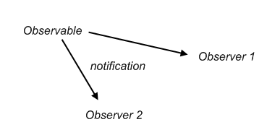
Observer Design Pattern
An observable object can notify any number of observers who would like to know when an event happens and what happened.

Slide 3
Ext.util.Observable
To create an Observable Class in Ext inherit from Ext.util.Observable
Use the inherited addEvents method to define events in the constructor
Ex:
  var MyObservable = function() {
  this.addEvents({event1: true,
  event2: true});
  };
  Ext.extend(MyObservable, Ext.util.Observable);

Slide 4
Ext.util.Observable
The MyObservable class inherits the following methods by inheriting Ext.util.Obserable:
  addEvents
  addListener – shorthand of on
  fireEvent
  hasListener
  purgeListener
  removeListener – shorthand of un

Slide 5
Observers
Observers can subscribe to the Observable object at any time by adding an event handler.
var myObservable = new MyObservable();
myObservable.on(‘event1’, function() {console.log(‘event1 ran!’);});

Slide 6
Ext.util.Observable
Observers can also unsubscribe at any time.
var myObservable = new MyObservable();
myObservable.on(‘event1’, function() {console.log(‘event1 ran!’);});
myObservable.un(‘event1’, function() {console.log(‘event1 ran!’);});
console.log(myObservable.hasListener(‘imaginary’));

Slide 7
Firing Events
By firing events an observable class can notify its observers that a particular event and provide them with relevant information by arguments.
Ex:
this.fireEvent(‘event1’, relevantInfo, moreInfo);

Slide 8
Consuming Events
Match method signature to the additional arguments that were fired. In this case, relevantInfo and moreInfo
Then setup an event handler for this method
myCallback : function(relevantInfo, moreInfo) {
  // use relevantInfo and moreInfo to act accordingly
  }
  myObservable.on(‘event1’, myCallback, scope);

Slide 9
Ext.util.Observable
Static Methods
Ext.util.Observable has 2 static methods
  capture (Observable o, Function fn, [Object scope])
  releaseCapture (Observable o)
Capture is often useful to view the events which are firing and the order in which they fire

Slide 10
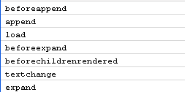
Capturing Events
Here is a utility function to log the event names to the console of any observable object
function captureEvents(observable) {
  Ext.util.Observable.capture(observable,
  function(eventName) {
    console.log(eventName);
  }, this);
}
// then to use it…
captureEvents(myObservable);
Firebug Output:

Slide 11
ObservableStack
Create the following class:
  ObservableStack is a simple stack data structure which can be observed.
  Events of:
    push : (Array stack, Mixed node)
    pop : (Array stack, Mixed node)
  Methods of:
    push : function(node)
    pop : function()

Slide 12
ObservableStack.js
var ObservableStack = function() {
  this.stack = new Array();
  this.addEvents({push: true,
  pop: true});
};
Ext.extend(ObservableStack, Ext.util.Observable, {
  push : function(node) {
    this.stack.push(node);
    this.fireEvent('push', this.stack, node);
  },
  pop : function() {
    var node = this.stack.pop();
    this.fireEvent('pop', this.stack, node);
  }
});

Slide 13
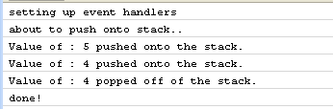
Example of ObservableStack
Ext.onReady(function() {
  var obsStack = new ObservableStack();
  console.log('setting up event handlers');
  obsStack.on('push',
    function(stack, node) {
      console.log('Value of : ' + node + ' pushed onto the stack.');
  });
  obsStack.on('pop',
    function(stack, node) {
      console.log('Value of : ' + node + ' popped off of the stack.');
  });
  console.log('about to push onto stack..');
  obsStack.push(5);
  obsStack.push(4);
  obsStack.pop();
  console.log('done!');
});
Firebug Output:

Slide 14
ObservableStack Uses
By creating an ObservableStack we can update multiple parts of a UI or communicate to multiple classes at the same time!
This way they always keep in sync with each other.
ExtJS contains a powerful observable data structure Ext.util.MixedCollection which maintains both numeric indexes and keys.

