Slide 1
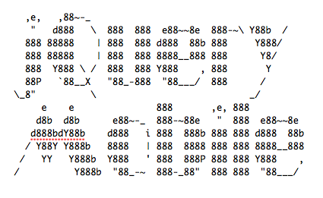
Andreas Bjärlestam
2011-05-25

Slide 2
Web vs Apps
Referral traffic is lost with Apps
Google does not index Apps
Customers are already going to the website
Cross device
Apps are in the hands of platform vendors

Slide 3
Frameworks Frameworks Frameworks

Slide 4
For building mobile applications with web technology
For building mobile friendly websites
Sencha Touch
jQuery Mobile
dojox.mobile
SproutCore
jQTouch

Slide 5
Features
HTML5 based
Progressive enhancement
Works in less capable browsers but with limited features
Accessibility
Designed to work with screen readers
WAI-ARIA

Slide 6
jQuery means JavaScript right?

Slide 7
Well… not in this case
jQuery-mobile development is mostly about markup

Slide 8
Pages

Slide 9
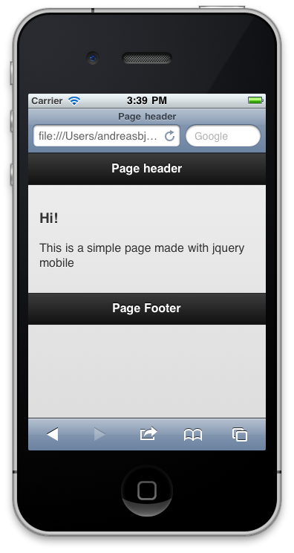

Slide 10
Simple page example
<div data-role="page" id="home"> <div data-role="header"> <h1>Page header</h1> </div> <div data-role="content"> <h3>Hi!</h3> <p>This is a simple page made with jquery mobile</p> </div> <div data-role="footer"> <h4>Page Footer</h4> </div>
</div>

Slide 11
Page navigation

Slide 12
UI elements
List views
Checkboxes
Buttons
Sliders
Popup menus
Dialogs

Slide 13
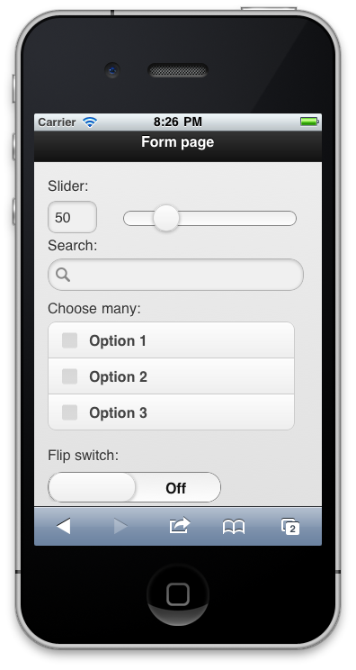
<form action="form.php" method="post"> <label for="slider">Slider: </label> <input type="number" data-type="range”
name="slider" id="slider"
min="40" max="80" value="50"/> <label for="q">Search: </label> <input data-type="search" name="q" id="q"/> <fieldset data-role="controlgroup"> <legend>Choose many:</legend> <input type="checkbox"
name="checkbox-1" id="checkbox-1" /> <label for="checkbox-1">Option 1</label> <input type="checkbox"
name="checkbox-2" id="checkbox-2" /> <label for="checkbox-2">Option 2</label> <input type="checkbox"
name="checkbox-3" id="checkbox-3" /> <label for="checkbox-3">Option 3</label> </fieldset> <label for=”switch">Flip switch:</label> <select name=”switch" id=”switch"
data-role="slider"> <option value="off">Off</option> <option value="on">On</option> </select>
</form>

Slide 14
Page transitions
Slide
Fade
Pop
Flip
Slide up
Slide down

Slide 15
How are these nice effects done?

Slide 16
CSS transforms
GPU accelerated
Compact code = efficient
Currently only implemented for webkit

Slide 17
.flip { -webkit-animation-name: flipinfromleft; -webkit-animation-timing-function: ease-in-out; -webkit-animation-duration: 2s; } @-webkit-keyframes flipinfromleft { from { -webkit-transform: rotateY(180deg); } to { -webkit-transform: rotateY(0); } }

Slide 18
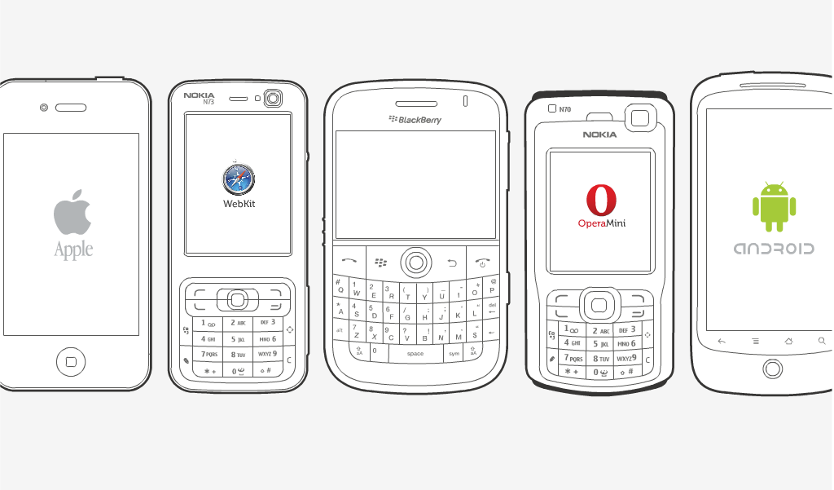
How can we handle all these phones?

Slide 19
Progressive Enhancement

Slide 20
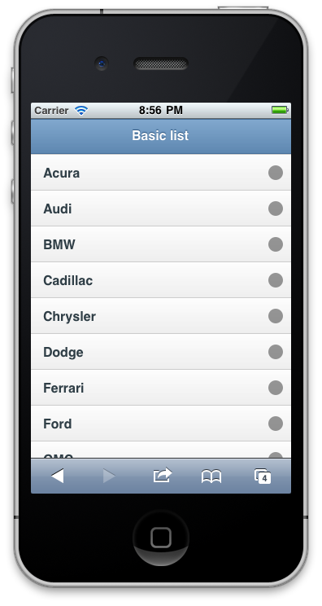
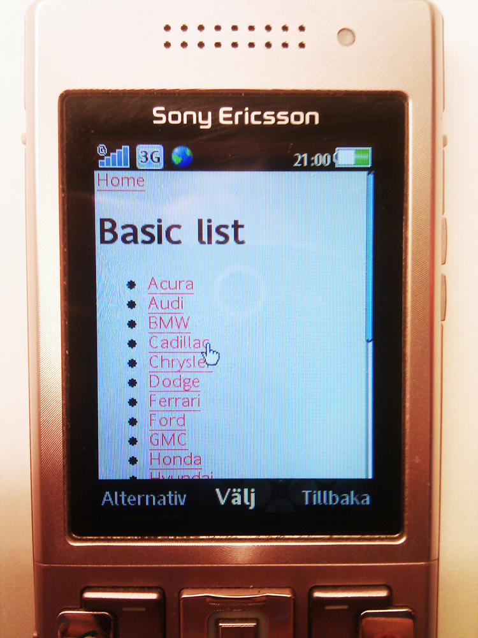

Slide 21
Performance in the mobile environment

Slide 22
Bandwidth vs Latency

Slide 23
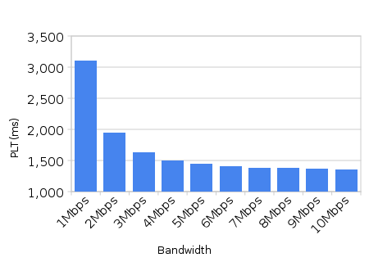
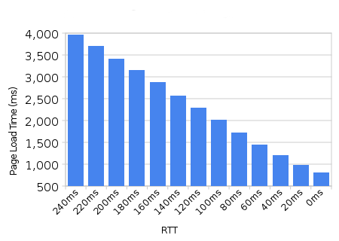
Bandwidth
Latency
source: http://www.belshe.com/2010/05/24/more-bandwidth-doesnt-matter-much/

Slide 24
Latency is bad for wireless

Slide 25
Reduce roundtrips to fight latency

Slide 26
How does jQuery Mobile handle this?

Slide 27
How jQuery fights Latency
Gradients and shadows with CSS3
No background-images to load
Image icons in css-sprite
And…

Slide 28

Remember WAP and WML?
The Card Deck

Slide 29
jQuery mobile supports multiple pages in a single html document

Slide 30
JavaScript Event-listeners
tap
swipe
taphold
swipeleft
swiperight
orientationchange
scrollstart
scrollstop

Slide 31
Events - examples
$('#tapMe').tap(function(e) { alert('tap!' ); });
$('#home').swipeleft(function(e) { alert('swipe left!' ); });

Slide 32
Theming
Object oriented CSS
Similar to jQuery-UI
CSS3 to minify footprint
Rounded corners
Shadows
Gradients
Color “swatches”
A theme includes several color schemes that can be applied on different content

Slide 33
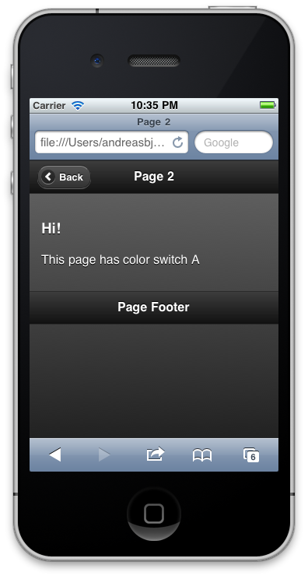
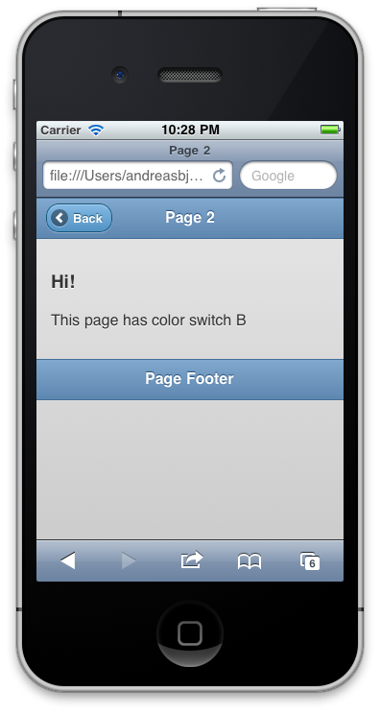
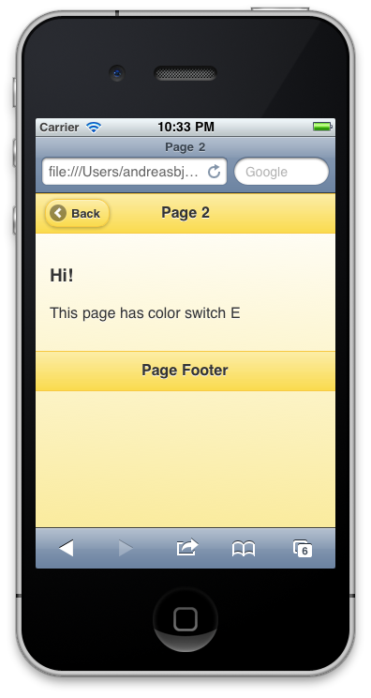
data-theme=“a”
data-theme=“b”
data-theme=“e”

Slide 34
Andreas Bjärlestam
mailto:andreas@bjarlestam.com
http://twitter.com/bjarlestam

Slide 35
Attribution
http://www.flickr.com/photos/brdavids/2699221787
http://www.slideshare.net/bryanrieger/rethinking-the-mobile-web-by-yiibu
http://www.belshe.com/2010/05/24/more-bandwidth-doesnt-matter-much

