Slide 1
jQuery essentials
Mark Veltzer
mark@veltzer.net

Slide 2
Topics
Introduction
Page loading
Basic selection
Advanced selection
Ajax
Animations
Writing plug ins
...
...
...
...
...
...
...
...
…

Slide 3
Topics
Introduction
Page loading
Basic selection
Advanced selection
Ajax
Animations
Writing plug ins
...
...
...
...
...
...
...
...
…

Slide 4
What is jQuery ?
A light weight JavaScript
A simple API.
A powerful API.
An API that works uniformly across common browsers.
An extend-able API.
Wraps many JavaScript API
Easier to write than regular JavaScript

Slide 5
Compare jQuery to javascript
Lets say you want to hide some divs in javascript
Lets say you want to hide some divs in javascript
divs = document.getElementByTagName(‘div’);
for (i = 0; i < divs.length; i++) {
divs[i].style.display = ‘none’
}
And now in Jquery...
$(“div”).hide();

Slide 6
jQuery usage philosophy
Find some HTML
Do something to it
Do it to it again....
$(“div”).hide();
$(div) – finds the elements
.hide() - hides them

Slide 7
jQuery design philosophy
Keep the toolkit light weight
Let others build more functionality on top of jQuery (jQuery UI for instance)
Keep the API simple
Strong emphasis on cross browser compatibility with extensive testing

Slide 8
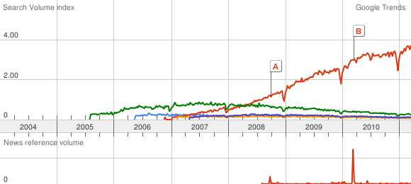
jQuery market share
As you can see jQuery is on the rise...
Checkout http://www.google.com/trends?q=dojo+javascript,+jquery+javascript,+yui+javascript,+prototype+javascript,+mootools+javascript&ctab=0&geo=all&date=all&sort=1

Slide 9
Topics
Getting started
More here

Slide 10
Using jQuery – first method
Download jQuery from http://docs.jquery.com/Downloading_jQuery
Current version is 1.5.1
Use minified for production (ugly comment-less compressed code)
Use uncompressed for development (to debug properly via firebug or the like)
You get a file called jquery-1.5.1.min.js
Symlink or call it jquery.js (you don't want to hardcode the jquery version in every HTML file)

Slide 11
Using jQuery – first method - cont
Place it in your server/webapp
Import it from your html files
Best practice is a relative path to where jquery is installed
<script type='text/javascript' src='jquery/jquery.js'></script>
A begginers mistake is to fast close the <script> tag.
<script type='text/javascript' src='jquery/jquery.js'/>

Slide 12
Using jQuery – second method
You can avoid storing jQuery on your server
This is done via CDN (Content Delivery Network)
This means someone else (google, Microsoft,...) is hosting jQuery for you
There are advantages (they have plenty of servers of close proximity and very good bandwidth)
There are disadvantages (maybe you want to customize jQuery and maybe the user has no web access)

Slide 13
Using jQuery – second method (cont)
For example, if you like the google API then you can use it to load many libraries, among them jQuery
You need a google API key
Google will bring the library over compressed via gzip (even better performace)
<script type="text/javascript"
src="https://www.google.com/jsapi?key=INSERT-YOUR-KEY"></script>
<script type=”text/javascript”>
google.load("jquery", "1.5.1");
</script>

Slide 14
Topics
Ajax
More here

Slide 15
The problems with plain javascript Ajax
You need to check for different browsers
HTML 5 is supposed to fix this and all browsers will support XmlHttpRequest with the new API
HTML 5 will be here at 2022 while the jQuery ajax API is here now
You have to deal with various, usually unwanted, callbacks.
Does not have general hooks for ajax start and end
Does not do any parsing on the result. Do it yourself.

Slide 16
The problems with plain javascript Ajax (cont)
Code is too long
Parameters for get have to be passed in the URL
Different browsers generate different number of callbacks

Slide 17
Simple HTTP get with jQuery
jQuery.get( url, [data], [callback], [type] )
Url – String – necessary - Is the URL on the server you want the data from. Better to make it relative instead of absolute.
Date – Map – optional - is an optional payload
Callback – Function – optional - to be called when data returns from the server successfully
Type – String – optional – type of data returned from the server (parsing is done by jQuery)

Slide 18
Jquery HTTP get example
A GET with some data and JSON parsing
The API is still asynchronous
The API is high level and browser independent.
$.get(
"http://myserver/myurl",
"{key:value}",
function(data) { alert(data); },
"json"
);

Slide 19
Handling return types from the server
Text – you get the exact result from the server
Json – result from server parsed using various json parsers (window.JSON included).
XML – jQuery will parse the result using various browser XML parsing API. You will get the DOM tree.
HTML – result is HTML and is parsed into a DOM node.
There are also jsonp and script for advanced uses...

Slide 20
Topics
Writing plug ins
More here

