Slide 1
Snowflock: Cloud computing made agile
H. Andrés Lagar-Cavilla
Joe Whitney, Adin Scannell, Steve Rumble,
Philip Patchin, Charlotte Lin,
Eyal de Lara, Mike Brudno, M. Satyanarayanan*
University of Toronto, *CMU
http://compbio.cs.toronto.edu/snowflock
andreslc@cs.toronto.edu
http://www.cs.toronto.edu/~andreslc

Slide 2
SnowFlock In One Slide
(The rest of the presentation is one big appendix)
Virtual Machine cloning
Same semantics as UNIX fork()
All clones are identical, save for ID
Local modifications are not shared
API allows apps to direct parallelism
Sub-second cloning time
Negligible runtime overhead
Scalable: experiments with 128 processors

Slide 3
SnowFlock Enables:
Impromptu Clusters: on-the-fly parallelism
Pop up VMs when going parallel
Fork-like: VMs are stateful
Near-Interactive Parallel Internet services
Parallel tasks as a service (bioinf, rendering…)
Do a 1-hour query in 30 seconds
Cluster management upside down
Pop up VMs in a cluster “instantaneously”
No idle VMs, no consolidation, no live migration
Fork out VMs to run un-trusted code
i.e. in a tool-chain
etc…

Slide 4

Embarrassing Parallelism
GATTACA
GACATTA
CATTAGA
AGATTCA
Sequence to align: GACGATA
GATTACA
GACATTA
CATTAGA
AGATTCA
Another sequence to align: CATAGTA

Slide 5
Near-Interactive Internet Services
Embarrassing Parallelism
Throw machines at it: completion time shrinks
Big Institutions
Many machines
Near-interactive parallel Internet service
Do the task in seconds
NCBI BLAST
EBI ClustalW2

Slide 6
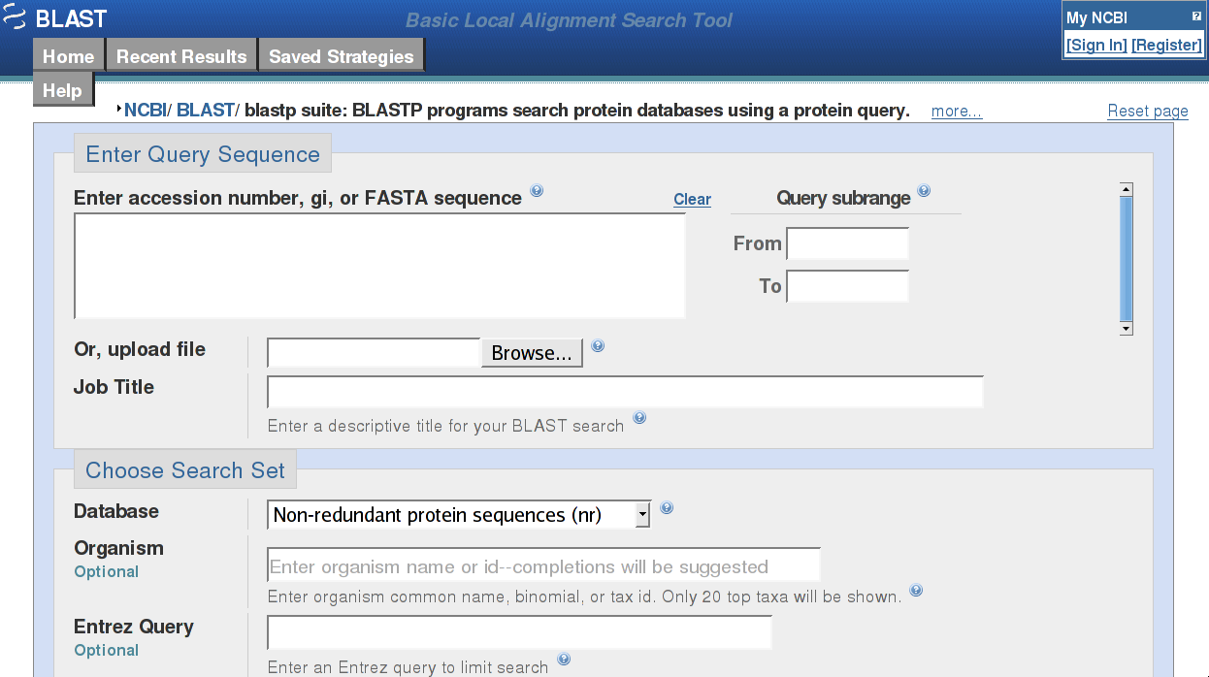
Near-Interactive Internet Services
Notes:
National Centre for Biotechnology Information

Slide 7
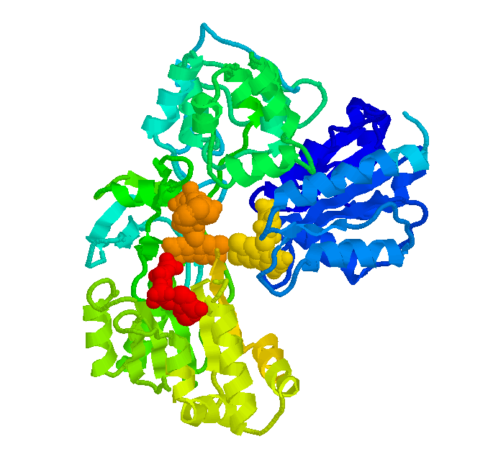



Near-Interactive Internet Services
Embarrassing Parallelism
Throw machines at it: completion time shrinks
Big Institutions
Many machines
Near-interactive parallel Internet service
Do the task in seconds
NCBI BLAST
EBI ClustalW2
Not just bioinformatics
Render farm
Quantitative finance farm
Compile Farm (SourceForge)

Slide 8
Cloud Computing
Dedicated clusters are expensive
Movement toward using shared clusters
Institution-wide, group-wide cluster
Utility Computing: Amazon EC2
Virtualization is a/the key enabler
Isolation, security
Ease of accounting
Happy sys admins
Happy users, no config/library clashes
I can be root! (tears of joy)

Slide 9
Parallel Internet Service + VM Cloud
Impromptu: highly dynamic workload
Requests arrive at random times
Machines become available at random times
Need to swiftly span new machines
The goal is parallel speedup
The target is tens of seconds
VM clouds: slow “swap in”
Resume from disk
Live migrate from consolidated host
Boot from scratch (EC2: “minutes”)
Notes:
Don’t fiddle with seconds/minutes

Slide 10
Impromptu Clusters
Fork copies of a VM
In a second, or less
With negligible runtime overhead
Providing on-the-fly parallelism, for this task
Nuke the Impromptu Cluster when done
Beat cloud slow swap in
Near-interactive services need to finish in seconds
Let alone get their VMs

Slide 11

Parallel VM Forking
Impromptu Cluster:
On-the-fly parallelism
0:“Master” VM
Virtual Network
Transient
1:GACCATA
2:TAGACCA
3:CATTAGA
4:ACAGGTA
5:GATTACA
6:GACATTA
7:TAGATGA
8:AGACATA

Slide 12
But How Do I Use This?
Impromptu Cluster API
Programmatically direct parallelism
sf_request_ticket
Talk to physical cluster resource manager (policy, quotas…)
Modular: Platform EGO bindings implemented…
Hierarchical cloning
VMs span physical machines
Processes span cores in a machine
Optional in ticket request

Slide 13
But How Do I Use This?
sf_clone
Parallel cloning
Identical VMs save for ID
No shared memory, modifications remain local
Explicit communication over isolated network
sf_sync (slave) + sf_join (master)
Synchronization: like a barrier
Deallocation: slaves destroyed after join

Slide 14
The Typical Script
tix = sf_request_ticket(howmany)
prepare_computation(tix.granted)
me = sf_clone(tix)
do_work(me)
if (me != 0)
send_results_to_master()
sf_sync()
else
collate_results()
sf_join(tix)
Split input query n-ways, etc
Block…
scp … up to you
IC is gone
Notes:
Drive analogies with fork()

Slide 15
Nuts and Bolts
VM descriptors
VM suspend/resume correct, but slooow
Distill to minimum necessary
Memtap: memory on demand
Copy-on-access
Avoidance Heuristics
Don’t fetch something I’ll immediately overwrite
Multicast distribution
Do 32 for the price of one
Implicit prefetch

Slide 16
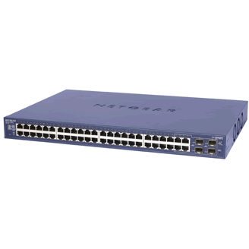
The Secret Sauce
Memory
State
Memtap
?
Virtual
Machine
Multicast
VM Descriptor
VM Descriptor
VM Descriptor
Metadata
Pages shared with Xen
Page tables
GDT, vcpu
~1MB for 1GB VM
Memtap
?

Slide 17
Zooming In: Cloning Time
Clone set up
Multicast descriptor
Xend
resume
code
Wait for clones to start
VM spawn
(from descriptor)
Contact all hosts
Xend suspend code
VM suspend
(make descriptor)

Slide 18
Cloning Time
Order of 100’s of milliseconds: fast cloning
Roughly constant: scalable cloning
Natural variance of waiting for 32 operations
Multicast distribution of descriptor also variant

Slide 19
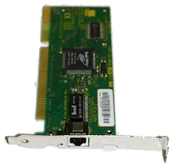
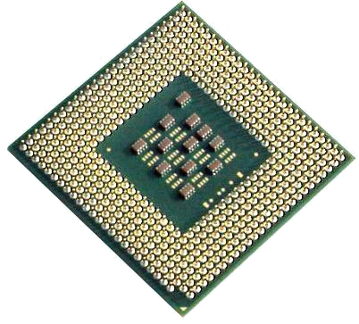
Memtap: Memory-on-demand
Dom0 - memtap
VM
paused
Maps
Page Table
9g056
9g056
R/W
Bitmap
c0ab6
bg756
bg756
Kick back
776a5
0
03ba4
1
1
1
1
00000
00000
9g056
Read-only
Shadow
Page
Table
c0ab6
00000
Kick
00000
Hypervisor
00000
Page Fault
03ba4

Slide 20
Memory on Demand Latency
Network
(unicast)
Memtap logic
(map page)
Context switch
to dom0
Xen hypervisor
(shadow PT)
SnowFlock
in hypervisor
Page Fault (HW)

Slide 21
Avoidance Heuristics
Don’t fetch if overwrite is imminent
Guest kernel makes pages “present” in bitmap
Read from disk -> block I/O buffer pages
Pages returned by kernel page allocator
malloc()
New state by applications
Effect similar to balloon before suspend
But better
Non-intrusive
No OOM killer: try ballooning down to 20-40 MBs

Slide 22
Effect of Heuristics and Multicast
SHRiMP 32 clones, 1GB Memory footprint
Heuristics
OFF
Heuristics
ON
10K
18K
10K
Push saves many client requests
Lockstep: Single reply for many requests
Sent only 40 Megs!
But push sends more data
Notes:
Units are confusing, megs, ks thousands

Slide 23
API Implementation
Client library in VM (C, Python, Shell)
Marshall and post requests to Xenstore
Shared memory control interface
SnowFlock daemon in dom0
Watches Xenstore and posts replies
Daemons make up a distributed system
Orchestrate cloning, joining
Suspend VM to produce descriptor
Distribute descriptor
Use descriptor to spawn clones

Slide 24
Implementation Topics
Multicast
Sender simple: rate limiting, switch programming
Receiver in charge of reliability: time-out, resend
Push mode to exploit spatial locality
Lockstep awareness
Batching multiple page updates
SMP-safety
Virtual disk
Same ideas as memory
Virtual network
Isolate ICs from one another
Yet allow access to select external resources

Slide 25
Implementation Recap
Fast cloning
VM descriptors
Memory-on-demand
Little runtime overhead
Avoidance Heuristics
Multicast (implicit prefetching)
Scalability
Avoidance Heuristics (less state transfer)
Multicast
Notes:
Try too not mention stats

Slide 26
Show Me The Money
Cluster of 32 Dell PowerEdge, 4 cores
128 total processors
Xen 3.0.3 1GB VMs, 32 bits, linux pv 2.6.16.29
Obvious future work
Macro benchmarks
Bioinformatics: BLAST, SHRiMP, ClustalW
Quantitative Finance: QuantLib
Rendering: Aqsis (RenderMan implementation)
Parallel compilation: distcc

Slide 27
Application Run Times
128 processors
(32 VMs x 4 cores)
1-4 second overhead
ClustalW: tighter integration,
best results
Notes:
Ideal is really ideal
Low is good

Slide 28
Application Parallel Speedup
110min
143min
87min
61min
20min
7min
Measured against ideal with one processor
Embarrassing parallelism: hour-long task shrunk to seconds
As fast as slowest worker
Notes:
High is good

Slide 29
Throwing Everything At It
Four concurrent Impromptu Clusters
BLAST , SHRiMP , QuantLib , Aqsis
Cycling five times
Ticket, clone, do task, join
Shorter tasks
Range of 25-40 seconds: near-interactive service
Evil allocation

Slide 30
Throwing Everything At It
Higher variances (not shown): up to 3 seconds
Need more work on daemons and multicast

Slide 31
Multicast Scalability
BLAST, heuristics on,
but 256MB DB cached in memory
Push too
aggressive
Unicast doesn’t scale
Notes:
Further explain ideal

Slide 32
Plenty of Future Work
>32 machine testbed
Change an existing API to use ICs
MPI in progress: backwards binary compatibility
mpirun –np 128 -> forks 128 clones
Cluster consolidation and management
Much much simpler with VM cloning
No idle VMs, VMs come up immediately
Shared Memory
For specific tasks
In many workloads, all we need is a shared array
Each worker “files” its results before calling sf_sync
Notes:
Do not use “flux”
Drop shmem

Slide 33
Big Data
Genomics, Proteomics, Search
All exhibit embarrassing parallelism
Big-Data Internet services
VM allocation cognizant of data availability
VM data R/W warms physical node cache
Indices created by one IC used by other ICs
API porting take 2: Map/Reduce
VM modularly/opaquely uses appropriate FS
Lustre, Hadoop, PVFS, pNFS
Open Data: go to any cloud, crunch the data

Slide 34
Wrap Up
SnowFlock clones VMs
Fast: 32 VMs in less than one second
Scalable: 128 processor job, 1-4 second overhead
Addresses cloud computing + parallelism
Abstraction that opens many possibilities
Impromptu parallelism → Impromptu Clusters
Near-interactive parallel Internet services
Lots of action going on with SnowFlock

Slide 35
Thanks For Your Time
andreslc@cs.toronto.edu
http://www.cs.toronto.edu/~andreslc
http://compbio.cs.toronto.edu/snowflock

Slide 36
Backup

Slide 37

Meet A Protein
Sequence of Amino acids
CFGATTGATTACAC
Notes:
NFS slide breaks flow (probably will move to the front)
Tim’s question: get the data
Refer to LaMarca
20 min talk: push, hierarchical, last two results

Slide 38
Near-Interactive Internet Services
Embarrassing Parallelism
Throw machines at a task
Time to completion shrinks
Loose or no synchronization between parallel workers

Slide 39
Straw Man Experiment
Linear … minutes … arggh!!

Slide 40
Impromptu Clusters
Impromptu: highly dynamic workload
Need to swiftly span new machines
Near-interactive service: tens of seconds
VM clouds have slow “swap in”
Minutes, tens of seconds
Impromptu Cluster (IC)
Fork copies of a VM
In a second, or less
With negligible runtime overhead
Providing on-the-fly parallelism, for this task
Nuke the IC when done

Slide 41
Impromptu Clusters
Bioinformatics Rendering
Quantitative Finance etc…
CLOUD COMPUTING
UNBOUNDED
PARALLELISM
VIRTUALIZATION
NEAR-INTERACTIVE
INTERNET SERVICES
IMPROMPTU CLUSTERS
VIRTUAL MACHINE
PARALLEL FORK

Slide 42
fork()
A bit of a kitchen sink abstraction
Copy an entire process
But quite a comfortable one
New stateful computing element
Tricks under the hood make it viable
COW et al.
Same thing for VM cloning

Slide 43
Hierarchical Forking
Clone VMs
Then fork processes
VMs span physical machines
Processes span cores in a machine
Intuition: better to spawn one 4-vcpu VM then four 1-vcpu VMs
Optional
One may want to leverage VM cloning only
Automated process forking may not fit all needs

Slide 44
Anatomy of a VM Descriptor
Metadata (Xend, virtual I/O devices)
Pages shared with Xen
Memory management data structures
Segmentation: GDT
Page Tables: bulk of the descriptor
Physical memory addresses canonicalized
Machine->physical
Loosely constant-sized, small
1MB for a 1GB VM

Slide 45
Memtap: Memory-on-demand
Dom0 - memtap
VM
(paused)
Maps
Page Table
9g056
9g056
R/W
Bitmap
Heuristics
c0ab6
bg756
bg756
Write-only
776a5
Kick back
0
1
03ba4
1
1
1
1
00000
00000
9g056
Read-only
Shadow
Page
Table
c0ab6
00000
Kick
00000
Hypervisor
00000
Page Fault
03ba4
Notes:
No heuristics here
No more than one thing happening at once

Slide 46
Multicast Distribution
Sender simple
Switch programming
Rate-limit
Receiver in charge of reliability
Time out, request again
Optional push mode
Exploit spatial locality of memory accesses
Send x, x+1, x+2….
Lockstep
Clone VMs start simultaneously, with a slight skew
And access memory similarly, with a slight skew
Ignore repeated requests within a small window

Slide 47
Multicast Distribution
Sender simple
IGMP group management
Tell switch what to do
Handshake protocol to add new clients
Logic to rate-limit sending
Must not overflow receivers
Keep receiver averages, drop rate on message drop
Optional push mode
Exploit spatial locality of memory accesses
Send x, x+1, x+2….

Slide 48
Multicast Distribution (2)
Receiver in charge of reliability
Time out, ask again
Receiving rate fed back to sender
Lockstep avoidance
All cloned VMs start from the same instruction
With a slight skew
Likely to receive n requests for the same page
Slightly skewed
Send once, ignore the rest for a small window of time

Slide 49
Virtual I/O
Virtual disk: same principles as memory
Multicast distribution
Don’t fetch if overwrite is imminent
Lightly exercised, in general
Virtual network: isolation
Multiple “virtual clusters” coexisting
Discriminate traffic, avoid address clashes
Ebtables filtering
Need to access cluster-hosted data, outside world
Iptables routing
Also automatic IP reconfig based on clone ID

Slide 50
Changing ClustalW
tix = ic_request_ticket(howmany)
me = ic_clone(tix)
for i in pairs
for j in pairs
pairwise_align(i,j)
send_results_to_master()
ic_sync()
else
collate_results()
ic_join(tix)

Slide 51
Throwing Everything At It
Four concurrent Impromptu Clusters
BLAST , SHRiMP , QuantLib , Aqsis
Cycling five times
Ticket, clone, do task, join
Shorter tasks
Range of 25-40 seconds: near-interactive service
Evil allocation
32 processors to each task
One per physical host
Each host holds one VM for each IC
Each hosts receives multicast for each IC
Notes:
Animate

Slide 52
Cloning Time
Order of 100’s of miliseconds
Roughly constant
Natural variance of waiting for 32 operations
Multicast distribution of descriptor also variant

Slide 53
Parallel VM Forking
Impromptu Cluster:
On-the-fly parallelism
0:“Master” VM
Virtual Network
Transient
1:GACCATA
2:TAGACCA
3:CATTAGA
4:ACAGGTA
5:GATTACA
6:GACATTA
7:TAGATGA
8:AGACATA

