Slide 1
Understanding Android Security Model
Pragati Ogal Rai
MTS1, Software Engineer, PayPal Mobile
Pragati.Rai@paypal.com
SV Android Dev Camp
March 04, 2011

Slide 2
Agenda
Why should I understand Android’s Security Model?
What is Android’s security model?
Architecture
Components
Intents
Permissions
AndroidManifest.xml
Application Signing
System Packages
External Storage
Files
Binders

Slide 3
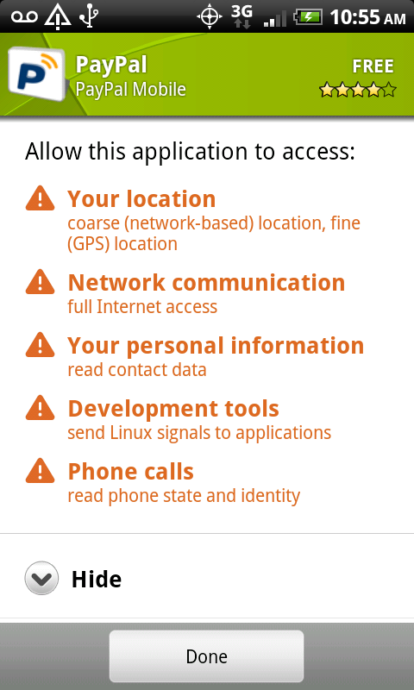
Why should I understand Android’s Security Model?
Smart(er) Phones
Mail, calendar, Facebook, Twitter
Open Platform
Open sourced
Well documented
YOU control your phone

Slide 4
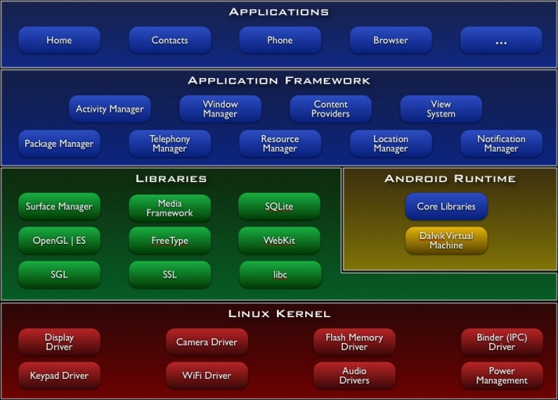
Architecture
http://developer.android.com/guide/basics/what-is-android.html

Slide 5
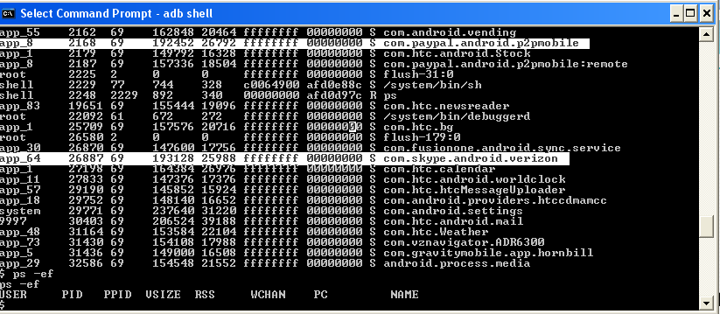
Linux Kernel
Unique UID and GID for each application at install time
Sharing can occur through component interactions
Linux Process Sandbox

Slide 6
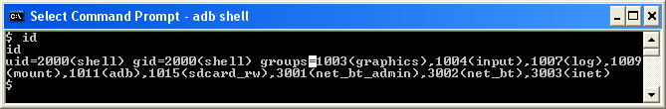
Linux Kernel (Cont’d)
include/linux/android_aid.h
AID_NET_BT 3002 Can create Bluetooth Sockets
AID_INET 3003 Can create IPv4 and IPv6 Sockets

Slide 7
Middleware
Dalvik VM is not a security boundary
No security manager
Permissions are enforced in OS and not in VM
Bytecode verification for optimization
Native vs. Java code

Slide 8
Binder Component Framework
BeOS, Palm, Android
Applications are made of various components
Applications interact via components

Slide 9
Application Layer
Permissions restrict component interaction
Permission labels defined in AndroidManifest.xml
MAC enforced by Reference Monitor
PackageManager and ActivityManager enforce permissions

Slide 10
Permission Protection Levels
Normal
android.permission.VIBRATE
com.android.alarm.permission.SET_ALARM
Dangerous
android.permission.SEND_SMS
android.permission.CALL_PHONE
Signature
android.permission.FORCE_STOP_PACKAGES
android.permission.INJECT_EVENTS
SignatureOrSystem
android.permission.ACCESS_USB
android.permission.SET_TIME

Slide 11
User Defined Permissions
Developers can define own permissions
<permission android:name="com.pragati.permission.ACCESS_DETAILS"
android:label="@string/permlab_accessDetails"
android:description="@string/permdesc_accessDetails"
android:permissionGroup="android.permission-group.COST_MONEY"
android:protectionLevel=“signature" />

Slide 12
Components
Activity: Define screens
Service: Background processing
Broadcast Receiver: Mailbox for messages from other applications
Content Provider: Relational database for sharing information
All components are secured with permissions

Slide 13
Activity
Often run in their UID
Secured using Permissions
android:exported=true
Badly configured data can be passed using Intent
Add categories to Intent Filter
Do not pass sensitive data in intents

Slide 14
Service
Started with Intent
Permissions can be enforced on Service
Called can “bind” to service using bindService()
Binder channel to talk to service
Check permissions of calling component against PERMISSION_DENIED or PERMISSION_GRANTED
getPackageManager().checkPermission(
permToCheck, name.getPackageName())

Slide 15
Broadcasts
Sending Broadcast Intents
For sensitive data, pass manifest permission name
Receiving Broadcast Intents
Validate input from intents
Intent Filter is not a security boundary
Categories narrow down delivery but do not guarantee security
android:exported=true
Sticky broadcasts stick around
Need special privilege BROADCAST_STICKY

Slide 16
Content Provider
Allow applications to share data
Define permissions for accessing <provider>
Content providers use URI schems
Content://<authority>/<table>/[<id>]

Slide 17
Binder
Synchronous RPC mechanism
Define interface with AIDL
Same process or different processes
transact() and Binder.onTransact()
Data sent as a Parcel
Secured by caller permission or identity checking

Slide 18
Intents
Inter Component Interaction
Asynchronous IPC
Explicit or implicit intents
Do not put sensitive data in intents
Components need not be in same application
startActivity(Intent), startBroadcast(Intent)

Slide 19
Intent Filters
Activity Manager matches intents against Intent Filters
<receiver android:name=“BootCompletedReceiver”>
<intent-filter>
<action android:name=“android.intent.action.BOOT_COMPLETED”/>
</intent-filter>
</receiver>
Activity with Intent Filter enabled becomes “exported”
Activity with “android:exported=true” can be started with any intent
Intent Filters cannot be secured with permissions
Add categories to restrict what intent can be called through
android.intent.category.BROWSEABLE

Slide 20
Pending Intent
Token given to a foreign application to perform an action on your application’s behalf
Use your application’s permissions
Even if its owning application's process is killed, PendingIntent itself will remain usable from other processes
Provide component name in base intent
PendingIntent.getActivity(Context, int, Intent, int)

Slide 21
AndroidManifest.xml
Application Components
Rules for auto-resolution
Permissions
Access rules
Runtime dependencies
Runtime libraries

Slide 22
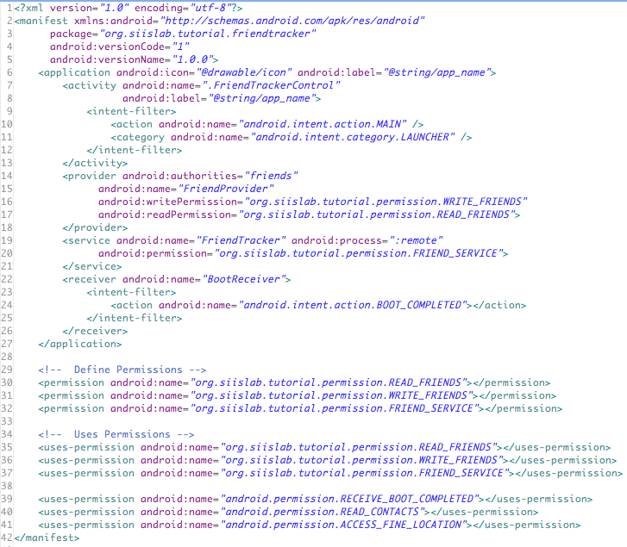
AndroidManifest.xml
http://www.cse.psu.edu/~enck/cse597a-s09/slides/cse597a-android.pdf

Slide 23
External Storage
Starting API 8 (Android 2.2) APKs can be stored on external devices
APK is stored in encrypted container called asec file
Key is randomly generated and stored on device
Dex files, private data, native shared libraries still reside on internal memory
External devices are mounted with “noexec”
VFAT does not support Linux access control
Sensitive data should be encrypted before storing

Slide 24
Application Signature
Applications are self-signed; no CA required
Signature define persistence
Detect if the application has changed
Application update
Signatures define authorship
Establish trust between applications
Run in same Linux ID

Slide 25
Application Upgrade
Applications can register for auto-updates
Applications should have the same signature
No additional permissions should be added
Install location is preserved

Slide 26
System Packages
Come bundled with ROM
Have signatureOrSystem Permission
Cannot be uninstalled
/system/app

Slide 27
Files and Preferences
Applications have own area for files
Files are protected by Unix like file permissions
Different modes: world readable, world writable, private, append
File = openFileOutput(“myFile”, Context.MODE_WORLD_READABLE);
SharedPreferences is system feature with file protected with permissions

Slide 28
Summary
Linux process sandbox
Permission based component interaction
Permission labels defined in AndroidManifest.xml
Applications need to be signed
Signature define persistence and authorship
Install time security decisions

Slide 29
References
http://developer.android.com
Jesse Burns http://www.isecpartners.com/files/iSEC_Securing_Android_Apps.pdf
William Enck, Machigar Ongtang, and Patrick McDaniel, Understanding Android Security. IEEE Security & Privacy Magazine, 7(1):50--57, January/February, 2009.

Slide 30
Thank You!
Pragati.Rai@paypal.com

