Slide 1
From monolith to service mesh
Mark Veltzer
<mark.veltzer@gmail.com>

Slide 2
About me...
Mark Veltzer <mark.veltzer@gmail.com>
Background in Math
Open Source developer
GNU grep maintainer
Several startups
Direct Democracy advocate (read my book anyone?)
Jazz Piano player

Slide 3
The goals of this presentation
To explain how we moved through various design paradigms:
  Monolith app
  Micro Services
  Cloud native
  Service mesh
Examine their advantages and disadvantages, their philosophies, their organizational implications, how they fit with other development paradigms and more...

Slide 4

A look into the future...

Slide 5
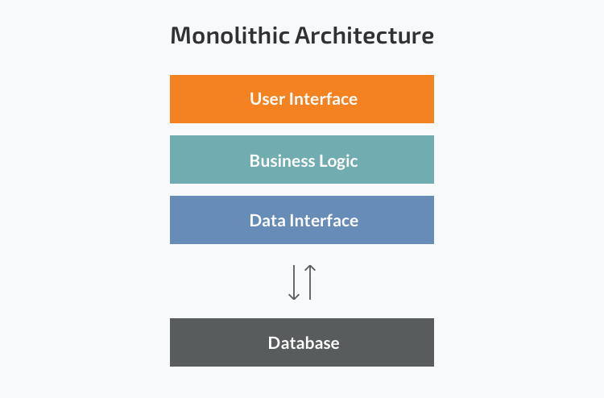
First there was the monolith web app...

Slide 6
The monolith app - advantages
Easy to understand
Single technology
Code is shared
Supposed to be easy to change design

Slide 7
The monolith app - disadvantages
Turns out: very hard to change
Changes are not always about design: a lot of the time they are about technology
Very hard to try out new languages
Very hard to be innovative
Companies have a hard time rewriting apps – they are not build for that.

Slide 8
Monolith apps make developers into cowards...

Slide 9
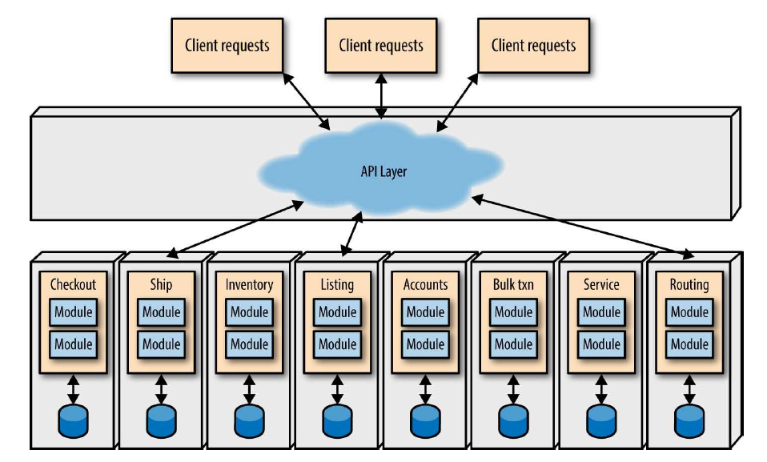
And then there was micro services

Slide 10
Micro services - advantages
More agility
The ability to rewrite the app, albeit slowly.
Adapt quicker to new technologies, especially the public clouds PASS
Adapt quicker to new languages
Allow developers be brave again!

Slide 11
Micro services - disadvantages
Harder to test
Now I gotta have devops
… and CI/CD
And testing environments
And I need a programmable cloud for that…
And again developers turn into cowards...

Slide 12
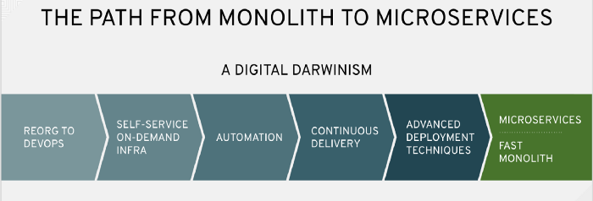
Many things to change...

Slide 13
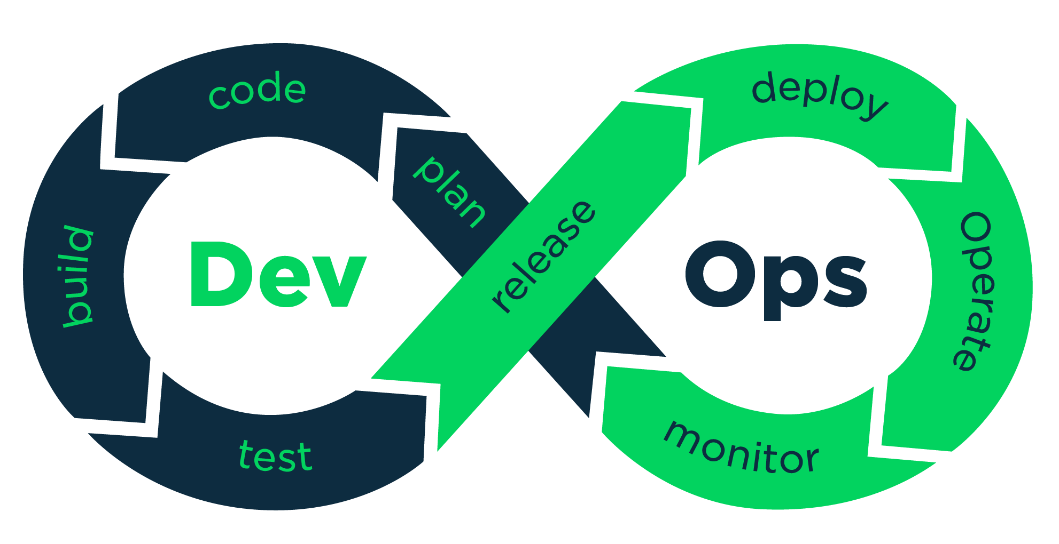
This is what they tell you about devops...

Slide 14
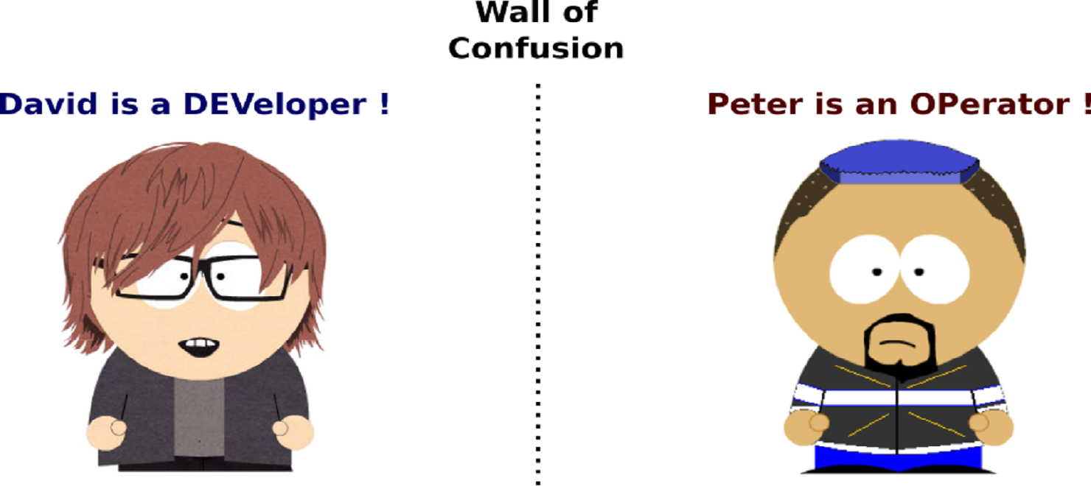
This is what they tell you about devops...

Slide 15
Devops is really the surrender of operations to the developers!
This is part of a longer trend of surrendering everything to the developers…
We will see more of this during this lecture...

Slide 16
Micro services supports other paradigms...
Devops
  It’s hard to see how you could do micro services without devops
CI/CD
  It’s hard
Cloud and PASS infrastructure
  It’s hard to see how to deploy micro service apps without the flexibility and programmability of the cloud
Agile
  By allowing you to be flexible micro service advance agile goals

Slide 17
All of these actually support each other…
When several trends converge it usually means you are on to some sweet spot in design methodology space...

Slide 18
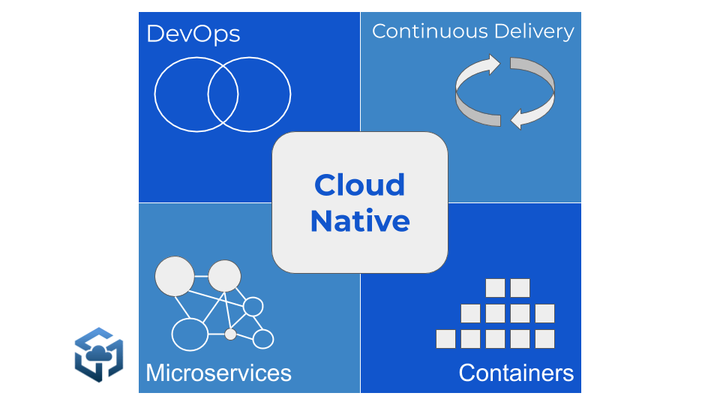
And then there was cloud native

Slide 19
Cloud native is the sweet spot where...
You use devops
You use micro services
You use CI/CD
Usually accompanied by some container technology (did someone say docker?)
And some orchestration technology (did some say k8s?)

Slide 20
Cloud native - advantages
A fairly well understood collection of components
The advertisement says you can deploy on any cloud (private, public).
Don’t believe everything you hear...

Slide 21
Cloud native - disadvantages
Testing and CI/CD requires access to cloud
Have to pick all the technologies
Lots of configuration and devops work to do
Limitations on creativity!

Slide 22
Cloud native does not deal with the elephant in the room….
Public clouds PASS offerings

Slide 23
There are actually two types of cloud native apps
Those that use PAAS extensively
And those that don’t…
  And that is what makes all the difference...

Slide 24
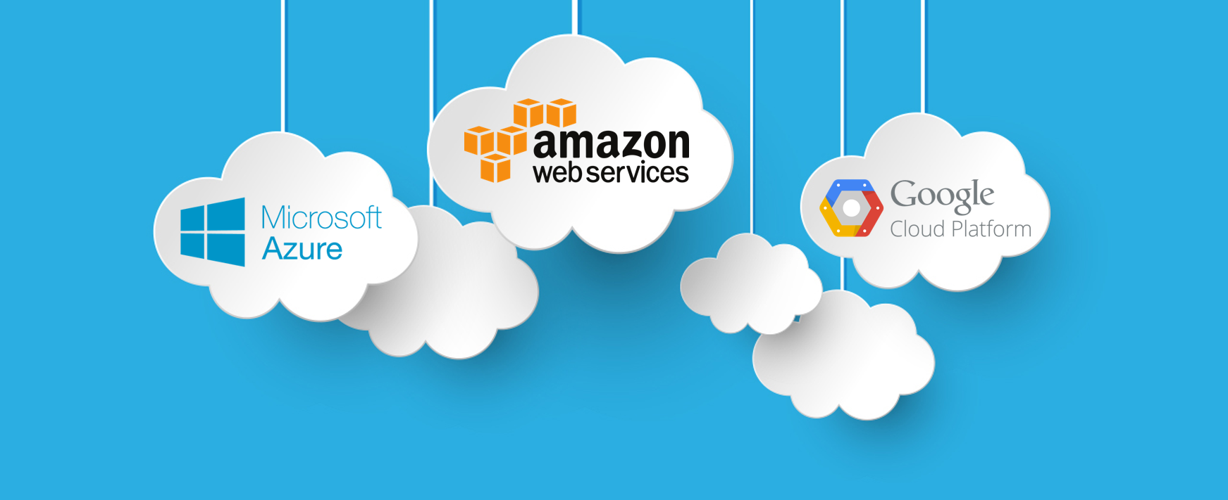
And then there was the public cloud...

Slide 25
Micro services + Cloud PASS
Attempts to drop devops…
This is a good thing.
More power to the developers is a good thing…
At the end there will be nothing but developers…
And they will be brave again!

Slide 26
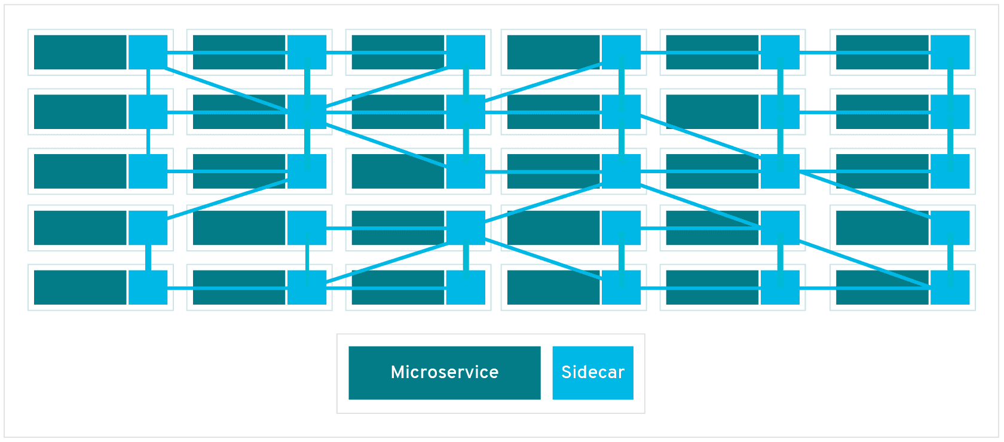
And then there was the service mesh...

Slide 27
What is the service mesh?
A attempt to control “micro services hell”
Impose security, data management and other concerns on large micro services solutions…

Slide 28
Service mesh - advantages
Let’s people who are not the developers of the micro services control the interactions between micro services
Now we can be security compliant again!
Now we can make sure certain architectural concerns or invariables are met
Order from chaos

Slide 29
Service mesh - disadvantages
If you are using it, it means you are already in hell
Another technology to learn, deploy, …
And again, reduces innovation and …
Turns developers into cowards again…
Maybe allows architects to be brave, but this remains to be seen...

Slide 30
Summary...
A cycle of technologies….
The target is to put more power into the hands of innovator.
Some technologies succeed more, some less…
Remember GAE? Does it look better now?

