Slide 1
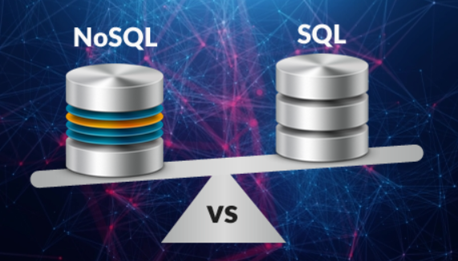

Databases
Hezi Daniel
FLP-RT
Nov, 2019
SAP

Slide 2
Agenda
RDBMS:
Theory – What is a relational DB and how it works?
What does ACID mean?
Advantages and disadvantages of relational DBs
RDBMS Standardization
Example of DBs
The CAP (Consistency, Availability & Partition tolerance) theorem
4 minutes Demo of a "layer" DB (If time remains(
NoSQL database:
Theory – What is NoSQL DB?
How does it work?
Advantages and disadvantages of NoSQL DBs
Example of DBs (open source and propriety) and the differences between them
When should we use a NoSQL DB and when an RDBMS
Google spanner:
What is it and how does it work?
Is it a game changer for the DBs market?

Slide 3
Why do we need a DB for?
Responsible of R/W from file and let me leave in a “data world”
Indexing
The important reason for using an DB is to let multiple agents to work simultaneously on the same data

Slide 4
RDBMS stands for Relational DataBase Management System
Data is stored in the form of tables, and there is a relationship between those tables

Slide 5
RDBMS can be defined as followed:
a decreases exponent in the sizes of the tables
Few (2-3) very big tables with a lots of work on them
As the size of the table decreases, it has less operations on it
The large tail of RDBMS is many table that rarely change

Slide 6
RDBMS – Problems that it solves for us
What happen if someone changes the same data that I have already read but still did not commit?
What happen if I’m changing a value that other users read at the same time?
What happen if I want to do sequence of operations and don’t want anyone to see the data in between?

Slide 7
Transactions
An action, or a series of actions, carried out by a single user or an application program, which reads or updates the contents of a database.
In other words - Transaction is a collection of actions on the DB that moves the DB from one consistent state to another consistent state

Slide 8
The ACID Properties –
Four properties are used to define transactions: the ACID properties
Atomicity
Consistency
Isolation
Durability

Slide 9
Atomicity – A transaction is an atomic unit of processing; It should either be performed in its entirety or not performed at all
Consistency – Means that the DB keeps his answers consistent with me (otherwise I could not do any program)
Isolation – A transaction should appear as though it is being executed in isolation from other transactions, even though many transactions are executing concurrently
Durability – guarantees that transactions that have committed will survive permanently. These changes must not be lost because of any failure

Slide 10
ACID
Atomicity
Consistency
Durability
Isolation

Slide 11
Durability - solution
It consist of 2 aspects:
1. Improving the performance by using a transaction log that allows:
Multiple users to write simultaneously
Improve DB performance
2. Integrated deeply with OS in order to bypass its caching system, so it can be 100% sure that the data was written to disc

Slide 12
Concurrency
If multiple threads operate simultaneously in your application (e.g., web server), concurrency problems (we categorized them as ACID) may arise.
There are three types of possible problems:
Dirty reads,
Unrepeatable reads
Phantom reads.

Slide 13
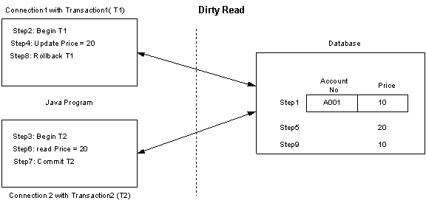
Dirty Read Problem

Slide 14
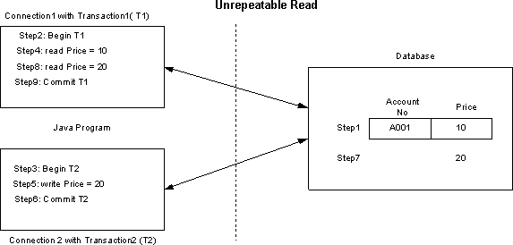
Unrepeatable Read Problem

Slide 15
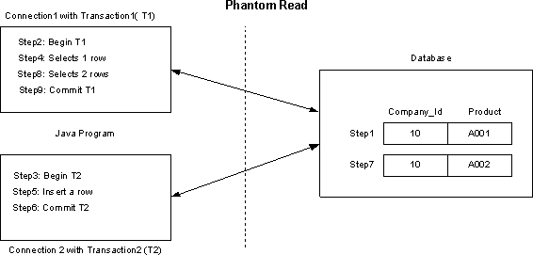
Phantom Read Problem

Slide 16
Isolation Levels
To overcome these problems, databases support different transaction isolation levels, dictated by ANSI SQL:
Read uncommitted
Read committed
Repeatable read
Serializable
More transactions per second
Bad performance

Slide 17
Isolation Levels
The following table describes isolation levels and the problems prevented by each:
Transaction Level | Permitted Phenomena |  |  | Performance impact
 | _{Dirty reads} | _{Non- Repeatable reads} | _{Phantom} _{reads}
Read uncommitted | YES | YES | YES | FASTEST
Read committed | NO | YES | YES | FAST
Repeatable read | NO | NO | YES | MEDIUM
Serializable | NO | NO | NO | SLOW
@ Copyrights InterBit LTD.

Slide 18
RDBMS - examples
MySQL - Opensource
Postgresql - Opensource
Oracle database (Oracle)
SQL Server (Microsoft)
Aurora (AWS – built for the cloud)
Cloud SQL (Google)
Very big enterprise type of DB (you might need a mainframe to run them):
Sybase
DB2 (IBM)

Slide 19

The Dream… ☺
Oracle – but million times stronger
DB with Billion of user
With satisfied performance & efficiently
With ACID support
With my lovely JOINs of SQL
With simple SQL

Slide 20
…and its interpretation ☹

Slide 21
The future is going to decentralize computers

Slide 22
The CAP (Consistency, Availability & Partition tolerance) Theorem
It states that it is impossible for a distributed data store to simultaneously provide more than two out of the following three guarantees:
a. Consistency: Every read receives the most recent write or
an error
b. Availability: Every request receives a (non-error) response, without the guarantee that it contains the most recent write
c. Partition fault tolerance: The system continues to operate despite an arbitrary number of messages being dropped (or delayed) by the network between nodes

Slide 23
NoSQL DB – towards the end of RDBMS?
Scaling definitions:
Up – replace to a better machine
Down – replace to a slower machine
In – reduce amount of machines
Out – increase amount of machines
NoSQL meant to be a DB with scale-out abilities

Slide 24
NoSQL Types
NoSQL DBs are classified into four types:
Key-Value pair bases
Column based
Document based
Graph based

Slide 25
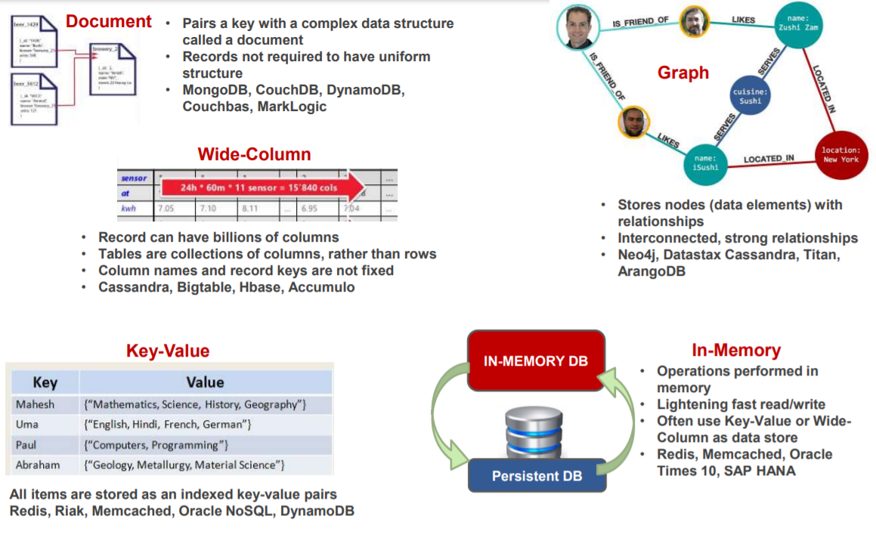

Slide 26
Avoid losing data - Replicate
Avoid bottle-neck - Minimum talk with the master
Master
Avoid bad performance - Minimum talk between the nodes

Slide 27
NoSQL API
Main APIs:
Get(key)
Put(key, value)
Delete(key)

Slide 28
Restrictions (for some open source)
Mongo DB and Casandra are not 100% scale-out
It is possible to scale out to ~100 machines
They have never use the Planet-wide-load scenario like in Google
Don’t have the same scalability ability like Google and AWS, but still defeats Oracle

Slide 29
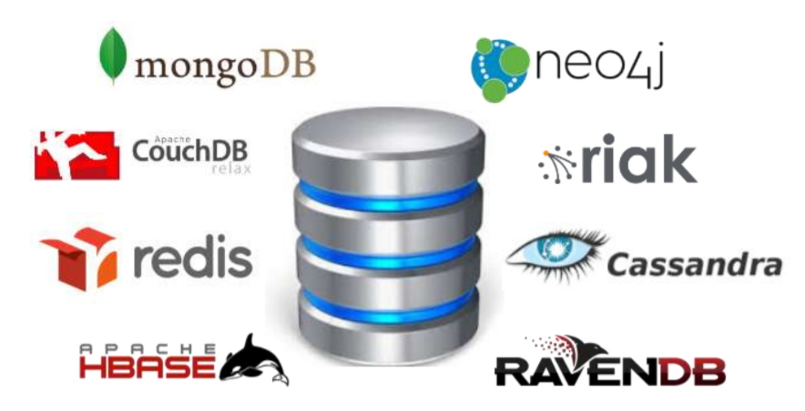
NoSQL DBs example

Slide 30

NoSQL Standardization

Slide 31
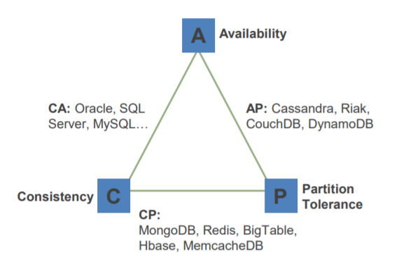
The CAP Theorem – cont.

Slide 32
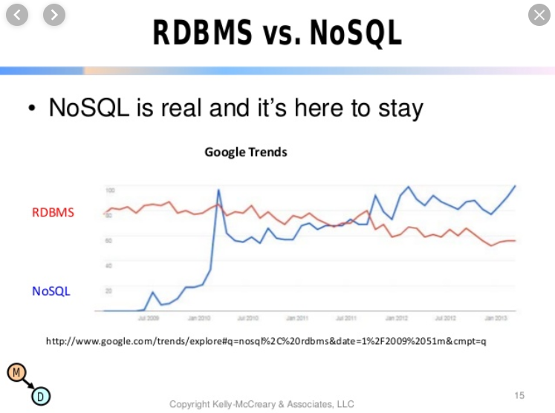

Slide 33
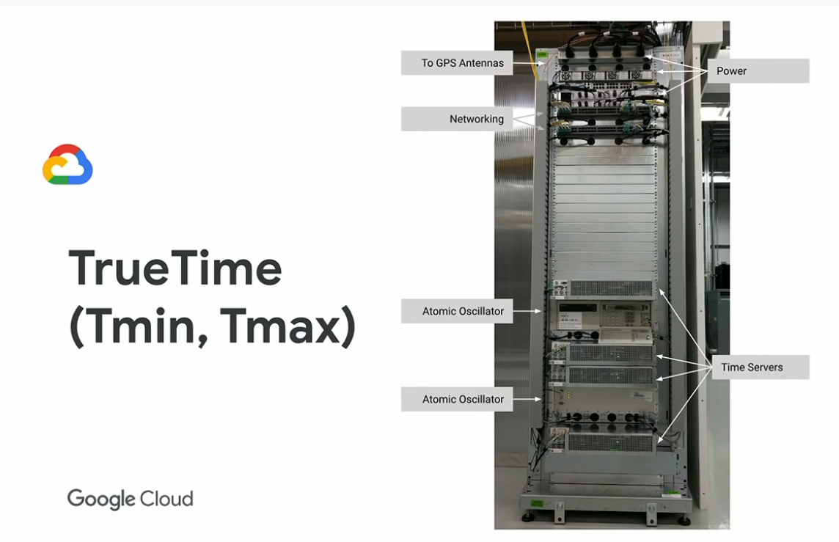
Google Spanner
The problem:
Synchronize of data centers killed
performance
The Solution:
Creating a new hardware with atomic clocks.
A new architecture with no master
By doing that, consistency is possible with quite good performance
- A system can support CAP

Slide 34
Thank you for joining

