Slide 1
AWS overview
Mark Veltzer
veltzer@gnu.org

Slide 2
About me...
Background: Math, Music, History, Philosophy
Expert developer
3 startups
Consulting
First AWS instructor in Israelmain-qimg-09d768045d5e043535ef75b1084e2488

Slide 3
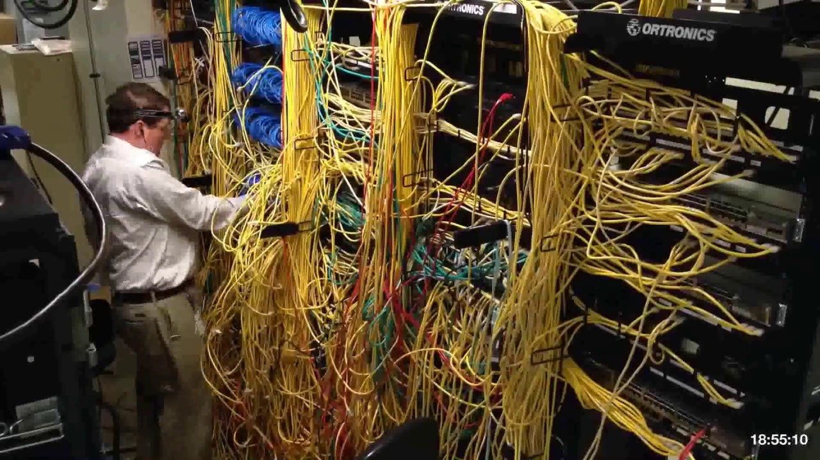
The old database

Slide 4
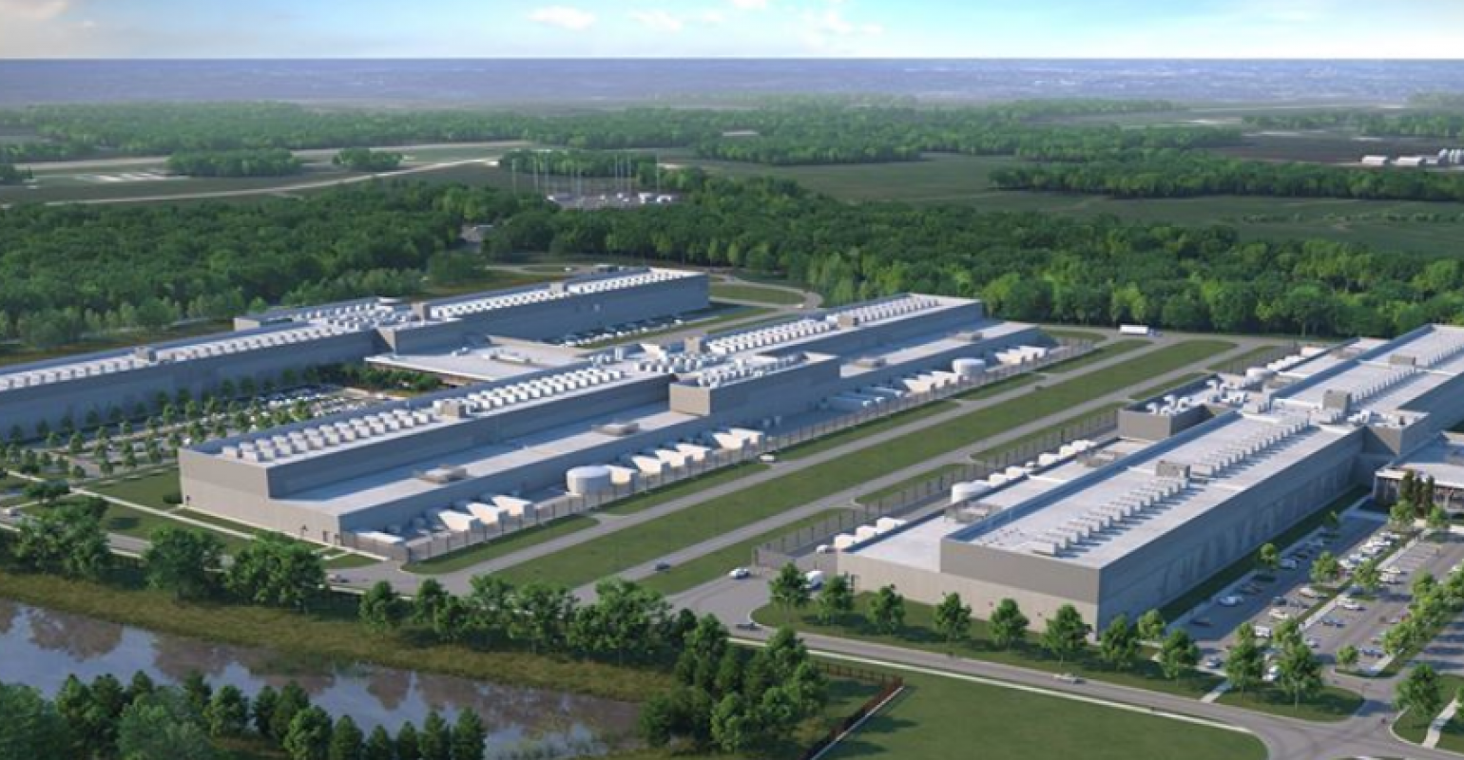
The public cloud - outside

Slide 5

The public cloud - inside
gartner-iaas-2019-mq

Slide 6
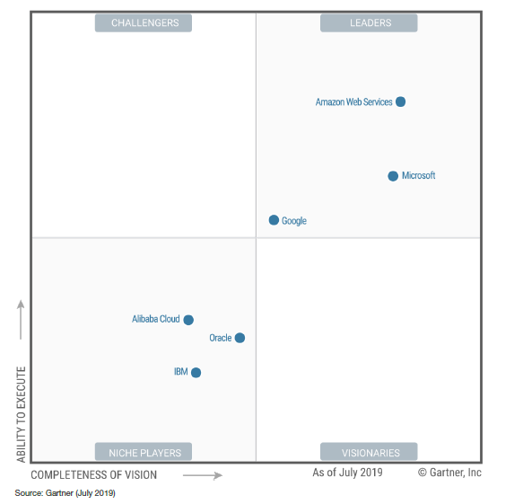
The market

Slide 7
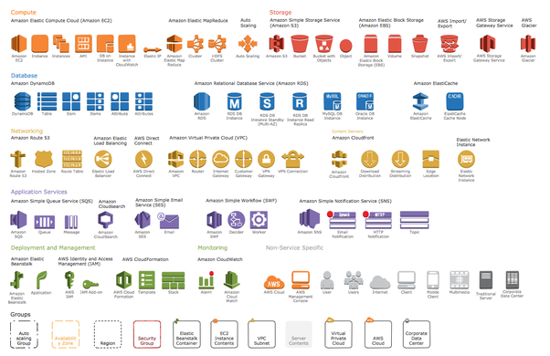
Services is what it’s all about

Slide 8
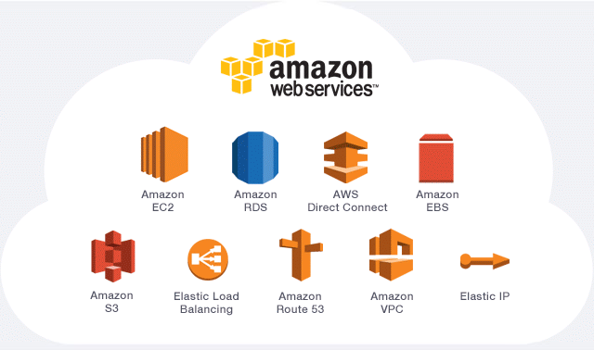
Main services

Slide 9
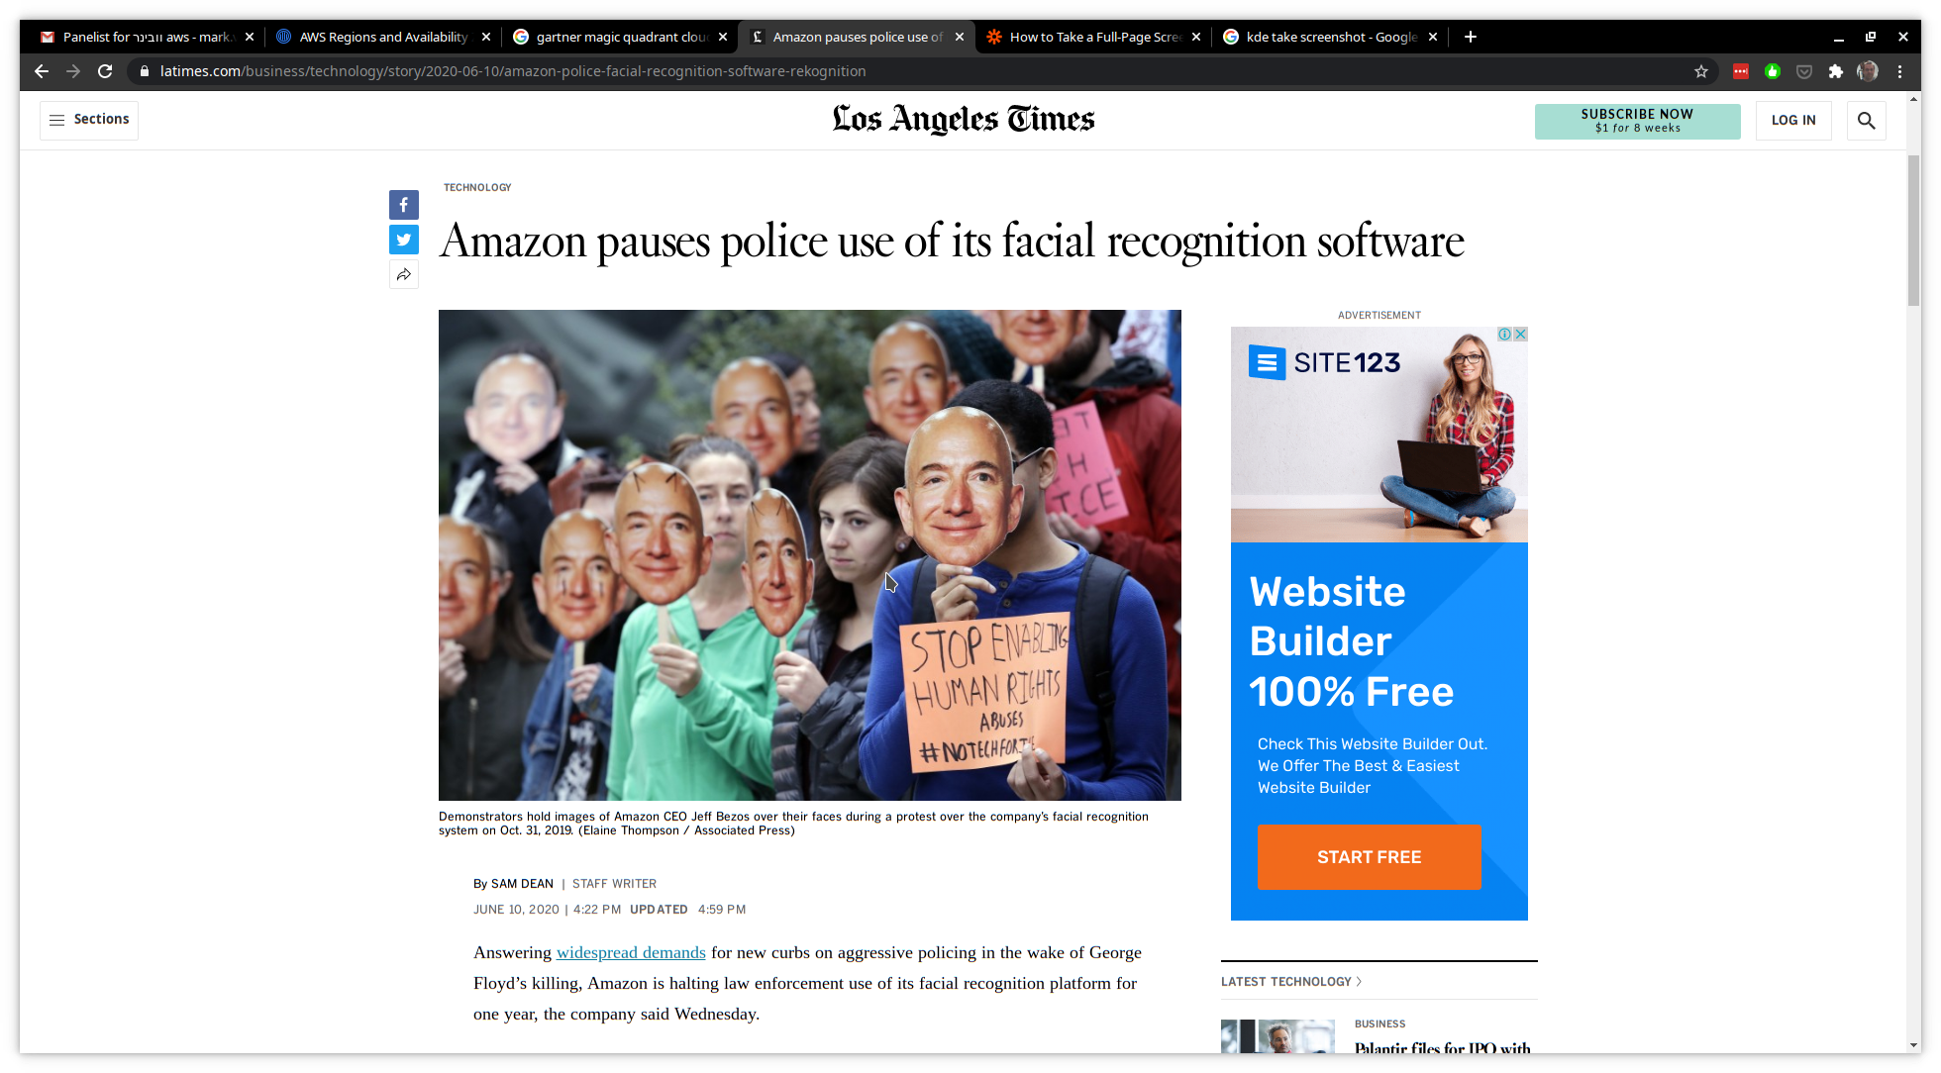
Too big to fail

Slide 10
“Cloud is democracy”
Leverage sophisticated technologies
Focus on the app, not the tech
Allow startups to scale with no investment
And what about politics? Block chain? Zero knowledge?

Slide 11
Questions?

