Slide 1
Gradle
Mark Veltzer
mark.veltzer@gmail.com

Slide 2
Who am I?
Come from math background (Masters obligations completed, didn’t do final thesis, Tel-Aviv University)
Instructor (instructed about 170 different courses in terms of different syllabi)
Wrote and helped with lots of open source projects
Maintained GNU grep for about 7 years
GNU member for many years
Anarchist (yes, there are sane ones)
Wrote a Political Philosophy book (everyone should write one)
Jazz Piano player (the most free form of Music there is...)
Founded the Israeli movement for Direct Democracy
Got Rafael excellence award for things I’m not allowed to say I was part of
Studied Political science (nope, there is no such science) and History (yep, it’s a real thing) at the Open University.
Devout Atheist and Anti-Theist (Richard Dawkins is a christian when compared to me)
Consulted large companies and therefore hate large organizational structures with a passion...

Slide 3
Who am I? - now for the relevant stuff
Programming Java since the mid 90s.
Dealing with large projects since the same time.
Used tons of build systems (scons, make, cmake, ant, ivy, maven, gradle, cons, nmake, …)
Helped solved large build problems for Amdocs and Check Point.
An expert on tuning build systems and why corporate build systems suck.

Slide 4
Origins

Slide 5
Origin of the name “Gradle”
Hans Dockter (Gradle founder) wanted to call it “Cradle”
But he thought that it was too diminutive and not unique (would be hard to search for on google).
But since Gradle uses groovy as it’s DSL changing the first letter to “G” seemed obvious.

Slide 6

Origins of the Icon
“Why the elephant?” I hear you ask. Well, Gradle recognizes that sometimes you need a lot effort and sheer tenacity to perform a successful build, hence the elephant.

Slide 7
What is gradle?
“Gradle is an open-source build automation tool that is designed to be flexible enough to build almost any type of software.” (gradle documentation)
This doesn’t sound any different from other build tools

Slide 8
Implementation and licensing
JVM based
Gradle is written in Java (some Groovy, some Kotlin)
License is open source, Apache Standard License 2.0
Can build projects which are not in Java

Slide 9
Agnostic Build System
Java ecosystem
  Groovy, Kotlin, Scala
Native ecosystem
  C, C++, Swift, …
Android (official build system for Android)
Misc
  Python, Go, Asciidoctor, Javascript

Slide 10
Dependence on Java

Slide 11
Does gradle depend on Java?
Yes. Gradle is written in Java and and so needs a JRE to run.
But do you need a JDK and not just a JRE?
It’s complicated...

Slide 12
What does gradle need: JRE vs JDK?
For installing and running: JRE
Building gradle from source: JDK
Building plugins to gradle in Java: JDK
Building plugins to gradle in Groovy: JRE (gradle comes with a groovy compiler)
Building plugins to gradle in Kotlin: JRE (you do need to install a Kotlin compiler)

Slide 13
Build Theory

Slide 14
The definition of build
The regular answer is “compilation”
This is not so.
The more general answer is
  “Running anything on top of the source code that is needed”
Compilation certainly falls into this definition
But so do other things...

Slide 15
Are these part of the build?
Compiling → obvious
Optimization of the code (usually part of compiling but sometimes not)
Linting → checking your source code for local bugs
Finding duplicate code
Find larger bug patterns
Checking coding standards
Testing
Test coverage analysis
Packaging
Signing
Uploading to artifact repository
Mailing relevant parties
Delivering to real production systems
Delivering to play store
Putting up on website so that users can download

Slide 16
What build tools are out there?
Java
  Ant, maven, ivy, gradle, bazel,
C/C++
  Make, cmake, xmake, nmake, scons
Many other tools:
  Cons, psos, ...

Slide 17
How do build tools generally work?
Scan instructions file and build a DAG of targets to be built
Find out which targets are already up to date
Build targets which are out of date in dependency order
Stop when targets fail to build (do not build targets which depend on failed targets).
Some tools fail on the first target that fails to build and some try to build as much as possible. Some offer both options.

Slide 18
Features of build tools (all are important, gradle has all of these)
Knowing to only build things which are out of date is called “incremental build”
Storing on disk stuff which has already built in case we need it in the future is called “Caching build results”. The caching is usually achieved by digital signatures.
The ability to run build phases which are independent of each other in parallel to utilize multiple cores and possibly clusters of build machines is called “Parallel building”

Slide 19
Over building and under building
Over building: building more than you strictly need to.
Under building: not building things that you really need to build.
Both are problems.
Which one do you think is more serious?
That why people prefer over building and get horrible build times.
When there are under building problems people develop mistrust of their build systems and have the “clean all” syndrom.

Slide 20
Understanding the heart of Gradle

Slide 21
What is a task?
In Gradle the atomic build unit is called a task.
Gradle comes with predefined tasks.
You can install plugins with more tasks.
And you can write your own tasks in either Java Groovy or Kotlin.

Slide 22
The heart of the build system
At the heart of the build system lies a directed a-cyclic graph of tasks.
This graph is built during the configuration phase of a gradle build
This graph determines what gradle will do next:
  Which tasks need to be run
  In what order
  Which tasks can be run in parallel
  Etc...

Slide 23
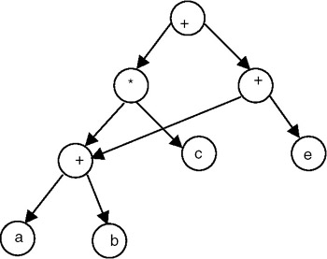
DAG - reminder
Directed - because tasks depend on one another in a non symmetrical way
A-Cyclic – because a cyclic build is impossible.
DAG = Forrest in computer science lingo
This leads us to the conclusion that we can describe to gradle many components to be built which have nothing to do one with the other. Which is true.

Slide 24
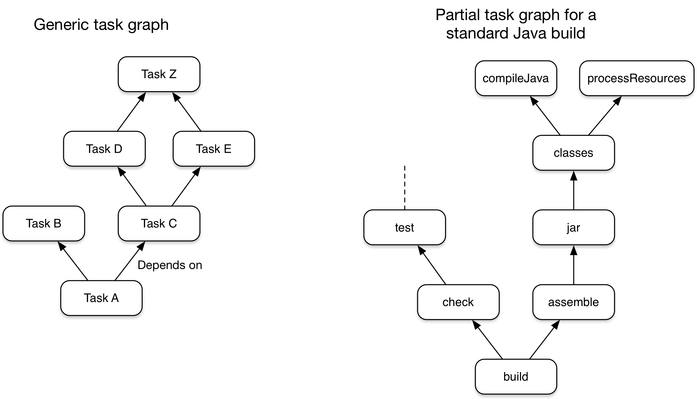
Illustrations of the DAG

Slide 25
Installing Gradle

Slide 26
Installing Gradle
You can install Gradle in various ways:
  From you distributions package manager
    sudo apt install gradle → ubuntu
    brew install gradle → macos
  From sdkman
    First install sdkman
    Then install gradle using it
  From binary packages
    Download the binary package
    Unzip it in some permanent location
    Point your environment variables (esp PATH) to it

Slide 27
The .gradle folder that was created
It’s where gradle holds it’s own data.
It’s where some it holds cache.
Can get big.
If you remove it – everything is fine.
This is because everything in there can be re-generated.

Slide 28
Don’t add .gradle to your source control
In git this means add “.gradle” to your “.gitignore” file
It can get big and be full of binary files
There can be machine specific data in there
There's a lot of churn in there (you'd be constantly committing changes to files in there)
Everything in there can be completely re-generated whenever it is needed anyway

Slide 29
Third party dependency management

Slide 30
Why dependency management?
In order to answer why we need dependency management we need to review the history of development in Java.
We also need to understand the intricacies of dependencies.

Slide 31
History of Java development (DM wise)
At first there were no tools. You had to issue your own command lines. No DM at all. You had to download jars and put them in the right place yourself.
First generation tools (e.g. Ant) did not do DM at all. You had to download jars and put them in the right place yourself.
Second generation tools (e.g. Maven, Ivy) did do DM but simply. They knew how to download the dependencies for you and check for basic compatibility.

Slide 32
Why is dependency management hard? → The combinatorial aspect
Imagine we have 50 software components (jars) which are inter-dependent.
Imagine each software component has 4 versions.
How many software configurations can we have with regard to these 50 software components?
Are these all tested? Can they ever be?
How do we know we have a good configuration?

Slide 33
Why is dependency management hard? → The transitional aspect
Let’s say you need a jar a.jar
How do you know what a.jar depends on?
There is no standard. You need to read the text on the HTML page for that jar.
The .jar standard has no dependency information standard
Ivy and maven solved this by forcing the authors of jar that upload to maven.org to add this meta data manually.
But how do you know if the data is correct? And what versions are specified?
And when you pull a dependency you need to pull it’s dependencies! Recursively!
A current project may need 50 or even 200 jars. Doing this is a nightmare.

Slide 34
The results of these problems → the inflexibility problem
Once you finally get a list of jars which is:
  Transitionally complete (have all dependencies in place)
  Works well and doesn’t crash and doesn’t have obvious bugs
You now stand still and don’t want to upgrade anything that may disturb your status
This is really bad in terms of innovation, freedom to experiment.
This turns developers in cowards, dissuades them from trying to improve things and more.
This is also a security problem since old versions are not well supported in terms of security patches.

Slide 35
Solutions to the combinatorial and the transitional problems → stacks
Pre made stacks.
  The idea is to publish a full stack of libraries (with specific versions) that are known to work.
  This way many users will share the same stack.
  They will get security patches applied to the stacks.
  They will get their bugs revealed and fixed before they get to the scene.
The drawback → you lose liberty in choosing the set of libraries or their versions. You now choose a stack and are bound to that stack.
Hopefully someone is taking care of that stack and is publishing new versions of the stack, in addition to bug fixes and security patches.

Slide 36
Solutions→ stacks with additions
To solve the main problem of stacks you can add extra libraries to stacks.
The problems:
  You have to make sure that the extra libraries you add do not conflict with the stack.
  And only add your library and dependencies it has that are not already in the stack
  And you have to take care of security and bug fixing the libraries you added

Slide 37
Examples of stack solutions...
On https://stackshare.io/ people share stacks that seem to work (watch out!)
AWS opsworks allows you to use “standard” stacks and so you share them with many AWS users and hopefully you get a more stable, bug free stack

Slide 38
Third parties – using source
Where is the source (there is no standard place)
Compiling is slow
Compiling required other components (Chicken and egg?)
What version of the source to take? Latest? Stable? Which stable?
At the end you have your own version. Your version → your bugs.
In theory you can check the source code to see if there is malicious code in it. In practice you don’t (too time consuming to do). This is a false advantage.

Slide 39
Third parties – using binaries
It’s faster to download
No need to build → no dependency chick and egg problem
Requires you to trust the person who built the library
Not clear what the dependencies are

Slide 40
Gradle with regard to the dependency management problem
Gradle is compatible with all previous solutions:
  lib or custom repositories
  Ivy metadata
  Maven metadata
  Gradle module Metadata (since 5.3)
  And more...

Slide 41
Configuring Gradle

Slide 42
Configuring Gradle
Is done via the gradle.properties file
This file has an ini format
You can have several of these files in places where Gradle looks for them
More specific locations override less specific ones.
The locations that Gradle searches for are (from specific to general)
  Any sub project
  The project directory (where your build file is)
  In $GRADLE_USER_HOME (if this variable is set)
  In the users home directory ~/.gradle if the environment variable is not set

Slide 43
Debugging your configuration
You can use:
  $ gradle :properties
  to list all properties and this way check if your configuration is correct
Note that you can put any property into your gradle.properties file
Gradle does not check and will not issue warnings or errors if you put entries in this file that it does not understand
It will only issue warnings or errors if the file format is bad

Slide 44
Examples of configuration items

Slide 45
The Gradle Cache

Slide 46
Enabling the cache
By default the cache is disabled
To enable either:
  Pass --build-cache on the command-line
  Put org.gradle.caching=true in your gradle.properties
To see your cache at work:
  TBD

Slide 47
What tasks utilize the cache?
Java toolchain: JavaCompile, Javadoc
Groovy toolchain: GroovyCompile, Groovydoc
Scala toolchain: ScalaCompile, PlatformScalaCompile, ScalaDoc
Native toolchain: CppCompile, CCompile, SwiftCompile
Testing: Test
Code quality tasks: Checkstyle, CodeNarc, Pmd
JaCoCo: JacocoMerge, JacocoReport
Other tasks: AntlrTask, ValidatePlugins, WriteProperties

Slide 48
Can third party or your tasks utilize the cache?
YES!
There is an API for this
You need to annotate your tasks as cachable

Slide 49
Clearing the cache
Once there was a task cleanBuildCache
It no longer exists
You can use:
  rm -rf $GRADLE_HOME/caches/build-cache-*

Slide 50
Running gradle

Slide 51
Basic usage
gradle build/clean – to build/clean the project
gradle tasks
gradle :[task_name] – to run just a single task
Add -i to get lots more info

