Slide 1
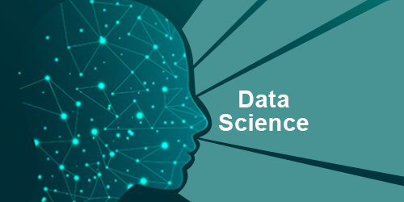
Data Science and ML Introduction
Mark Veltzer
<mark.veltzer@gmail.com>

Slide 2
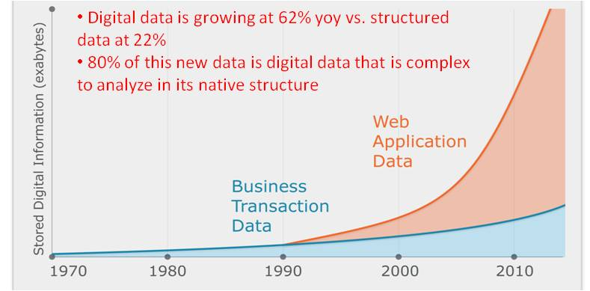
Data increase over time

Slide 3
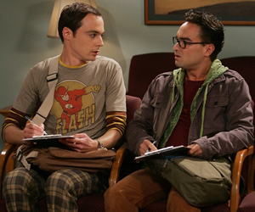
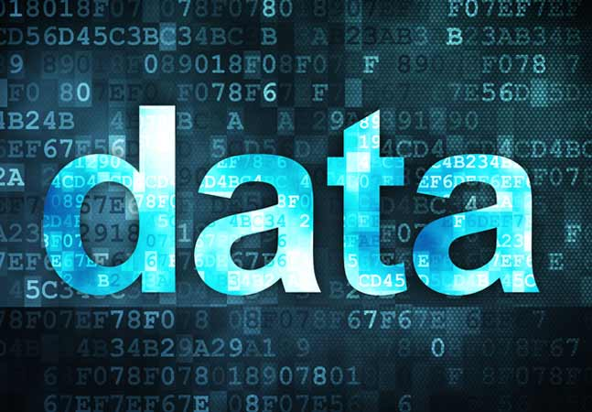
Data over algorithms

Slide 4
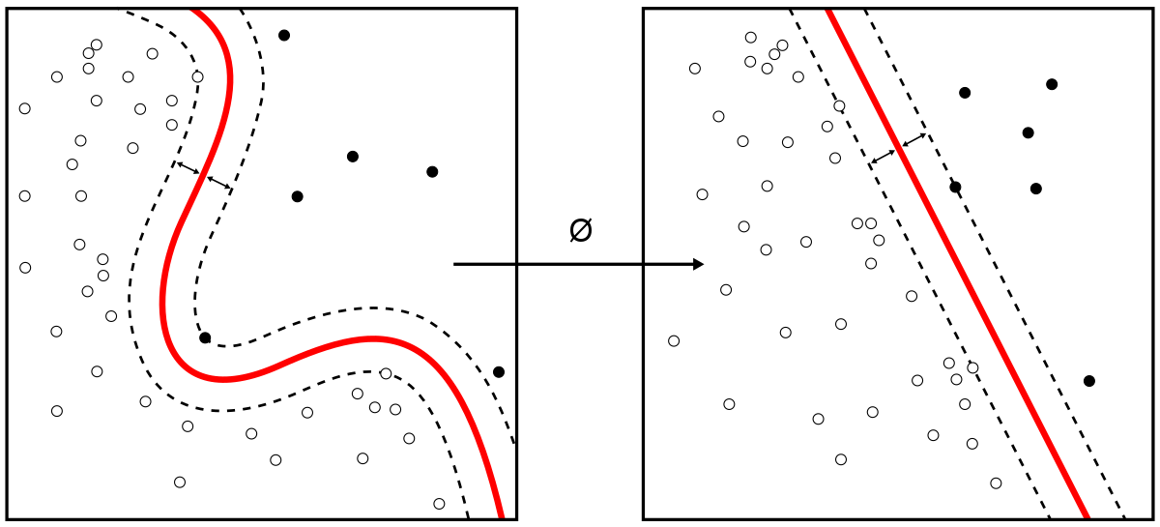
Machine learning

Slide 5
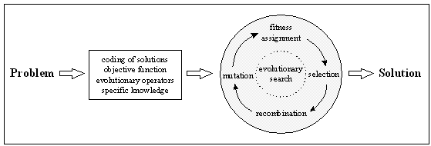
Optimization

Slide 6
What background do I need?
Math background is a plus. Liking math is a must.
Programming background is a plus. Liking programming is a must.

Slide 7
What will we learn in ML?
Applying standard ML algorithms: KNN, Decision Trees, Random Forests, Baysian analysis etc…
Learning the strengths and weaknesses of various algorithms
Learning to tune the various algorithms
Learning to engineer new data features to get better results from the each algorithm
Learning how to find the right algorithm for each ML problem

Slide 8
Questions?

