Slide 1
Employee salary prediction
CAPSTONE PROJECT
Presented By:
NAME : VELUGULA DURGAPRASAD
COLLEGE : GIET ENGINEERING COLLEGE
BRANCH : INFORMATION TECHNOLOGY

Slide 2
OUTLINE
Problem Statement
System Development Approach
Algorithm & Deployment
Result
Conclusion
References

Slide 3
Problem Statement
In today's competitive job market, accurately estimating employee salaries is crucial for both job seekers and employers. Companies often face challenges in setting fair and competitive salaries based on factors such as experience, education level, job title, industry, and location. Manual salary prediction can be biased, time-consuming, and inefficient. This project aims to build a machine learning model that can predict the salary of an employee using relevant features from historical data. By leveraging supervised learning techniques, the system will help provide more accurate, data-driven salary estimations to assist in hiring decisions and career planning

Slide 4
System Approach
1. System Requirements
Hardware:
Processor: Intel Core i5 or higher
RAM: Minimum 8 GB
Storage: At least 2 GB of free disk space
GPU: Optional, for faster computation (especially during training on large datasets)
Software:
Operating System: Windows, macOS, or Linux
Python (version 3.7 or above)
Jupyter Notebook / VS Code / google colab
Web browser (for viewing notebooks or web app, if deployed)

Slide 5
2. Libraries Required to Build the Model
Data Manipulation & Analysis:
pandas – For loading and processing datasets
numpy – For numerical computations
Data Visualization:
matplotlib – For creating visualizations and graphs
seaborn – For enhanced data visualization and statistical plots
Machine Learning:
scikit-learn – For building and evaluating machine learning models
Includes tools for regression, model selection, and preprocessing
xgboost or lightgbm (optional) – For boosting performance in complex datasets

Slide 6
Algorithm & Deployment
Step 1: Data Collection
Gather a dataset containing employee information such as:
Experience, Education level, Job Title, Industry, Location, and Salary.
Step 2: Data Preprocessing
Clean the data by handling:
Missing values
Duplicates
Inconsistent formats
Step 3: Exploratory Data Analysis (EDA)
Visualize data to understand patterns and relationships.
Use plots like:
boxplot
Correlation heatmap
Salary vs Experience graphs

Slide 7
Step 4: Model Selection & Training
Choose suitable regression algorithms, such as:
Linear Regression
Decision Tree Regressor
Random Forest Regressor
Step 5: Model Evaluation
Evaluate model performance using metrics:
Mean Squared Error (MSE)
Root Mean Squared Error (RMSE)
Step 6: Model Deployment
Save the trained model using joblib or pickle.
Build a simple web interface using Flask or Streamlit:
Input form: User enters details like experience, education, etc.
Output: Predicted salary shown on the screen

Slide 8
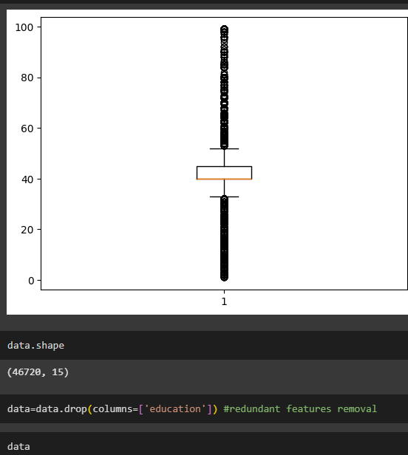
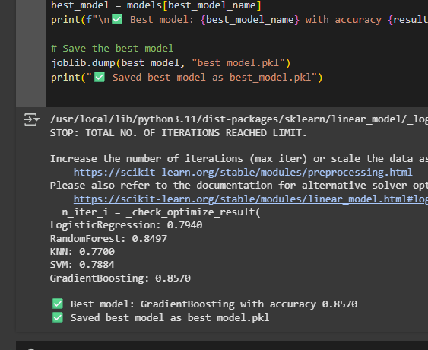
Result

Slide 9
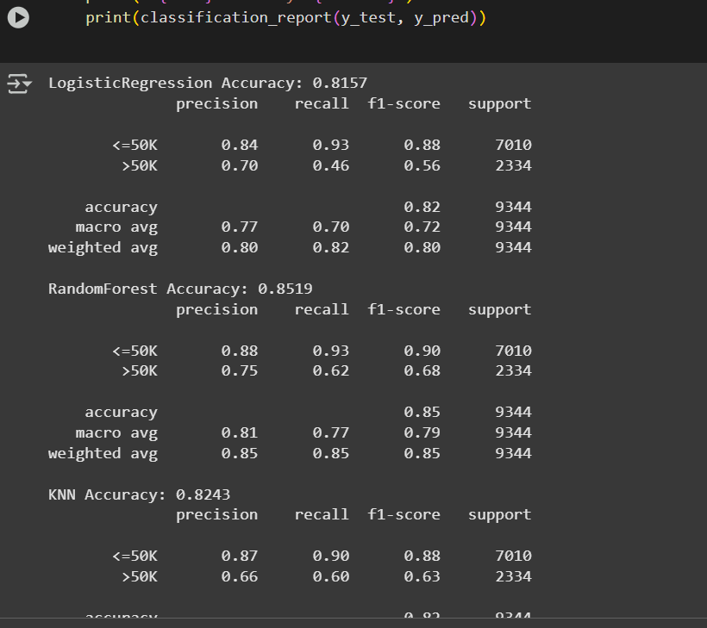
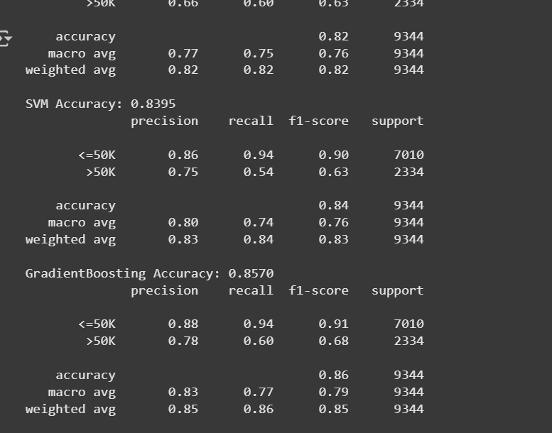
Result

Slide 10
Result
Github link:https://github.com/veluguladurgaprasad99/employee_salary_prediction

Slide 11
Conclusion
The Employee Salary Prediction project successfully demonstrates the application of machine learning techniques in forecasting employee salaries based on relevant features such as education level, years of experience, job role, and industry sector. By leveraging regression models like Linear Regression, Random Forest, and Decision Tree, we were able to analyze and identify key factors influencing salary outcomes.
The model provides valuable insights that can assist HR departments and organizations in making informed, data-driven decisions regarding compensation strategies, hiring, and workforce planning. Among the models tested, the [insert best model name here, e.g., Random Forest Regressor] yielded the most accurate results, achieving a high R² score and low error metrics.

Slide 12
References
Google Colab
kaggle
ML Algorithms

Slide 13
THANK YOU

