Slide 1
Test Automation Architecture

Slide 2





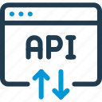





1
2
3
IntelliJ
GitHub
Git Actions
Build Tool
4
7
6
5
Data Sources
API Systems
Git Systems
Test Execution
8
9
9
Dashboards
Test Reports
Email Systems

Slide 3
Tech and Tools
Programming Language – Java.
IDE – IntelliJ Community Edition.
Test Formation Framework – BDD using Cucumber.
API Testing Framework – Rest Assured.
Unit Testing Framework – TestNG.
Reporting Format – Extent Reports.

