Slide 1

Airbnb Project Database Design and Implementation

Slide 2
Contents
Project Summary
ER Diagram
Assumptions
DDL queries
Entities list with attributes
Data Integrity
SQL queries
Data Visualization

Slide 3
Project Summary
In this project, we created a Hotel and Experiences (activities) Database (like Airbnb) that contains booking details and reviews provided by the customer. Broadly, there are two objectives for this project.
To Track the booking details of Stays and Experiences of the customers.
To Track the reviews provided by the customers.
Data was generated using Excel and references from Airbnb websites.
Total No of Customers | 4890
Total No of Hosts | 250
Total No of Hotels | 250
Total No of experiences | 100
Total No of Hotel bookings | 10000
Total No of Experience bookings | 2000
Total No of Hotel reviews | 1750
Total No of Experience reviews | 500

Slide 4
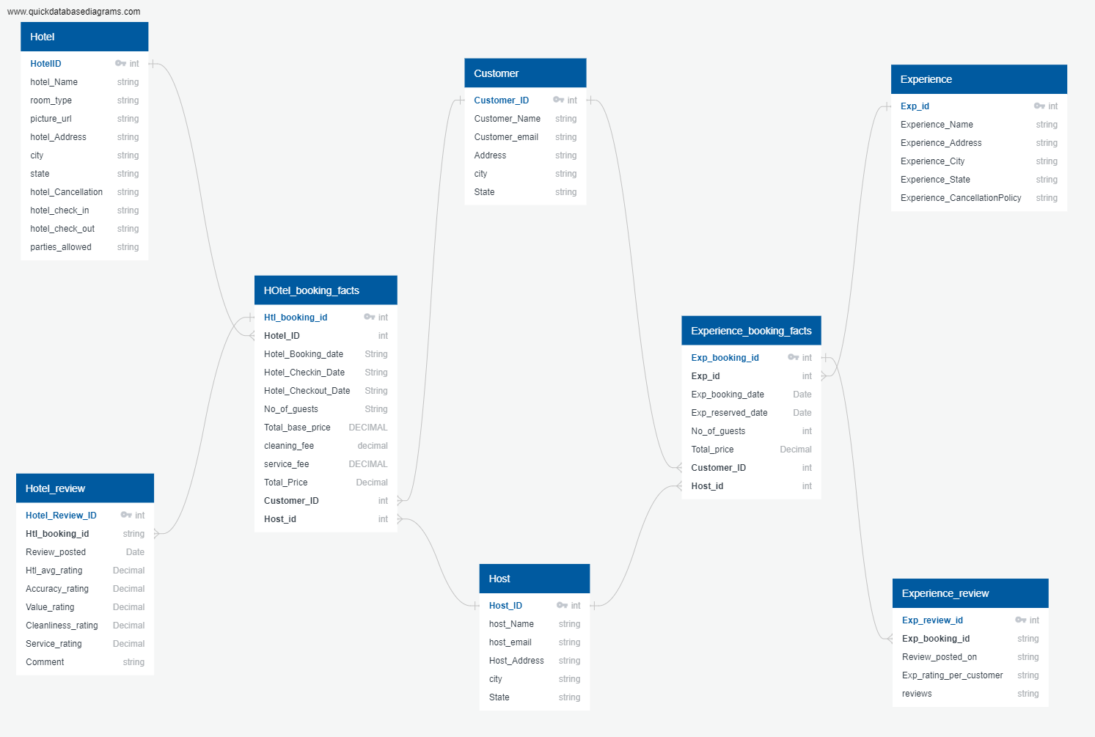
ER Diagram

Slide 5

Assumptions
Experiences are independent of hotels and booked separately.
Reviews are recorded separately for hotels and experiences.
A customer can book multiple times of a particular hotel/experience, but single booking belongs to one customer.
Reviews are provided by customers of each stay
Reviews can be provided only if the customers book a hotel or experience
A customer can provide multiple reviews/feedback for one hotel booking or experience.
Refunds and fines are not considered for this design.
Bookings cancelled are not considered for this design.
Hosts reviews for the customers are not considered for this design.

Slide 6

Data Integrity:
Data integrity refers to the maintenance and consistency of data across the course of a database. Integrity constraints in tables are used to protect data integrity in databases. Business rules are applied to database tables by integrity constraints. Column-level limits and table-level restrictions are two different types of constraints.
NOT NULL - Ensures that a column cannot have a NULL value
UNIQUE - Ensures that all values in a column are different
PRIMARY KEY- A combination of a NOT NULL and UNIQUE. Uniquely identifies each row in a table
FOREIGN KEY- Prevents actions that would destroy links between tables
CHECK - Ensures that the value in a column satisfies a specific condition
DEFAULT - Sets a default value for a column if no value is specified
CREATE INDEX -Used to create and retrieve data from the database very quickly

Slide 7
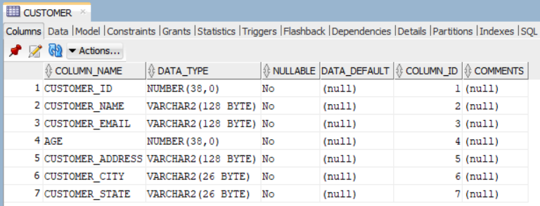
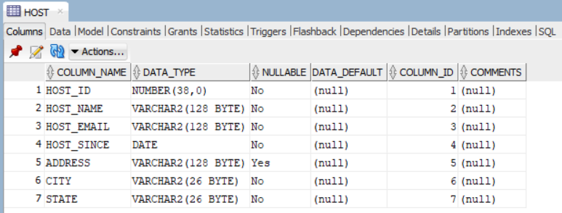
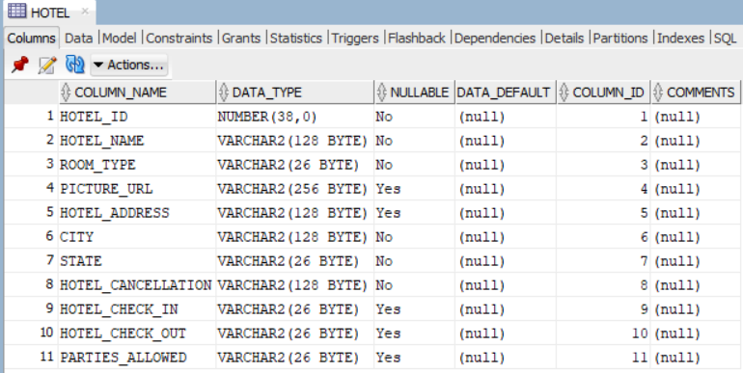
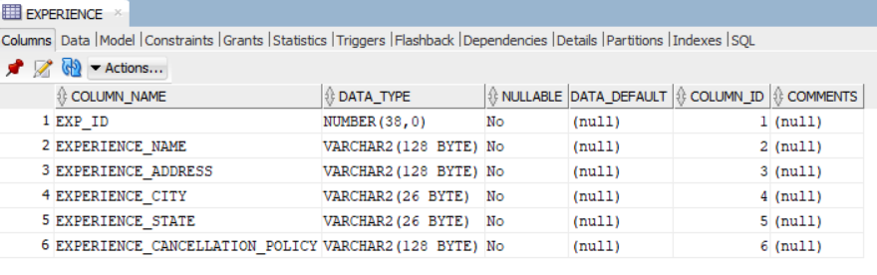
List of Entities(Tables) with Attributes and Indexes

Slide 8
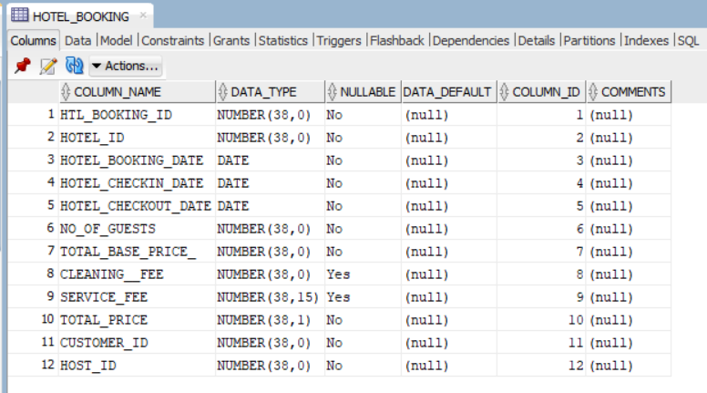
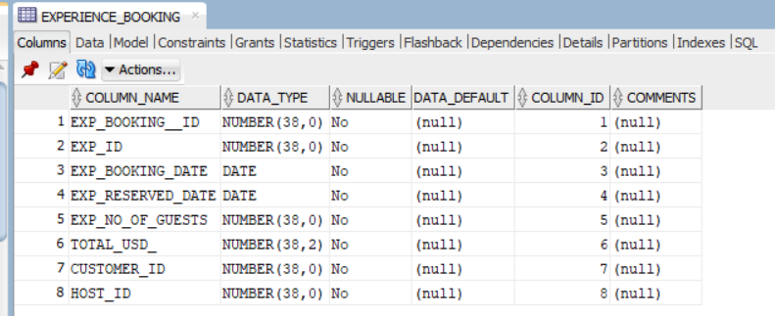
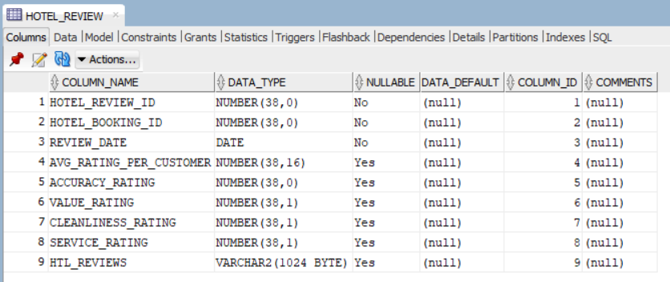
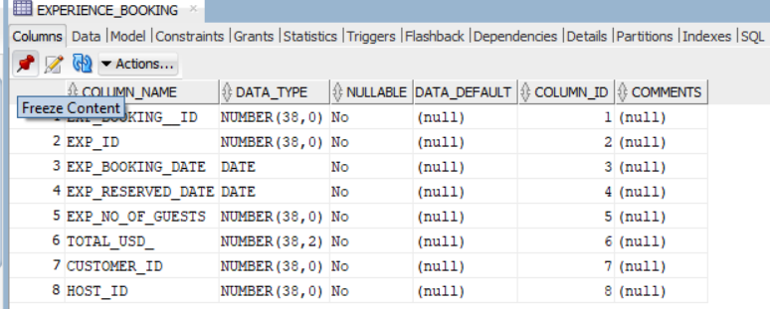
List of Entities(Tables) with Attributes and Indexes (continued)

Slide 9
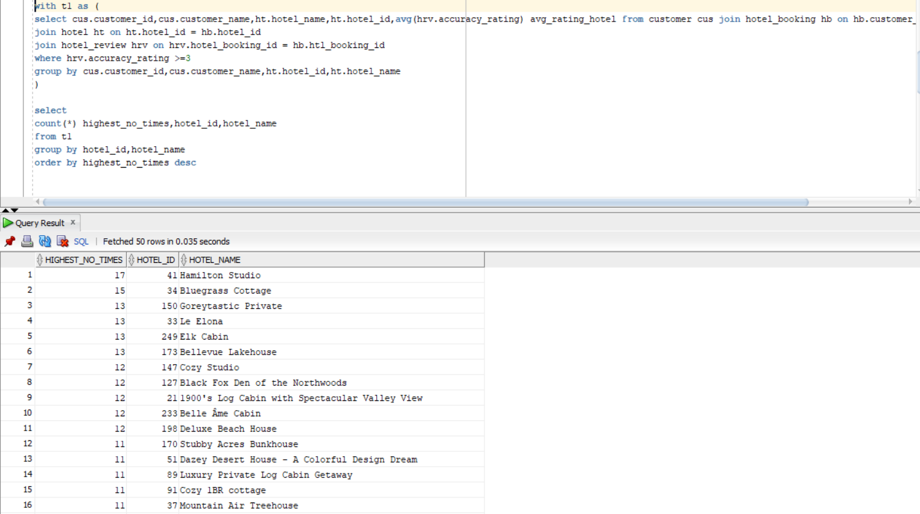
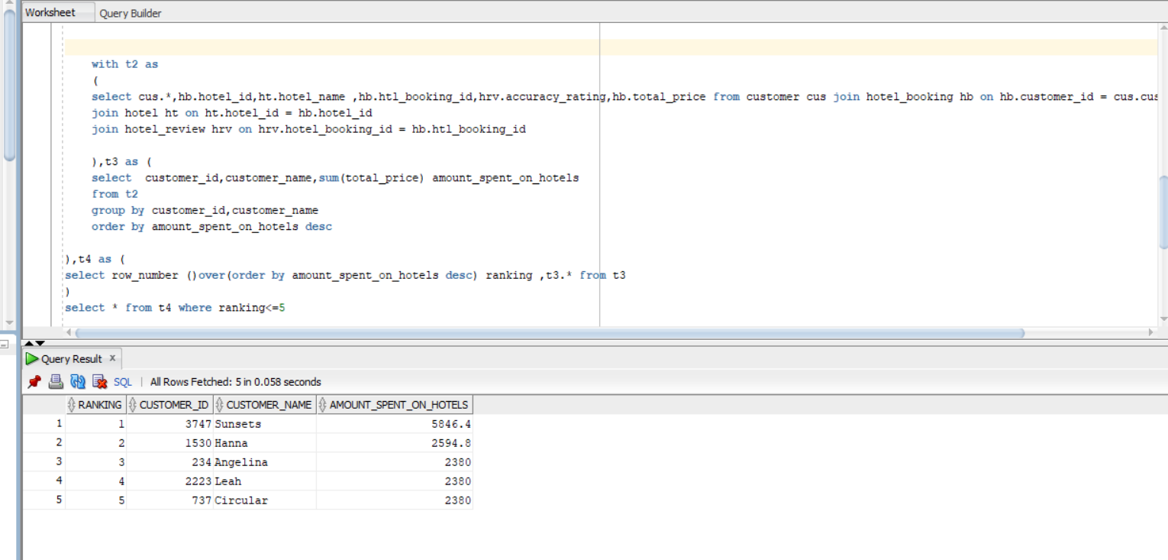
Query Writing
1)No of times the hotels got average rating of >=3 by each customer 2) List of Top 5 customers based on total amount spent on hotels

Slide 10
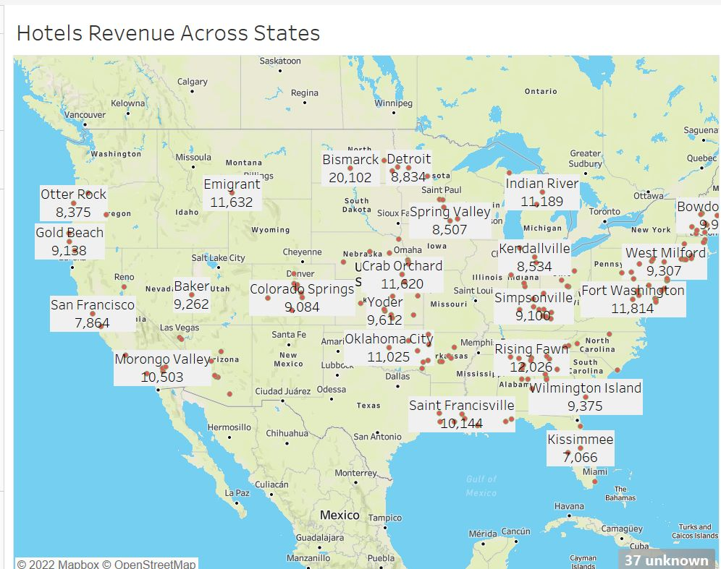
Data Visualization:
Hotel Revenue Across cities in various states
The highest among all states is Rising Fawn city with $12,026 K for the last 6 months.
The lowest is of Kissimmee city of $7066k for the last 6 months

Slide 11
Thank You

