Slide 1

Resume Classification
Team 1

Slide 2
Team members
Ms. Avantika Ravindra More
Mr. S Sathwik Pawar
Mr. M Ganesh
Mr. N Ashwin Siddhartha
Mr. M Narendra
Mr. Vemula Jagadish
Mr. S Bharath Kumar

Slide 3
Business Objective
The document classification solution should significantly reduce the manual human effort in the HRM .It should achieve a higher level of accuracy and automation with minimal human intervention.

Slide 4
Project architecture
Collection of Data
Business Understanding
Exploratory Data Analysis(EDA)
Deployment
Model Building

Slide 5
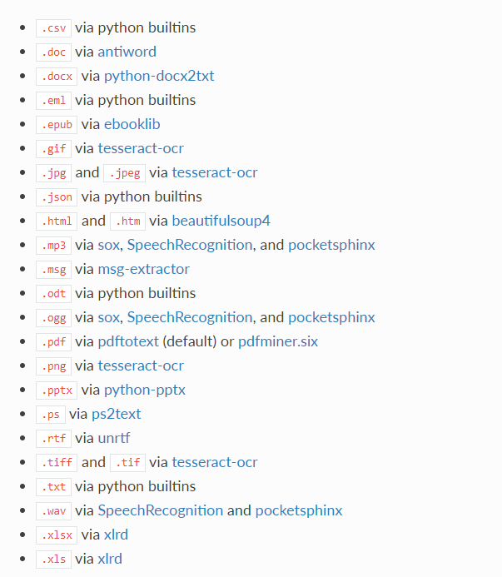
This package provides a single interface for extracting content from any type of file, without any irrelevant markup.
TEXTRACT

Slide 6
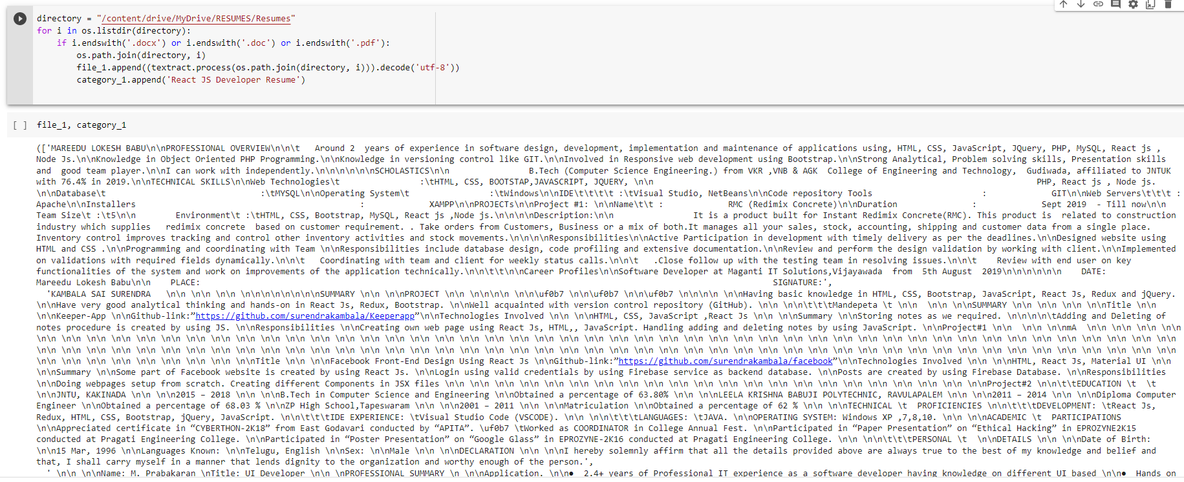
Converting all file to .txt (Process)

Slide 7
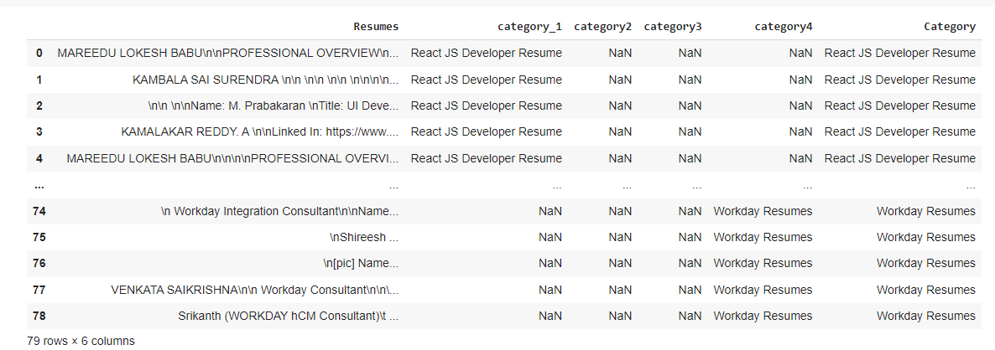
Merging all category files.

Slide 8
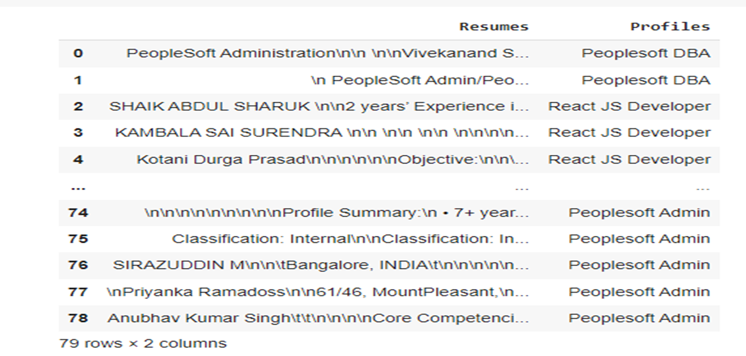
Converting text to .csv (Process)

Slide 9
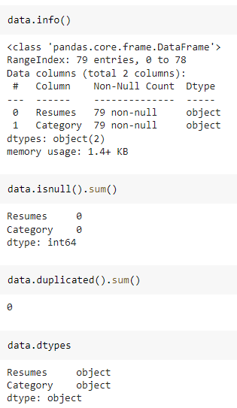
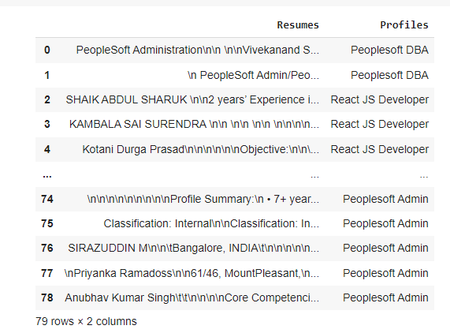
Data Set Details
After Extracting and Modifying the Dataset, given data contains a total of 4 Classes and 79 rows .

Slide 10
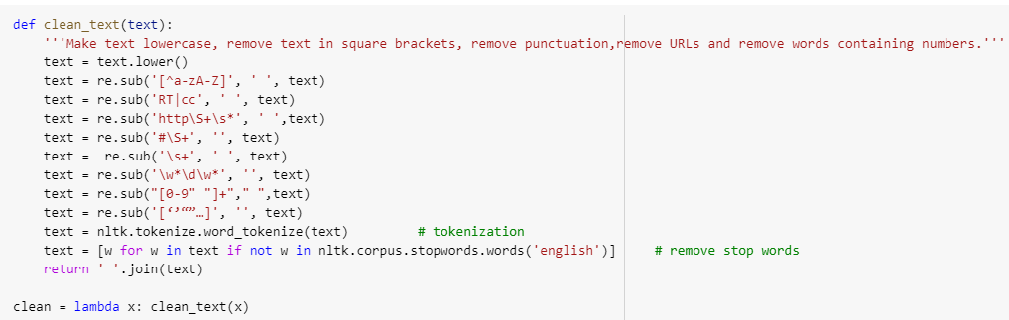
Removing All Unwanted Character’s
Unwanted Character’s like - \n \t, http links, tags, hashtags, html tags, converting to lower case, removing white spaces etc.
Word Tokenization - Tokenization is essentially splitting a phrase, sentence, paragraph, or an entire text document into smaller units, such as individual words or terms. Each of these smaller units are called tokens.
Removing Stop-words - A stop word is a commonly used word (such as “the”, “a”, “an”, “in”) that a search engine has been programmed to ignore, both when indexing entries for searching and when retrieving them as the result of a search query.

Slide 11
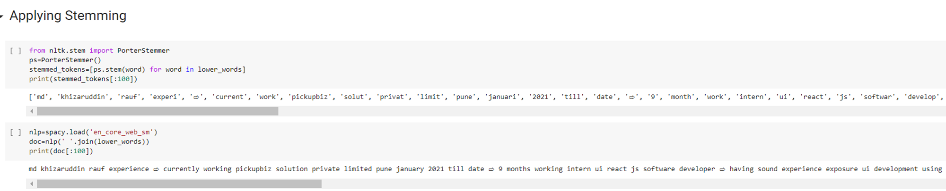
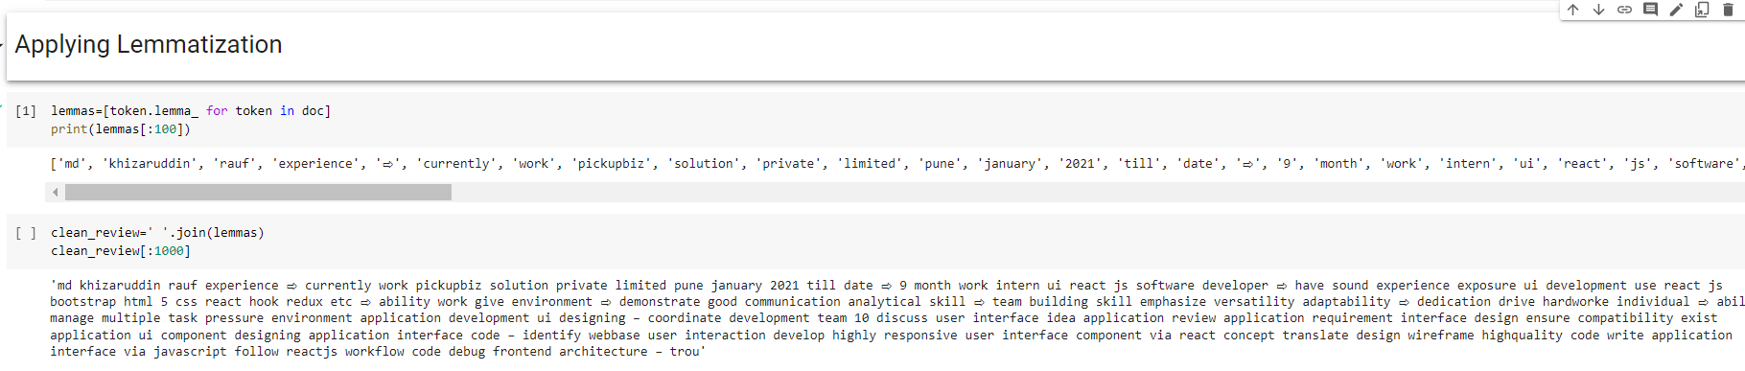
Text – Preprocessing
The Porter stemming algorithm (or 'Porter stemmer') is a process for removing the commoner morphological and inflectional endings from words in English.

Slide 12
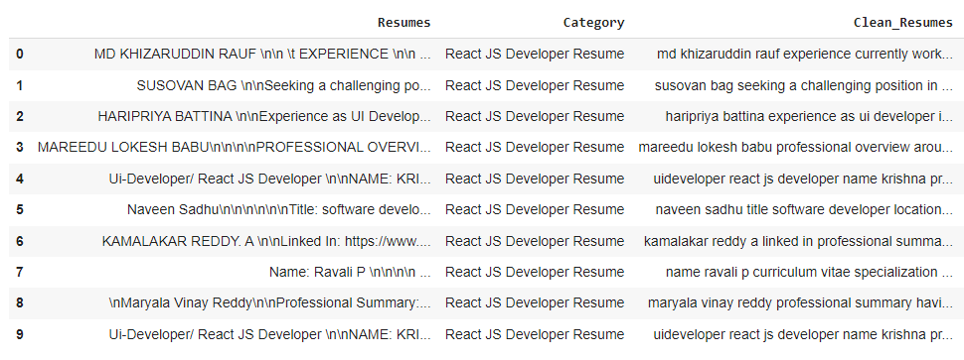
Text – Preprocessing
Before Text – Preprocessing After Text – Preprocessing
The Dataset contains 79 rows and 3 Column
There are total four Classes – Peoplesoft, Workday, React JS Developer and SQL Developer.

Slide 13
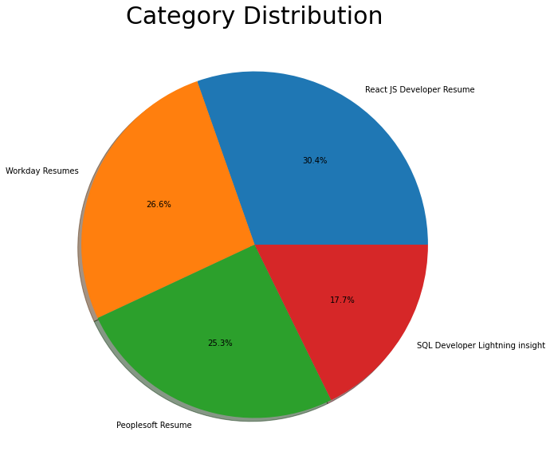
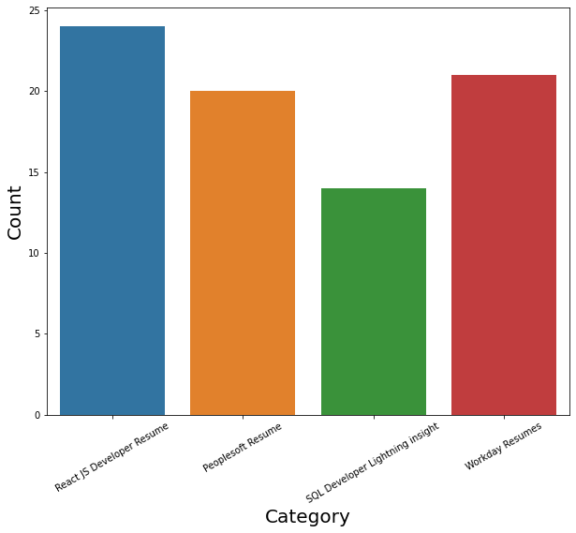
LABLES
By using Pie chart roles applied feature is displayed to visualize the job roles.
By using Histogram roles applied feature is displayed to check the job types.

Slide 14
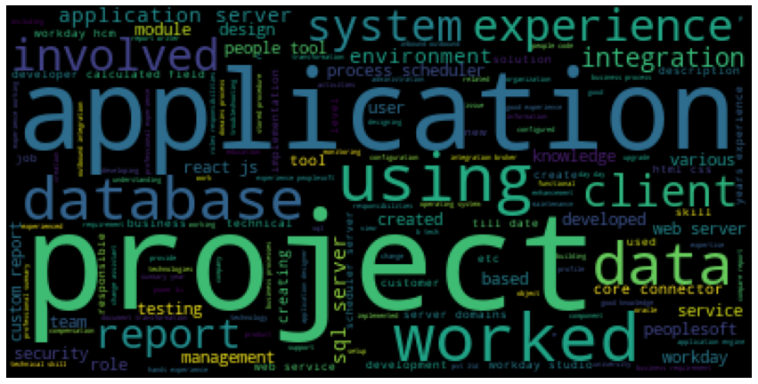
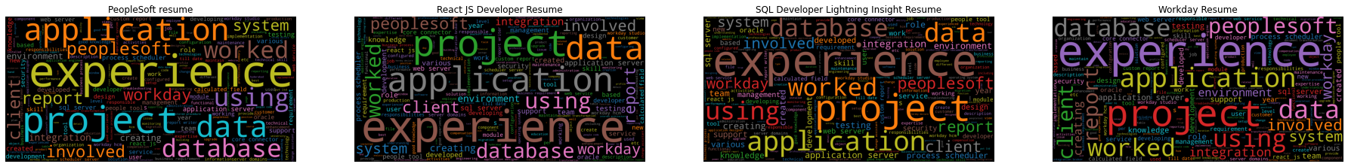
Word cloud

Slide 15
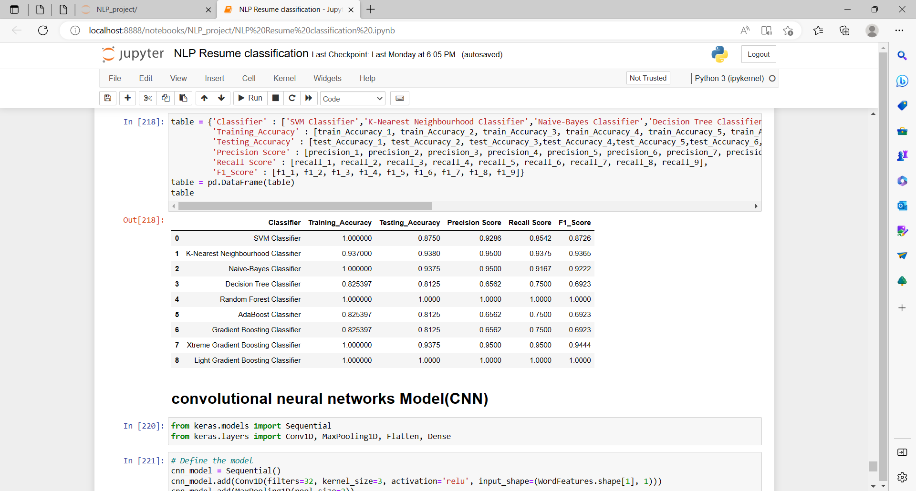
Model Building we tried out various type of classifier models

Slide 16
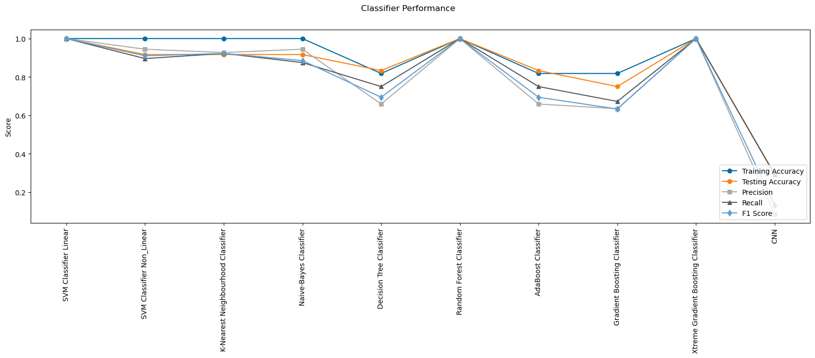

Slide 17
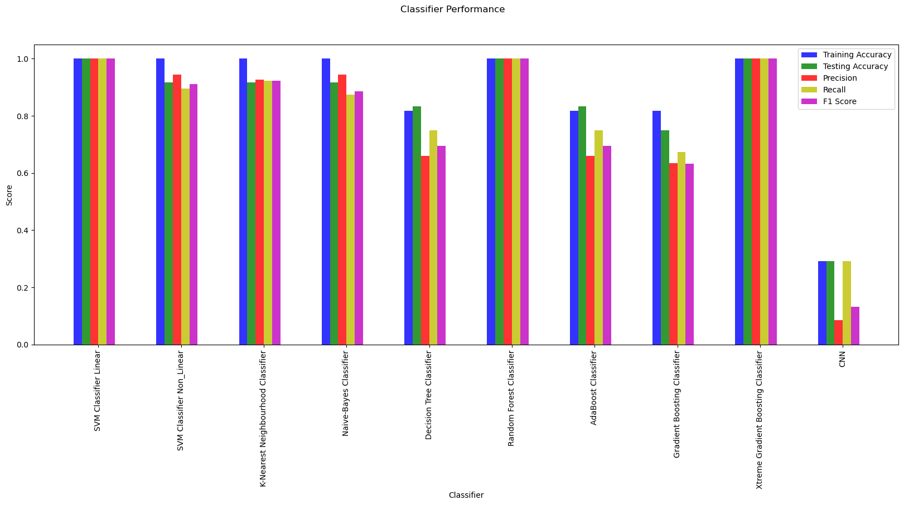

Slide 18
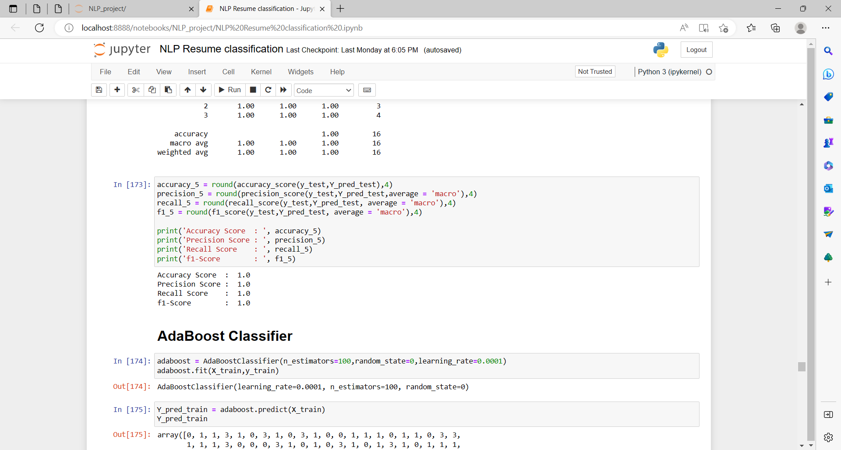
Among all those models random forest model gives more accuracy

Slide 19
Thank
You

