Slide 1

CHILDCARE COST ANALYSIS
GROUP-10

Slide 2
ABSTRACT
Investigates childcare costs, unemployment, and poverty levels across U.S. regions.
Uses datasets: National Database of Childcare Prices (NDCP) and Counties Dataset.
Employs spatial mapping and correlation analysis.
Identifies regional disparities and gender disparities.

Slide 3
1. Childcare Costs Dataset:
Data on childcare costs (2008–2018) by provider type, child age, and county characteristics.
Source: National Database of Childcare Prices (Tidytuesday)
2. Counties Dataset:
Geographic and demographic data for counties in the U.S.
Source: Tidytuesday
“
DATASET OVERVIEW

Slide 4
DATA CLEANING
Removed missing and erroneous values.
Imputed missing numerical values with median.
Filtered data for years before 2015.
Selected relevant columns for analysis.

Slide 5
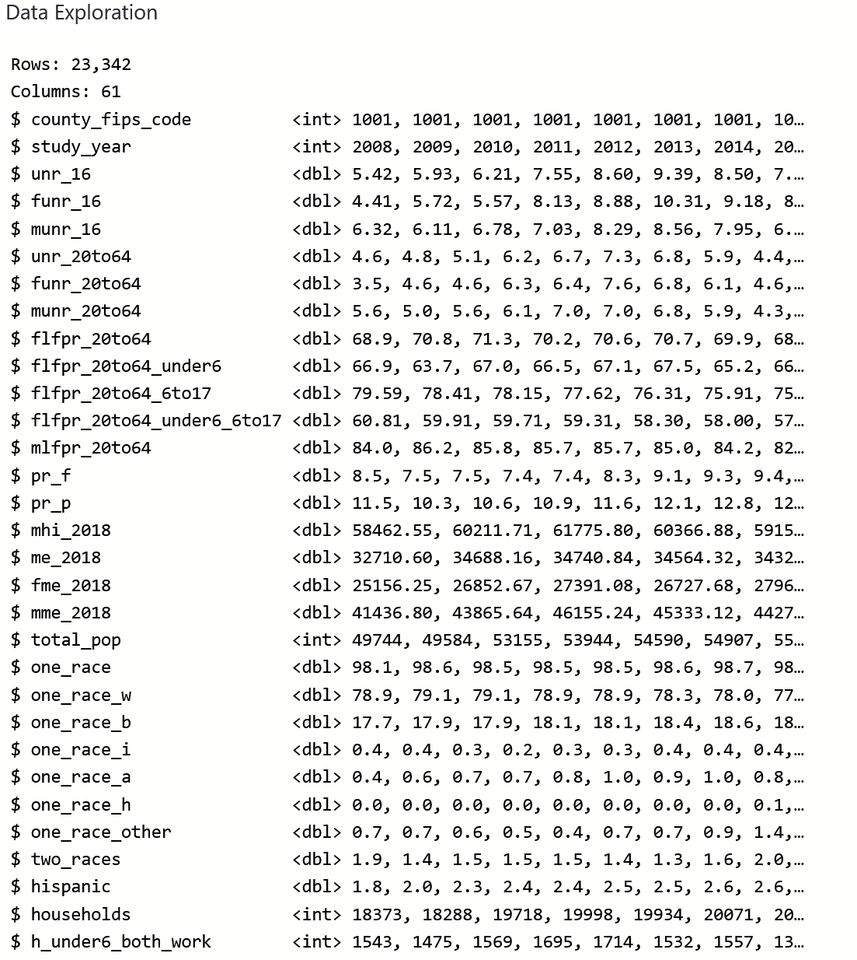
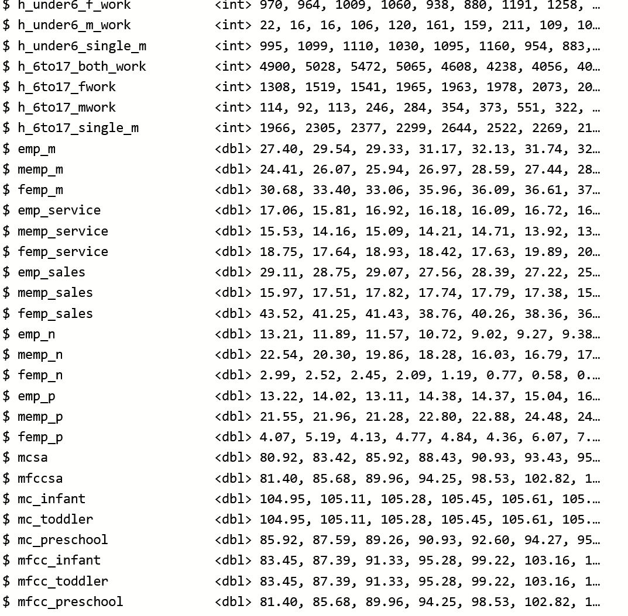
DATA EXPLORATION

Slide 6
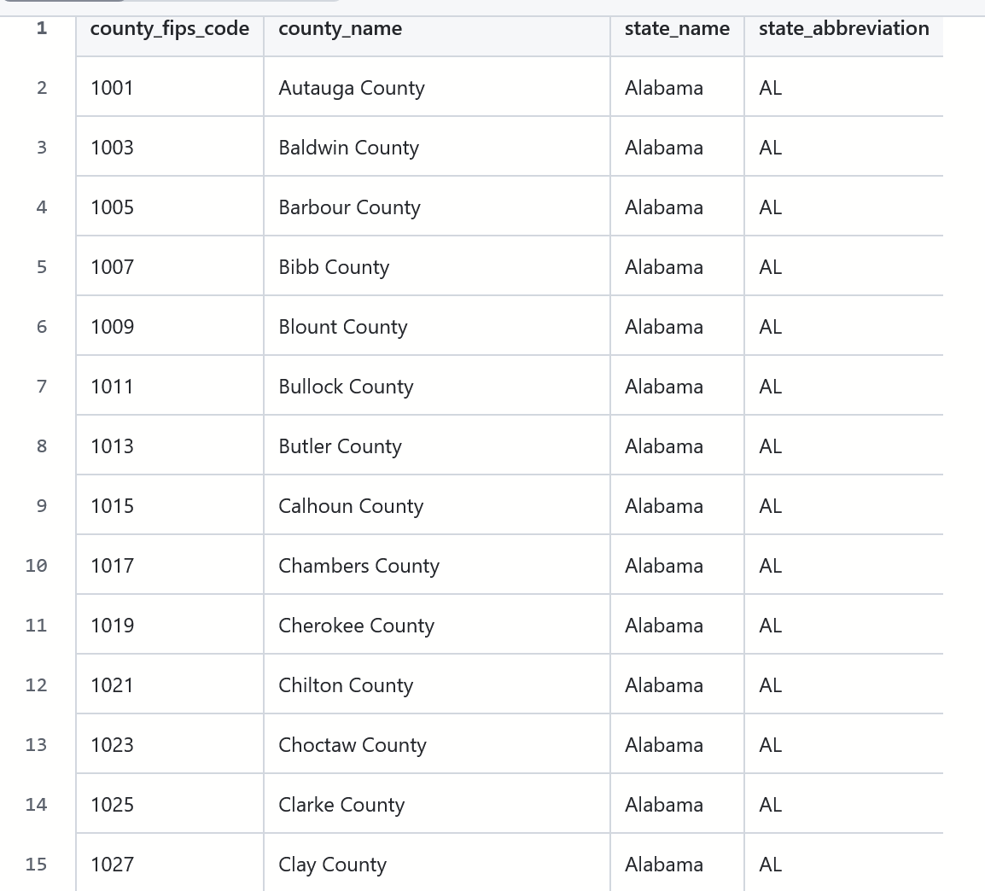
DATA EXPLORATION counties Dataset

Slide 7
DATA EXPLORATION
Unemployment rates: unr_16, funr_16, munr_16.
Median household income: mhi_2018.
Total population: total_pop.
Childcare costs: mc_infant, mc_toddler, mc_preschool.

Slide 8
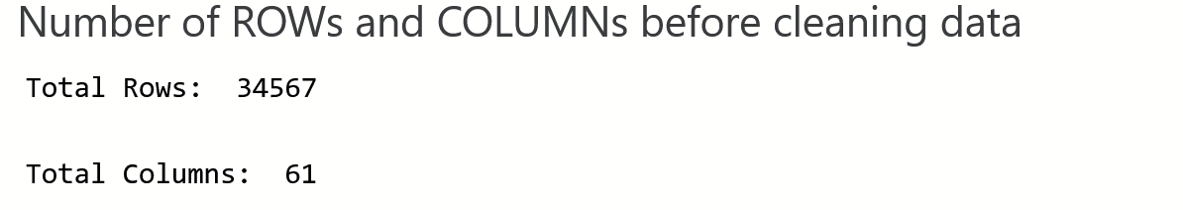
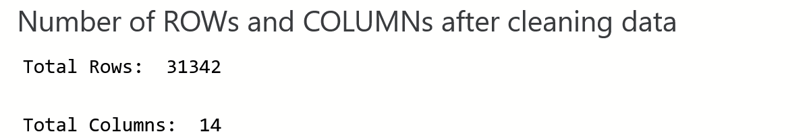
RESULT OF DATA CLEANING

Slide 9
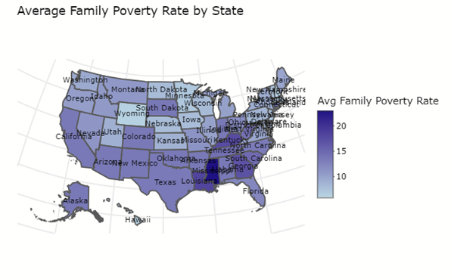
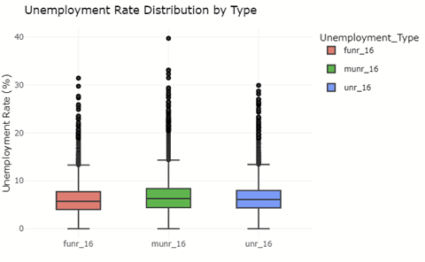
EXPLORATORY DATA ANALYSIS

Slide 10
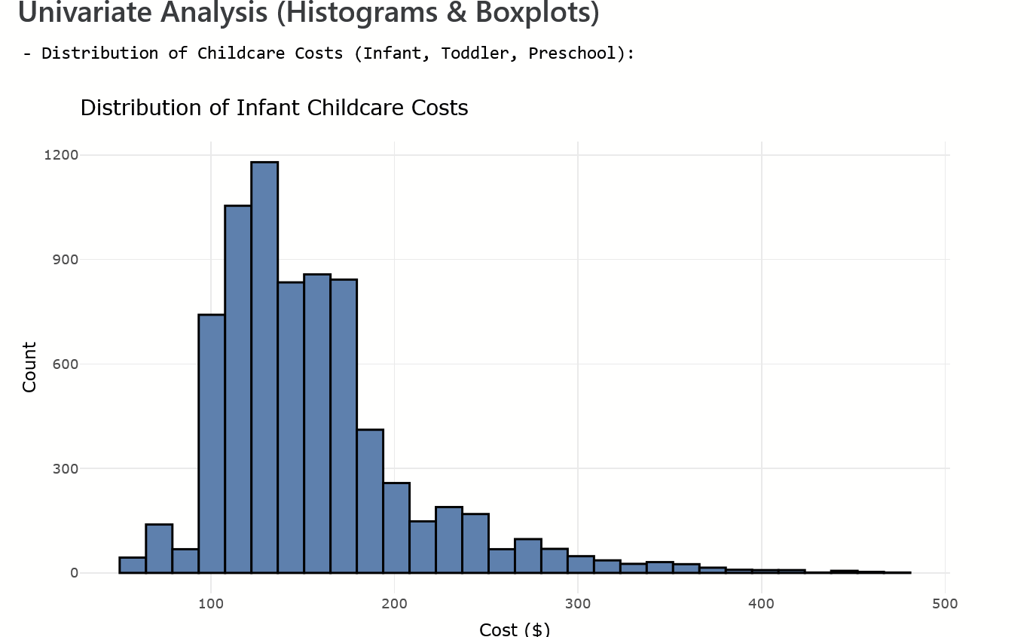
UNIVARIATE ANALYSIS

Slide 11
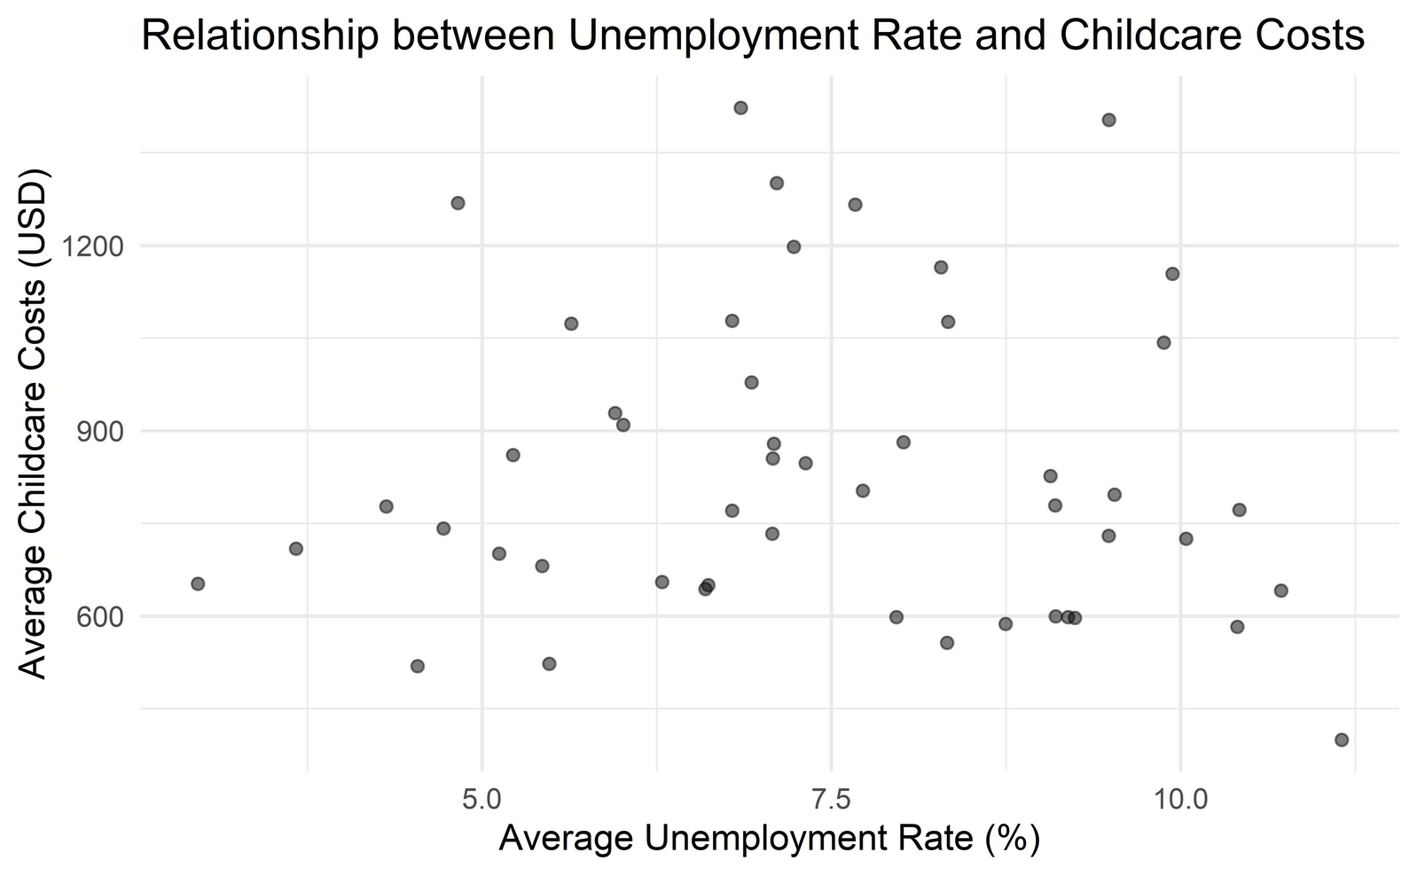
UNEMPLOYMENT RATE AND CHILDCARE COST

Slide 12
Association Rule
Data Preparation:
Discretization of numeric variables into categorical ranges.
Conversion of data into transaction format.
Apriori Algorithm:
Application of the Apriori algorithm to discover association rules between factors.
Interpretation of rules (e.g., support, confidence, lift).
Eclat Algorithm:
Application of the Eclat algorithm to find frequent itemsets.
Interpretation of frequent itemsets and their significance.

Slide 13
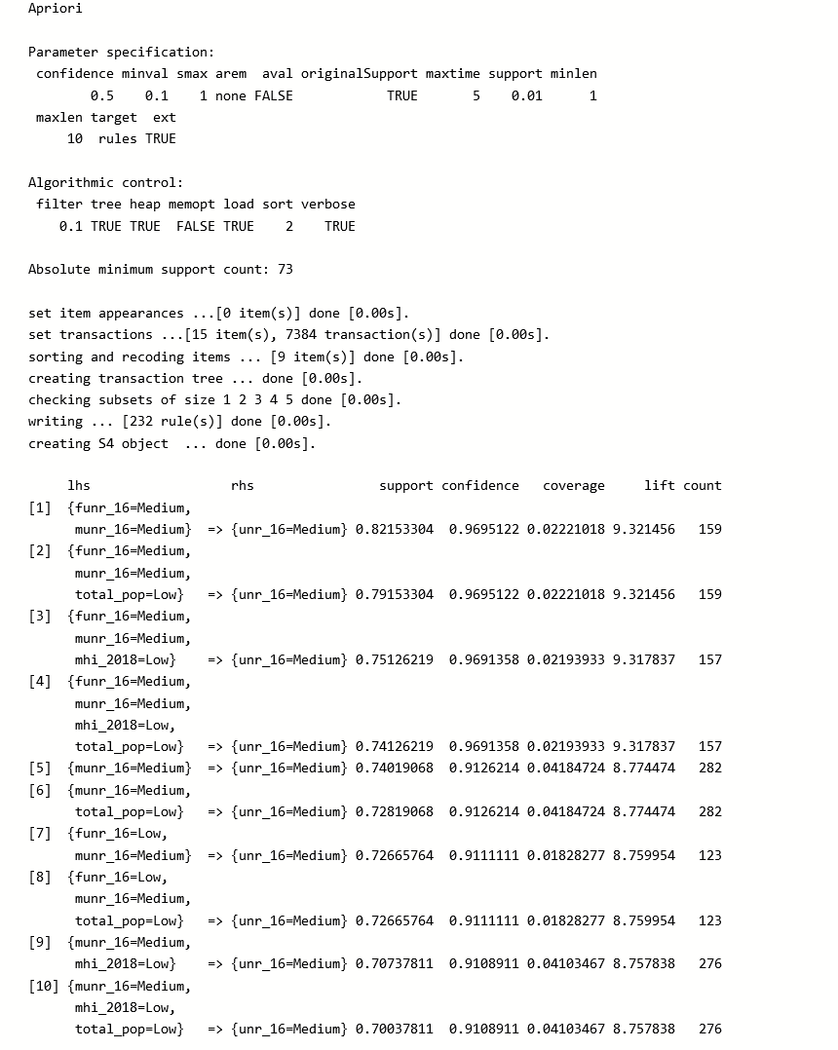
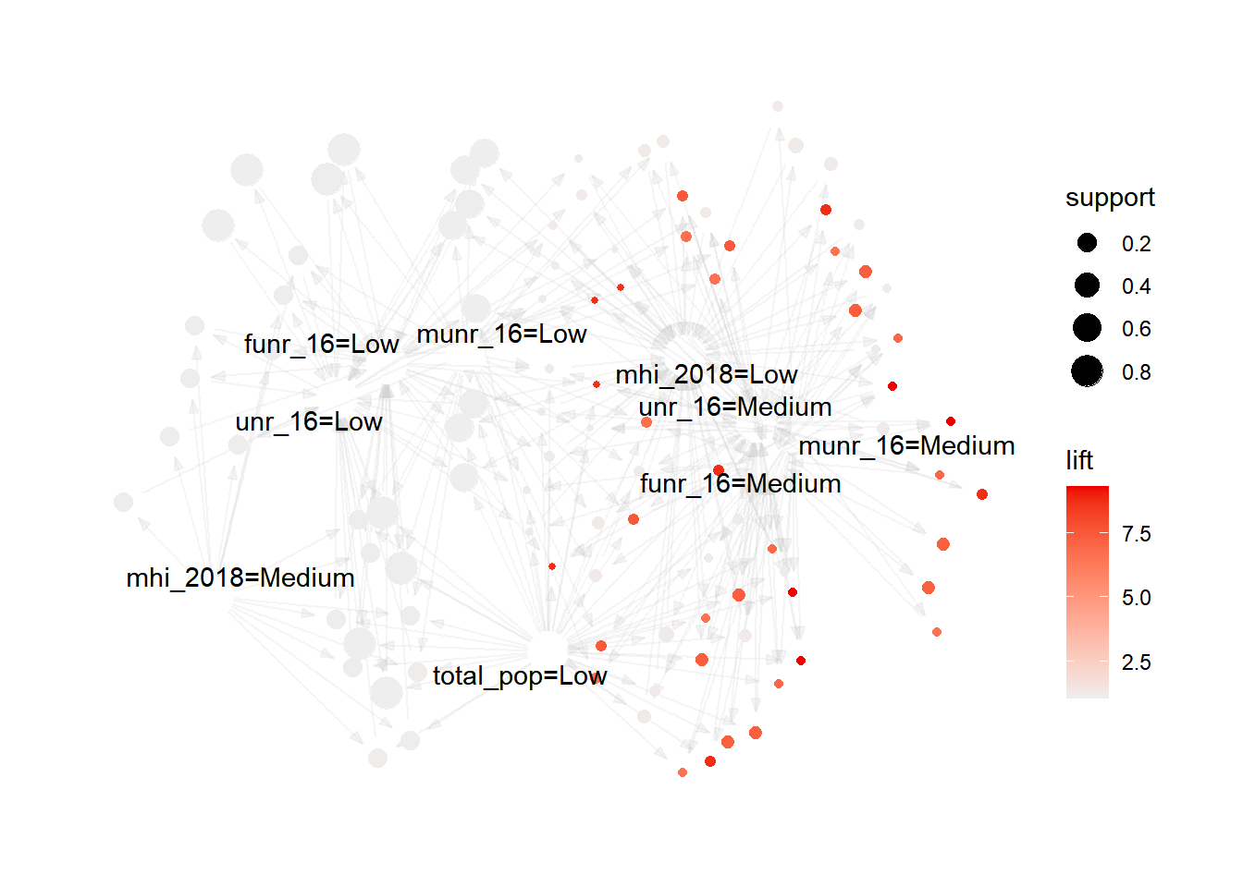
Apriori Algorithm

Slide 14
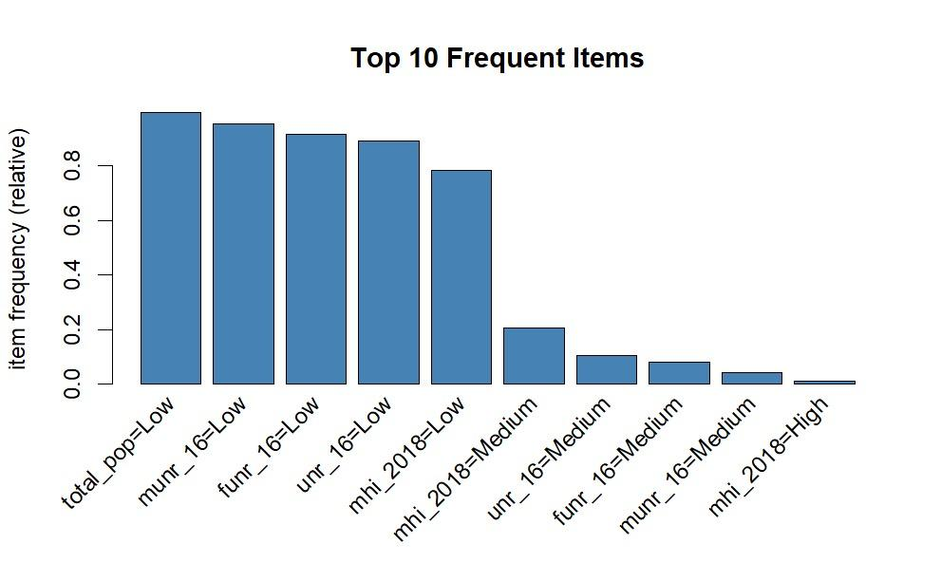
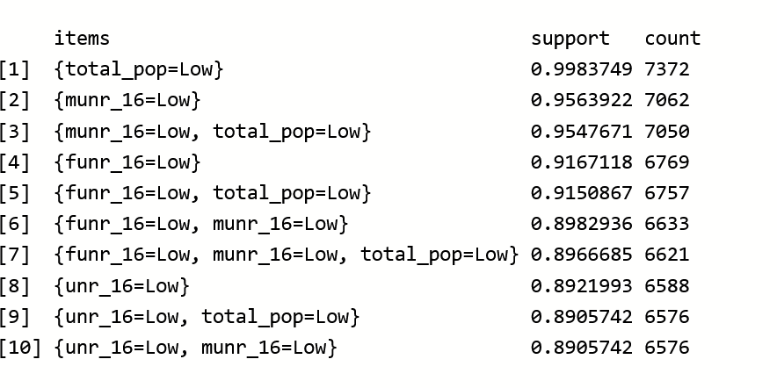
Eclat Algorithm

Slide 15
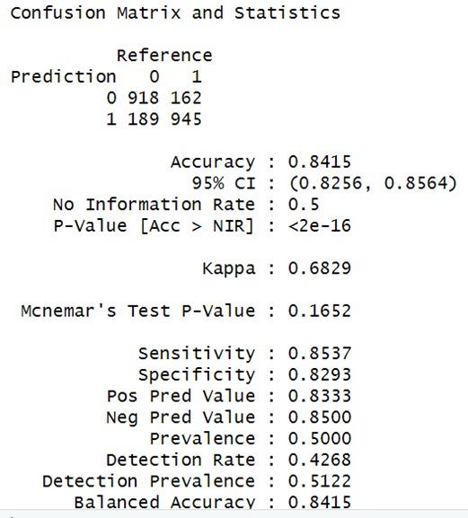
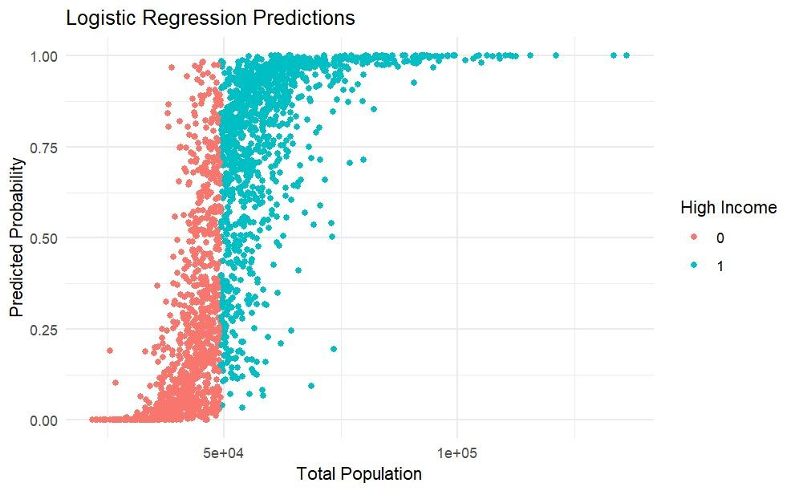
Logistic regression

Slide 16
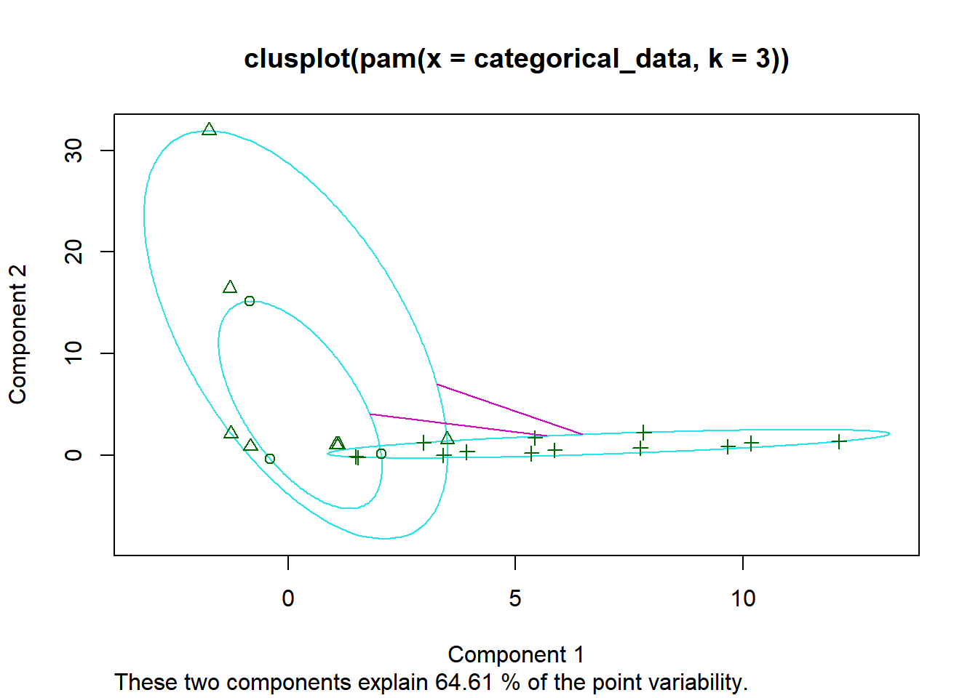
K-Medoids clustering
Clusters: Distinct shapes (e.g., triangles, circles, crosses) visually represent the separate clusters identified by the K-medoids algorithm. Each shape corresponds to one of the k clusters (three in this case).
Ellipses: Ellipses drawn around each cluster illustrate the data spread and variability within that cluster. Smaller, tighter ellipses indicate a more compact, closely related group of data points. Larger, more dispersed ellipses suggest greater internal variability.
Medoids: The medoids are the central points of each cluster, representing the most typical or representative data point within that group. They are marked by the cluster's corresponding shape at the center of each ellipse. Unlike centroids (used in K-means), medoids are actual data points within the dataset.
Pink Lines: Lines connecting each data point to its nearest medoid visually demonstrate the assignment of data points to specific clusters. These lines clearly show which data points are grouped together based on their proximity to the medoids.

Slide 17
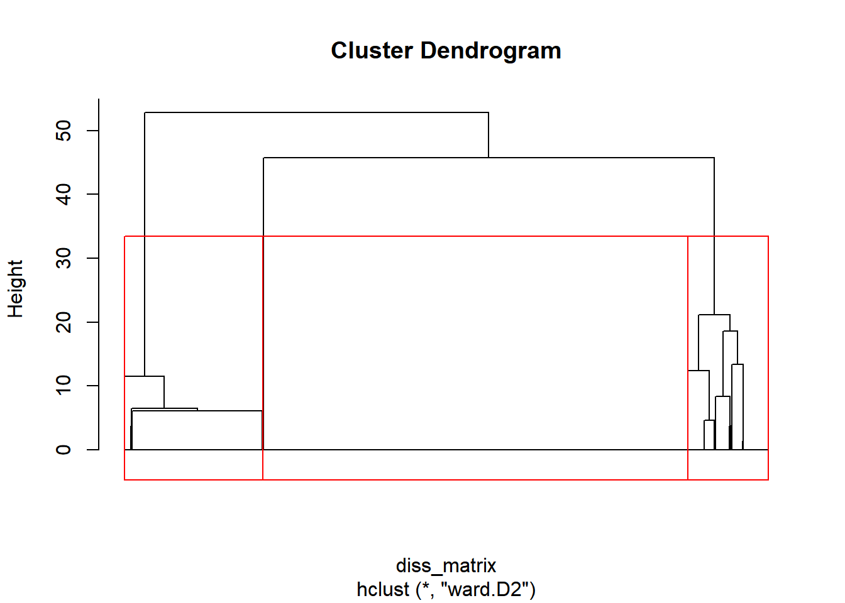
Hierarchical clustering
The code likely discretize numeric variables into categorical values (e.g., "Low," "Medium," "High") for better interpretability.
It then converts these categorical variables into numeric representations for the clustering algorithm.

Slide 18
CONCLUSION
Link Between Unemployment and Poverty showed a strong relationship between the rates, stressing the need for focused support.
The Childcare Costs Affecting Family Poverty identified regions where high childcare costs contribute significantly to family poverty.

Slide 19
FUTURE ENHANCEMENTS
Temporal Analysis: Incorporating a temporal analysis by examining how the relationships between unemployment rates, poverty levels, and childcare costs evolve over time can provide insights into trends and potential long-term impacts.
Interactive Data Visualization: Enhancing data visualization techniques by creating interactive dashboards which allow users to explore the data dynamically, customize views based on their interests, and gain deeper insights.

Slide 20
THANK YOU

