Slide 1
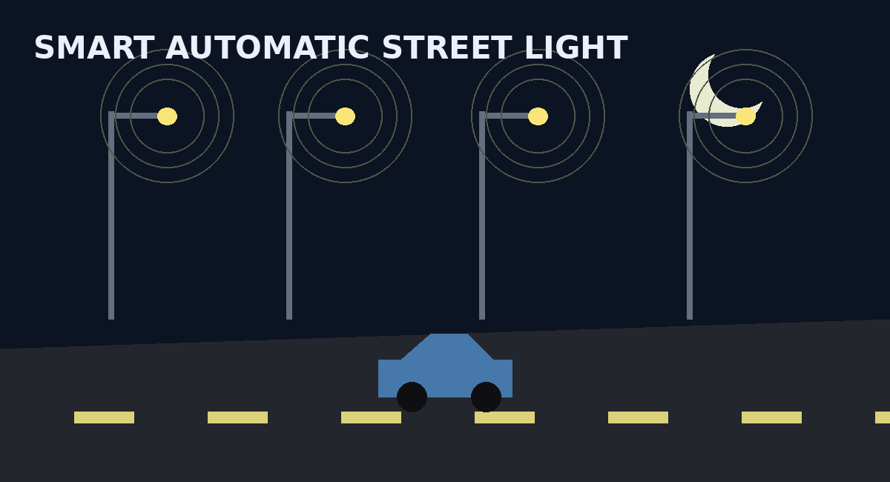
DIGITAL DESIGN & COMPUTER ARCHITECTURE
Design and Simulation of an Automatic Street Light Control System
Using Combinational Logic
TEAM MEMBERS
SECTION
CSE – Section: ______
Department of CSE
Name | Roll Number
Srishouri Thottempudi | 2620030041
Praveen Kumar | 2620030030
Pravalika Bodapati | 2620030029
Pujitha Vemulapalli | 2620030051
Notes:
Section is not stated in the source files; fill in the blank on this slide before presenting.

Slide 2
Introduction & Objective
Why automate street lighting with digital logic?
OBJECTIVES
INTRODUCTION
Conventional street lights run continuously or rely on manual switching, wasting energy and reducing safety.
This project is a smart digital controller built only from combinational logic gates. It reads five inputs and decides whether the light should be ON:
Day/Night status (N)
Vehicle presence (V)
Pedestrian presence (P)
Emergency condition (E)
Manual override (M)
1
Save energy
Light only when needed; zone-based control avoids power wastage.
2
Improve safety
Emergency has priority; people and vehicles trigger lighting.
3
Automate
Remove manual intervention using condition-based logic.
4
Build & verify
Truth table → K-Map → gates, tested in Logisim.

Slide 3
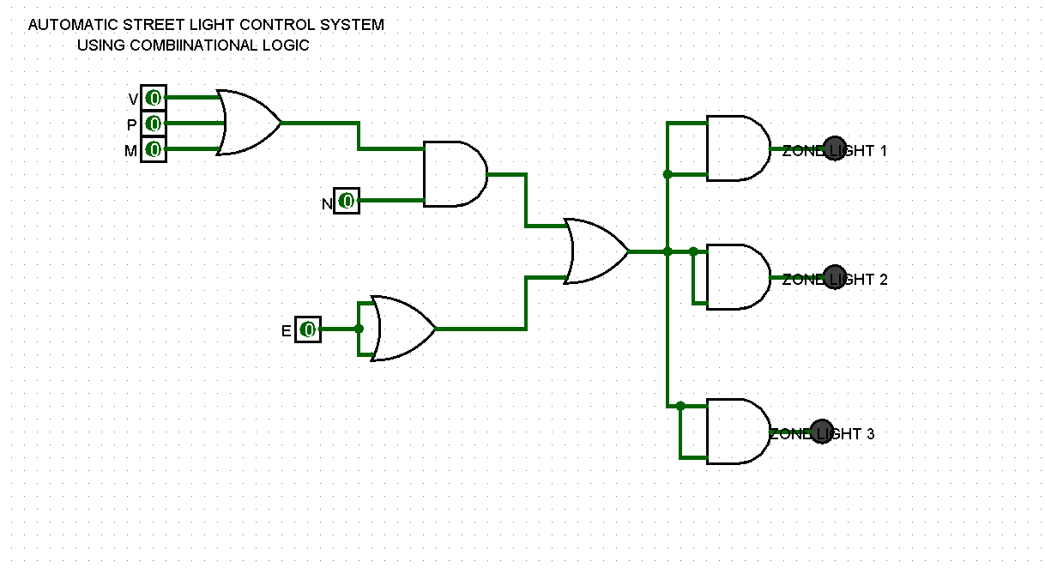
Theory & Logic Circuit
Boolean model, gates used and the circuit diagram
BASIC CONCEPT
Combinational logic: output depends only on the present inputs (no memory).
F = E + N(V + P + M)
GATES USED
OR (×2): V + P + M → activity request
AND (×1): N · (activity) → night demand
OR (×1): E + night demand → LIGHT ON
Emergency overrides everything; at night any activity or manual request turns the light ON.

Slide 4
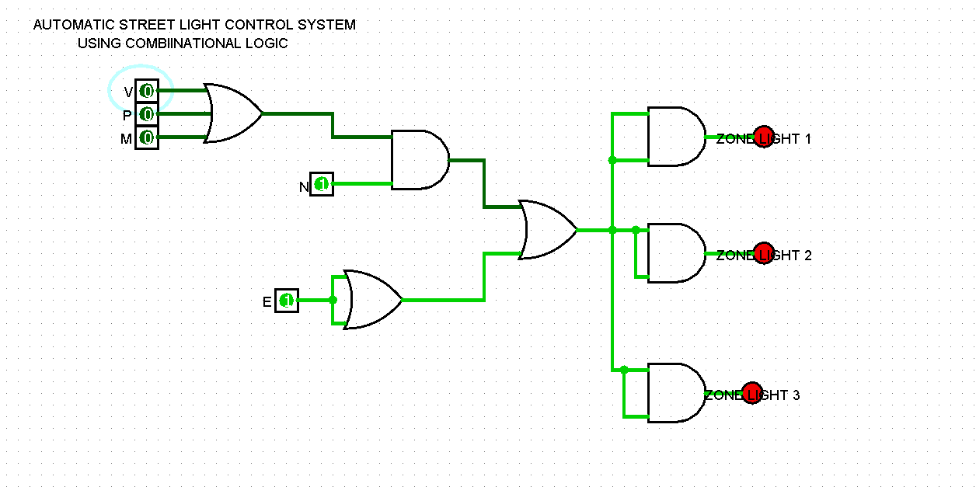
Circuit Design in Logisim
Gate-level implementation and working
HOW IT WORKS
Five input pins (N, V, P, E, M) are toggled with the poke tool.
First OR gate combines V and P; second OR adds M.
AND gate passes this request only when N = 1 (night).
Final OR gate adds E, so emergency always lights the road.
Output LED F lights red when F = 1.
Notes:
The circuit image is a Logisim-style recreation. Replace it with a screenshot of your own .circ file if you have it.

Slide 5
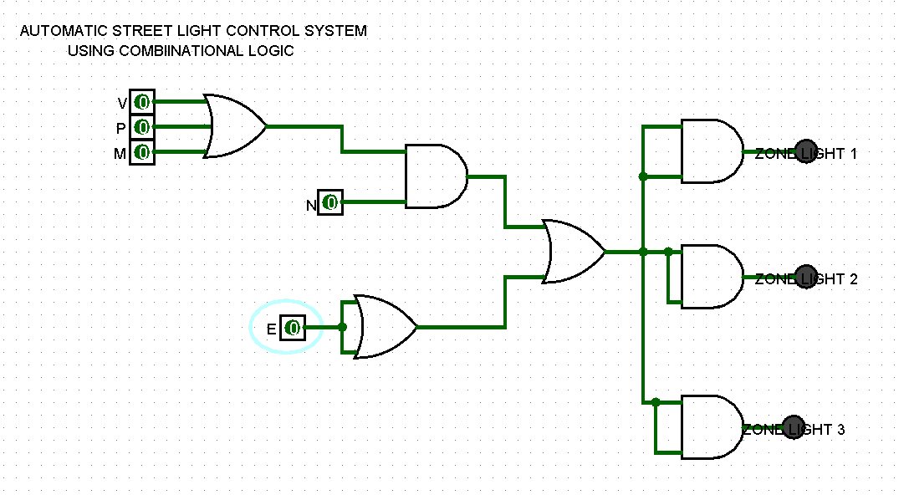
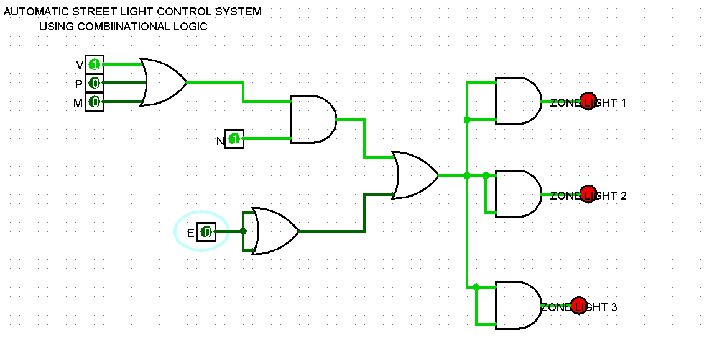
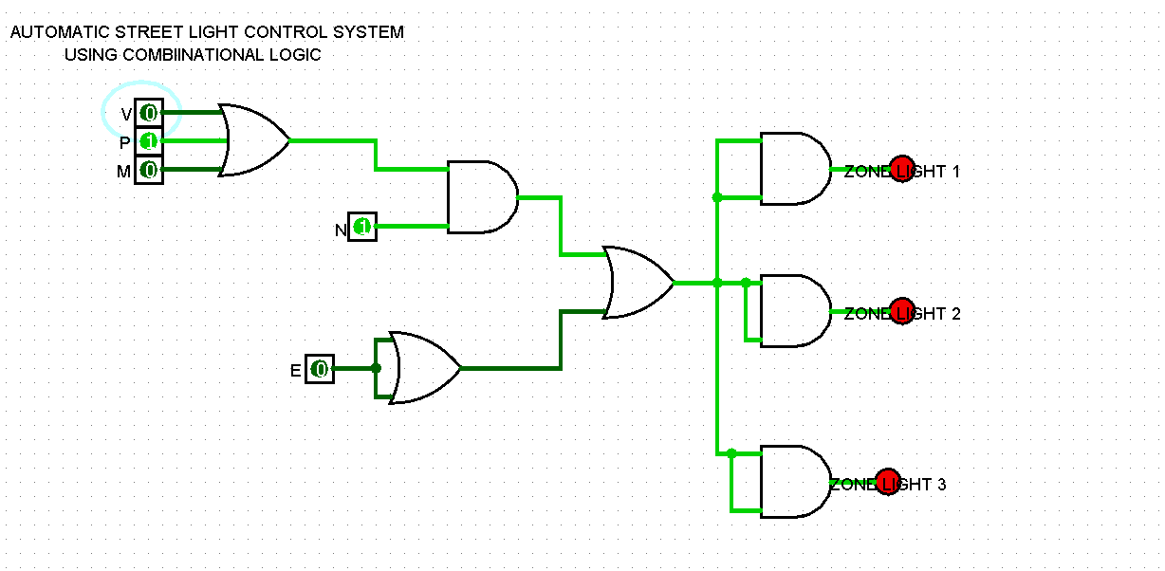
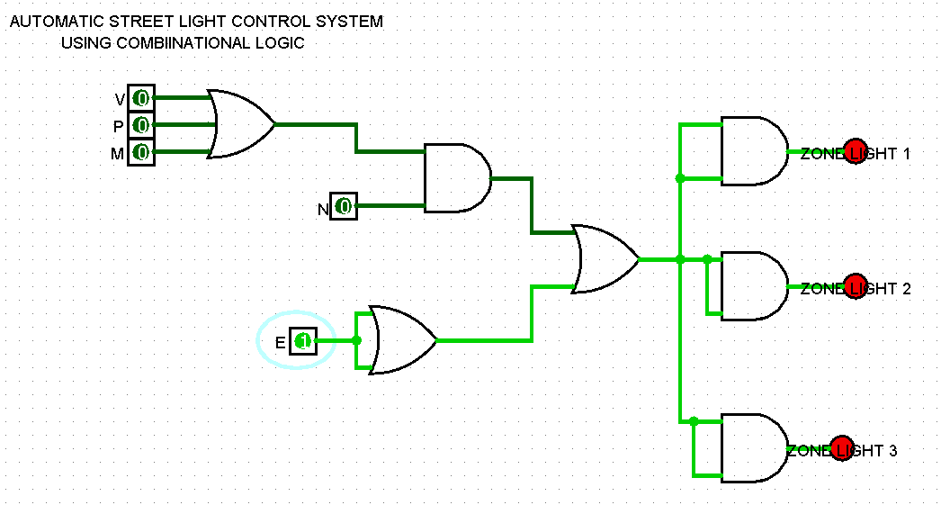
Simulation Results
Logisim test cases and truth table (N V P E M → F)
Day, no activity
0 0 0 0 0 → 0 (OFF)
Night + vehicle
1 1 0 0 0 → 1 (ON)
Night + pedestrian
1 0 1 0 0 → 1 (ON)
Emergency (day)
0 0 0 1 0 → 1 (ON)
Notes:
Simulation frames are Logisim-style recreations. Replace with real screenshots from your Logisim project if required by the instructor.

Slide 6
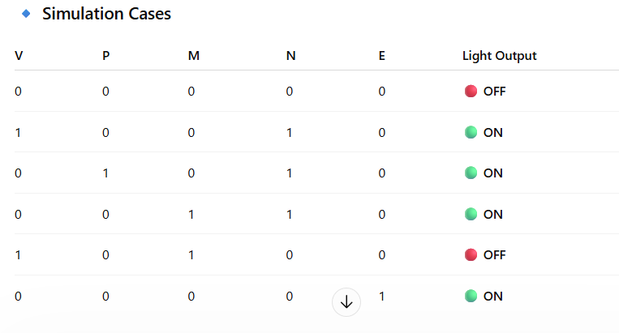

Slide 7
Conclusion & Applications
Outcome, uses and future scope
OUTCOME
APPLICATIONS
POSSIBLE IMPROVEMENTS
Working controller built from OR/AND gates using F = E + N(V + P + M).
Truth table and K-Map simplification reduced the logic.
Logisim confirmed correct output for day, night, pedestrian, vehicle, emergency and manual cases.
Smart city streets and highways
Campus, residential and industrial roads
Parking lots and public parks
Energy-saving, low-maintenance lighting
Add LDR / IR / ultrasonic sensors for real inputs
Expand to multi-zone outputs (Zone 1–3)
Add dimming levels and timers
IoT monitoring and solar power
Thank you

