Slide 1
SYSTEM ONLINE
SyncLock
Concurrent File Access Management System
Hackathon Prototype
Safe shared-file access using OS-level locks,
version control, atomic writes and activity logging.
P.Likith Kumar • P.Rithwik Rao • V.Santhosh
Operating Systems / System Programming
1

Slide 2
Abstract
02
What SyncLock solves
The challenge
When multiple processes or users access the same file at the same time, unsynchronized writes can overwrite changes or leave inconsistent data.
Our solution
SyncLock provides controlled shared-file access through shared read locks, exclusive write locks, optimistic version checking and atomic file replacement.
Monitoring
A FastAPI web dashboard displays shared files, versions, operations, blocked conflicts and successful writes, while SQLite stores metadata and activity logs.
Demonstration
A five-process simulator creates real contention for one shared file so judges can see safe serialization and conflict handling live.
SyncLock • Concurrent File Access Management System
2

Slide 3
Problem Statement
03
Why concurrent file access needs synchronization
Lost updates
Race conditions
Two writers can overwrite each other's changes.
The final file may depend on unpredictable timing.
Inconsistent data
No visibility
Partial or conflicting updates reduce reliability.
Traditional file operations provide little user-facing audit information.
Core question
How can multiple clients safely share one file without silent overwrites?
SyncLock • Concurrent File Access Management System
3

Slide 4
Objectives
04
Design goals of the prototype
Safe concurrent reads
Exclusive writes
Conflict prevention
Allow multiple readers to access a shared file concurrently.
Allow only one conflicting writer at a time.
Reject stale updates using file-version checks.
Atomic persistence
Auditability
Live demonstration
Write to a temporary file and replace the original atomically.
Record operations, status and versions in SQLite.
Visualize behavior through a browser dashboard and process simulator.
SyncLock • Concurrent File Access Management System
4

Slide 5
Existing Approach vs Proposed
05
Why SyncLock is useful
Typical / unsynchronized approach
SyncLock
• Direct file writes can race
• Shared and exclusive OS-level locks
• No optimistic version validation
• Version checked before every write
• Limited visibility into conflicts
• Conflict status shown in dashboard
• Manual recovery from stale changes
• Atomic replacement reduces partial writes
• Little centralized activity history
• SQLite activity log + live statistics
SyncLock • Concurrent File Access Management System
5

Slide 6
System Architecture
06
Browser → API → locking → storage
Shared Files
File Lock Manager
Browser Dashboard
FastAPI API
SQLite
Metadata + Logs
Concurrency control happens before file mutation; metadata and activity are persisted separately.
SyncLock • Concurrent File Access Management System
6

Slide 7
Core Concurrency Mechanisms
07
The technical heart of SyncLock
1 Shared Read Lock
Multiple readers may read the same file without conflicting with one another.
2 Exclusive Write Lock
A writer obtains an exclusive OS-level lock so conflicting writes are serialized.
3 Version Checking
A client sends the version it originally read; a mismatch blocks the stale write.
4 Atomic Replacement
New content is written to a temporary file, then replaced into place.
CLIENT A
reads V2
CLIENT A
writes V3
CLIENT B
stale V2
BLOCKED
SyncLock • Concurrent File Access Management System
7

Slide 8
Modules
08
How the application is organized
Web Dashboard
FastAPI Backend
Create, select, edit, reload and delete shared files; view live statistics.
Exposes API endpoints for files, reads, writes, versions and activity.
File Lock Manager
Version & Conflict Engine
Implements shared/exclusive OS-level locking and controlled release.
Checks expected version against current version before committing writes.
SQLite Activity Logger
Multi-Process Simulator
Stores file metadata, versions, operation history and outcomes.
Launches five independent processes to demonstrate write contention.
SyncLock • Concurrent File Access Management System
8

Slide 9
Technology Stack
09
Lightweight, cross-platform prototype
Python
FastAPI
Portalocker / OS file locks
Application language
Web/API layer
Concurrency control
SQLite
HTML / CSS / JavaScript
Atomic file replacement
Metadata + activity logging
Interactive dashboard
Safe persistence
Runtime
Windows / Linux / macOS • Python 3.9+
SyncLock • Concurrent File Access Management System
9

Slide 10
Implementation Workflow
10
From user action to safe persistence
1
2
3
4
5
6
7
Select / create file
Read using shared lock
Edit locally
Request exclusive write lock
Check expected version
Atomic write + version increment
Release lock + log result
Failure path
Lock unavailable → operation blocked/logged. | Version mismatch → stale update rejected/logged.
Result: the shared file remains internally consistent while every important event is traceable.
SyncLock • Concurrent File Access Management System
10

Slide 11
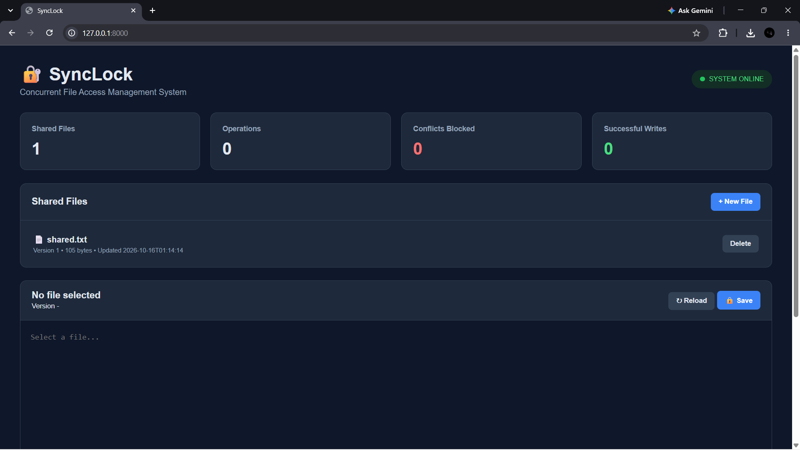
Web Dashboard
11
Live visual interface for the concurrency system
Dashboard shows
• Shared file count
• Operation count
• Conflicts blocked
• Successful writes
• File versions and size
• Create / delete controls
• Reload and Save actions
• Activity Monitor
The UI turns an OS-level concurrency concept into something judges can observe immediately.
SyncLock • Concurrent File Access Management System
11

Slide 12
Live Demo Scenario
12
Two clients, one shared file, one stale update
Step-by-step
CLIENT A
SAVE
1. Open shared.txt in Client A and Client B.
Version 2
→ Version 3
2. Both clients initially read Version 2.
3. Client A edits and saves → Version 3.
CLIENT B
CONFLICT
stale Version 2
4. Client B still holds stale Version 2.
Expected: V2
Current: V3
WRITE BLOCKED
5. Client B attempts to save its old version.
6. SyncLock detects mismatch and blocks the overwrite.
SyncLock • Concurrent File Access Management System
12

Slide 13
Multi-Process Concurrency Simulator
13
Five independent processes contend for one write lock
python simulator.py
Process 1
PID 4210
→ requests EXCLUSIVE lock
→ waits / acquires → writes → releases
Process 2
PID 4211
→ requests EXCLUSIVE lock
→ waits / acquires → writes → releases
Process 3
PID 4212
→ requests EXCLUSIVE lock
→ waits / acquires → writes → releases
Process 4
PID 4213
→ requests EXCLUSIVE lock
→ waits / acquires → writes → releases
Process 5
PID 4214
→ requests EXCLUSIVE lock
→ waits / acquires → writes → releases
Only one conflicting writer enters the critical section at a time.
SyncLock • Concurrent File Access Management System
13

Slide 14
Applications & Advantages
14
Where the concept can be extended
Applications
Advantages
• Collaborative document editing
• Shared configuration files
• Server-side logs and reports
• Data-processing pipelines
• OS / concurrency education
• Prevents silent overwrites
• Clear version history
• Auditable activity log
• Real-time dashboard
• Lightweight and easy to demonstrate
Key value: synchronization becomes visible, testable and explainable.
SyncLock • Concurrent File Access Management System
14

Slide 15
Limitations & Future Scope
15
Prototype today, scalable platform tomorrow
Current limitations
Future scope
• Designed as a single-machine prototype
• Local filesystem locking is not a distributed lock
• Authentication / authorization is not included
• Conflict resolution is reject-and-retry rather than automatic merge
• Dashboard is intended for demonstration and controlled environments
• Distributed locks for multi-server deployments
• Role-based authentication and authorization
• Automatic merge / collaborative editing
• WebSocket-based live activity streaming
• Cloud object storage and version history
• Containerized deployment and observability
SyncLock • Concurrent File Access Management System
15

Slide 16
Conclusion
SyncLock demonstrates how operating-system synchronization can protect shared data in a practical web application.
• Multiple readers can safely read a shared file.
• Conflicting writers are serialized through exclusive locking.
• Version checks prevent stale clients from overwriting newer data.
• Atomic replacement reduces partial-write risk.
• SQLite activity logging makes the behavior auditable.
References
• Operating System Concepts — Silberschatz, Galvin & Gagne
• Python / FastAPI documentation
• Portalocker documentation
• SQLite documentation
• Linux / Windows file-locking concepts
Thank You
P.Likith Kumar • P.Rithwik Rao • V.Santhosh
Questions?
SyncLock • Concurrent File Access Management System
16

