Slide 1

Arcade Game Score Tracking System
DS PROJECT
Implementation of Data Structures in Java
A Data Structures Project
Using Java
Section - 4
Faculty name : Dr Ramasubramanian Krishnamurthy
College name : KL University Aziz Nagar Hyderabad
Date : 18-03-2026

Slide 2
List of Students
1.VEDANTH | 2510080016
2.CHAITANYA | 2510030096
3.PREETHAM | 2510004022
4.VISHNU | 2510030161
5.LIKITH | 2510030232
6.RISHIKESH | 2510030024
7.YASHWANTH | 2510030163
8.DEEKSHITH | 2510030164
.

Slide 3
Project Abstract
This system manages player scores in arcade games.
It stores, sorts, searches, and displays scores efficiently.
Uses multiple data structures for performance and organization.
Problem statement:
“Manual score tracking is inefficient and error-prone”
Solution:
“Automated system using DS for fast operations”
Key features:
Real-time leaderboard
Undo functionality
File persistence

Slide 4
Project Modules
1. Add Score
2. Search Score
3. Display Scores
4. Leaderboard
5. Sorting
6. Undo
7. Queue Processing
8. File Handling
8. Score Management Module
9. Leaderboard Module
10. Search Module
11. Sorting Module
12. Undo Module
13. Queue Processing Module
14. File Handling Module

Slide 5
Module Description
Add Score: Stores player data
Search: Finds player by ID
Leaderboard: Sorted high scores
Undo: Removes last entry
Queue: Processes scores
File: Save & Load data
Score Management (Arrays)
Stores IDs, names, scores
Fast access using index
Leaderboard (Linked List)
Maintains sorted order dynamically
Efficient insertion without shifting elements
Undo (Stack)
Follows LIFO principle
Removes last added score
Queue Processing (Queue)
FIFO processing of score entries
Sorting (Bubble Sort)
Simple implementation
Used for ordering scores

Slide 6
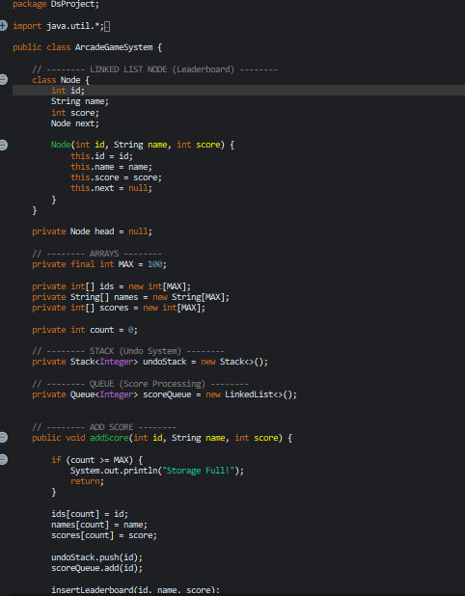
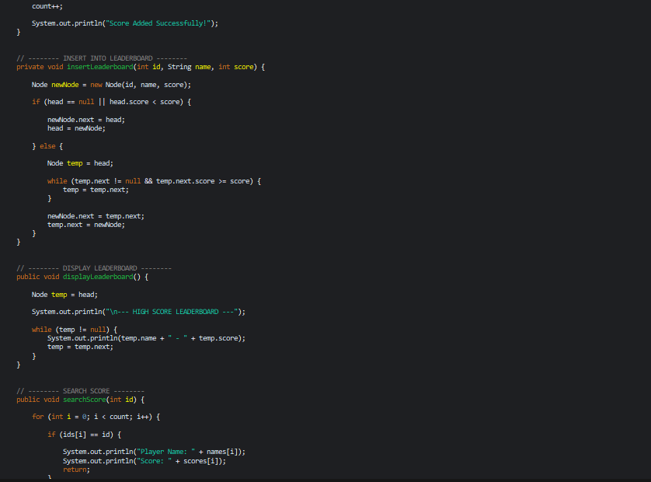
Code Screenshot
Insert your Java code screenshot here

Slide 7
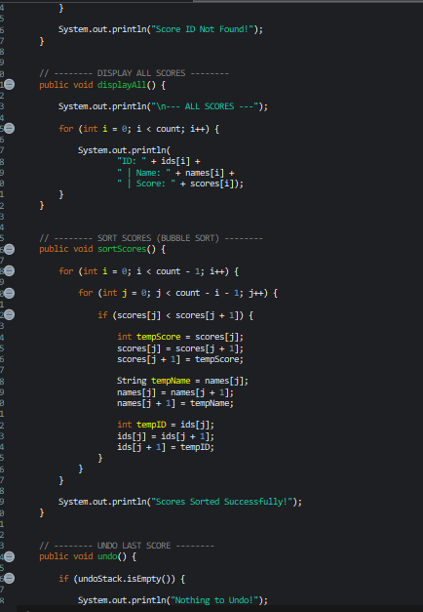

Slide 8
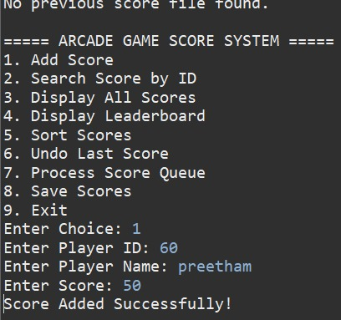
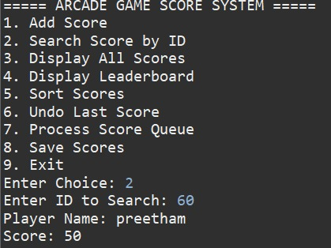
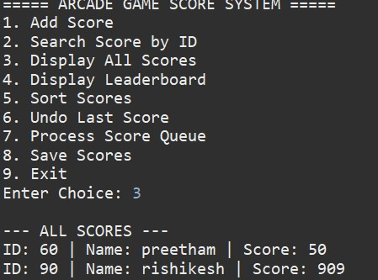
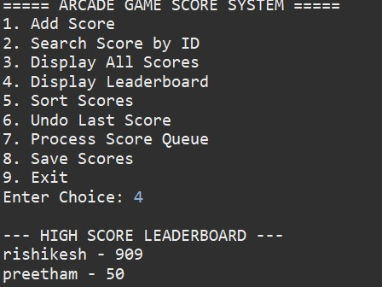
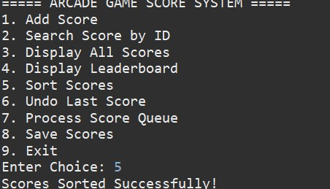
Output Screenshot
Insert program output screenshot here

Slide 9
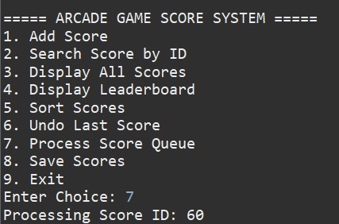
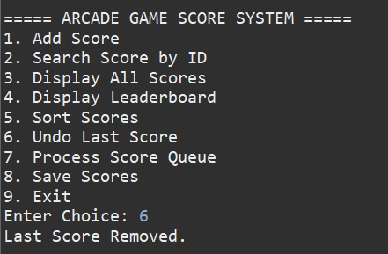
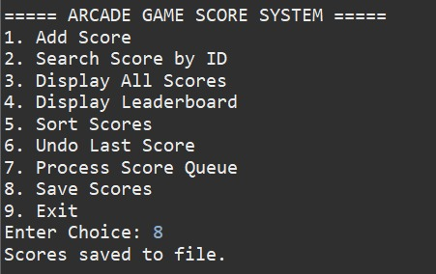
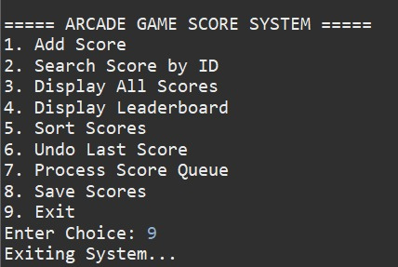

Slide 10
Data Structures Used
Arrays → Store bulk data efficiently
Linked List → Dynamic sorted leaderboard
Stack → Undo last operation (LIFO)
Queue → Sequential processing (FIFO)
Searching → Linear search used
Sorting → Bubble sort implemented

Slide 11
Future Improvements
GUI Interface
Database Integration
Online Leaderboard
Better Sorting Algorithm
Replace Bubble Sort with Merge Sort / Quick Sort
Use HashMap for faster search (O(1))
Add GUI using Java Swing/JavaFX
Convert to Web App (HTML/CSS/JS + Backend)
Store data in Database (MySQL)
Add User Login System

Slide 12
Outcome
Learned implementation of DS concepts
Improved problem-solving skills
Understood real-world application of data structures
Understood practical use of Data Structures
Learned how to combine multiple DS in one system
Improved debugging and logical thinking
Gained experience in file handling
Understood time complexity concepts

