Slide 1
Autoencoder to Better Visualize High-Dimensional Data
Bhargav Vemuri
Autumn 2021
Deep Learning
Notes:
For my final project I used an autoencoder framework to better visualize a high-dimensional gene expression dataset

Slide 2
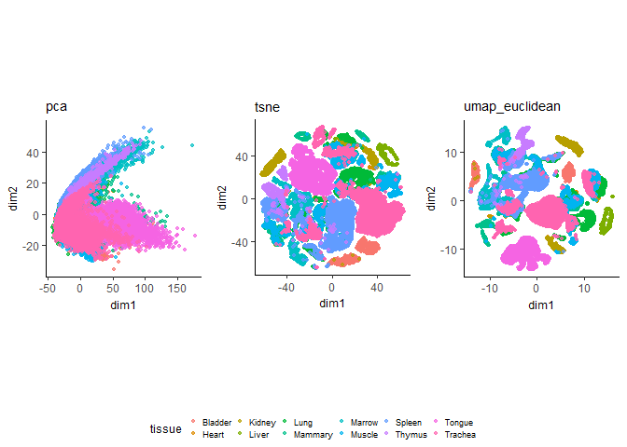
Autoencoder?
Notes:
Principal component analysis is a well known and widely used technique for dimensionality reduction. However it can be limited by its linearity and nonlinear alternatives like t-SNE and UMAP often end up working better. I wanted to see what kind of improvement a deep autoencoder architecture might bring in terms of visualization.

Slide 3
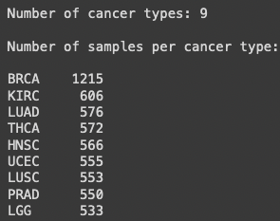
TCGA Pan-Cancer Atlas RNASeq Dataset
After processing:
Number of samples: 5,726
Number of genes: 17,475
Notes:
I used a subset of the TCGA pancancer atlas rnaseq dataset, a total of 17,475 genes expressed in 5,726 samples across 9 cancer types. The goal was to learn a 2d representation of this dataset such that cancer types would separate out when visualized along those two dimensions.

Slide 4
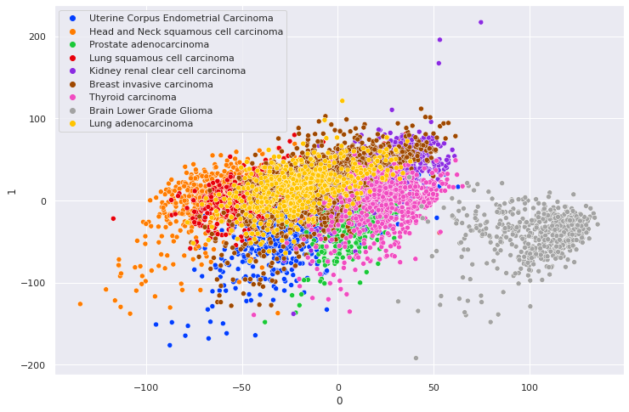
Notes:
First I applied PCA to get the 2 components which explained the most variance and plotted the samples colored by cancer type. As you can see only one of the types really separated out in any discernable way.

Slide 5
Input layer: 17,475 neurons
h1: 4,096
Encoder
h2: 1,024
h3: 256
h4: 64
h5: 16
h6: 2
Decoder
. . . . . .
Same layers,
in reverse
Output layer: 17,475 neurons
Notes:
This was the architecture I used for the autoencoder, starting with the number of input neurons being 17,475 from the genes in the dataset. Then I gradually bottlenecked the data down to 2 latent dimensions to assess the visualization improvement compared to PCA. The decoder portion was the same layers just in reverse. I used mean squared error loss and the Adam optimizer.

Slide 6
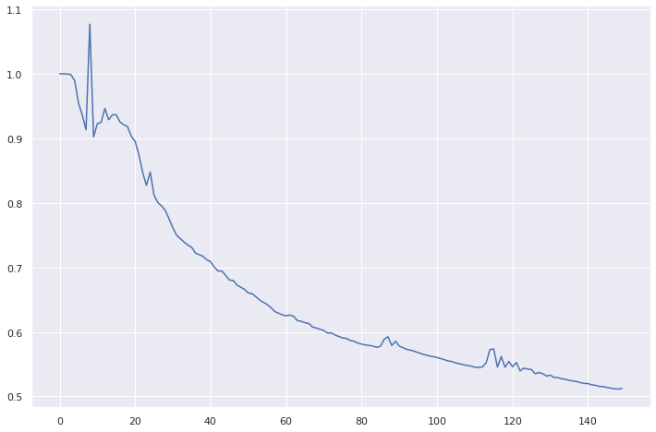
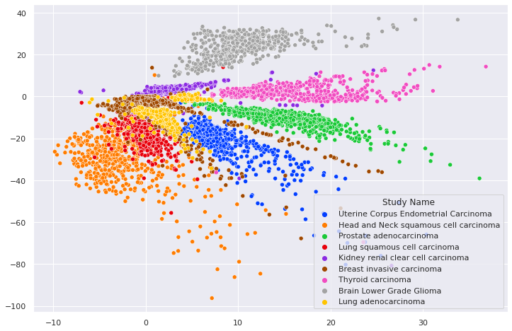
lr = 0.001
n_epochs = 150
Final loss = 0.5124
Notes:
Visually, the best run I had through the network was with a learning rate of 0.001 and 150 epochs. This gave me a final loss of 0.5124 and the 2d plot shown here.

Slide 7
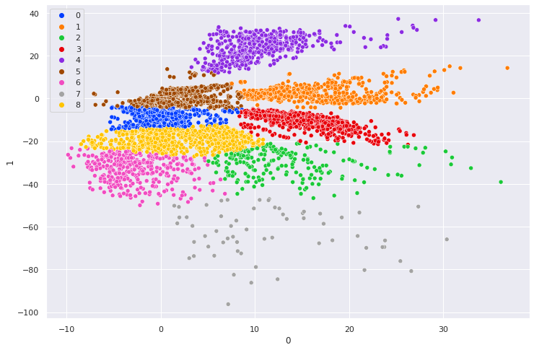
Notes:
Here’s the same visualization in the top left. Bottom right is kmeans with k=9, one per cancer type, applied to the encoding. The colors don’t match, but you can see that at least 3 of the identified clusters match up well with the ground truth cancer type labels. Also, the fact that some of the other types remained close together might be biologically relevant, for example lung cancers in red and yellow.

Slide 8
Future Directions
Quantitative measure of cancer type separation
Comparison with other dimensionality reduction techniques
More than 2 latent features
Biological insights
Notes:
Future directions could include a quantitative way to measure the performance of the autoencoder in terms of cancer type separation in the final encoding. Can also compare with aforementioned nonlinear techniques like t-SNE and UMAP. And scaling back the encoding to result in 5, 10, 20 latent features might yield some biological insights if we dig further into which samples activate which neurons.

Slide 9
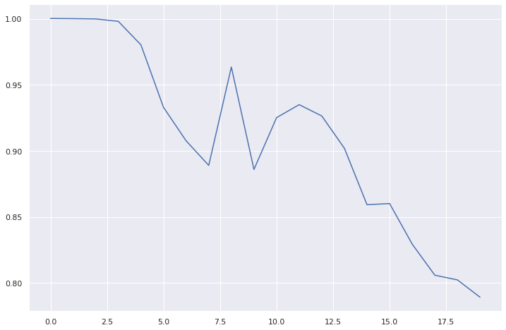
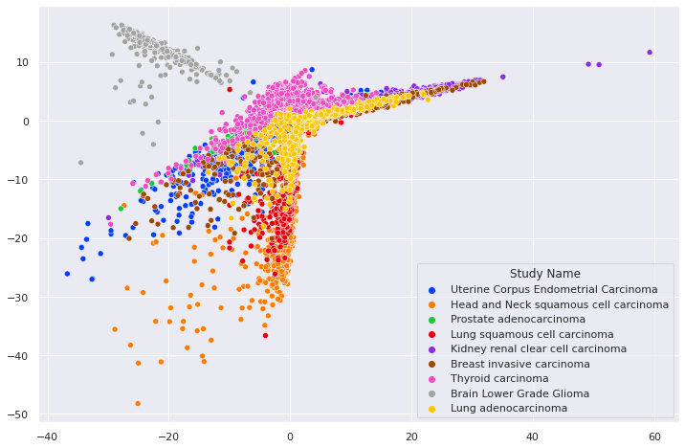
lr = 0.001
n_epochs = 20
Final loss = 0.7892

Slide 10
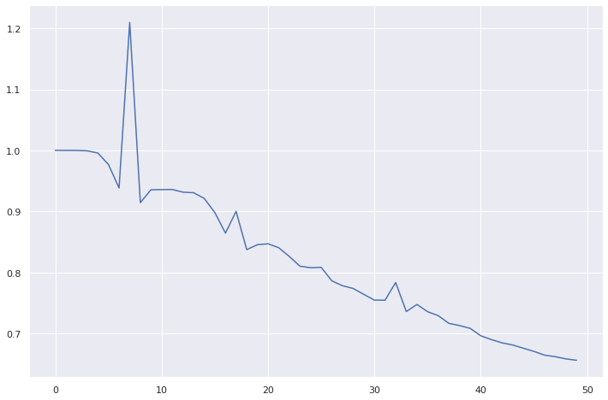
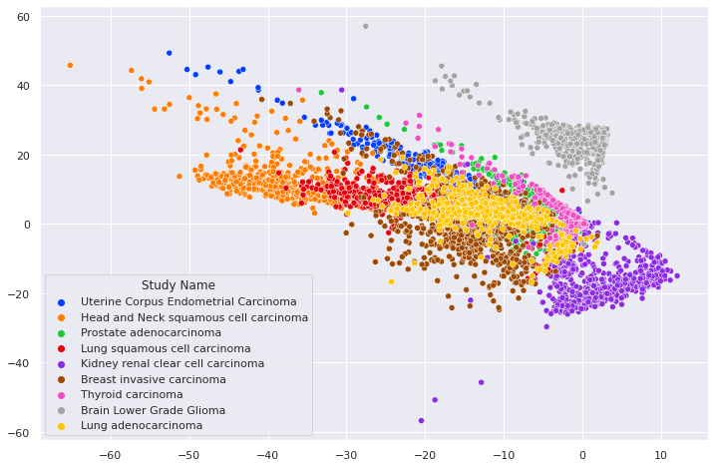
lr = 0.001
n_epochs = 50
Final loss = 0.6562

Slide 11
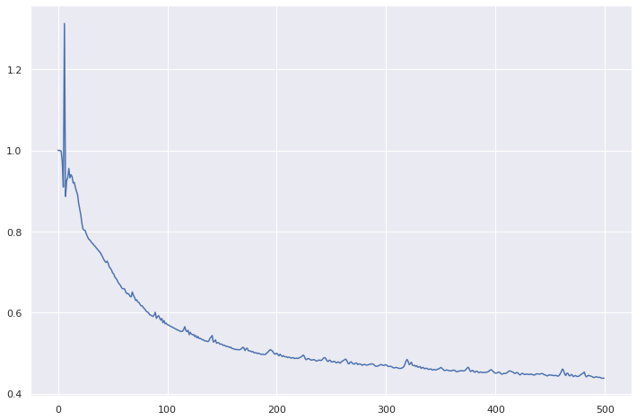
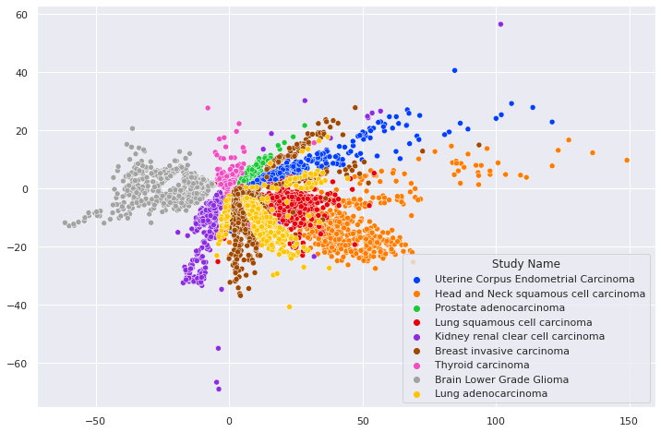
lr = 0.001
n_epochs = 500
Final loss = 0.4383

